Slide 1
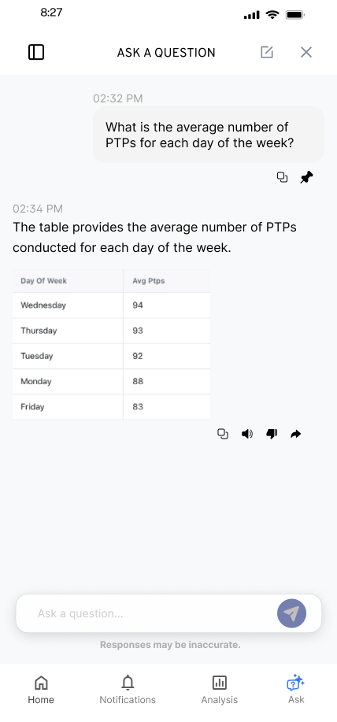
KYLE HOBSON / SHOPMY SENIOR PRODUCT DESIGNER APPLICATION
Useful choices.
Clear next steps.
Interface craft, resilient flows,
and research that informs the next decision.
Selected work for ShopMy
September 2026
01
Notes:
ShopMy Product Designer, 4893334008. Employer source: https://job-boards.greenhouse.io/shopmy/jobs/4893334008, verified September 8, 2026. Selected information-hierarchy, reusable-interface, interaction and handoff artifacts. No prior ShopMy work, commerce-domain expertise or enterprise design-system ownership is claimed.

Slide 2
ABOUT ME / SMARTTAGIT, FACTORLAB
Give each insight
a clear job
01
Summaries
02
Recommendations
03
Simple 7
I developed five widget groups, then explored their information order and content density.
04
Comparisons
05
Accomplishments
Editable summary of the reviewed structure
Original screen iterations in the linked case
02
Notes:
About Me April–May 2026 design walkthroughs, especially May 15. The five groups are summaries, recommendations, Simple 7, comparisons and accomplishments. This native diagram summarizes the reviewed organization; it is not an original screenshot. Customization and final policy remained open in the walkthrough.

Slide 3
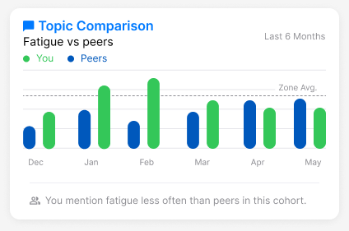
ABOUT ME / INFORMATION AND INTERPRETATION
A comparison
needs context
Mentioning fatigue less often is a comparison. Whether that is good depends on the context.
I raised the cohort and wording questions while developing reusable insight widgets.
Original design iteration with sample values
03
Notes:
Original About Me comparison widget and April–May 2026 walkthroughs. The web/server team release was confirmed September 2, 2026, but the exact pictured layout and completed mobile rollout are not established. Illustrative values are not measured customer outcomes.

Slide 4
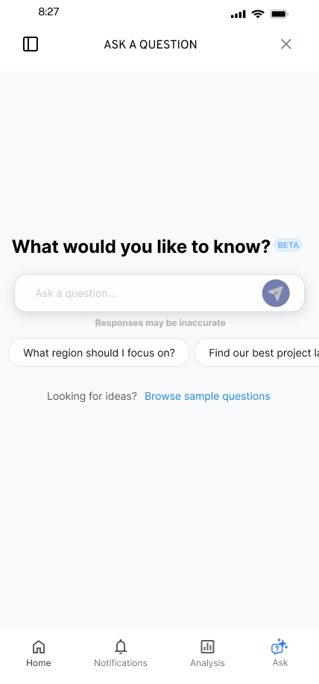
FLINT / SMARTTAGIT, FACTORLAB
A useful
first question
UX Designer & Researcher (Contract)
2025–2026
I explored suggested questions and a question library while keeping a person’s own question close at hand.
Mobile design states and engineering handoff
04
Notes:
Original FactorLab Flint mobile design and design walkthroughs. These are designed states and handoff artifacts, not confirmation that every pictured variant shipped. Interface content is sample data.

Slide 5


FLINT / INTERRUPTED AND OFFLINE STATES
Incomplete answer
Connection lost
Recovery follows
the failure
An incomplete answer and a lost connection need different next actions.
I connected the flows and their recovery actions in an annotated walkthrough for engineering.
05
Notes:
Original SmartTagIt Flint interrupted-response and offline variants, including the March 27, 2026 error-state handoff. This documents design decisions and annotations for developers, not measured task-success improvement.

Slide 6
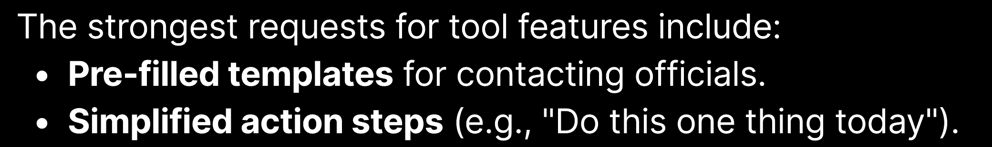
OAK AI / CREATOR-AUDIENCE RESEARCH, MARCH 2025
Turn audience needs
into a testable step
I led survey creation, launch, and analysis for a creator and advocacy audience. The report included requests for templates and clearer steps.
Those requests informed a proposed Action Hub. Product adoption and business impact were not measured.
Original report excerpt · page 15
06
Notes:
Reviewed Oak / creator-audience survey report, March 2025, page 15. Original crop shows summarized feature requests. The report example is not a participant quotation and gives no request frequencies. This voluntary advocacy/creator audience is not a commerce sample. The Action Hub was a proposal, not a measured product outcome. See the linked case for reported barriers, sample-count checkpoint and limitations.

Slide 7
FACTORLAB + OAK / TEAM COLLABORATION
Make the handoff
a design conversation
My walkthroughs put the state, the next action, and the unresolved choice where a team can review them.
01 Connect the normal path to waiting and recovery
02 Explain the alternative and its tradeoff
03 Revise with developers as constraints become clear
07
Notes:
Synthesis of reviewed FactorLab design walkthroughs and Oak recommendations/handoff. The list describes an approach supported by those artifacts. It does not establish platform-release ownership, quantified handoff efficiency, or work for ShopMy.

Slide 8
SHOPMY / PROPOSED APPROACH
Follow one creator task end to end
I would work with Product, Design, and Engineering to understand one creator or brand task and what the next decision needs to resolve.
01 Review the task and what research already tells us
02 Prototype the decisions across web and mobile
03 Test comprehension and recovery, then iterate
Proposed collaboration approach; no prior ShopMy client work is claimed.
08
Notes:
Proposed approach based on ShopMy Product Designer role 4893334008. Creator/brand task ownership, available research and measures would need to be established with the team. This is a proposed approach, not evidence of prior ShopMy product work or commerce-domain specialization.

Slide 9
SHOPMY / SENIOR PRODUCT DESIGNER
Kyle Hobson
Reusable interfaces, complete flows,
and research-informed design decisions.
Mesa, Arizona / Available for U.S. remote work
JonathanKyleHobson@gmail.com
Portfolio selected for ShopMy
09
Notes:
Candidate contact and travel availability are confirmed. Intended isolated portfolio route: https://jonathankhobson.github.io/application-portfolios/shopmy-product-designer/. Publication is a separate campaign action.

