Slide 1

KYLE HOBSON / Eliza · PARTNER AI DEPLOYMENT ENGINEER
AI ideas made
inspectable
Local AI tools, client-facing research
and practical technical teaching.
Partner AI Deployment Engineer application · September 2026
01
Notes:
Selected work for Eliza Partner AI Deployment Engineer: https://jobs.ashbyhq.com/eliza/c3ebcdb8-eace-4ff1-8db1-04ac8172b123 . Prior work shown includes independent Prompt Compass development, FactorLab interaction design and Coursera instruction.

Slide 2
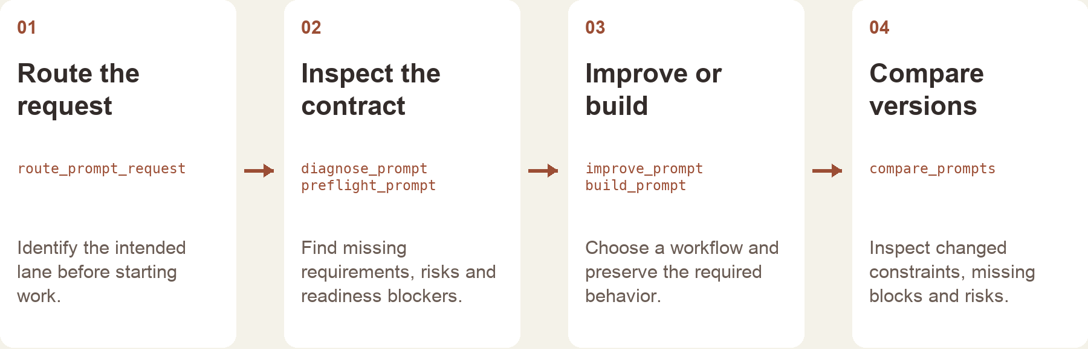
PROMPT COMPASS / RELEASED TOOL AND WORKFLOW DESIGN
Prompt Compass workflow
The local tool returns structured checks and routing.
The host assistant handles the conversation and final wording.
Implementation-based portfolio diagram · public beta release, April 2026
02
Notes:
Prompt Compass public beta: https://github.com/JonathanKHobson/prompt-compass/releases/tag/v0.1.0-beta.3 . The diagram explains a selected workflow reconstructed from the implementation. The local tool returns structured analysis and routing; the host assistant supplies conversation and final wording. Later local features are distinct from the April 2026 beta. No employee or customer adoption is claimed.

Slide 3
COURSERA / ASSESSMENT REVIEW, OCTOBER 2024
Assessment review and revision
Review finding | My documented revision
Choices were easy to eliminate | Reworked distractors, especially Questions 7, 8 and 10.
Question 7 tested only a definition | Added application of the concept alongside the definition.
Retry feedback revealed answers | Made feedback more neutral and referred learners to the lesson task.
Task references were incorrect | Corrected references across the assessment.
Paraphrased original review and instructor-response notes · revisions, not final QA signoff
03
Notes:
Original October 1, 2024 Course Shell Feedback and instructor responses. These four rows summarize actual review concerns and Kyle’s recorded revisions. Completed revision status does not establish separate final QA approval or measured learner improvement. Published course: https://www.coursera.org/projects/chatgpt-beginners .

Slide 4
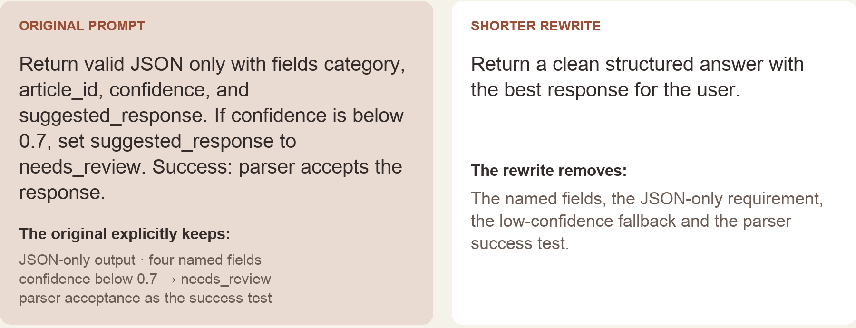
PROMPT COMPASS / LOCAL REGRESSION EXAMPLE, MAY 2026
Requirements lost in a rewrite
Original test inputs, excerpted from the portfolio rendering · expected winner: original prompt
04
Notes:
Prompt Compass local regression example, May 2026. Exact test instructions appear in an implementation-grounded portfolio rendering. The literal-term checks report missing requirements in the shorter prompt. They do not execute an LLM, parse generated output or validate the confidence threshold. This later local example is separate from the public April beta.

Slide 5


FLINT / INTERRUPTED AND OFFLINE STATES
Incomplete answer
Connection lost
Recovery from
interrupted answers
An incomplete answer and a lost connection need different next actions.
I assembled the flows and their next actions into an annotated handoff for engineering.
05
Notes:
Original FactorLab Flint incomplete-answer and offline design variants. The March 27, 2026 handoff separates partial response, stopped response and connection loss, with different next actions. Work shown is interaction design and annotated engineering handoff; no deployed adoption result is claimed.

Slide 6
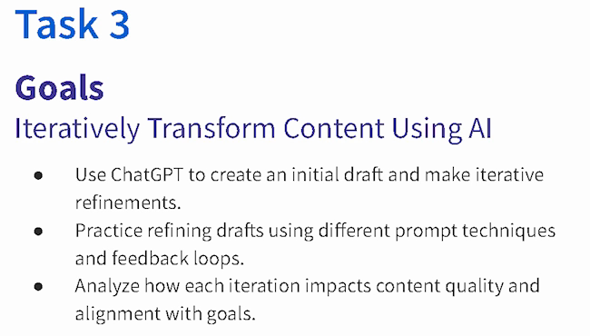
COURSERA · GUIDED PROJECT / ORIGINAL TEACHING, 2024
AI revision as
guided practice
I created a beginner project around drafting, reviewing and refining content against a goal.
Published teaching activity. Learner improvement is not measured here.
Original 2024 lesson material · goals excerpt
06
Notes:
Original 2024 teaching material for ChatGPT 4o for Beginners: Create Social Media Content. Kyle created and taught this published Guided Project. The displayed Task 3 goals connect drafting, revision, feedback and goal alignment. https://www.coursera.org/projects/chatgpt-beginners . No measured learning gain is asserted.

Slide 7

COURSERA / RECORDED PRACTICE SEQUENCE
Original lesson
revision sequence
The lesson made an instruction visible beside the result it changed. That gave learners something concrete to inspect.
The revised answer added detail. In my retrospective, I would make factual checks and length limits more explicit.
Original 2024 recording, Task 3 · 03:35
Fictional practice brand · unchanged source excerpt
07
Notes:
Original Coursera Task 3 teaching recording, 2024, at 03:35. The displayed revision instruction preserves historical wording and typos. Brew Bliss is fictional practice material. The reflection about checking added facts and length is a retrospective recommendation, not a reported assessment result.

Slide 8
RELATED EXPERIENCE
Discovery, demonstration
and handoff
Oak AI · 2023–2025
Research findings and design recommendations
FactorLab Flint · 2026
My work connects a question from a person or team to a concrete artifact: a tool, interaction decision or learning example that others can examine.
Failure conditions and recovery actions
Coursera · 2024
Guided practice and assessment revision
Prompt Compass · 2026
For Eliza, I would use that combination to clarify a client task and make the demonstration useful to both business and technical collaborators.
Explicit requirements and local checks
08
Notes:
Selected related experience: Oak AI Lead UX Researcher November 2023–2025, end month unknown; ASU IT Specialist October 2020–December 2022; FactorLab contract since October 2025; Coursera Guided Project instructor 2024; Prompt Compass independent creation and public beta 2026. ASU instructional design April 2022–October 2024 and AI Analyst February–October 2024 overlap. These roles are not added to claim extra tenure. Eliza contribution described here is proposed.

Slide 9
PROPOSED CONTRIBUTION / ELIZA CLIENT WORKSHOPS
Start with a task the client recognizes
Understand the client’s task
Build a bounded demonstration
Trace the current task with its owner.
Name the input, output and decision.
Check which constraints the example must keep.
Choose one useful slice with the delivery team.
Show what works and where it fails.
Keep assumptions visible during discussion.
Turn observation into practice
Prepare the next handoff
Let participants try a changed input.
Ask how they would judge the result.
Record confusion, missing context and errors.
Document setup, limits and review needs.
Keep the example and practice material together.
Confirm what needs engineering work next.
09
Notes:
Proposed discussion approach for Eliza Partner AI Deployment Engineer, https://jobs.ashbyhq.com/eliza/c3ebcdb8-eace-4ff1-8db1-04ac8172b123 . The role connects client discovery, AI demonstrations, technical workshops and reusable delivery material. This is not prior Eliza work or a committed program. Client access, data and any deployment would follow the responsible team’s permissions and review practices. No measured adoption or savings is asserted.

Slide 10
KYLE HOBSON / Eliza · PARTNER AI DEPLOYMENT ENGINEER
Let’s make the
next idea testable
Mesa, Arizona. Full U.S. work authorization. Available to start as soon as possible.
JonathanKyleHobson@gmail.com
jonathankhobson.github.io/application-portfolios/eliza-ai-deployment
10
Notes:
Related work includes released local MCP tooling, product interaction design and technical teaching. Available in Mesa, Arizona with full United States work authorization. No enterprise forward-deployed engineering, OpenAI partner delivery or executive sales ownership is asserted.

