Slide 1
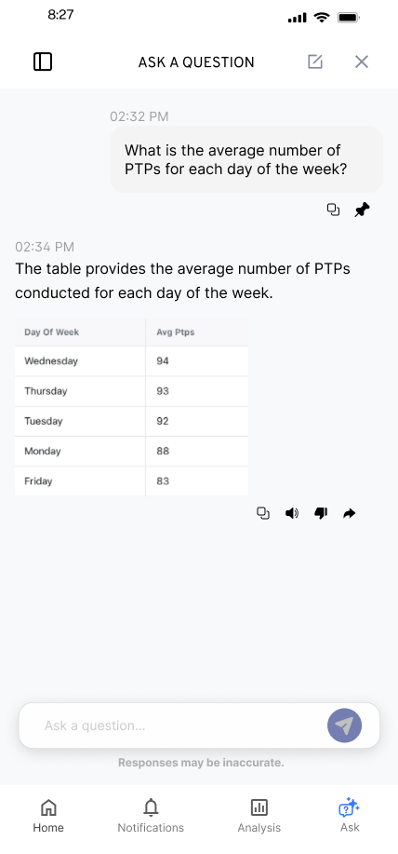
KYLE HOBSON / LIVEFRONT PRODUCT DESIGNER APPLICATION
Clear flows.
Useful handoffs.
Mobile interaction design, research,
and the details a team can build.
Selected work for Livefront
September 2026
01
Notes:
Livefront Product Designer, 4215612009. Employer source: https://job-boards.greenhouse.io/livefront/jobs/4215612009, verified September 8, 2026. Selected mobile design, research-to-design and engineering-handoff artifacts. No prior Livefront work or completed native platform release is claimed.

Slide 2
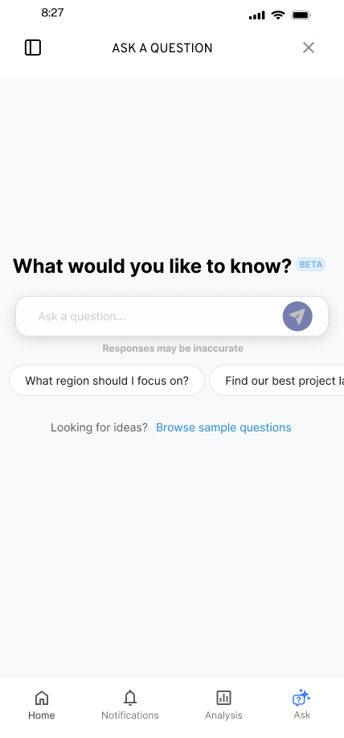
FLINT / SMARTTAGIT, FACTORLAB
A useful
first question
UX Designer & Researcher (Contract)
2025–2026
I explored suggested questions and a question library while keeping a person’s own question close at hand.
Mobile design states and engineering handoff
02
Notes:
Original FactorLab Flint mobile design and design walkthroughs. These are designed states and handoff artifacts, not confirmation that every pictured variant shipped. Interface content is sample data.

Slide 3


FLINT / INTERRUPTED AND OFFLINE STATES
Incomplete answer
Connection lost
Recovery follows
the failure
An incomplete answer and a lost connection need different next actions.
I connected the flows and their recovery actions in an annotated walkthrough for engineering.
03
Notes:
Original SmartTagIt Flint interrupted-response and offline variants, including the March 27, 2026 error-state handoff. This documents design decisions and annotations for developers, not measured task-success improvement.

Slide 4
ABOUT ME / SMARTTAGIT, FACTORLAB
Give each insight
a clear job
01
Summaries
02
Recommendations
03
Simple 7
I developed five widget groups, then explored their information order and content density.
04
Comparisons
05
Accomplishments
Editable summary of the reviewed structure
Original screen iterations in the linked case
04
Notes:
About Me April–May 2026 design walkthroughs, especially May 15. The five groups are summaries, recommendations, Simple 7, comparisons and accomplishments. This native diagram summarizes the reviewed organization; it is not an original screenshot. Customization and final policy remained open in the walkthrough.

Slide 5
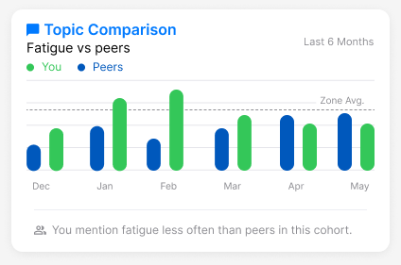
ABOUT ME / INFORMATION AND INTERPRETATION
A comparison
needs context
Mentioning fatigue less often is a comparison. Whether that is good depends on the context.
I raised the cohort and wording questions while developing reusable insight widgets.
Original design iteration with sample values
05
Notes:
Original About Me comparison widget and April–May 2026 walkthroughs. The web/server team release was confirmed September 2, 2026, but the exact pictured layout and completed mobile rollout are not established. Illustrative values are not measured customer outcomes.

Slide 6

OAK AI / RESEARCH TO DESIGN, 2023–2025
Put a visible choice
beside the finding
The original login error sat below the form. The recommendation connected the feedback to the password field.
I developed recommendations and collaborated with the lead UX designer. Fuller recovery guidance still needed work.
Proposed interface · implementation unverified
06
Notes:
Oak original heuristic evaluation and design recommendations. The original small bottom banner reported invalid login credentials; the proposed treatment added a password-field outline and Incorrect Password message. Kyle led the evaluation and recommendations and collaborated with the lead UX designer on mockups. No measured result or exact released variant is claimed.

Slide 7
FACTORLAB + OAK / TEAM COLLABORATION
Make the handoff
a design conversation
My walkthroughs put the state, the next action, and the unresolved choice where a team can review them.
01 Connect the normal path to waiting and recovery
02 Explain the alternative and its tradeoff
03 Revise with developers as constraints become clear
07
Notes:
Synthesis of reviewed FactorLab design walkthroughs and Oak recommendations/handoff. The list describes an approach supported by those artifacts. It does not establish platform-release ownership, quantified handoff efficiency, or work for Livefront.

Slide 8
LIVEFRONT / PROPOSED APPROACH
Start with one complete client task
I would align with the client and team on the task, the constraints, and what the next design decision needs to resolve.
01 Understand the user’s goal and delivery constraints
02 Prototype the path, including waiting and recovery
03 Review with users and engineering, then refine
Proposed collaboration approach; no prior Livefront client work is claimed.
08
Notes:
Proposed approach based on Livefront Product Designer role 4215612009. Client requirements, platform conventions, research access and measures would need to be established with the project team. It is not a speculative redesign of a Livefront client product.

Slide 9
LIVEFRONT PRODUCT DESIGNER APPLICATION
Kyle Hobson
Mobile flows, research-informed design,
and clear engineering handoffs.
Mesa, Arizona / U.S. remote work / Occasional travel available
JonathanKyleHobson@gmail.com
Portfolio selected for Livefront
09
Notes:
Candidate contact and travel availability are confirmed. Intended isolated portfolio route: https://jonathankhobson.github.io/application-portfolios/livefront-product-designer/. Publication is a separate campaign action.

