Slide 1

KYLE HOBSON / APPLICATION TO ONDO FINANCE
Make the state clear.
Make the next step useful.
Web and mobile product design
with research and engineering handoff
Product Designer · Remote (US)
01
Notes:
Prepared for Ondo Finance Product Designer, job 4323247009: https://job-boards.greenhouse.io/ondofinance/jobs/4323247009 . This application presents non-financial product design and research evidence. No fintech, banking, trading, crypto or investment product delivery is claimed. The paper-path illustration is existing decorative portfolio art.

Slide 2
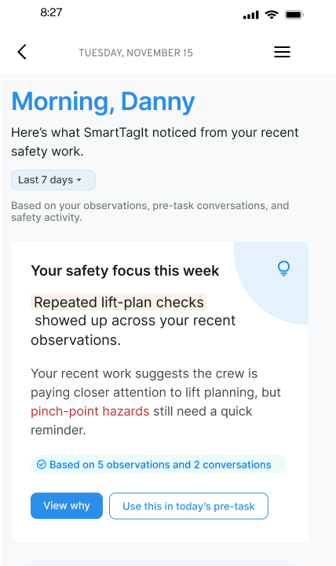
FACTORLAB / SMARTTAGIT ABOUT ME
A summary connected
to its evidence
I explored feedback layouts, widget families and content density so people could inspect the basis of a summary and find a useful next action.
Original design iteration. About Me web/server changes released September 2, 2026; this pictured variant is not claimed as the final released layout.
02
Notes:
Kyle explored About Me information models and widget families in original April–May 2026 design walkthroughs. Source: reviewed portfolio-suite design About Me case and original about-me-widget-system.png. Numbers and named content inside the design are interface example data, not measured outcomes. September 2 release evidence supports web/server feature release, not this exact variant or mobile rollout. Public case: https://jonathankhobson.github.io/portfolio/design/case/about-me/ .

Slide 3
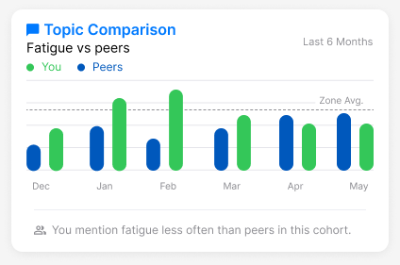
FACTORLAB / ABOUT ME COMPARISON DESIGN
A comparison needs
a careful explanation
The caption describes how often a topic appears in a cohort. It avoids turning a difference into an unsupported performance judgment.
Original interface design with example data. No financial data or measured performance result is shown.
03
Notes:
Original FactorLab About Me design variant. Source about-me-comparison.png and reviewed design source map. Chart is retained as a source screenshot to show the actual interface design; it is not an editable analytic chart or report of real user performance. Kyle’s contribution was comparison language and interface reasoning; no investment/risk disclosure expertise or trading outcome is claimed.

Slide 4


FACTORLAB / FLINT CONVERSATIONAL PRODUCT DESIGN
Recovery depends
on what happened
An interrupted answer and a lost connection leave different information available. I designed their messages and actions, then annotated the behavior for engineering.
Original mobile designs and handoff. No claim that the pictured states are shipped.
04
Notes:
FactorLab UX Designer & Researcher (Contract), October 2025–Present. Original Kyle-authored Figma designs and March 27 error-state walkthrough. Entry, waiting, saved questions and response actions are organized with engineering annotations. These are design and handoff artifacts; the exact states are not verified as shipped. Public case: https://jonathankhobson.github.io/portfolio/design/case/flint/ .

Slide 5

OAK AI / LEAD UX RESEARCHER, 2023–2025
A finding becomes
a visible recommendation
The audit identified vague login feedback. I recommended locating the error beside the relevant field so people could see what to correct.
Original proposed interface. This is evaluation and design guidance, not a measured conversion improvement.
05
Notes:
Oak original DesignRecOak findings and recommendations, reviewed September 2026. Kyle led UX research and developed navigation/error-feedback recommendations with the lead UX designer. The public crop preserves the original proposed treatment; no production deployment, conversion gain or ownership of every design element is inferred. Public case: https://jonathankhobson.github.io/portfolio/design/case/oak/ .

Slide 6
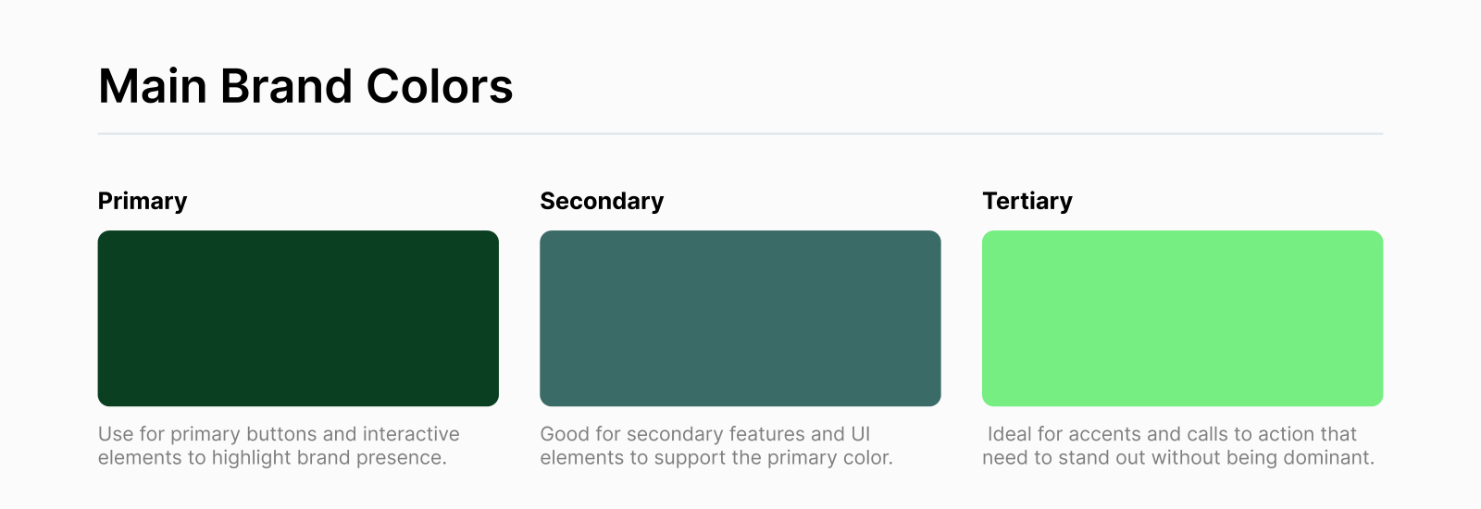
OAK AI / ORIGINAL COLOR-ROLE GUIDANCE
Shared color roles support consistency
I paired design recommendations with shared color guidance for the next iteration.
This artifact establishes color guidance; it does not establish ownership of a complete component library.
06
Notes:
Source: Oak UI Kit V2.pdf, selected page exported as oak-ui-kit.png in the approved source portfolio. It documents color roles and use guidance. No typography system, complete coded component library or design-system governance leadership is inferred from this page.

Slide 7
ONDO FINANCE / PROPOSED STARTING APPROACH
Map one client journey completely
I would learn the product rules with Product, Engineering and Research before proposing an interface change.
Map what the client needs to understand at each step.
Define ordinary, waiting, incomplete and failure states.
Prototype the flow and check comprehension with relevant users.
Agree on success measures and review the implementation.
Proposed approach, not delivered Ondo work. Financial and legal content needs domain review.
07
Notes:
A proposed design/research starting approach for Ondo’s client-facing products. Not an Ondo case study, product audit or claim of financial/legal expertise. No investment recommendations or redesigned financial controls are supplied. Official role describes product, engineering and research collaboration: https://job-boards.greenhouse.io/ondofinance/jobs/4323247009 .

Slide 8
KYLE HOBSON / ONDO FINANCE APPLICATION
Product Designer
Mesa, Arizona · Available for U.S. remote work
Product flows, Figma prototypes and engineering handoff
JonathanKyleHobson@gmail.com
View the tailored Ondo portfolio
08
Notes:
Candidate confirmed Mesa location, U.S. work authorization without sponsorship and ASAP start. Portfolio link targets the separately prepared Ondo site. No previous Ondo employment or financial-product delivery is claimed.

