Slide 1

KYLE HOBSON / STRIKE TRUST DESIGNER
Product feedback
and recovery flows
Interface states at FactorLab
and recommendations for Oak AI.
Trust Designer application · September 2026
01
Notes:
Prepared for Trust Designer (Strike), https://job-boards.greenhouse.io/strike/jobs/6166903004 . Strike is a prospective employer; the displayed projects are prior FactorLab and Oak work. Decorative cover uses existing canonical artwork and is not evidence.

Slide 2
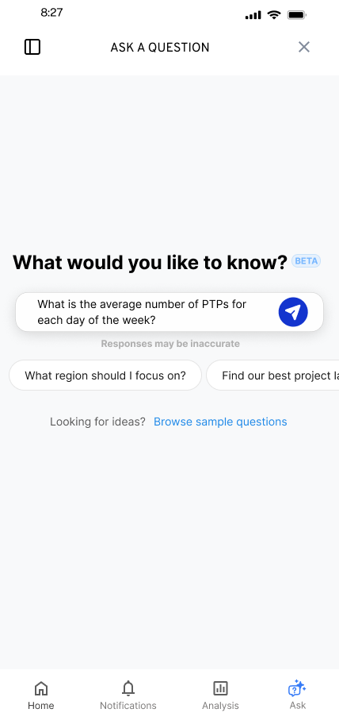
FACTORLAB · FLINT / INTERACTION DESIGN, 2026
Editable starting questions
Suggested questions offered a starting point while leaving the person free to edit or ask something else.
I worked within the existing product, keeping the answer layout and agreed phase scope in view.
02
Notes:
Source: original Flint suggested-question state and project walkthroughs in canonical design.json. Selecting a suggestion was intended to populate the input for review or editing. Design variant and engineering handoff; release of each variant is unverified.

Slide 3
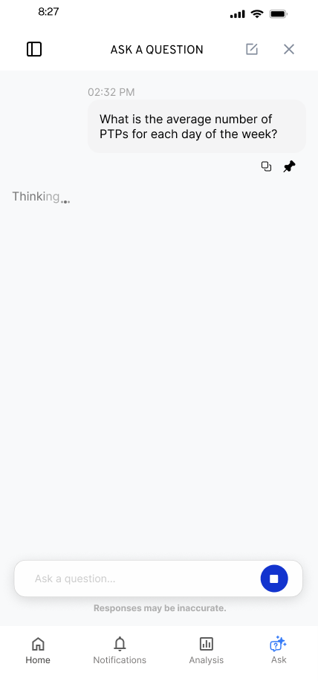
FACTORLAB · FLINT / RESPONSE IN PROGRESS
A request in progress
The conversation needed to show that a request was still in progress, without making a new result appear before it existed.
I explored waiting feedback within the existing conversation and worked through animation constraints with the product lead.
03
Notes:
Source: Flint original loading state and canonical design case waiting decision. This is a design exploration and discussion of constraints, not a measured wait-time reduction or evidence of a shipped animation system.

Slide 4


FLINT / INTERRUPTED AND OFFLINE STATES
Incomplete answer
Connection lost
Different failures
need different actions
An incomplete answer and a lost connection need different next actions.
I assembled the flows and their next actions into an annotated handoff for engineering.
04
Notes:
Source: selected original Flint interrupted-response and offline design variants, including the March 27, 2026 error-state handoff. Distinct recovery actions follow the state: Ask again or Continue for a partial response, and retry after connection loss with the question preserved. Deliverable: connected flows, interaction states and engineering annotations.

Slide 5
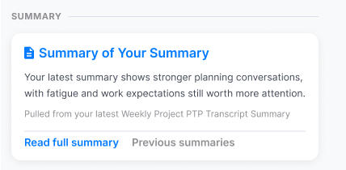
FACTORLAB · ABOUT ME / INFORMATION ARCHITECTURE, 2026
Feedback organized
by purpose
Summaries. Recommendations. Simple 7. Comparisons. Accomplishments.
I explored content density and reusable widget structures, then worked with engineers on what each action opened.
Original design detail · sample content
05
Notes:
Sources: About Me original Figma design and April–May 2026 walkthroughs, canonical design.json. Kyle developed page directions, content families and visual alternatives. Product lead and engineering clarified data availability, existing capabilities and routes into detail. Team release of web/server changes is confirmed September 2, 2026; the exact pictured layout is unverified. The crop preserves original source pixels.

Slide 6
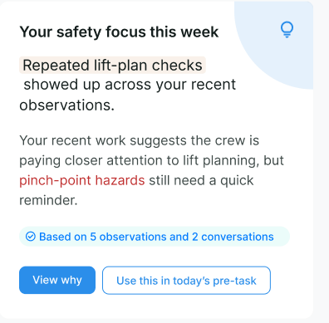
FACTORLAB · ABOUT ME / SUMMARY TO SUPPORTING DETAIL
The detail behind
a recommendation
A short summary needs a route to the observations behind it and to a useful next action.
I explored that connection before expanding the range of widgets and content on the page.
Original direction exploration · sample content
06
Notes:
Source: original About Me widget-system direction and canonical detail for the summary decision. Source values and content are design examples, not measured user results. The screenshot shows View why and an action route. Exact released layout is unverified.

Slide 7


OAK AI / LOGIN FEEDBACK
Error feedback
beside the field
Original
Proposed
I made the problem field visible where a person could act on it.
The recommendation gave the team a specific behavior to discuss and prioritize.
Original error at the page footer
Proposed feedback beside the field
07
Notes:
Source: original Oak error-message recommendation artifact containing Before and After panels. Displayed interface panels retain source pixels and are labeled Original and Proposed to clarify the work state. Kyle connected an evaluation finding to visual alternatives and implementation recommendations. No conversion or task-success percentage is asserted.

Slide 8
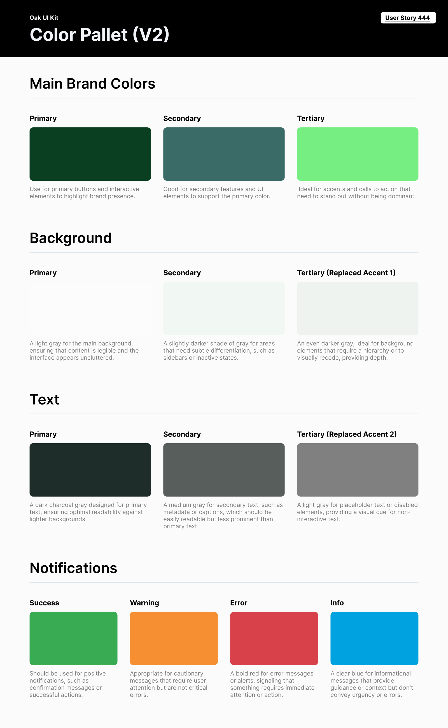
OAK AI / VISUAL GUIDANCE
Consistent color roles
Brand, backgrounds, text and feedback needed consistent roles across the interface.
I documented those roles for the next design iteration. This focused guide did not establish a complete component library.
08
Notes:
Source: original Oak UI Kit V2 export tied to User Story 444 and canonical design.json. Focused color specification; no complete design-system coverage or accessibility-compliance claim.

Slide 9
PROPOSED APPROACH / STRIKE TRUST TEAM
A trust flow to investigate
The customer’s understanding
The system’s actual state
Observe a blocked account task.
Ask what the customer thinks happened
and what they expect to do next.
Map the state with engineers and Trust.
Clarify what can be disclosed, what remains
available and where support can help.
A bounded design comparison
Comprehension before expansion
Prototype the explanation and next action.
Compare web and mobile behavior while
retaining platform conventions.
Test what people believe is protected,
what is pending and what they can do.
Document states and unresolved questions.
09
Notes:
Proposed discussion approach for Strike Trust Designer, https://job-boards.greenhouse.io/strike/jobs/6166903004 . Historical employer context: https://strike.me/blog/announcing-better-limits/ dated March 27, 2024 describes pending and available balances. The proposal is not prior Strike work, a finding about its current interface or a compliance solution. Security and disclosure rules require the team’s domain expertise.

Slide 10
KYLE HOBSON / STRIKE TRUST DESIGNER
Clear feedback
through difficult moments
Mesa, Arizona. Full U.S. work authorization. Available to start as soon as possible.
JonathanKyleHobson@gmail.com
jonathankhobson.github.io/application-portfolios/strike-trust-designer
10
Notes:
Selected product-design work for Strike Trust Designer. Kyle’s reviewed history combines research, interface design and engineering handoff. Fintech, KYC/fraud delivery, native production ownership and complete design-system ownership are not established. Mesa, Arizona; full U.S. work authorization and availability as soon as possible.

