Slide 1

KYLE HOBSON / SAND CHERRY ASSOCIATES · UX & DIGITAL DESIGN
Clear interactions.
Considered visual decisions.
Mobile and web design, visual communication
and creative instruction.
UX Designer, Digital Design · September 2026
01
Notes:
Prepared for Sand Cherry Associates — UX Designer, Digital Design, https://apply.workable.com/sand-cherry-associates-1/j/363B2ED538/ . Prior FactorLab, Oak AI and Coursera work demonstrates interaction design, visual communication and teaching. No previous Sand Cherry client work is claimed. Decorative canonical cover artwork is not evidence.

Slide 2
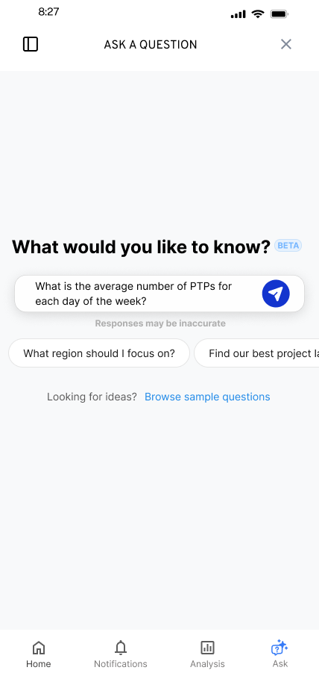
FACTORLAB · FLINT / INTERACTION DESIGN, 2025–2026
Make the first question
easier to ask
Suggested questions offered a starting point while leaving the person free to edit or ask something else.
I worked within the existing product, keeping the answer layout and agreed phase scope in view.
02
Notes:
Source: original Flint suggested-question state and project walkthroughs in canonical design.json. Selecting a suggestion was intended to populate the input for review or editing. Design variant and engineering handoff; release of each variant is unverified.

Slide 3
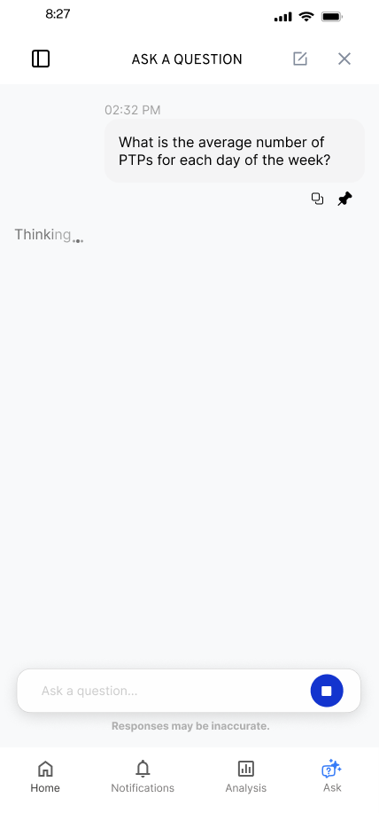
FACTORLAB · FLINT / RESPONSE IN PROGRESS
Keep the request visible
while it runs
The conversation needed to show that a request was still in progress, without making a new result appear before it existed.
I explored waiting feedback within the existing conversation and worked through animation constraints with the product lead.
03
Notes:
Source: Flint original loading state and canonical design case waiting decision. This is a design exploration and discussion of constraints, not a measured wait-time reduction or evidence of a shipped animation system.

Slide 4


FLINT / INTERRUPTED AND OFFLINE STATES
Incomplete answer
Connection lost
Recovery follows
the failure
An incomplete answer and a lost connection need different next actions.
I assembled the flows and their next actions into an annotated handoff for engineering.
04
Notes:
Source: selected original Flint interrupted-response and offline design variants, including the March 27, 2026 error-state handoff. Distinct recovery actions follow the state: Ask again or Continue for a partial response, and retry after connection loss with the question preserved. Deliverable: connected flows, interaction states and engineering annotations.

Slide 5
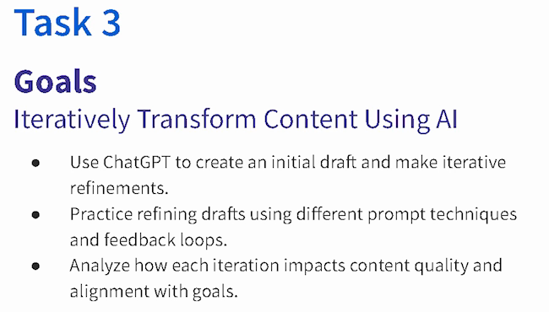
COURSERA · GUIDED PROJECT / ORIGINAL TEACHING, 2024
Make revision
something the
learner can see
I created a beginner project around drafting, reviewing and refining content against a goal.
Published teaching activity. Learner improvement is not measured here.
Original 2024 lesson material · goals excerpt
05
Notes:
Source: canonical ai.json teaching-ai case, original 2024 lesson material and https://www.coursera.org/projects/chatgpt-beginners . Kyle created and taught the published project ChatGPT 4o for Beginners: Create Social Media Content. The crop preserves all original Task 3 goal text without changing source pixels: ai-course-goals.png x80 y85 w650 h370. Learning sequence and teaching materials are direct evidence; enrollment is not a learning-gain measure.

Slide 6

COURSERA / RECORDED PRACTICE SEQUENCE
Turn a broad request
into a specific revision
A familiar café example gave beginners a draft to inspect and an instruction to change.
The revised answer added detail. In my retrospective, I would make factual checks and length limits more explicit.
Original 2024 recording, Task 3 · 03:35
Fictional practice brand · unchanged source excerpt
06
Notes:
Source: canonical teaching-ai case and original recorded revision instruction at 03:35. The screenshot preserves the historical interface and original text, including typos. Brew Bliss is fictional practice material. This slide shows teaching judgment, not a commercial campaign, controlled experiment or measured learner result. The retrospective check is a later reflection, not an assessment reported as run.

Slide 7


OAK AI / LOGIN FEEDBACK
Error feedback
beside the field
Original
Proposed
I made the problem field visible where a person could act on it.
The recommendation gave the team a specific behavior to discuss and prioritize.
Original error at the page footer
Proposed feedback beside the field
07
Notes:
Source: original Oak error-message recommendation artifact containing Before and After panels. Displayed interface panels retain source pixels and are labeled Original and Proposed to clarify the work state. Kyle connected an evaluation finding to visual alternatives and implementation recommendations. No conversion or task-success percentage is asserted.

Slide 8
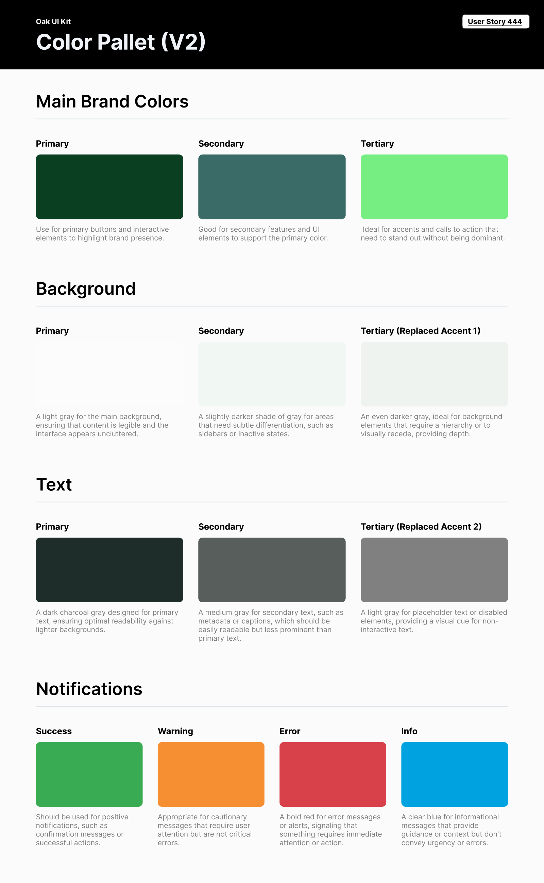
OAK AI / VISUAL GUIDANCE
Give color
a defined job
Brand, backgrounds, text and feedback needed consistent roles across the interface.
I documented those roles for the next design iteration. This focused guide did not establish a complete component library.
08
Notes:
Source: original Oak UI Kit V2 export tied to User Story 444 and canonical design.json. Focused color specification; no complete design-system coverage or accessibility-compliance claim.

Slide 9
PROPOSED APPROACH / SAND CHERRY ASSOCIATES
A shared brief for the next design task
Understand the audience
Make the direction visible
Clarify who the work is for and what
they should do next. Review the channel,
brand guidance and delivery constraints.
Sketch a flow or draft a visual direction.
Use a concrete example to discuss
hierarchy, content and tone with the team.
Use feedback to revise
Prepare a clear handoff
Compare stakeholder feedback with the
brief. Resolve unclear choices and keep
the next iteration focused on the task.
Check states, copy and layout at the
intended sizes. Document decisions and
remaining questions before delivery.
09
Notes:
Proposed approach for discussion based on the Sand Cherry Associates UX Designer, Digital Design description, https://apply.workable.com/sand-cherry-associates-1/j/363B2ED538/ . The client and domain are not identified. This is not prior Sand Cherry work, a diagnosed defect or a promised commercial result.

Slide 10
KYLE HOBSON / SAND CHERRY ASSOCIATES · UX & DIGITAL DESIGN
Let’s talk about the
next design task
Mesa, Arizona. Full U.S. work authorization. Available to start as soon as possible.
JonathanKyleHobson@gmail.com
jonathankhobson.github.io/application-portfolios/sandcherry-ux-designer
10
Notes:
Tailored for Sand Cherry Associates UX Designer, Digital Design. Kyle has six years of Figma experience and reviewed bachelors degrees in Technical Communication and Electronic Media, plus an MS User Experience. Experience combines UX research, hands-on interface work and creative instruction. Coursera teaching is adjacent to commercial campaign production. Broad Adobe proficiency, inflated design tenure and commercial performance metrics are not claimed.

