Slide 1

KYLE HOBSON / VIRTUALITICS - SR PRODUCT DESIGNER
Useful AI needs
clear interaction
FactorLab interaction design, Oak research
and local AI tools.
Sr Product Designer application - September 2026
01
Notes:
Prepared for Sr Product Designer (Virtualitics), https://jobs.lever.co/virtualitics/aa051de1-736c-46f4-a7c9-701a14059bbf . Virtualitics is a prospective employer; the displayed projects are prior FactorLab and Oak work. Cover artwork is decorative; project screenshots provide the work evidence.

Slide 2
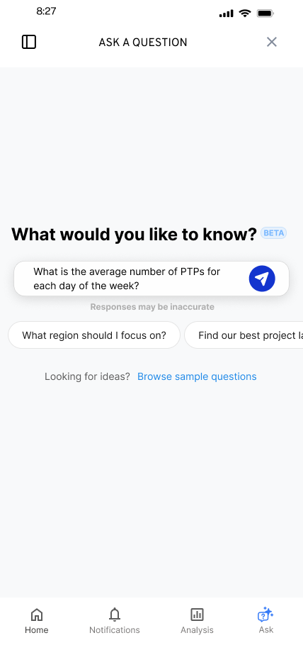
FACTORLAB · FLINT / INTERACTION DESIGN, 2026
Editable starting questions
Suggested questions offered a starting point while leaving the person free to edit or ask something else.
I worked within the existing product, keeping the answer layout and agreed phase scope in view.
02
Notes:
Source: original Flint suggested-question state and project walkthroughs in the original portfolio case. Selecting a suggestion was intended to populate the input for review or editing. Design variant and engineering handoff; release of each variant is unverified.

Slide 3
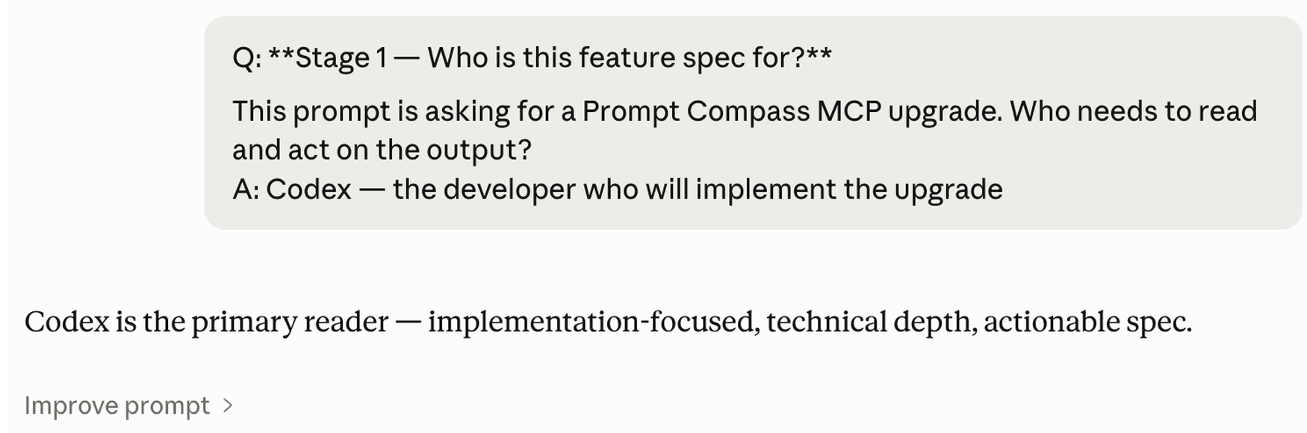
APPLIED AI / PROMPT COMPASS, 2026
The requirements
still need to hold
I built a tool for inspecting prompt requirements and comparing versions. A shorter instruction can lose an important review step.
Public beta release, April 2026. The example here shows a request clarified before a feature proposal.
Original example session · feature proposal
03
Notes:
Prompt Compass: https://github.com/JonathanKHobson/prompt-compass/releases/tag/v0.1.0-beta.3 . Public prerelease April 27, 2026, with later local evaluation examples in May. Displayed excerpt comes from an original example session; it is a feature proposal, not deployed enterprise adoption. This illustrates Kyle’s judgment about preserving requirements when working with AI.

Slide 4


FLINT / INTERRUPTED AND OFFLINE STATES
Incomplete answer
Connection lost
Different failures
need different actions
An incomplete answer and a lost connection need different next actions.
I assembled the flows and their next actions into an annotated handoff for engineering.
04
Notes:
Source: selected original Flint interrupted-response and offline design variants, including the March 27, 2026 error-state handoff. Distinct recovery actions follow the state: Ask again or Continue for a partial response, and retry after connection loss with the question preserved. Deliverable: connected flows, interaction states and engineering annotations.

Slide 5
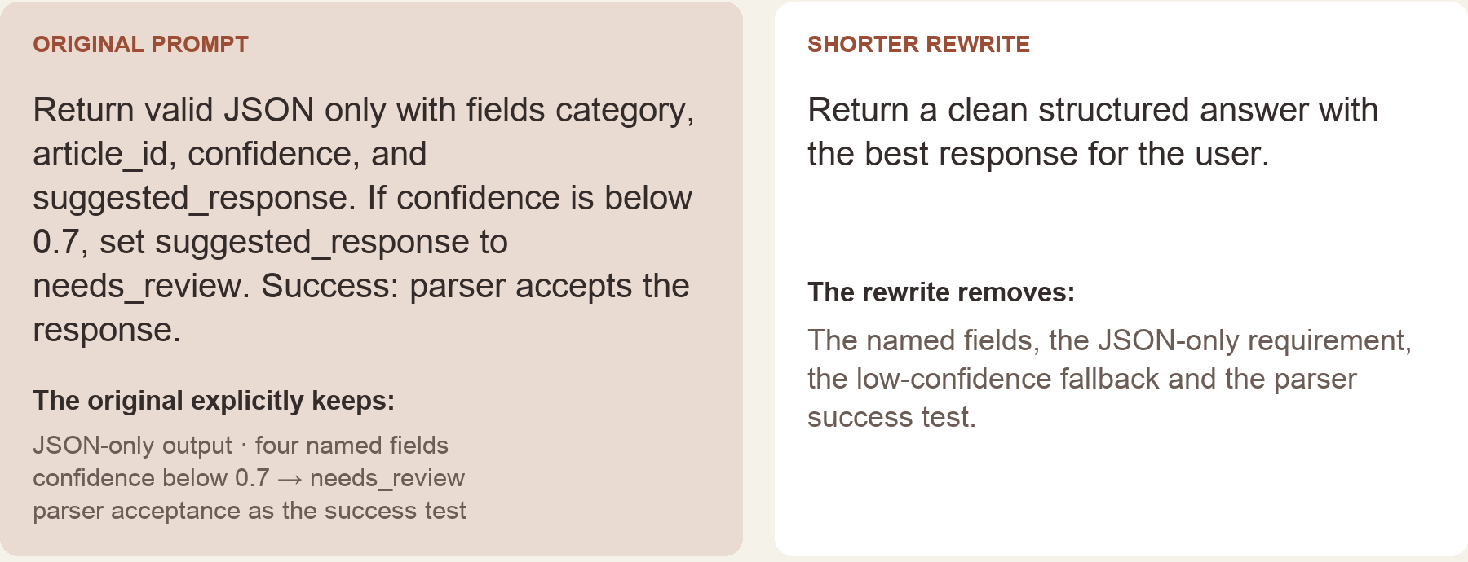
PROMPT COMPASS / LOCAL REGRESSION EXAMPLE, MAY 2026
A shorter prompt can
drop a review step
I compare prompt versions against explicit requirements instead of treating cleaner wording as automatically better.
This local example checks whether the revision still asks for review before implementation. It does not measure model accuracy.
Original local evaluation example - requirement comparison
05
Notes:
Source: original Prompt Compass local regression example, May 2026. The example checks whether a rewritten prompt preserves an explicit review condition. It is local tool evidence, not a claim of enterprise deployment, adoption or measured model accuracy.

Slide 6
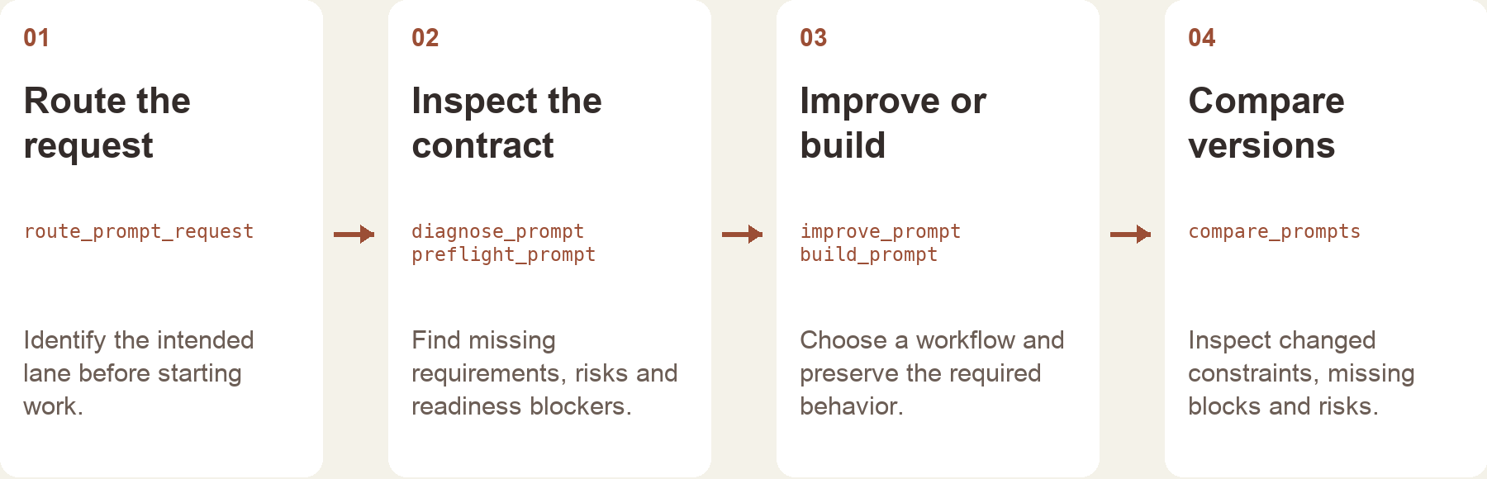
PROMPT COMPASS / WORKFLOW AND REVIEW BOUNDARIES
Route the work before
generating the answer
A useful AI workflow needs a named task, a review point and a clear handoff to the person making the decision.
I use that structure in Prompt Compass and in my own AI-assisted design work. Generated output remains subject to review.
Original workflow example - task, output and review
06
Notes:
Source: original Prompt Compass workflow example. Prompt Compass is an independent project, separate from FactorLab and Oak employment. The screenshot shows an authored workflow concept and does not claim production engineering ownership or enterprise deployment.

Slide 7


OAK AI / LOGIN FEEDBACK
Error feedback
beside the field
Original
Proposed
I made the problem field visible where a person could act on it.
The recommendation gave the team a specific behavior to discuss and prioritize.
Original error at the page footer
Proposed feedback beside the field
07
Notes:
Source: original Oak error-message recommendation artifact containing Before and After panels. Displayed interface panels retain source pixels and are labeled Original and Proposed to clarify the work state. Kyle connected an evaluation finding to visual alternatives and implementation recommendations. No conversion or task-success percentage is asserted.

Slide 8
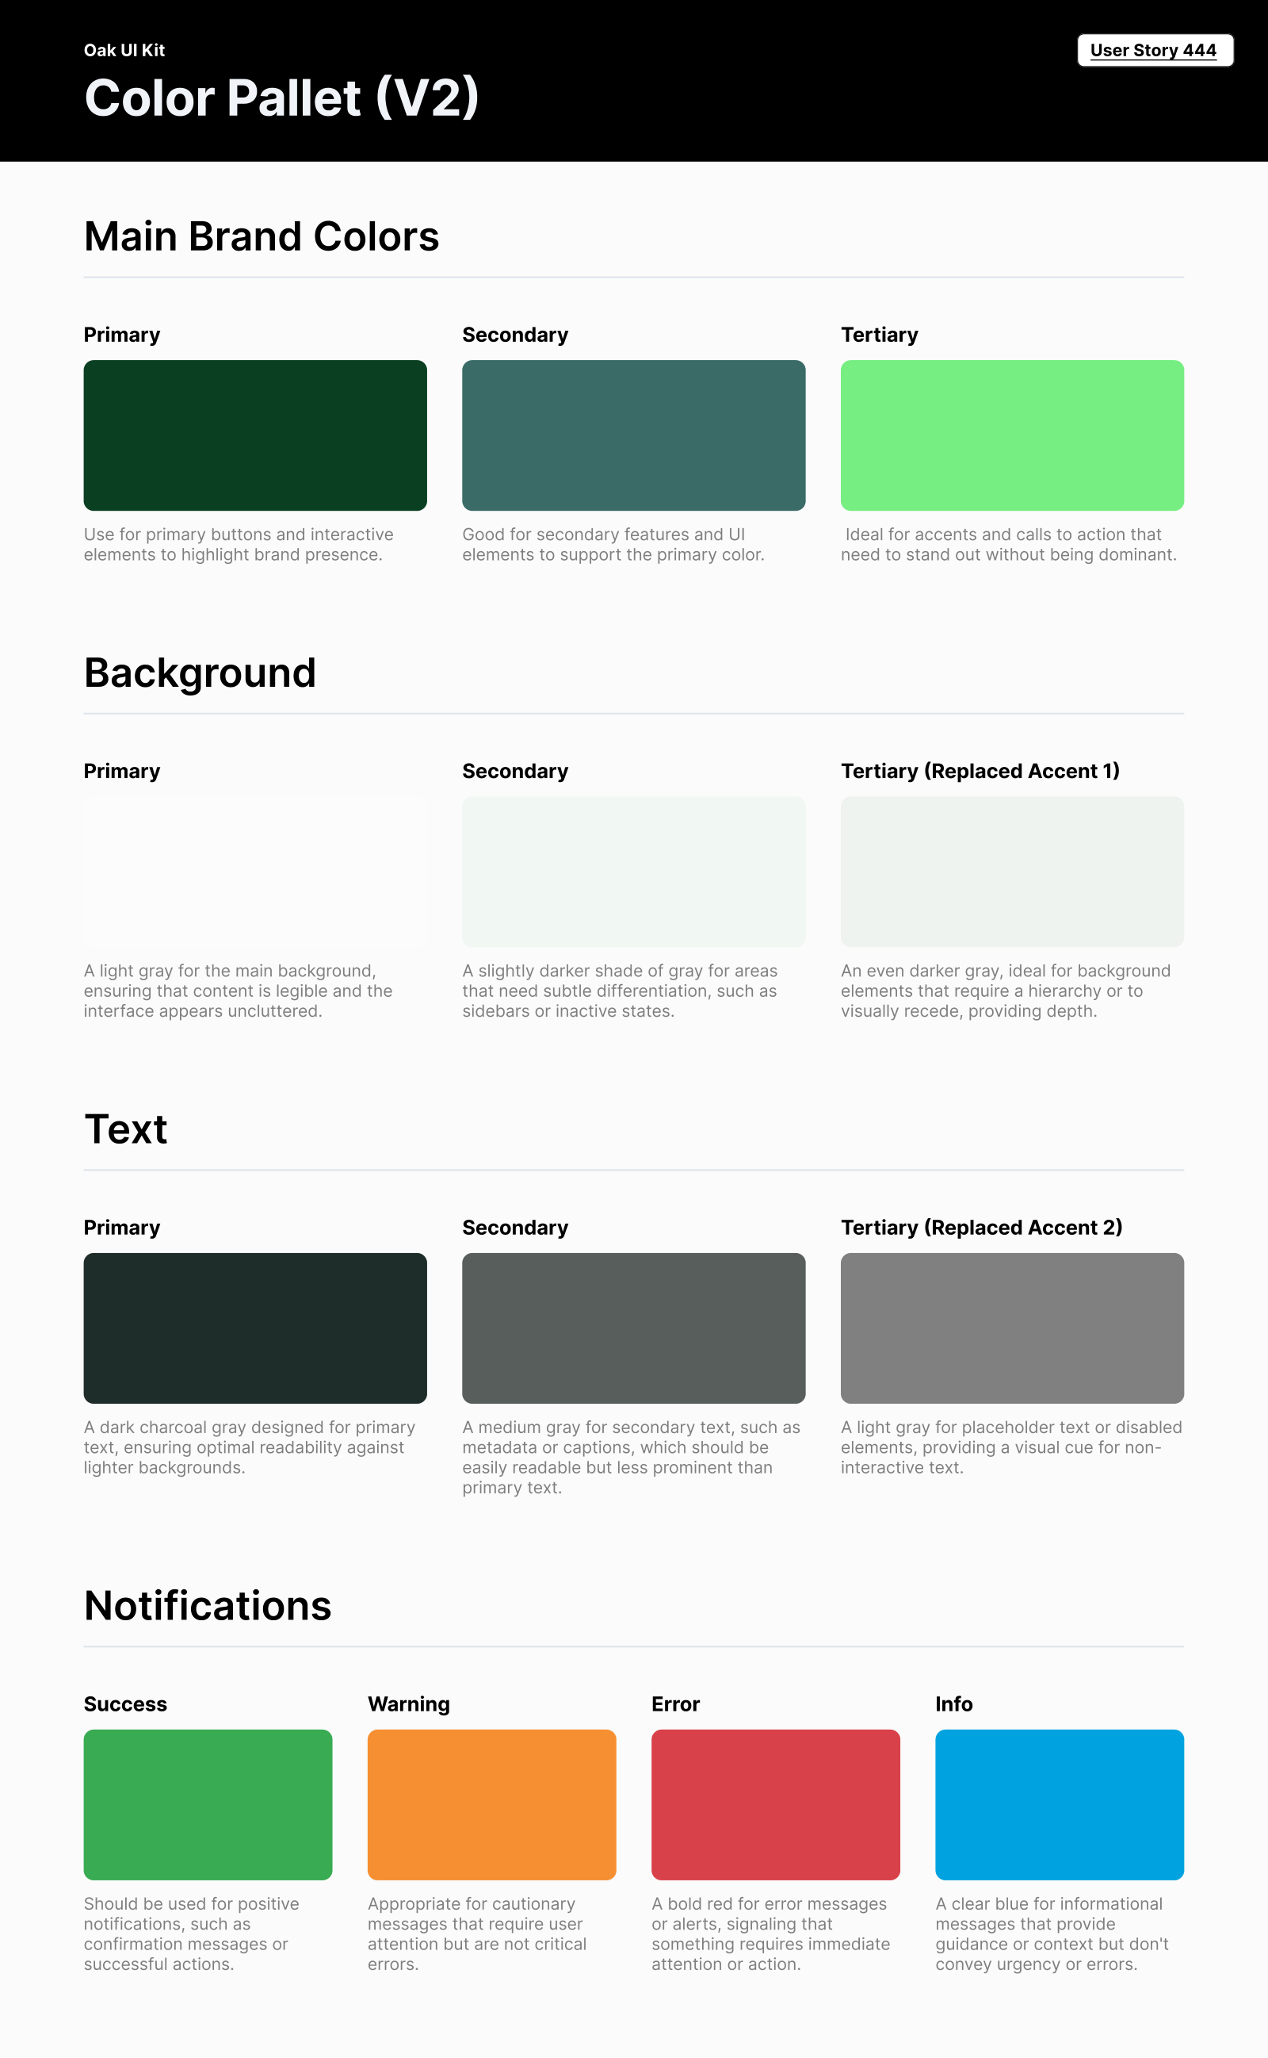
OAK AI / VISUAL GUIDANCE
Consistent color roles
Brand, backgrounds, text and feedback needed consistent roles across the interface.
I documented those roles for the next design iteration. This focused guide did not establish a complete component library.
08
Notes:
Source: original Oak UI Kit V2 export tied to User Story 444 and the original portfolio case. Focused color specification; no complete design-system coverage or accessibility-compliance claim.

Slide 9
PROPOSED APPROACH / VIRTUALITICS READINESS AI
Define the task before the interface
The analyst’s immediate task
The interaction contract
Observe one recurring readiness task.
Find what a person needs to review, edit
or compare before taking the next action.
Map inputs, agent responses and failures.
Agree with engineers on permissions,
follow-on actions and recoverable states.
A focused interactive prototype
Evidence for the next decision
Explore a small flow with AI-assisted tools.
Check generated behavior against the design
and involve engineering in implementation.
Watch people use the proposed flow.
Revise unclear feedback and document
what is agreed and what still needs testing.
09
Notes:
Proposed discussion approach for Virtualitics Sr Product Designer, https://jobs.lever.co/virtualitics/aa051de1-736c-46f4-a7c9-701a14059bbf . This is not prior Virtualitics delivery, a diagnosis of the product or a measured outcome. User needs and technical constraints require discovery with the team.

Slide 10
KYLE HOBSON / VIRTUALITICS - SR PRODUCT DESIGNER
AI product design
people can work with
Mesa, Arizona. Full U.S. work authorization. Available to start as soon as possible.
JonathanKyleHobson@gmail.com
jonathankhobson.github.io/application-portfolios/virtualitics-product-designer
10
Notes:
Selected work for Virtualitics Sr Product Designer. Kyle’s experience combines research, interface design, applied AI tools and engineering handoff. The shown work distinguishes design and engineering handoff, original recommendations and local tool development from enterprise deployment ownership. Mesa, Arizona; full U.S. work authorization and availability as soon as possible.

