Slide 1

KYLE HOBSON / APPLICATION TO BLACKBAUD
Help people use AI
with judgment
Practical teaching, workflow guidance
and careful review of AI output
AI Adoption Specialist · R0014520 · Remote, United States
01
Notes:
Prepared for Blackbaud AI Adoption Specialist R0014520, Remote Anywhere USA. This is an internal employee-enablement role in the Enterprise Technology Group. Job source: https://blackbaud.wd1.myworkdayjobs.com/en-US/ExternalCareers/job/AI-Adoption-Specialist_R0014520 . The approved paper-path illustration is decorative, not project evidence.

Slide 2
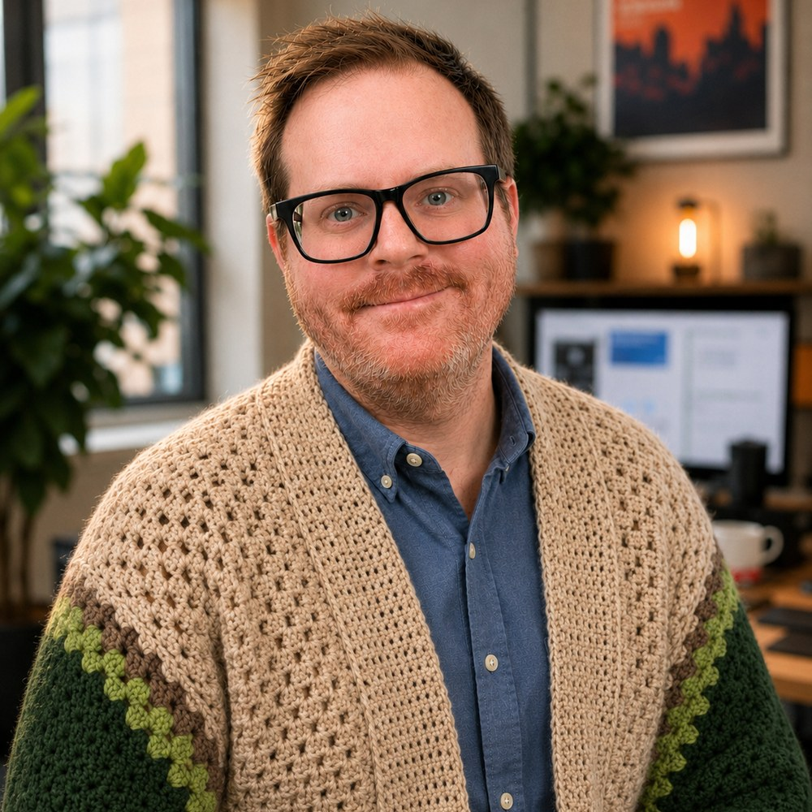
ARIZONA STATE UNIVERSITY / INSTRUCTIONAL DESIGNER
Understand the task
before introducing change
At ASU Knowledge Enterprise, I developed digital learning materials and workshops with accessibility improvements and AI-supported content workflows.
April 2022–October 2024
MS in User Experience · BS in Technical Communication
02
Notes:
Reviewed career evidence: ASU Knowledge Enterprise, Instructional Designer, April 2022–October 2024. MS User Experience with UX Research concentration, ASU, May 2024; BS Technical Communication with UX concentration, ASU, May 2023. The concise role scope is reviewed evidence; this slide does not claim specific SCORM/LMS production tools or measured learning gains. Public profile: https://www.linkedin.com/in/jonathankylehobson/ .

Slide 3
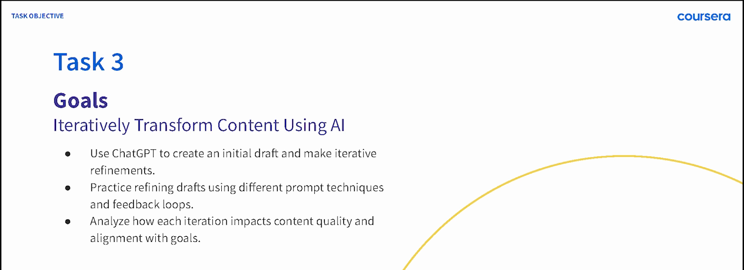
COURSERA / GUIDED PROJECT INSTRUCTOR, 2024
A practice sequence people can follow
ChatGPT 4o for Beginners: Create Social Media Content
Published in 2024 · 4,700+ enrollments as of September 2026
03
Notes:
Source: original 2024 lesson materials and the official Coursera page https://www.coursera.org/projects/chatgpt-beginners . The image is an original course slide. Enrollments describe reach, not course completion or measured skill improvement.

Slide 4
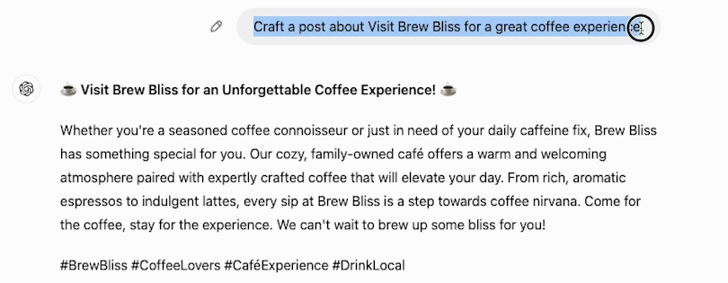
COURSERA / ORIGINAL DEMONSTRATION
Make the change visible
in a lesson
The next step is to make the request more specific and compare the result.
04
Notes:
Source: original 2024 Task 3 recording at 02:30. This initial fictional Brew Bliss cafe draft gives learners material to inspect and revise. Later lesson steps demonstrate a more specific instruction and its resulting draft. It is not a client campaign or evidence of measured learner proficiency. Official course: https://www.coursera.org/projects/chatgpt-beginners .

Slide 5


FACTORLAB / SMARTTAGIT FLINT DESIGN
Recovery guidance
has to describe
the real state
An interrupted answer and a lost connection needed different messages and actions. I organized those states in Figma and annotated the behavior for engineering.
For AI adoption: explain what happened and what the person can do next.
05
Notes:
FactorLab UX Designer & Researcher (Contract), October 2025–Present. Original Kyle-authored Figma designs and engineering annotations, reviewed in the September 2026 portfolio. Design and handoff evidence; exact pictured state is not claimed to be shipped. Its relevance to end-user documentation is adjacent: Kyle is explaining product behavior, showing product-design evidence with adjacent application to learning materials. Public case: https://jonathankhobson.github.io/portfolio/design/case/flint/ .

Slide 6
PROMPT COMPASS / DESIGNED LOCAL REGRESSION CASE
A rewrite must preserve the requirement
ORIGINAL FIXTURE PROMPT
SHORTER REWRITE
Return valid JSON only with fields category, article_id, confidence, and suggested_response. If confidence is below 0.7, set suggested_response to needs_review. Success: parser accepts the response.
Return a clean structured answer with the best response for the user.
Expected winner: the original
The rewrite loses named fields, JSON-only output and the review condition.
06
Notes:
Original developer-authored Prompt Compass local regression fixture, May 2026. Both prompts are exact fixture values. This is a designed evaluation example, not a client incident, production-model benchmark, or measured ROI. The public beta release is https://github.com/JonathanKHobson/prompt-compass/releases/tag/v0.1.0-beta.3 . Relevant to AI adoption guidance: a rewritten instruction still needs to preserve conditions and review requirements.

Slide 7
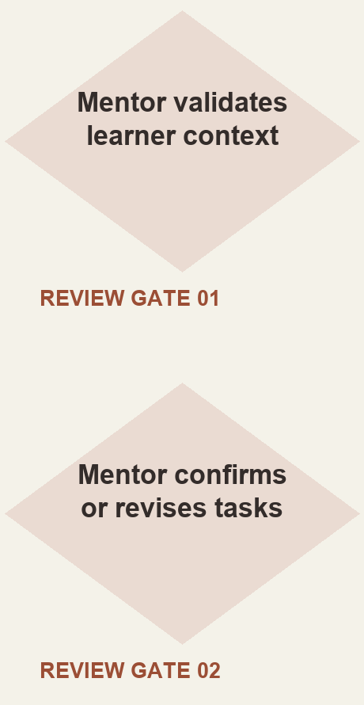
ASU LEARNING INNOVATIONS / AI ANALYST, FEB–OCT 2024
Mentor review in
a proposed workflow
I proposed staged generation of personalized learner tasks, with a mentor checking the context and the output.
Simplified reconstruction of my 2024 proposal. Deployment and time savings were not established.
07
Notes:
Original ASU for Life collaborative prompt architecture attributes the displayed proposed approach to Kyle. The reconstruction shows the mentor review steps without claiming production deployment, model training, or measurable savings. Reviewed AI case: https://jonathankhobson.github.io/portfolio/ai/ .

Slide 8
BLACKBAUD / PROPOSED FIRST CONTRIBUTION
One team. One task.
Observable progress.
For R0014520, I would begin with one employee task and agree on the workflow, review responsibilities and signs of readiness.
Observe the current task and record where people need help.
Build one worked example, practice task and short reference aid.
Check accuracy, accessibility and required human review with the team.
Compare repeat-task performance and use feedback to revise guidance.
Proposed approach; no Blackbaud rollout or measured adoption outcome is claimed.
08
Notes:
Proposed adoption pilot for the internal employee enablement role. Establish a baseline, task-level success criteria and evidence of repeat use with the product owner; numbers are not invented. Primary source: https://blackbaud.wd1.myworkdayjobs.com/en-US/ExternalCareers/job/AI-Adoption-Specialist_R0014520 .

Slide 9
KYLE HOBSON / BLACKBAUD APPLICATION
AI Adoption
Specialist
Based in Mesa, Arizona. Available for U.S. remote work.
Authorized to work without sponsorship. Available ASAP.
JonathanKyleHobson@gmail.com
View the tailored Blackbaud portfolio
09
Notes:
Contact and work-authorization statements are candidate-confirmed for this application. Portfolio link targets the separately prepared Blackbaud site.

