Slide 1
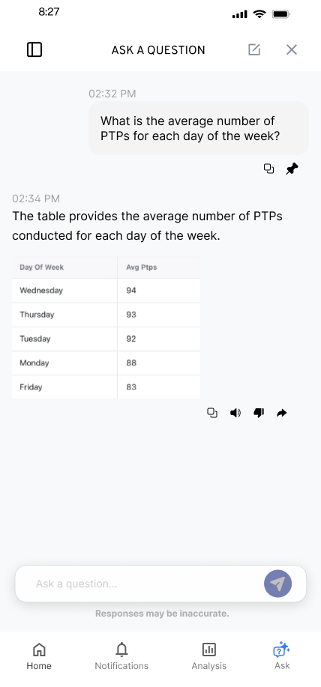
KYLE HOBSON / FUELED CONTENT SOLUTIONS APPLICATION
Content people
can use.
Information hierarchy, reusable patterns,
and the details behind an interaction.
Selected work for Fueled
September 2026
01
Notes:
Fueled Product Designer, 5173502008. Employer source: https://job-boards.greenhouse.io/fueledcareers/jobs/5173502008, verified September 8, 2026. Selected information-hierarchy, reusable-interface, interaction and handoff artifacts. No prior Fueled work, CMS implementation or enterprise design-system ownership is claimed.

Slide 2
ABOUT ME / SMARTTAGIT, FACTORLAB
Give each insight
a clear job
01
Summaries
02
Recommendations
03
Simple 7
I developed five widget groups, then explored their information order and content density.
04
Comparisons
05
Accomplishments
Editable summary of the reviewed structure
Original screen iterations in the linked case
02
Notes:
About Me April–May 2026 design walkthroughs, especially May 15. The five groups are summaries, recommendations, Simple 7, comparisons and accomplishments. This native diagram summarizes the reviewed organization; it is not an original screenshot. Customization and final policy remained open in the walkthrough.

Slide 3
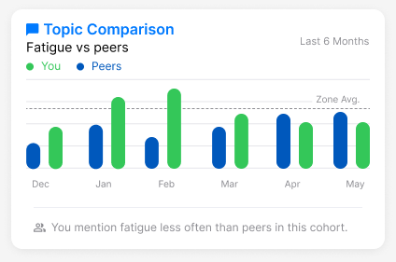
ABOUT ME / INFORMATION AND INTERPRETATION
A comparison
needs context
Mentioning fatigue less often is a comparison. Whether that is good depends on the context.
I raised the cohort and wording questions while developing reusable insight widgets.
Original design iteration with sample values
03
Notes:
Original About Me comparison widget and April–May 2026 walkthroughs. The web/server team release was confirmed September 2, 2026, but the exact pictured layout and completed mobile rollout are not established. Illustrative values are not measured customer outcomes.

Slide 4
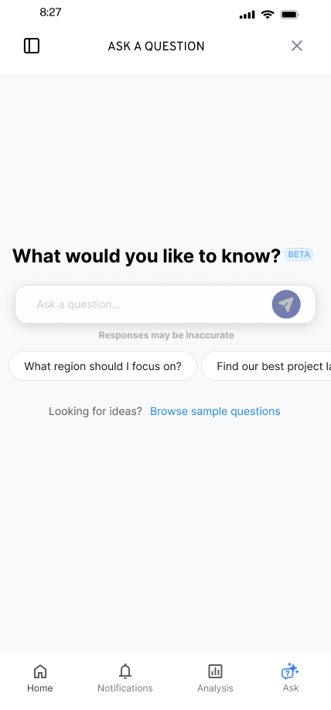
FLINT / SMARTTAGIT, FACTORLAB
A useful
first question
UX Designer & Researcher (Contract)
2025–2026
I explored suggested questions and a question library while keeping a person’s own question close at hand.
Mobile design states and engineering handoff
04
Notes:
Original FactorLab Flint mobile design and design walkthroughs. These are designed states and handoff artifacts, not confirmation that every pictured variant shipped. Interface content is sample data.

Slide 5


FLINT / INTERRUPTED AND OFFLINE STATES
Incomplete answer
Connection lost
Recovery follows
the failure
An incomplete answer and a lost connection need different next actions.
I connected the flows and their recovery actions in an annotated walkthrough for engineering.
05
Notes:
Original SmartTagIt Flint interrupted-response and offline variants, including the March 27, 2026 error-state handoff. This documents design decisions and annotations for developers, not measured task-success improvement.

Slide 6

OAK AI / RESEARCH TO DESIGN, 2023–2025
Put a visible choice
beside the finding
The original login error sat below the form. The recommendation connected the feedback to the password field.
I developed recommendations and collaborated with the lead UX designer. Fuller recovery guidance still needed work.
Proposed interface · implementation unverified
06
Notes:
Oak original heuristic evaluation and design recommendations. The original small bottom banner reported invalid login credentials; the proposed treatment added a password-field outline and Incorrect Password message. Kyle led the evaluation and recommendations and collaborated with the lead UX designer on mockups. No measured result or exact released variant is claimed.

Slide 7
FACTORLAB + OAK / TEAM COLLABORATION
Make the handoff
a design conversation
My walkthroughs put the state, the next action, and the unresolved choice where a team can review them.
01 Connect the normal path to waiting and recovery
02 Explain the alternative and its tradeoff
03 Revise with developers as constraints become clear
07
Notes:
Synthesis of reviewed FactorLab design walkthroughs and Oak recommendations/handoff. The list describes an approach supported by those artifacts. It does not establish platform-release ownership, quantified handoff efficiency, or work for Fueled.

Slide 8
FUELED / PROPOSED APPROACH
Start with the content and its task
I would learn how the audience uses the content and how the team creates, structures, and publishes it.
01 Review content models, templates, and publishing constraints
02 Prototype the hierarchy with representative content
03 Review with users, editors, and engineering; then refine
Proposed collaboration approach; no prior Fueled client work is claimed.
08
Notes:
Proposed approach based on Fueled Product Designer role 5173502008. CMS-specific structures, client requirements, research access and measures would need to be established with the team. This is a proposed approach, not evidence of prior CMS implementation or Fueled client work.

Slide 9
FUELED / PRODUCT DESIGNER – CONTENT SOLUTIONS
Kyle Hobson
Content hierarchy, reusable interfaces,
and clear interaction decisions.
Mesa, Arizona / U.S. business hours / Contract and full-time opportunities
JonathanKyleHobson@gmail.com
Portfolio selected for Fueled
09
Notes:
Candidate contact and travel availability are confirmed. Intended isolated portfolio route: https://jonathankhobson.github.io/application-portfolios/fueled-content-product-designer/. Publication is a separate campaign action.

