Slide 1

KYLE HOBSON / Horace Mann · DEVELOPMENT ENABLEMENT SPECIALIST
Explain the tool.
Keep the task intact.
Original teaching, local prompt evaluation
and workflows documented for engineering.
Development Enablement Specialist application · September 2026
01
Notes:
Prepared for Horace Mann Development Enablement Specialist, https://job-boards.greenhouse.io/horacemannservicecorporation/jobs/6183213004 . Displayed work belongs to prior ASU, Coursera, FactorLab and independent tool projects. Decorative cover is existing canonical art, not evidence.

Slide 2
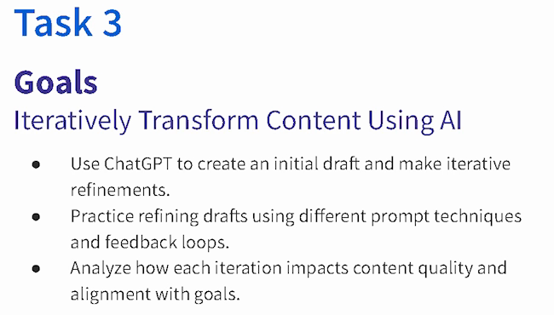
COURSERA · GUIDED PROJECT / ORIGINAL TEACHING, 2024
Make revision
something the
learner can see
I created a beginner project around drafting, reviewing and refining content against a goal.
Published teaching activity. Learner improvement is not measured here.
Original 2024 lesson material · goals excerpt
02
Notes:
Source: canonical ai.json teaching-ai case, original 2024 lesson material and https://www.coursera.org/projects/chatgpt-beginners . Kyle created and taught the published project ChatGPT 4o for Beginners: Create Social Media Content. The crop preserves all original Task 3 goal text without changing source pixels: ai-course-goals.png x80 y85 w650 h370. Learning sequence and teaching materials are direct evidence; enrollment is not a learning-gain measure.

Slide 3
COURSERA / ASSESSMENT REVIEW, OCTOBER 2024
Make the review change the material
Review finding | My documented revision
Choices were easy to eliminate | Reworked distractors, especially Questions 7, 8 and 10.
Question 7 tested only a definition | Added application of the concept alongside the definition.
Retry feedback revealed answers | Made feedback more neutral and referred learners to the lesson task.
Task references were incorrect | Corrected references across the assessment.
Paraphrased original review and instructor-response notes · revisions, not final QA signoff
03
Notes:
Source: original October 1,2024 Course Shell Feedback rows16,19,20,22 and instructor-response notes. Four rows summarize actual concerns and recorded revisions. Completed appears in instructor-response status; separate QA ID Approval remains false. No final row-level signoff or measured learner gain claimed. Native editable two-column table.

Slide 4
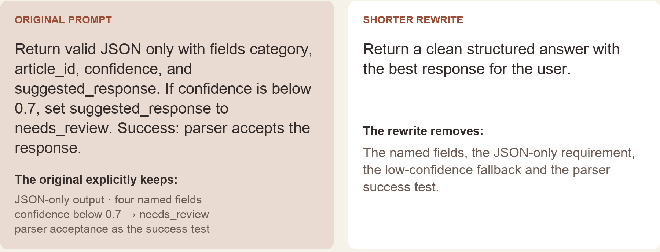
PROMPT COMPASS / LOCAL REGRESSION EXAMPLE, MAY 2026
A cleaner rewrite can lose the task
Original test inputs, excerpted from the portfolio rendering · expected winner: original prompt
04
Notes:
Canonical ai.json prompt-compass case. Original developer-authored regression fixture, reformatted for the portfolio. May2026 local work is separate from the April27 public beta. Deterministic literal-term checks report missing fields in the rewrite; they do not execute an LLM, parse its output or establish model accuracy. The low-confidence threshold is a test instruction, not a deployed enterprise policy.

Slide 5
ASU LEARNING INNOVATIONS / 2024 WORKFLOW PROPOSAL
Human review before learner-facing tasks
A staged prompt workflow for personalized learner tasks.
01
02
03
Condense learner context
→
Mentor validates context
→
Personalize task template
Prepare context for review.
Check the interpretation.
Use the reviewed context.
↓
06
05
04
Prepare learner-facing output
←
Mentor confirms tasks
←
Generate and refine tasks
Structured output and feedback.
Approve or revise the tasks.
Prepare candidate tasks.
Simplified reconstruction · Documented proposal; no deployment or measured efficiency claimed.
05
Notes:
Source: reviewed 2024 ASU Learning Innovations proposal and accompanying source brief. Kyle proposed a prompt workflow that condensed learner context, included mentor validation of context, personalized a task template, generated and refined tasks, included mentor confirmation or revision, and prepared structured learner-facing output and feedback. This editable reconstruction groups the original steps into six stages while retaining both mentor review gates. It is a proposal, not a deployed clinical system or a measured efficiency or learning outcome. The human review pattern is adjacent evidence for discussing learning workflows at Horace Mann; no prior Horace Mann engagement is claimed.

Slide 6


FLINT / INTERRUPTED AND OFFLINE STATES
Incomplete answer
Connection lost
Recovery follows
the failure
An incomplete answer and a lost connection need different next actions.
I assembled the flows and their next actions into an annotated handoff for engineering.
06
Notes:
Source: selected original Flint interrupted-response and offline design variants, including the March 27, 2026 error-state handoff. Distinct recovery actions follow the state: Ask again or Continue for a partial response, and retry after connection loss with the question preserved. Deliverable: connected flows, interaction states and engineering annotations.

Slide 7
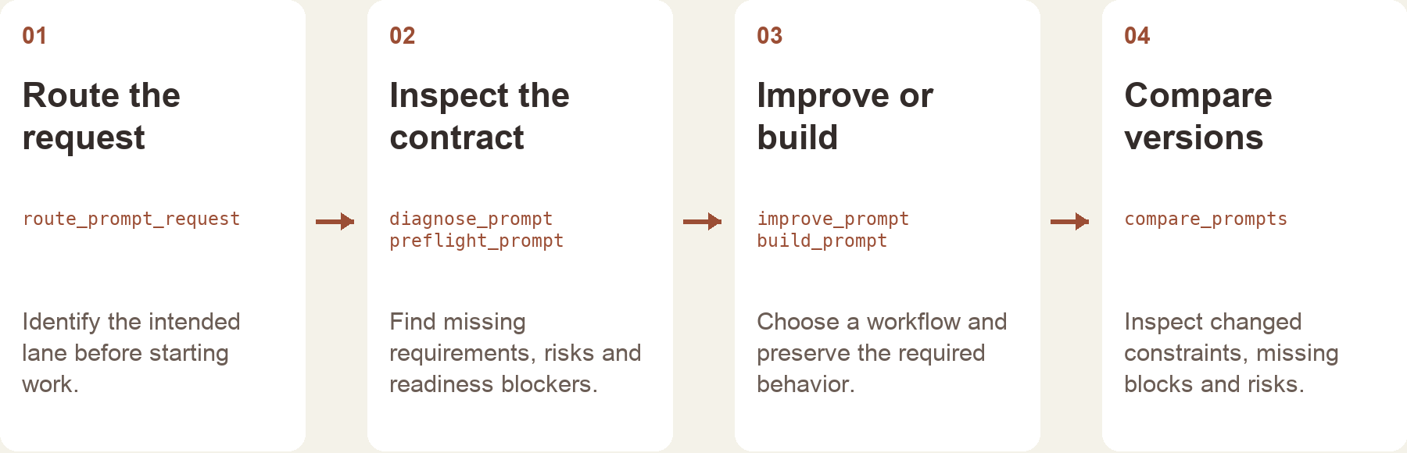
PROMPT COMPASS / RELEASED TOOL AND WORKFLOW DESIGN
Give the tool a clear role
The local tool returns structured checks and routing.
The host assistant handles the conversation and final wording.
Implementation-based portfolio diagram · public beta release, April 2026
07
Notes:
Source: canonical prompt-compass case and public beta3 release. Kyle built and released the tool with installable packages and source downloads. Diagram is reconstructed from implementation, not an original product screenshot. Public beta and local work do not establish enterprise adoption or security-domain expertise.

Slide 8
PROPOSED APPROACH / HORACE MANN DEVELOPER ENABLEMENT
Connect the action to the decision
Start with one builder tier
Write a usable first guide
Choose a common task with the owning team.
Identify the tools, access and review points
a builder needs before beginning.
Show prerequisites and a worked example.
Pair the steps with a small practice task
and explicit criteria for checking the result.
Test the instructions in context
Keep the guidance current
Review the guidance with technical owners.
Watch a builder try it and record questions
that belong in the guide or support queue.
Learn the team’s release and access practices.
Record owners, dependencies and review dates.
Use recurring support issues to guide updates.
08
Notes:
Proposed approach for Horace Mann Development Enablement Specialist, https://job-boards.greenhouse.io/horacemannservicecorporation/jobs/6183213004 . Not prior Horace Mann delivery, a diagnosed product issue, a security investigation or a measured learner outcome. Horace Mann development tooling and governance processes require onboarding and owner review.

Slide 9
KYLE HOBSON / Horace Mann · DEVELOPMENT ENABLEMENT SPECIALIST
Let’s make technical work
easier to learn
Mesa, Arizona. Available for remote work in the United States.
JonathanKyleHobson@gmail.com
jonathankhobson.github.io/application-portfolios/horace-mann-development-enablement
09
Notes:
Tailored Development Enablement Specialist packet. Related experience spans ASU learning design, Coursera teaching and assessment revisions, the ASU workflow proposal and product research. Course-authoring and product-documentation evidence are distinct from LMS administration or independent publishing-control ownership. Enterprise CI/CD operations, Azure DevOps administration and compliance ownership are not claimed. Mesa is disclosed.

