Slide 1

KYLE HOBSON / BLUE STATE · FREELANCE UX
Find the friction.
Clarify the next step.
Research, information architecture and design
for useful audience experiences.
Future contractor pool · Contract UX Designer (Evergreen) · September 2026
01
Notes:
Interest in Blue State Contract UX Designer (Evergreen), https://www.bluestate.co/careers/job/?gh_jid=5476293 . Employer explicitly says this is not an active vacancy. Blue State is a prospective client/employer. Work examples are prior Oak and FactorLab projects. Cover art is decorative canonical portfolio imagery.

Slide 2
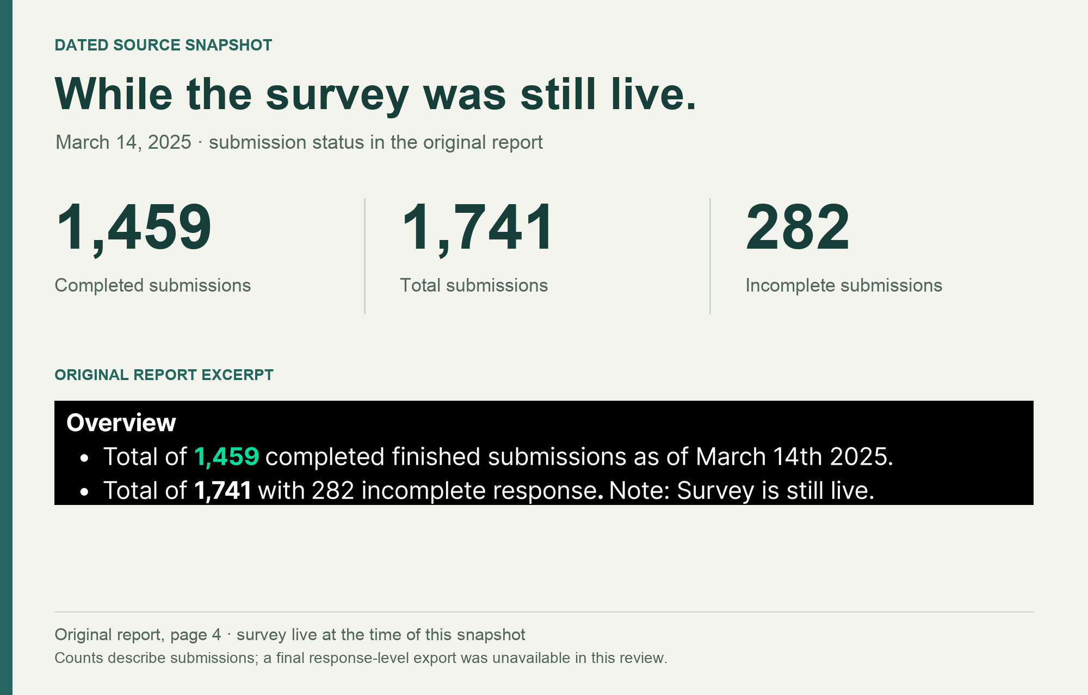
OAK + QASIM / AUDIENCE SURVEY, MARCH 2025
What keeps interest
from becoming action?
I led survey design, launch and analysis.
I combined structured questions about barriers with open responses about what would help.
A voluntary audience sample surfaced reported needs. It could not establish future use or purchase.
1,459 complete submissions
March 14, 2025 · survey still live
02
Notes:
Case: Oak + Qasim audience survey, March 2025. Kyle’s reviewed portfolio identifies his role as leading survey design, launch and analysis. Original source: Survey #1 Phase 2 — Findings Report: Understanding Audience Pain Points & Value-Aligned Actions, page 4. The report records 1,459 complete submissions as of March 14, 2025 while the survey remained live. This is a voluntary creator/advocacy audience sample, with predominantly older, female and highly educated respondents. Self-reported needs and preferences do not establish future behavior.

Slide 3
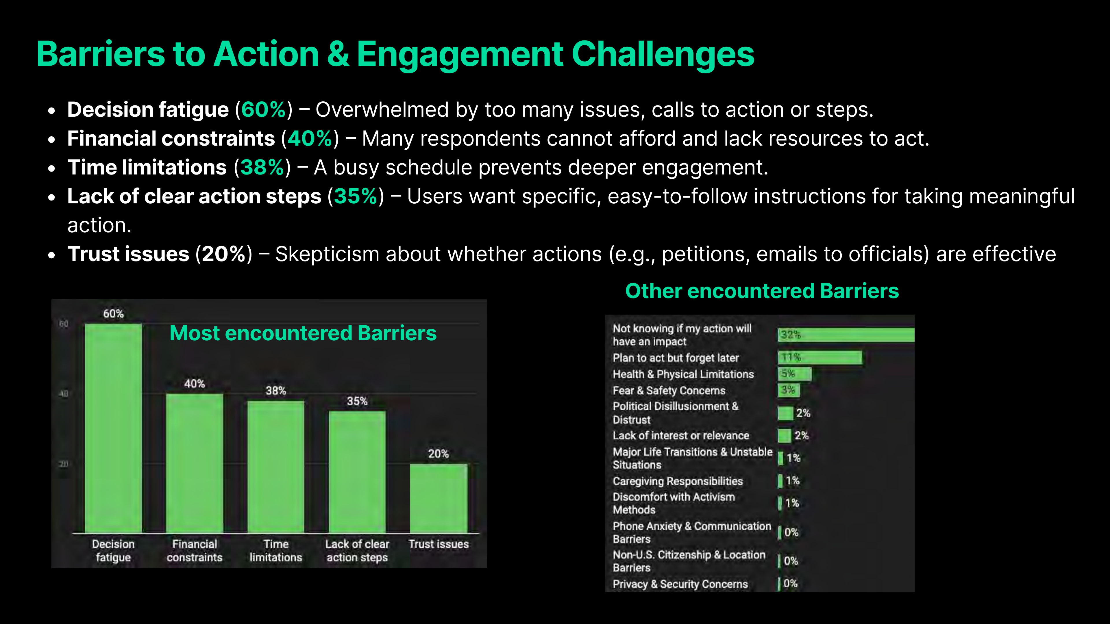
OAK + QASIM / REPORTED BARRIERS
Reported barriers to taking action
Original findings report · March 2025
Reported percentages · per-item response base unavailable · voluntary audience sample
03
Notes:
Source: original Oak + Qasim March 2025 findings report, page 14, shown unchanged at left. Native editable chart reproduces the report’s values: decision fatigue 60%; financial constraints 40%; time limitations 38%; lack of clear action steps 35%; trust issues 20%. The chart workbook is a new snapshot of these literal reported values, not the original response data. Per-item denominators, skip logic and response-level quality checks were not recovered. These are reported survey percentages, not independently recalculated estimates or population prevalence.

Slide 4
OAK + QASIM / FINDINGS INTO A PRODUCT QUESTION
A proposed Action Hub direction
The findings pointed toward smaller, clearer actions and support for following through.
REPORTED NEED
PROPOSED DIRECTION
Overwhelm and unclear steps
A focused action with instructions
Limited time
Reusable templates and task support
Doubt about whether action matters
Visible progress and feedback
Next validation: test whether people can choose and complete an action in a prototype.
04
Notes:
Source: original March 2025 report pages 14–15 and Kyle’s retrospective portfolio discussion of an Action Hub direction. This slide is an editable synthesis connecting reported barriers and feature requests to a proposed product direction. It does not show an implemented product, verified adoption, funding secured, or a causal outcome. The final sentence proposes a next validation step for the portfolio narrative; it is not a claim that the test occurred.

Slide 5
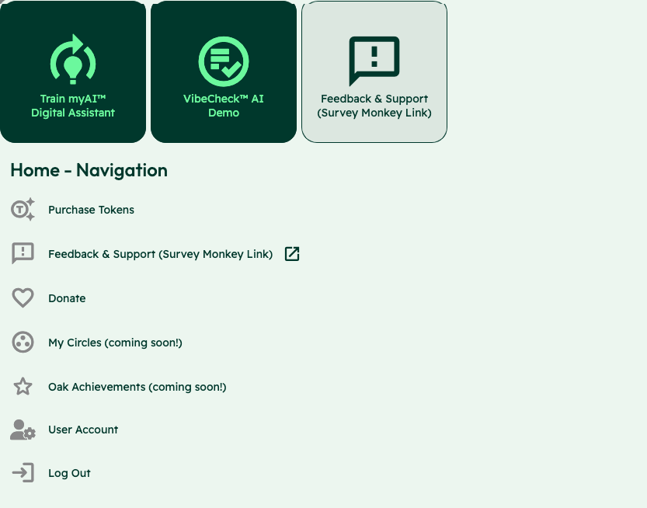
OAK AI / LEAD UX RESEARCHER, 2023–2025
Make the starting
choices clear
Training an assistant, starting a Vibecheck and requesting support competed at the same entry point.
I compared labels and sitemap alternatives, then collaborated on shared navigation with the lead designer.
Expert evaluation and design recommendations
05
Notes:
Sources: canonical Oak case, original November 22, 2023 evaluation, December contribution log and original screenshot with identity area omitted. Kyle developed two concise sitemap alternatives and contributed to shared header/footer refinement. Card sorting and comparative sitemap testing were future proposals; a validated winning sitemap is not claimed.

Slide 6
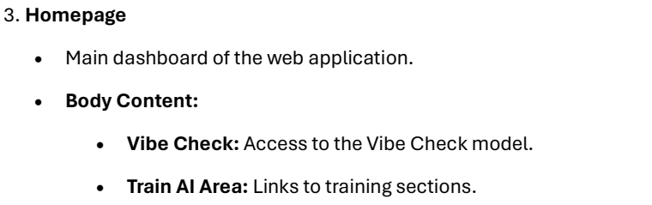
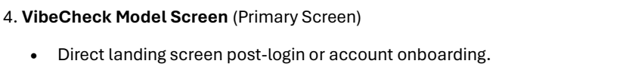
OAK AI / ORIGINAL SITEMAP DOCUMENT · DECEMBER 2023
Two outlines, different entry points
Version 1: VibeCheck first
Version 2: Homepage first
After login, consent and optional onboarding.
After login and consent.
Original page 8 · selected entry detail
Original page 14 · selected entry detail
Original text-outline excerpts · proposals, not a released or validated structure
06
Notes:
Source: SiteMap Outlines: Oak, authored Jonathan Hobson, PDF creation date December 20, 2023. Original page 8 and 14 excerpts preserve wording and structure. Version 1 moves from login/consent/onboarding to VibeCheck; Version 2 adds a homepage linking features. These are text sitemap outlines, not wireframe screenshots or a reconstructed diagram. Comparative usability testing remained future work in the document; no winning sitemap is claimed. Public excerpts contain no private identities or URLs.

Slide 7


OAK AI / LOGIN FEEDBACK
Error feedback
beside the field
Original
Proposed
I made the problem field visible where a person could act on it.
The recommendation gave the team a specific behavior to discuss and prioritize.
Original error at the page footer
Proposed feedback beside the field
07
Notes:
Source: original Oak error-message recommendation artifact containing Before and After panels. Displayed interface panels retain source pixels and are labeled Original and Proposed to clarify the work state. Kyle connected an evaluation finding to visual alternatives and implementation recommendations. No conversion or task-success percentage is asserted.

Slide 8
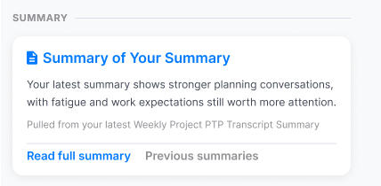
FACTORLAB · ABOUT ME / INFORMATION ARCHITECTURE, 2026
Organize content by
the question it answers
Summaries. Recommendations. Simple 7. Comparisons. Accomplishments.
I explored content density and reusable widget structures, then worked with engineers on what each action opened.
Original design detail · sample content
08
Notes:
Sources: About Me original Figma design and April–May 2026 walkthroughs, canonical design.json. Kyle developed page directions, content families and visual alternatives. Product lead and engineering clarified data availability, existing capabilities and routes into detail. Team release of web/server changes is confirmed September 2, 2026; the exact pictured layout is unverified. The crop preserves original source pixels.

Slide 9
PROPOSED APPROACH / A FUTURE BLUE STATE PROJECT
A focused first action to test
Understand the audience
Map the useful content
Agree on the user’s task and the client’s intended result. Review existing evidence and what is still unknown.
Compare labels, page relationships and the information people need before committing to an action.
Make a small prototype
Observe the next step
Use a concrete scenario to compare ideas
with clients, designers and developers.
Test comprehension and task completion.
Record where content or structure needs
revision.
09
Notes:
Proposed approach for discussion with Blue State, based on the evergreen UX role at https://www.bluestate.co/careers/job/?gh_jid=5476293 . Not prior Blue State work, committed scope or a tested nonprofit campaign. The client context and appropriate methods would be established at discovery.

Slide 10
KYLE HOBSON / BLUE STATE · CONTRACTOR POOL
Available for future
freelance UX work
Mesa, Arizona. Full U.S. work authorization. Available for remote projects as they arise.
JonathanKyleHobson@gmail.com
jonathankhobson.github.io/application-portfolios/bluestate-ux-designer
10
Notes:
Blue State’s evergreen listing is a future contractor pool, not a current job. The body describes remote freelance work and USD85–110/hour, while the location header lists NY/DC/Oakland. Kyle lives in Mesa; Arizona engagement eligibility, project availability, schedule and exact terms remain for discussion. No offer or compensation acceptance is made.

