Slide 1

KYLE HOBSON / APPLICATION TO HORIZONTAL TALENT
Practical learning
with careful AI review
Selected teaching, product guidance
and AI review examples
Instructional Design · Job 75755 · Tempe hybrid contract
01
Notes:
Prepared for Horizontal Talent Instructional Design, job 75755, Tempe hybrid contract. The end client and contract terms are undisclosed. Job source: https://www.horizontaltalent.com/job-board/75755 . The approved paper-path illustration is decorative, not project evidence.

Slide 2

ARIZONA STATE UNIVERSITY / INSTRUCTIONAL DESIGNER
Learning design
grounded in the task
At ASU Knowledge Enterprise, I developed digital learning materials and workshops with accessibility improvements and AI-supported content workflows.
April 2022–October 2024
MS in User Experience · BS in Technical Communication
02
Notes:
Reviewed career evidence: ASU Knowledge Enterprise, Instructional Designer, April 2022–October 2024. MS User Experience with UX Research concentration, ASU, May 2024; BS Technical Communication with UX concentration, ASU, May 2023. The concise role scope is reviewed evidence; this slide does not claim specific SCORM/LMS production tools or measured learning gains. Public profile: https://www.linkedin.com/in/jonathankylehobson/ .

Slide 3
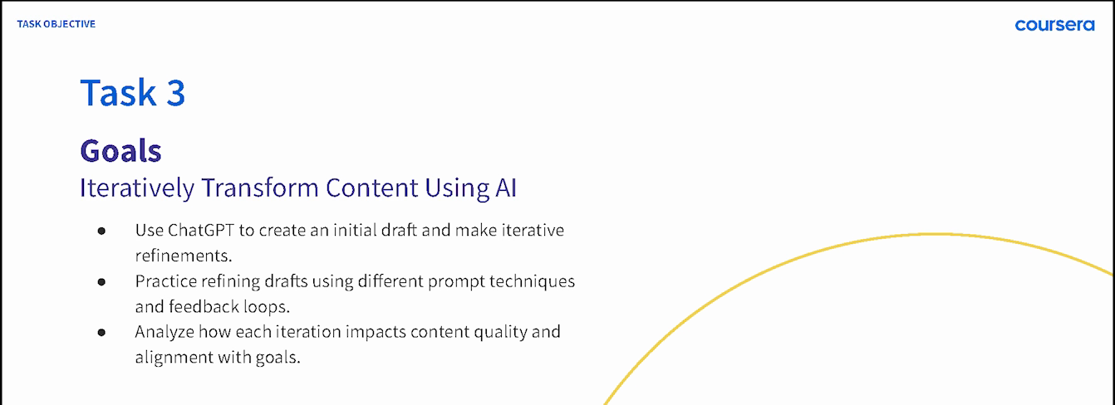
COURSERA / GUIDED PROJECT INSTRUCTOR, 2024
A practical sequence for beginners
ChatGPT 4o for Beginners: Create Social Media Content
Published in 2024 · 4,700+ enrollments as of September 2026
03
Notes:
Source: original 2024 lesson materials and the official Coursera page https://www.coursera.org/projects/chatgpt-beginners . The image is an original course slide. Enrollments describe reach, not course completion or measured skill improvement.

Slide 4
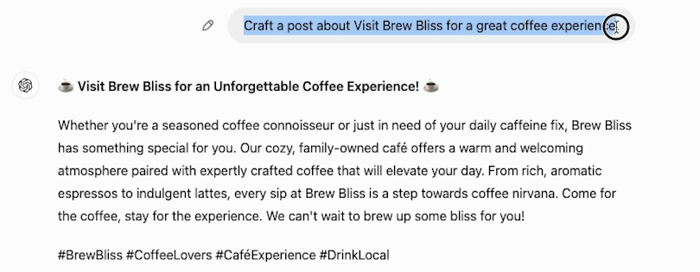
COURSERA / ORIGINAL DEMONSTRATION
Prompt revision in
a beginner lesson
The next step is to make the request more specific and compare the result.
04
Notes:
Source: original 2024 Task 3 recording at 02:30. This initial fictional Brew Bliss cafe draft gives learners material to inspect and revise. Later lesson steps demonstrate a more specific instruction and its resulting draft. It is not a client campaign or evidence of measured learner proficiency. Official course: https://www.coursera.org/projects/chatgpt-beginners .

Slide 5


FACTORLAB / SMARTTAGIT FLINT DESIGN
Recovery guidance
has to describe
the real state
An interrupted answer and a lost connection needed different messages and actions. I organized those states in Figma and annotated the behavior for engineering.
For technical learning: distinguish the condition before explaining the recovery action.
05
Notes:
FactorLab UX Designer & Researcher (Contract), October 2025–Present. Original Kyle-authored Figma designs and engineering annotations, reviewed in the September 2026 portfolio. Design and handoff evidence; exact pictured state is not claimed to be shipped. Its relevance to end-user documentation is adjacent: Kyle is explaining product behavior, showing product-design evidence with adjacent application to learning materials. Public case: https://jonathankhobson.github.io/portfolio/design/case/flint/ .

Slide 6
PROMPT COMPASS / DESIGNED LOCAL REGRESSION CASE
A rewrite must preserve the requirement
ORIGINAL FIXTURE PROMPT
SHORTER REWRITE
Return valid JSON only with fields category, article_id, confidence, and suggested_response. If confidence is below 0.7, set suggested_response to needs_review. Success: parser accepts the response.
Return a clean structured answer with the best response for the user.
Expected winner: the original
The rewrite loses named fields, JSON-only output and the review condition.
06
Notes:
Original developer-authored Prompt Compass local regression fixture, May 2026. Both prompts are exact fixture values. This is a designed evaluation example, not a client incident, production-model benchmark, or measured ROI. The public beta release is https://github.com/JonathanKHobson/prompt-compass/releases/tag/v0.1.0-beta.3 . Relevant to updating technical training: a clearer or shorter instruction still needs to preserve conditions and review requirements.

Slide 7
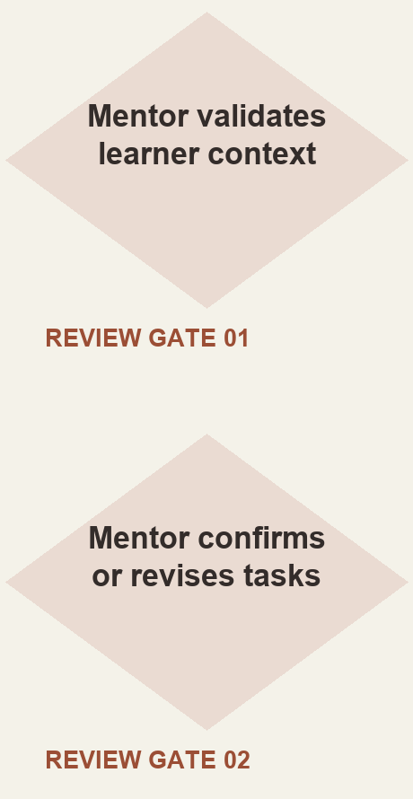
ASU LEARNING INNOVATIONS / AI ANALYST, FEB–OCT 2024
Mentor review in
a proposed workflow
I proposed staged generation of personalized learner tasks, with a mentor checking the context and the output.
Simplified reconstruction of my 2024 proposal. Deployment and time savings were not established.
07
Notes:
Original ASU for Life collaborative prompt architecture attributes the displayed proposed approach to Kyle. The reconstruction shows the mentor review steps without claiming production deployment, model training, or measurable savings. Reviewed AI case: https://jonathankhobson.github.io/portfolio/ai/ .

Slide 8
HORIZONTAL TALENT / PROPOSED FIRST CONTRIBUTION
A task learners
can practice
For job 75755, I would start with one learning asset that the team can review, revise and maintain using approved sources and tools.
Define the task, its starting conditions and a useful practice outcome.
Connect an example, a practice activity and a reference aid.
Review accuracy and accessibility with the subject matter expert.
Track feedback, source ownership and the next revision.
Proposed approach for discussion with the recruiter and client learning team.
08
Notes:
Proposed approach for discussion, based on the official Instructional Design job 75755: learning materials, practice activities, accessibility, review cycles and approved AI tools with human quality review. The client is not disclosed, so this is a proposed first assignment rather than a report of past client work. Primary source: https://www.horizontaltalent.com/job-board/75755 .

Slide 9
KYLE HOBSON / HORIZONTAL TALENT APPLICATION
Instructional
Design
Based in Mesa, Arizona. Available for Tempe hybrid work.
Authorized to work without sponsorship. Available ASAP.
JonathanKyleHobson@gmail.com
View the tailored Horizontal Talent portfolio
09
Notes:
Contact and work-authorization statements are candidate-confirmed for this application. Portfolio link targets the separately prepared Horizontal Talent site.

