Slide 1

KYLE HOBSON / TIMELY PRODUCT DESIGNER
Make the complex
workable.
Product design, research and
education experience
Product Designer · Remote (US)
01
Notes:
Prepared for Timely Product Designer, https://jobs.ashbyhq.com/timely/a39f8b47-fe51-4320-b76f-25101bf6c134 . Original operational software, research and education work. School master scheduling is a new domain. Existing paper-path art is decorative.

Slide 2
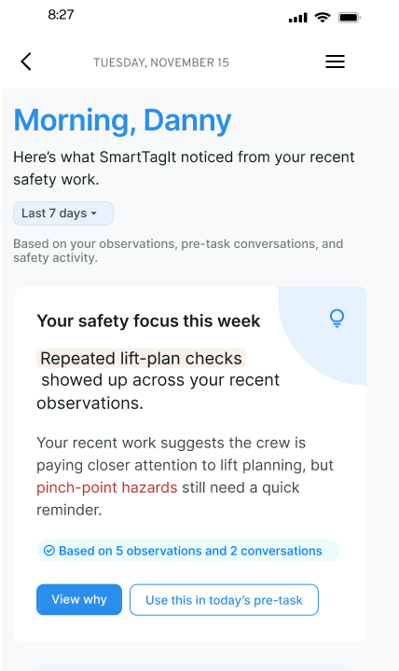
FACTORLAB / SMARTTAGIT ABOUT ME
A summary connected
to its evidence
I explored feedback layouts, widget families and content density so people could inspect the basis of a summary and find a useful next action.
Original design iteration. About Me web/server changes released September 2, 2026; this pictured variant is not claimed as the final released layout.
02
Notes:
Kyle explored About Me information models and widget families in original April–May 2026 design walkthroughs. Source: reviewed portfolio-suite design About Me case and original about-me-widget-system.png. Numbers and named content inside the design are interface example data, not measured outcomes. September 2 release evidence supports web/server feature release, not this exact variant or mobile rollout. Public case: https://jonathankhobson.github.io/portfolio/design/case/about-me/ .

Slide 3
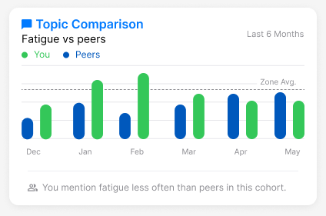
FACTORLAB / ABOUT ME COMPARISON DESIGN
A comparison needs
a careful explanation
The caption describes how often a topic appears in a cohort. It avoids turning a difference into an unsupported performance judgment.
Original interface design with example data. No measured performance result is shown.
03
Notes:
Original FactorLab About Me design variant. Source about-me-comparison.png and reviewed design source map. Chart is retained as a source screenshot to show the actual interface design; it is not an editable analytic chart or report of real user performance. Kyle’s contribution was comparison language and interface reasoning; no measured user outcome or school-scheduling delivery is inferred.

Slide 4


FACTORLAB / FLINT CONVERSATIONAL PRODUCT DESIGN
Recovery depends
on what happened
An interrupted answer and a lost connection leave different information available. I designed their messages and actions, then annotated the behavior for engineering.
Original mobile designs and handoff. No claim that the pictured states are shipped.
04
Notes:
FactorLab UX Designer & Researcher (Contract), October 2025–Present. Original Kyle-authored Figma designs and March 27 error-state walkthrough. Entry, waiting, saved questions and response actions are organized with engineering annotations. These are design and handoff artifacts; the exact states are not verified as shipped. Public case: https://jonathankhobson.github.io/portfolio/design/case/flint/ .

Slide 5

OAK AI / LEAD UX RESEARCHER, 2023–2025
A finding becomes
a visible recommendation
The audit identified vague login feedback. I recommended locating the error beside the relevant field so people could see what to correct.
Original proposed interface. This is evaluation and design guidance, not a measured conversion improvement.
05
Notes:
Oak original DesignRecOak findings and recommendations, reviewed September 2026. Kyle led UX research and developed navigation/error-feedback recommendations with the lead UX designer. The public crop preserves the original proposed treatment; no production deployment, conversion gain or ownership of every design element is inferred. Public case: https://jonathankhobson.github.io/portfolio/design/case/oak/ .

Slide 6
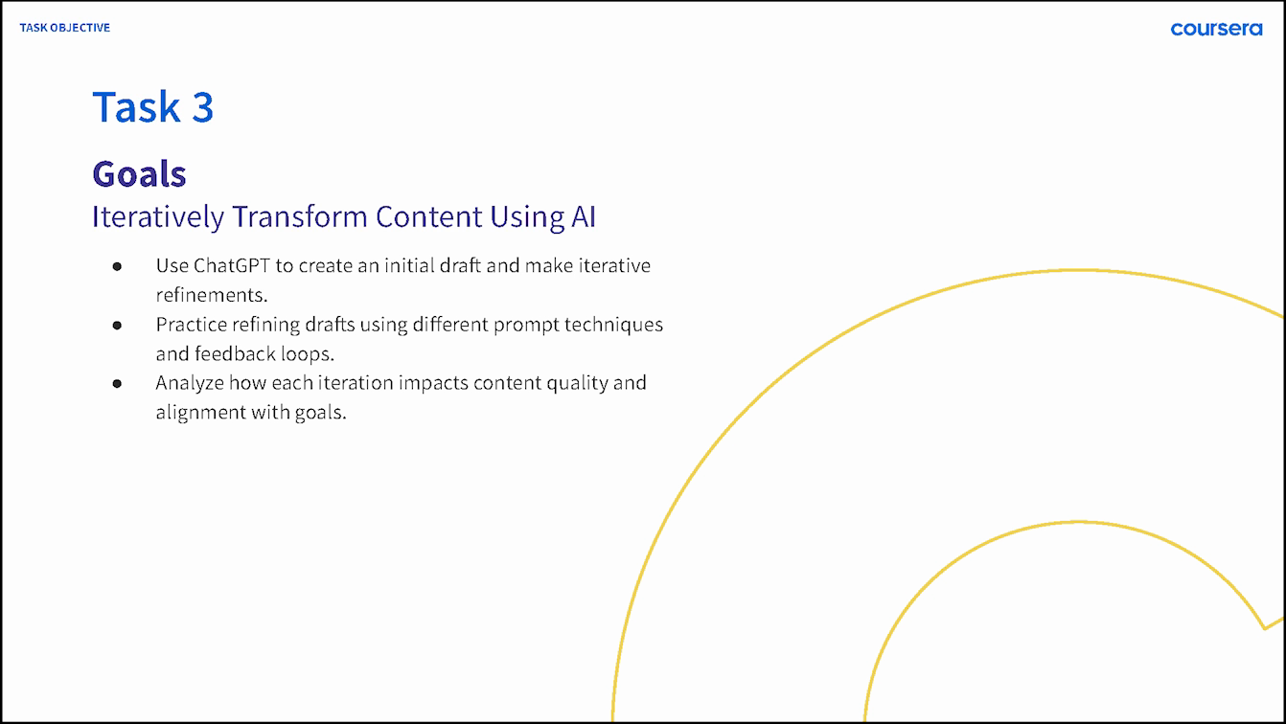
ASU · OPPIA · COURSERA / LEARNING AND EXPLANATION
Learning experience informs the interface
At ASU, I developed learning materials and proposed AI workflows with mentor review.
At Oppia, I questioned autosave and save-on-exit before finalizing dialog guidance.
My Coursera lesson makes iteration a practice activity.
Original 2024 Coursera lesson slide. ASU workflow was proposed; Oppia example is a design review.
06
Notes:
Career claim map C06/C08/C14/C18: ASU Knowledge Enterprise instructional design, ASU Learning Innovations proposed prompt architecture, current Oppia volunteer exit-dialog review. Coursera original ai-course-goals.png is approved published-course evidence; no raw private correspondence is displayed. These are education and design contributions, not school-scheduling delivery.

Slide 7
TIMELY / PROPOSED STARTING APPROACH
Follow one difficult scheduling decision
School scheduling would be a new domain. I would learn the constraints with your team before proposing a product change.
Observe a scheduler working through one difficult choice.
Map the information, constraints and handoffs involved.
Prototype a focused change and check comprehension.
Document the states and trade-offs with engineering.
Proposed approach, not a Timely project, product audit or measured scheduling result.
07
Notes:
Proposed starting approach for Timely Product Designer. No school-scheduling project, deployed optimizer, K-12 policy expertise or measured student result is claimed. Official product context: https://www.timelyschools.com/platform/ . Role: https://jobs.ashbyhq.com/timely/a39f8b47-fe51-4320-b76f-25101bf6c134 .

Slide 8
KYLE HOBSON / TIMELY PRODUCT DESIGNER
Product Designer
Mesa, Arizona · Available for U.S. remote work
Research, workflows and education
JonathanKyleHobson@gmail.com
View the Timely product design portfolio
08
Notes:
Candidate confirmed Mesa location, U.S. work authorization without sponsorship and ASAP start. Portfolio is isolated for the Timely Product Designer application. No prior Timely employment or school-scheduling delivery is claimed.

