Slide 1

KYLE HOBSON / APPLICATION TO GOGUARDIAN
Make the insight
understandable.
Product design, research synthesis
and human–AI interaction
Senior Product Designer · New Products
01
Notes:
Tailored to the GoGuardian Senior Product Designer role, New Products team. Role source: https://job-boards.greenhouse.io/goguardian/jobs/4705045006 . Three cases: About Me, Oak AI and Prompt Compass. The approved paper-path illustration is decorative.

Slide 2
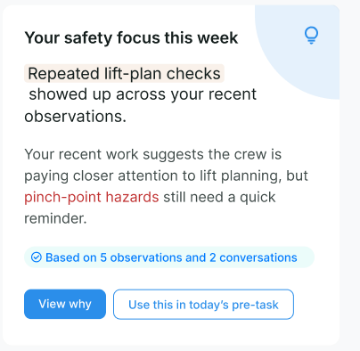
ABOUT ME / SMARTTAGIT, FACTORLAB
Feedback
with context
UX Designer & Researcher (Contract), 2026
I connected a personal summary to its supporting observations and a useful next action.
Design iterations shown with sample content.
Web/server release confirmed September 2, 2026.
02
Notes:
Case: About Me, SmartTagIt at FactorLab. Kyle: UX Designer & Researcher (Contract), 2026. Source: original About Me Figma direction and April–May 2026 walkthroughs. The displayed crop retains original sample content. A September 2, 2026 engineering update confirms the About Me web/server release. These images document design iterations rather than the exact released layout.

Slide 3
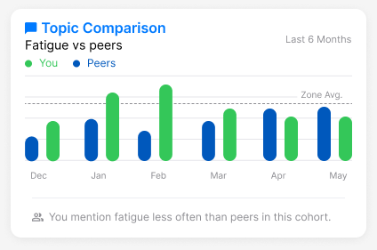
ABOUT ME / NEUTRAL COMPARISON
A comparison needs
an interpretation
Mentioning fatigue less often is a comparison. Whether that is good depends on the context.
I raised the cohort, percentile and wording questions before they became interface rules.
Original widget, illustrative values
03
Notes:
Source: original About Me Topic Comparison widget and stakeholder design discussions. Values are illustrative design content, not research outcomes. Kyle advocated neutral feedback and made cohort definition and interpretation questions explicit. The case output was a family of insight layouts and concrete product questions for alignment.

Slide 4
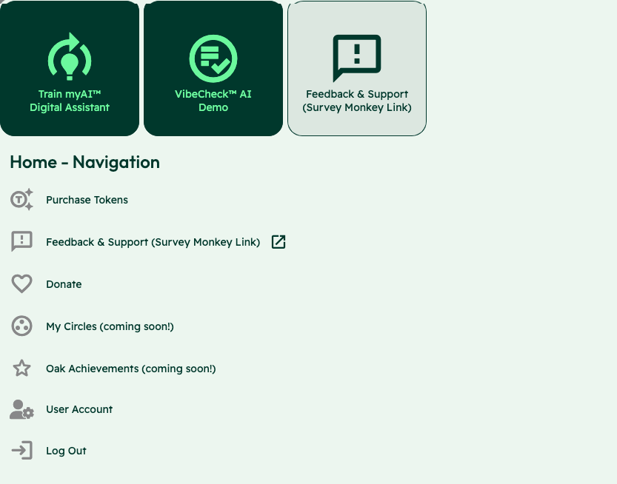
OAK AI / LEAD UX RESEARCHER, 2023–2025
Competing
entry points
Training an assistant, starting a Vibecheck and requesting support competed at the same entry point.
I used the audit to make these choices explicit for the team’s review.
Usability evaluation and design recommendations
04
Notes:
Case: Oak AI. Kyle: Lead UX Researcher, 2023–2025. Source: original Oak navigation evaluation screenshot, with the identity area omitted. Training the assistant, starting Vibecheck and requesting support appear as competing entry points. Kyle documented the labels and visual treatments and used the audit to make these choices explicit for review. Work stage: usability evaluation and design recommendations. This slide does not present a finished navigation redesign or a user-study finding.

Slide 5


OAK AI / LOGIN FEEDBACK
Error feedback
beside the field
Original
Proposed
I made the problem field visible where a person could act on it.
The recommendation gave the team a specific behavior to discuss and prioritize.
Original error at the page footer
Proposed feedback beside the field
05
Notes:
Source: original Oak error-message recommendation artifact containing Before and After panels. Displayed interface panels retain source pixels and are labeled Original and Proposed to clarify the work state. Kyle connected an evaluation finding to visual alternatives and implementation recommendations. No conversion or task-success percentage is asserted.

Slide 6
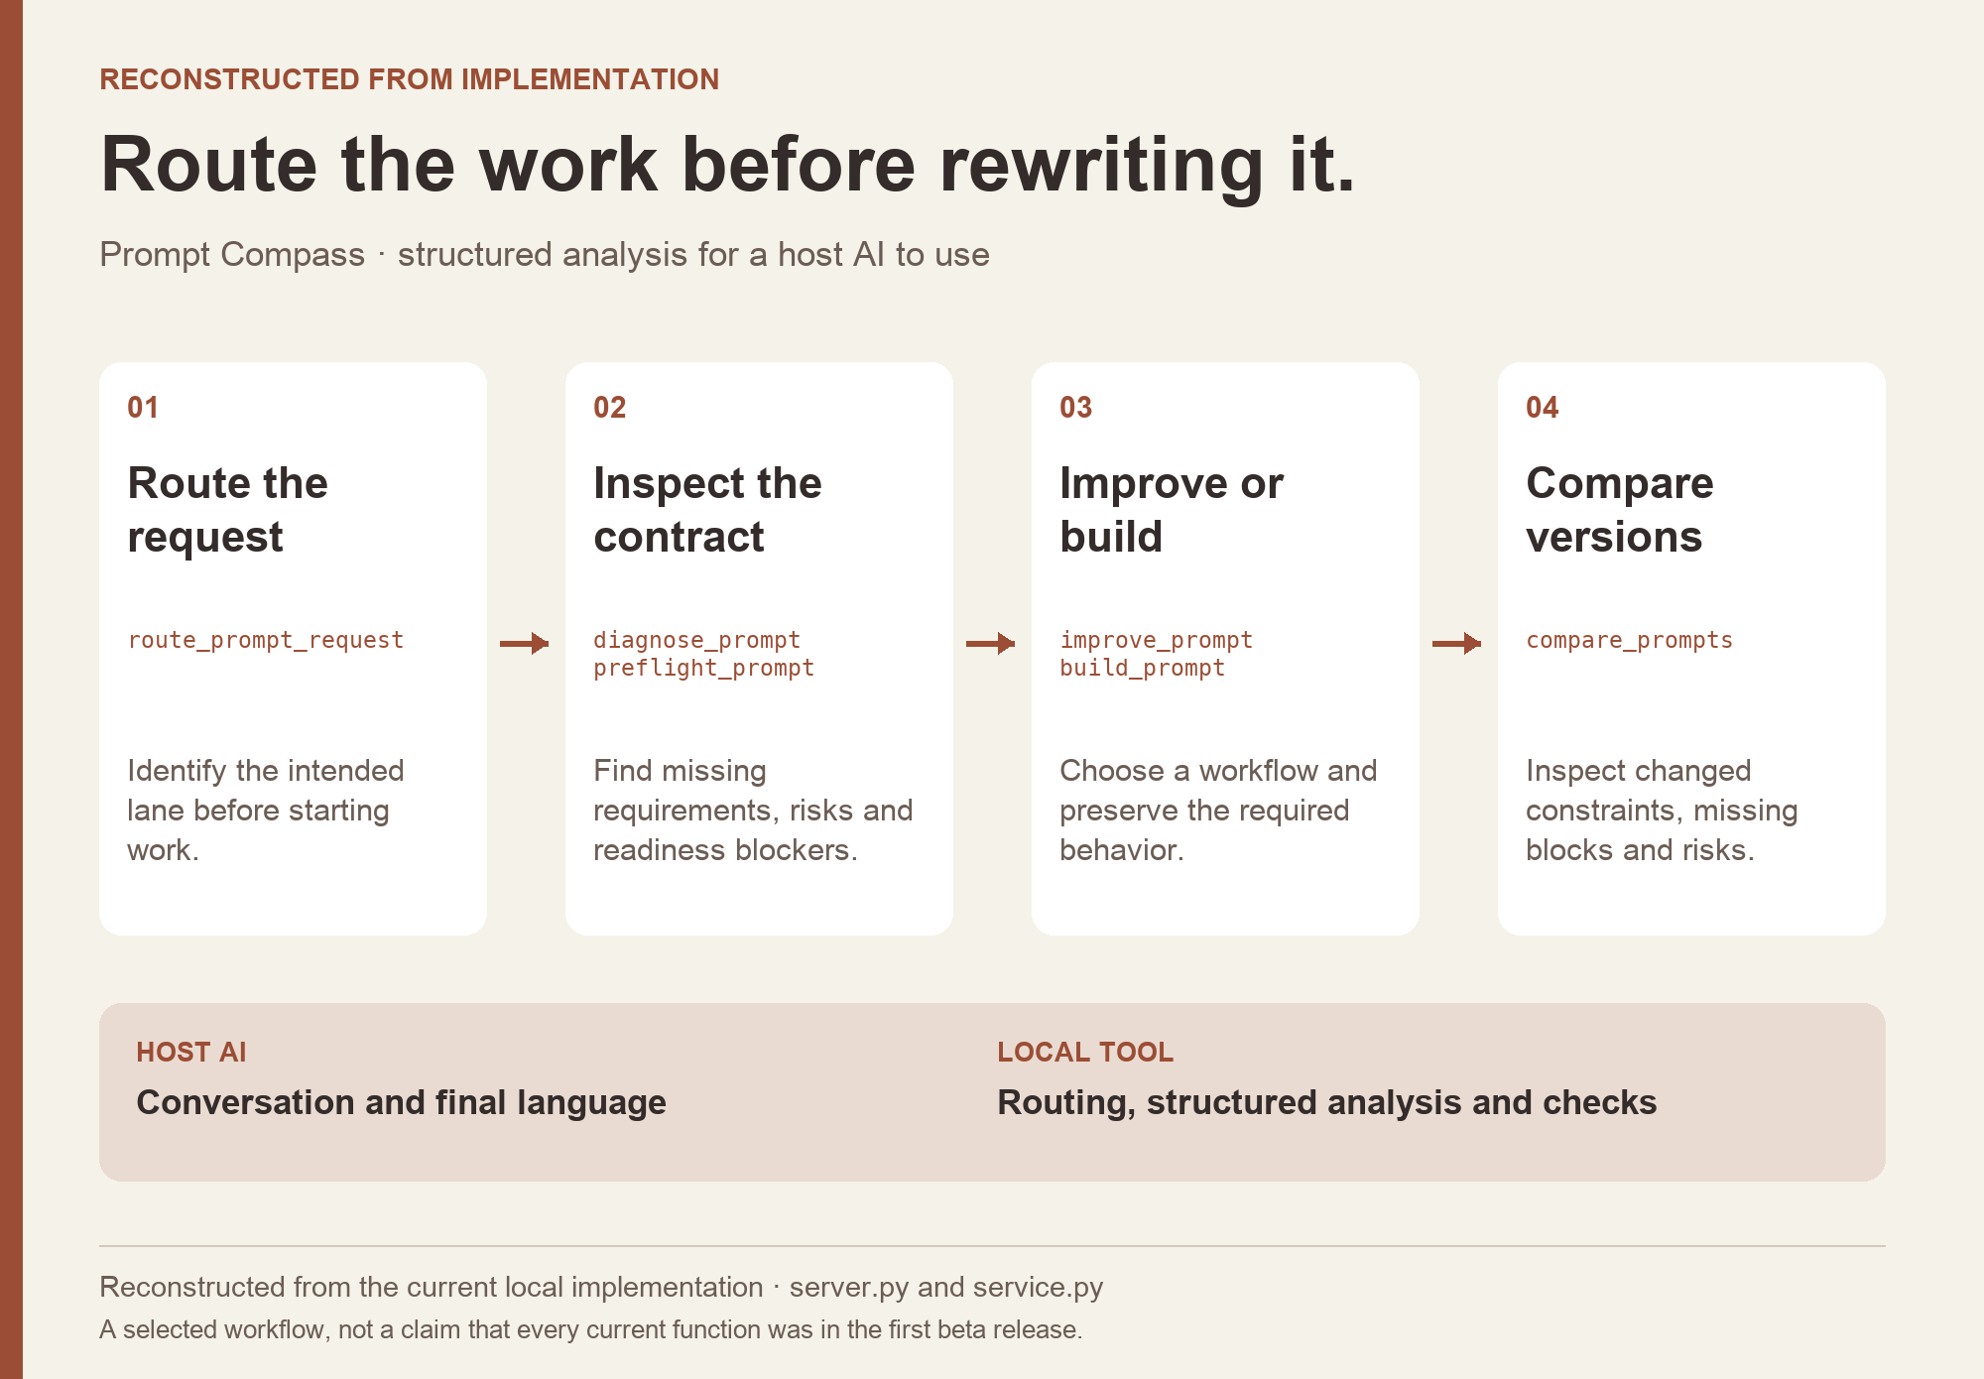
PROMPT COMPASS / INDEPENDENT CREATOR, 2026
From a question
to a public beta
Can a prompt rewrite sound clearer while losing the task’s requirements?
I built and released a local tool that structures the requirements, identifies gaps, and helps an assistant compare prompt versions.
Reconstruction of implemented workflow
06
Notes:
Source: original local implementation and public beta.3 release, April 27, 2026. Kyle independently created and released the tool. The host assistant owns the conversation; Prompt Compass supplies structured analysis and routing. Diagram is explicitly reconstructed from implementation. Public beta source: https://github.com/JonathanKHobson/prompt-compass/releases/tag/v0.1.0-beta.3 . No adoption, revenue or production-model performance claim.

Slide 7
PROMPT COMPASS / POST-BETA LOCAL EVALUATION
A rewrite must preserve the requirement
ORIGINAL FIXTURE PROMPT
SHORTER REWRITE
Return valid JSON only with fields category, article_id, confidence, and suggested_response. If confidence is below 0.7, set suggested_response to needs_review. Success: parser accepts the response.
Return a clean structured answer with the best response for the user.
Expected winner: the original
A designed regression case: the rewrite loses named fields and the review condition.
07
Notes:
Both prompts are exact values from a developer-authored May 2026 local regression fixture. The public beta was released in April; later local evaluation is a separate state. This is a designed example, not a customer incident or independent benchmark. It illustrates how Kyle makes a product judgment inspectable: task requirements should survive a rewrite.

Slide 8
GOGUARDIAN / PROPOSED STARTING QUESTIONS
What would make an insight useful?
I would begin with the decision an educator needs to make, then trace the information needed to support it.
What does the person understand from the summary?
Can they inspect the evidence and its limits?
Which next action fits their role and context?
Can they explain why that action is appropriate?
Proposed research questions for discovery; no claim of access to GoGuardian data or users.
08
Notes:
These are proposed discovery questions, tailored to the job description’s focus on digital-safety insights for K–12 leaders. They are not findings about GoGuardian, product requirements, clinical advice or a safety-risk classification method. Source: https://job-boards.greenhouse.io/goguardian/jobs/4705045006 .

Slide 9
KYLE HOBSON / GOGUARDIAN APPLICATION
Research into
product decisions.
Based in Mesa, Arizona. Available for U.S. remote work.
Authorized to work without sponsorship. Available ASAP.
JonathanKyleHobson@gmail.com
View the three GoGuardian case studies
09
Notes:
Candidate-confirmed location, work authorization and availability. The separate application portfolio contains About Me, Oak AI and Prompt Compass with ownership and delivery-stage boundaries.

