Slide 1
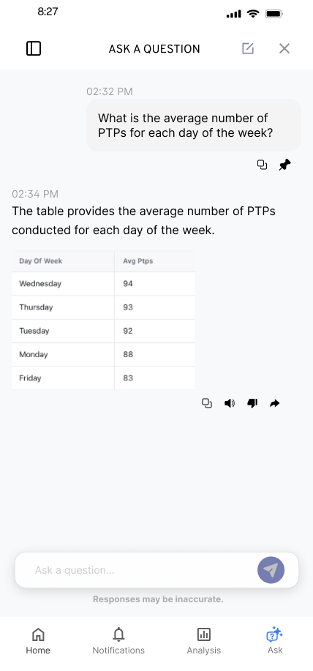
KYLE HOBSON / EAB PRODUCT EXPERIENCE DESIGNER
Product experiences
people can explore
Prototypes and walkthroughs
for complex product behavior.
Selected work for EAB
September 2026
01
Notes:
EAB Product Experience Designer (PXD), Senior Analyst, requisition 610993. Employer source: https://recruit.hirebridge.com/v3/Jobs/JobDetails.aspx?cid=7856&jid=610993&locvalue=1036, verified September 8, 2026. Original SmartTagIt Flint design from Kyle’s selected portfolio. Sample interface content.

Slide 2
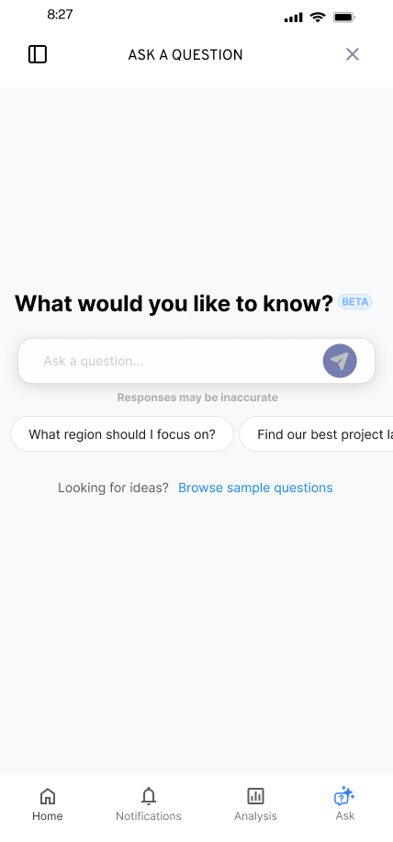
FLINT / SMARTTAGIT, FACTORLAB
A useful
first question
UX Designer & Researcher (Contract)
2025-2026
I explored suggested questions and a question library while keeping a person’s own question close at hand.
Design deliverables and engineering handoff
02
Notes:
Original FactorLab Flint mobile design and design walkthroughs. Kyle explored entry, suggestions and the question library and prepared annotated handoffs. These are designed states, not a claim that every pictured variant shipped.

Slide 3


FLINT / INTERRUPTED AND OFFLINE STATES
Incomplete answer
Connection lost
Recovery follows
the failure
An incomplete answer and a lost connection need different next actions.
I assembled the connected flows and their next actions into an annotated handoff for engineering.
03
Notes:
Original SmartTagIt Flint interrupted-response and offline variants, including the March 27, 2026 error-state handoff. The examples document design decisions and engineering annotations. Sample interface content.

Slide 4
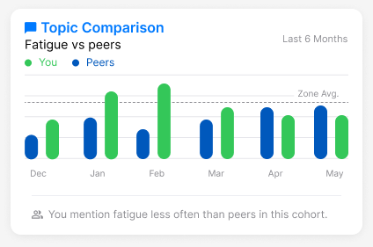
ABOUT ME / SMARTTAGIT, FACTORLAB
A comparison
needs context
Mentioning fatigue less often is a comparison. Whether that is good depends on the context.
I raised the cohort and wording questions while developing reusable insight widgets.
Original design iteration with sample values
04
Notes:
Original About Me widget and April-May 2026 walkthroughs. Kyle developed insight layouts and made interpretation questions explicit. About Me web/server release was confirmed September 2, 2026, but the exact pictured layout and completed mobile rollout are not established.

Slide 5
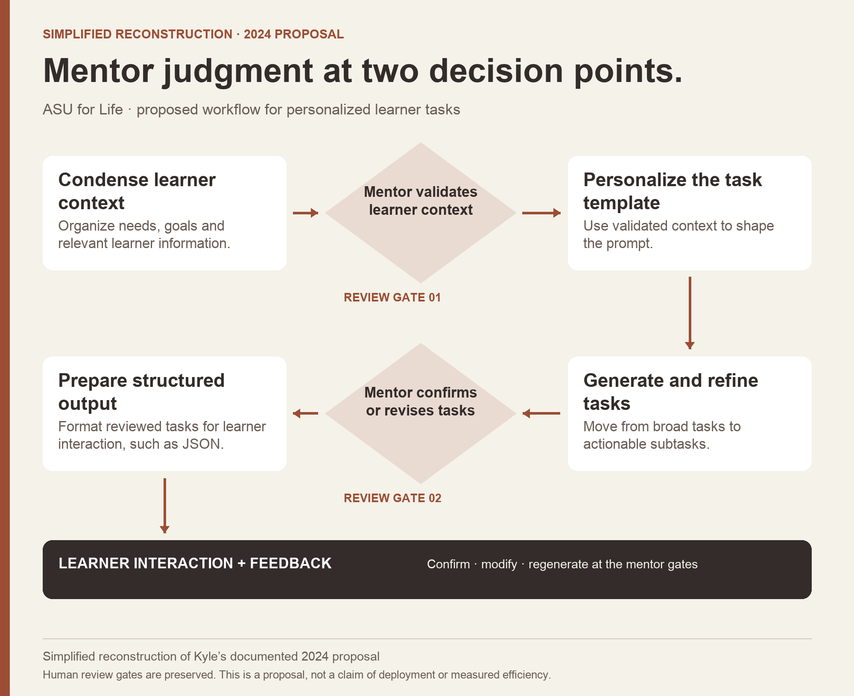
ASU / AI ANALYST, 2024
Mentor review
in a learner
workflow
I proposed review of learner context and generated tasks at two points in the workflow.
Documented proposal
Simplified reconstruction
05
Notes:
ASU Learning Innovations AI Analyst, February-October 2024. Kyle’s attributed section of a collaborative workflow document supports the proposed review stages. The image is a simplified portfolio reconstruction of that proposal. Deployment, learner outcomes and time savings are not established.

Slide 6
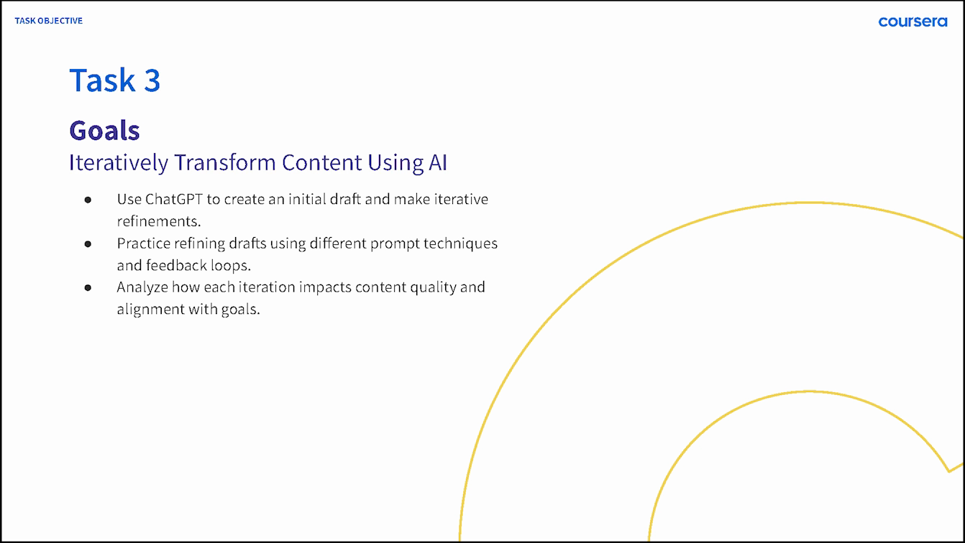
COURSERA / GUIDED PROJECT INSTRUCTOR, 2024
A demonstration becomes
a practice task
I created a guided project around a familiar task: draft a social post, inspect the result, and make a purposeful revision.
Published beginner instruction
Original lesson goals
06
Notes:
Published project: https://www.coursera.org/projects/chatgpt-beginners. Kyle created ChatGPT 4o for Beginners: Create Social Media Content in 2024. Original lesson excerpt retains its Coursera branding. This demonstrates authored instruction, not measured learner gains or an EAB product demo.

Slide 7
PROMPT COMPASS / INDEPENDENT CREATOR, 2026
A prompt rewrite can
lose requirements
Original request
Shorter rewrite
Valid JSON, four named fields, and a low-confidence review rule.
A clean structured answer with the best response for the user.
My tool compares requirements as well as wording. This developer-authored test exposes what the shorter request leaves out.
Public beta product; this example comes from later local evaluation work.
07
Notes:
Public beta.3: https://github.com/JonathanKHobson/prompt-compass/releases/tag/v0.1.0-beta.3, April 27, 2026. The example paraphrases a May local developer-authored regression fixture. Four named fields are category, article_id, confidence and suggested_response. The original also specifies confidence below 0.7 should yield needs_review. Local evaluation examples are separate from the April release and are not measured customer effectiveness.

Slide 8
EAB / PROPOSED APPROACH
An EAB product demonstration
I would begin with one education partner’s task and the product behavior that supports it.
01 A task the audience recognizes
02 A prototype reviewed with product and engineering
03 A clear label for current behavior and future concepts
Proposed approach for this role; no prior EAB work is claimed.
08
Notes:
Proposed approach, informed by EAB requisition 610993: https://recruit.hirebridge.com/v3/Jobs/JobDetails.aspx?cid=7856&jid=610993&locvalue=1036. The role concerns product demonstrations, reusable prototypes and accurate representation of current and future product behavior. This slide is a proposed collaboration approach.

Slide 9
EAB PRODUCT EXPERIENCE DESIGNER APPLICATION
Kyle Hobson
Product design, higher education experience,
and clear explanations of how a product works.
Mesa, Arizona / U.S. remote work / Available ASAP
JonathanKyleHobson@gmail.com
Portfolio selected for EAB
09
Notes:
Candidate contact and availability are confirmed. Intended isolated portfolio route: https://jonathankhobson.github.io/application-portfolios/eab-product-experience-designer/. Publication is a separate campaign action.

