Slide 1

KYLE HOBSON / TEAL MEDIA · UX/UI DESIGN
Complex information.
Clear next steps.
Selected work in content structure,
visual design and interaction behavior.
Senior UX/UI Designer · Contract application · September 2026
01
Notes:
Prepared for Teal Media Senior UX/UI Designer: Contractor Job Ad, https://job-boards.greenhouse.io/tealmedia/jobs/4271842009, reviewed September 8, 2026. All work examples are Kyle’s reviewed prior artifacts. Teal Media is a prospective employer, not a former client. Decorative cover from the canonical portfolio.

Slide 2
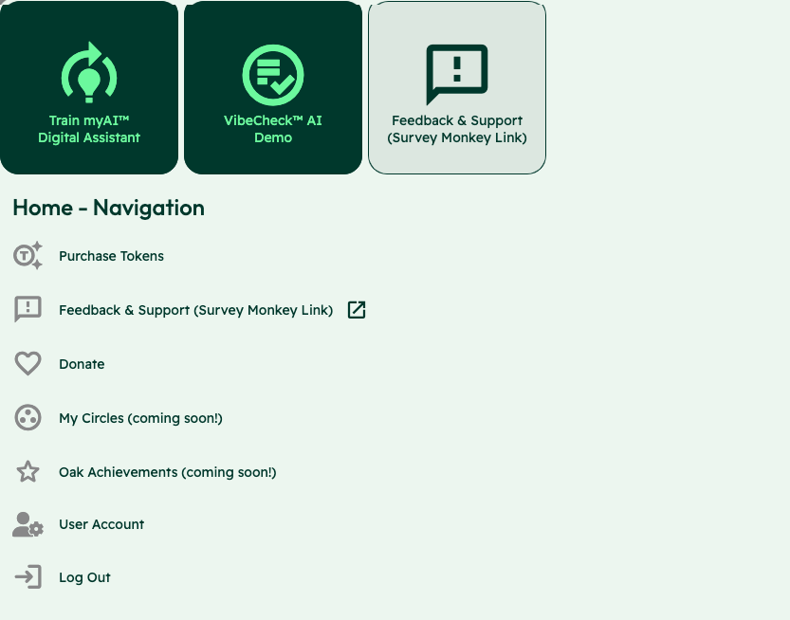
OAK AI / LEAD UX RESEARCHER, 2023–2025
Make the starting
choices clear
Training an assistant, starting a Vibecheck and requesting support competed at the same entry point.
I compared labels and sitemap alternatives, then collaborated on shared navigation with the lead designer.
Expert evaluation and design recommendations
02
Notes:
Sources: canonical Oak case, original November 22, 2023 evaluation, December contribution log and original screenshot with identity area omitted. Kyle developed two concise sitemap alternatives and contributed to shared header/footer refinement. Card sorting and comparative sitemap testing were future proposals; a validated winning sitemap is not claimed.

Slide 3


OAK AI / LOGIN FEEDBACK
Error feedback
beside the field
Original
Proposed
I made the problem field visible where a person could act on it.
The recommendation gave the team a specific behavior to discuss and prioritize.
Original error at the page footer
Proposed feedback beside the field
03
Notes:
Source: original Oak error-message recommendation artifact containing Before and After panels. Displayed interface panels retain source pixels and are labeled Original and Proposed to clarify the work state. Kyle connected an evaluation finding to visual alternatives and implementation recommendations. No conversion or task-success percentage is asserted.

Slide 4
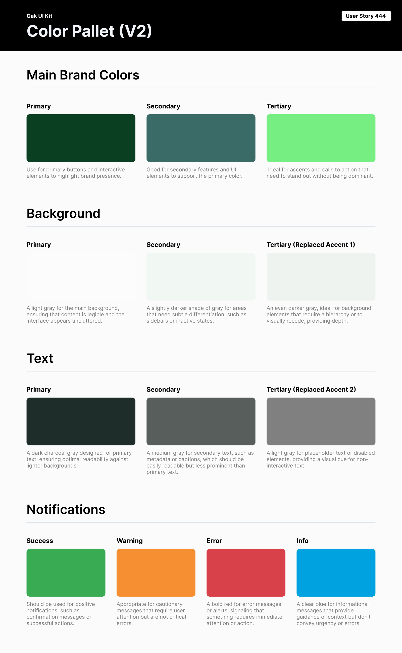
OAK AI / VISUAL GUIDANCE
Give color
a defined job
Brand, backgrounds, text and feedback needed consistent roles across the interface.
I documented those roles for the next design iteration. This focused guide did not establish a complete component library.
04
Notes:
Source: original Oak UI Kit V2 export tied to User Story 444 and canonical design.json. Focused color specification; no complete design-system coverage or accessibility-compliance claim.

Slide 5
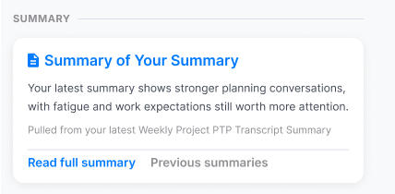
FACTORLAB · ABOUT ME / INFORMATION ARCHITECTURE, 2026
Organize content by
the question it answers
Summaries. Recommendations. Simple 7. Comparisons. Accomplishments.
I explored content density and reusable widget structures, then worked with engineers on what each action opened.
Original design detail · sample content
05
Notes:
Sources: About Me original Figma design and April–May 2026 walkthroughs, canonical design.json. Kyle developed page directions, content families and visual alternatives. Product lead and engineering clarified data availability, existing capabilities and routes into detail. Team release of web/server changes is confirmed September 2, 2026; the exact pictured layout is unverified. The crop preserves original source pixels.

Slide 6
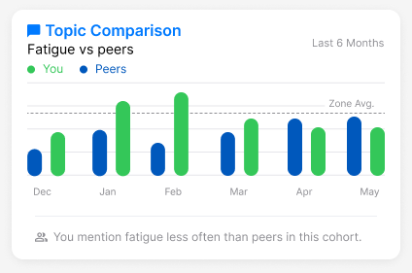
FACTORLAB · ABOUT ME / CONTENT AND VISUAL FRAMING
A comparison needs
its reference point
Original widget · sample values
Compared with whom, over what period, and what should this help me decide?
I questioned percentile framing and explored neutral descriptions that leave room for context.
06
Notes:
Sources: original comparison exploration and May 15, 2026 walkthrough. Displayed chart contains sample values, not measured project outcomes. Neutral framing was Kyle’s design position; adoption as final product policy and user interpretation are unverified.

Slide 7
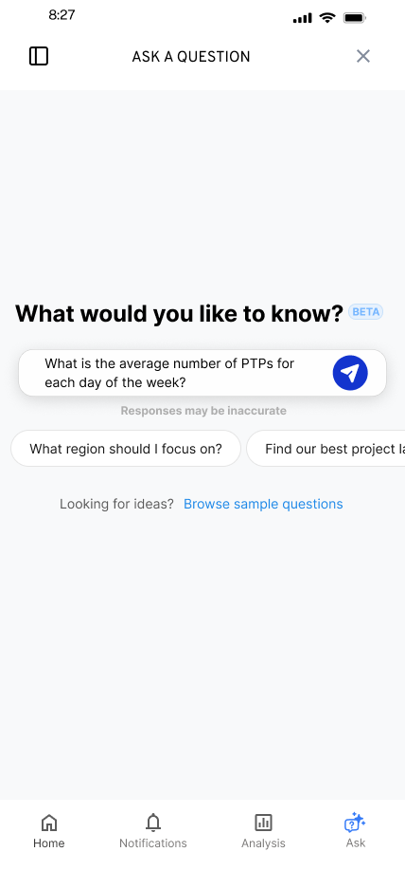
FACTORLAB · FLINT / INTERACTION DESIGN, 2025–2026
Make the first question
easier to ask
Suggested questions offered a starting point while leaving the person free to edit or ask something else.
I worked within the existing product, keeping the answer layout and agreed phase scope in view.
07
Notes:
Source: original Flint suggested-question state and project walkthroughs in canonical design.json. Selecting a suggestion was intended to populate the input for review or editing. Design variant and engineering handoff; release of each variant is unverified.

Slide 8


FLINT / INTERRUPTED AND OFFLINE STATES
Incomplete answer
Connection lost
Recovery follows
the failure
An incomplete answer and a lost connection need different next actions.
I assembled the flows and their next actions into an annotated handoff for engineering.
08
Notes:
Source: selected original Flint interrupted-response and offline design variants, including the March 27, 2026 error-state handoff. Distinct recovery actions follow the state: Ask again or Continue for a partial response, and retry after connection loss with the question preserved. Deliverable: connected flows, interaction states and engineering annotations.

Slide 9
PROPOSED APPROACH / A TEAL CLIENT PROJECT
Bring the content model
into the first review
Start with a real task
Map the content
Identify the audience, the information they need and the next action the page should support.
Review page types, relationships and reusable fields with the strategist and developer.
Make alternatives visible
Document the decision
Compare wireframes and visual directions against the content and technical constraints.
Record the chosen behavior, open questions and next check before moving into production.
09
Notes:
Proposal for discussion based on Teal’s current role description, https://tealmedia.com/career/senior-ux-ui-designer/ . Not a prior Teal engagement or implemented CMS model. Kyle has user-confirmed CMS-driven experience, but specific WordPress custom-field/post-type implementation expertise is unverified. Teal’s exact practices and stack would be learned with the team.

Slide 10
KYLE HOBSON / TEAL MEDIA · UX/UI DESIGN
Let’s make complex
information useful
Mesa, Arizona. Full U.S. work authorization. Available to start as soon as possible.
JonathanKyleHobson@gmail.com
jonathankhobson.github.io/application-portfolios/teal-media-ux-ui-designer
10
Notes:
The tailored portfolio contains selected case studies and all six application materials. Teal lists $75–$85/hour, a six-month contract and 30–40 hours/week for U.S. residents. Core-hour overlap and engagement terms remain for discussion; no availability or contract acceptance is made here.

