Slide 1

KYLE HOBSON / ASU EDPLUS · UX RESEARCHER SENIOR
Research for the next
learning step
Mixed methods, product decisions,
and digital learning experience.
Selected for ASU EdPlus · September 2026
01
Notes:
Kyle Hobson, UX Researcher. Selected work at Oak AI and Oak + Qasim. The cover uses a generated decorative paper-path image, not project evidence. The following cases show research methods, evidence, product decisions and the limits on each conclusion.

Slide 2
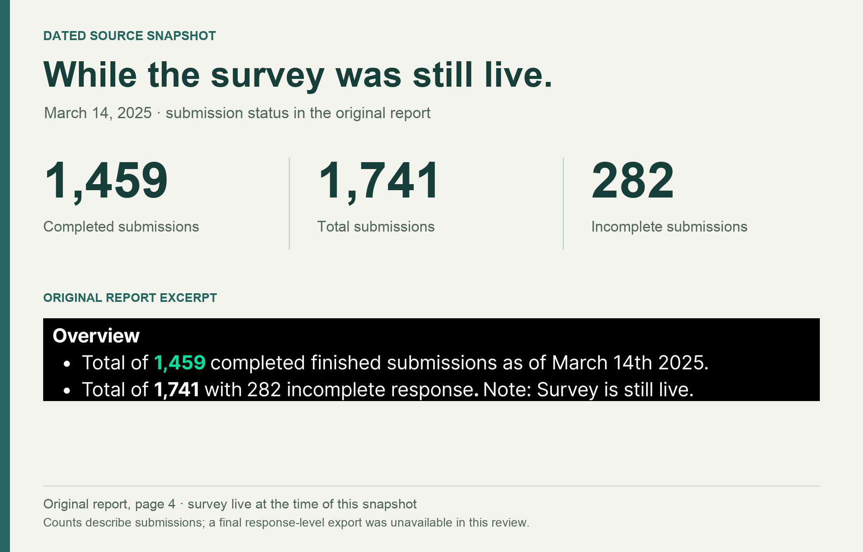
OAK + QASIM / AUDIENCE SURVEY, MARCH 2025
What keeps interest
from becoming action?
I led survey design, launch and analysis.
I combined structured questions about barriers with open responses about what would help.
A voluntary audience sample surfaced reported needs. It could not establish future use or purchase.
1,459 complete submissions
March 14, 2025 · survey still live
02
Notes:
Case: Oak + Qasim audience survey, March 2025. Kyle’s reviewed portfolio identifies his role as leading survey design, launch and analysis. Original source: Survey #1 Phase 2 — Findings Report: Understanding Audience Pain Points & Value-Aligned Actions, page 4. The report records 1,459 complete submissions as of March 14, 2025 while the survey remained live. This is a voluntary creator/advocacy audience sample, with predominantly older, female and highly educated respondents. Self-reported needs and preferences do not establish future behavior.

Slide 3
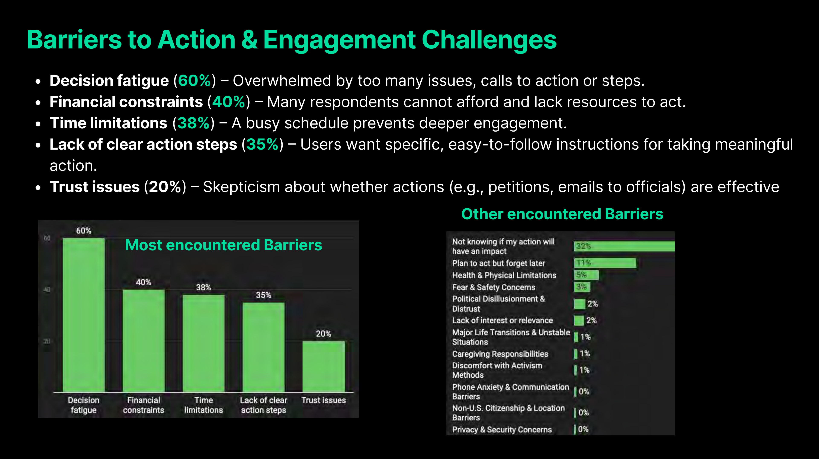
OAK + QASIM / REPORTED BARRIERS
Reported barriers to taking action
Original findings report · March 2025
Reported percentages · per-item response base unavailable · voluntary audience sample
03
Notes:
Source: original Oak + Qasim March 2025 findings report, page 14, shown unchanged at left. Native editable chart reproduces the report’s values: decision fatigue 60%; financial constraints 40%; time limitations 38%; lack of clear action steps 35%; trust issues 20%. The chart workbook is a new snapshot of these literal reported values, not the original response data. Per-item denominators, skip logic and response-level quality checks were not recovered. These are reported survey percentages, not independently recalculated estimates or population prevalence.

Slide 4
OAK + QASIM / FINDINGS INTO A PRODUCT QUESTION
A proposed Action Hub direction
The findings pointed toward smaller, clearer actions and support for following through.
REPORTED NEED
PROPOSED DIRECTION
Overwhelm and unclear steps
A focused action with instructions
Limited time and resources
Reusable templates and task support
Doubt about whether action matters
Visible progress and feedback
Next validation: test whether people can choose and complete an action in a prototype.
04
Notes:
Source: original March 2025 report pages 14–15 and Kyle’s retrospective portfolio discussion of an Action Hub direction. This slide is an editable synthesis connecting reported barriers and feature requests to a proposed product direction. It does not show an implemented product, verified adoption, funding secured, or a causal outcome. The final sentence proposes a next validation step for the portfolio narrative; it is not a claim that the test occurred.

Slide 5
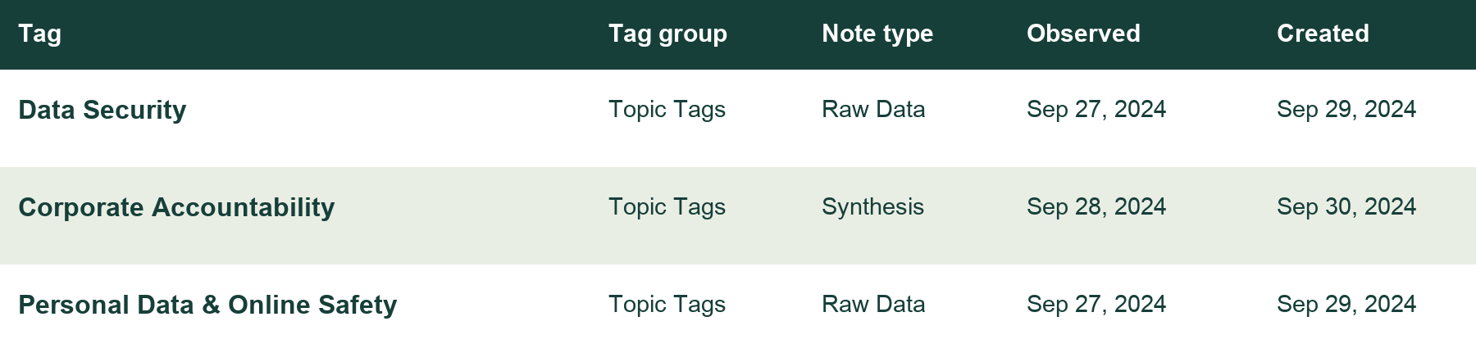
OAK AI / PRIVACY-COMMUNITY RESEARCH, SEPTEMBER 2024
Testing an audience assumption
I studied existing community discussions, then coded excerpts to examine whether Oak’s audience assumptions fit.
Reformatted source metadata · exploratory research and synthesis · September 2024
05
Notes:
Case: Oak AI privacy-community research, September 2024. Original evidence: a partial Dovetail coding export and synthesis notes with observations dated September 25–28 and entries created September 29–30. Kyle’s contribution log corroborates community synthesis and persona validation. The displayed source plate is reformatted from the coding export; this crop selects the first three metadata rows, with no participant excerpts or locators. The retrospective also describes later active engagement; the partial export does not establish the full sampling frame.

Slide 6
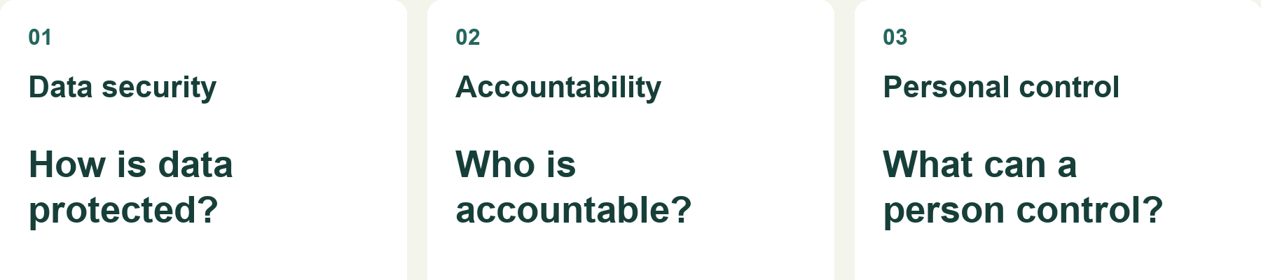
OAK AI / QUALITATIVE FINDINGS AND DECISION
Audience fit needed another look
I used concerns about data protection, accountability and control to question audience fit and reconsider the next research investment.
Portfolio synthesis based on source tags
A partial coding export supports exploration. A purposive sample cannot establish market-wide demand.
06
Notes:
Sources: original September 2024 coding export and synthesis; reviewed career evidence and retrospective case narrative. Themes include data security, corporate accountability and personal control. This visual is a retrospective portfolio synthesis, not a historical presentation artifact or a set of respondent quotations. The crop shows the three interpretive questions; the original full plate links those questions to source tags. The work raised concerns about audience fit and supported reconsidering the next research investment. It did not prove product-market fit impossible or establish a quantified budget saving. A next study should compare concrete needs and current workarounds across explicitly recruited audiences.

Slide 7
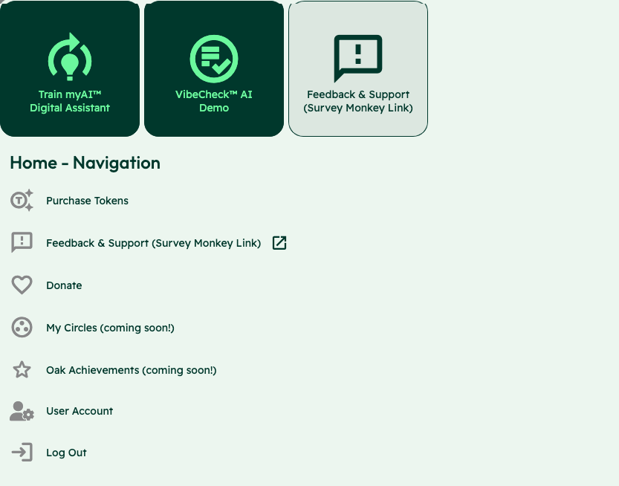
OAK AI / DESKTOP HEURISTIC EVALUATION, NOVEMBER 2023
Where would
someone get stuck?
I evaluated the desktop experience and documented findings for the product team.
Expert review exposed navigation and recovery problems to investigate next.
07
Notes:
Case: Oak AI desktop heuristic evaluation. Original evaluation workbook identifies Mac desktop/Chrome and November 22, 2023. Kyle conducted the heuristic evaluation and UX audit, examined information architecture, and compiled findings and recommendations. The original navigation detail shows competing entry points. This is expert judgment, not a controlled user study. The workbook contains 94 rated desktop checklist rows; those are neither 94 participants nor 94 distinct observed user failures. A completed mobile audit is not evidenced.

Slide 8


OAK AI / ERROR RECOVERY RECOMMENDATION
Recovery feedback
needed a clearer location
Original
Proposed
The existing error appeared at the page footer, away from the login fields.
I recommended placing the correction beside the field where someone could act.
Original page-footer error
08
Notes:
Sources: original Oak desktop evaluation and error-messaging recommendation artifact. The shown crops retain original interface pixels and exclude the identity-bearing example field. Original and Proposed labels distinguish the existing interface from the recommendation. The evaluation identified error feedback that did not explain recovery, and the recommendation made a specific correction visible near the password field. This is a recommendation, not a measured usability improvement or a claim that the exact variant shipped.

Slide 9
OAK AI / RESEARCH HANDOFF
Findings ready for backlog planning
I presented the evaluation and recommendations, then helped turn the findings into a UX improvement list.
22 NOV 2023
27 NOV 2023
03 DEC 2023
Desktop evaluation
Recommendations report
Presentation
Navigation, hierarchy and error recovery
Specific interface changes and rationale
Improvement list started for backlog planning
I collaborated on Figma mockups. Lead designer Megan led the later design refinements.
09
Notes:
Sources: original desktop heuristic evaluation dated November 22, 2023; recommendations report exported November 27, 2023; Kyle’s contribution log for December 3, 2023 documents presenting the evaluation and recommendations, then initiating a UX improvement list for transformation into a backlog. It does not establish delivery of a completed prioritized backlog on that date. The January 29, 2024 contribution entry credits lead designer Megan with later design refinements and mockup iterations. This slide documents the research handoff, not a shipping or outcome metric. Next validation would observe realistic navigation and error-recovery tasks; future methods named in the report are not presented as completed studies.

Slide 10
ASU LEARNING INNOVATIONS / 2024 WORKFLOW PROPOSAL
Human review before learner-facing tasks
A staged prompt workflow for personalized learner tasks.
01
02
03
Condense learner context
→
Mentor validates context
→
Personalize task template
Prepare context for review.
Check the interpretation.
Use the reviewed context.
↓
06
05
04
Prepare learner-facing output
←
Mentor confirms tasks
←
Generate and refine tasks
Structured output and feedback.
Approve or revise the tasks.
Prepare candidate tasks.
Simplified reconstruction · Documented proposal; no deployment or measured efficiency claimed.
10
Notes:
Source: reviewed 2024 ASU Learning Innovations proposal and accompanying source brief. Kyle proposed a prompt workflow that condensed learner context, included mentor validation of context, personalized a task template, generated and refined tasks, included mentor confirmation or revision, and prepared structured learner-facing output and feedback. This editable reconstruction groups the original steps into six stages while retaining both mentor review gates. It is a proposal, not a deployed system or a measured efficiency or learning outcome. It supports a discussion of learner context and human review. Prior ASU Learning Innovations work does not establish a prior EdPlus engagement.

Slide 11
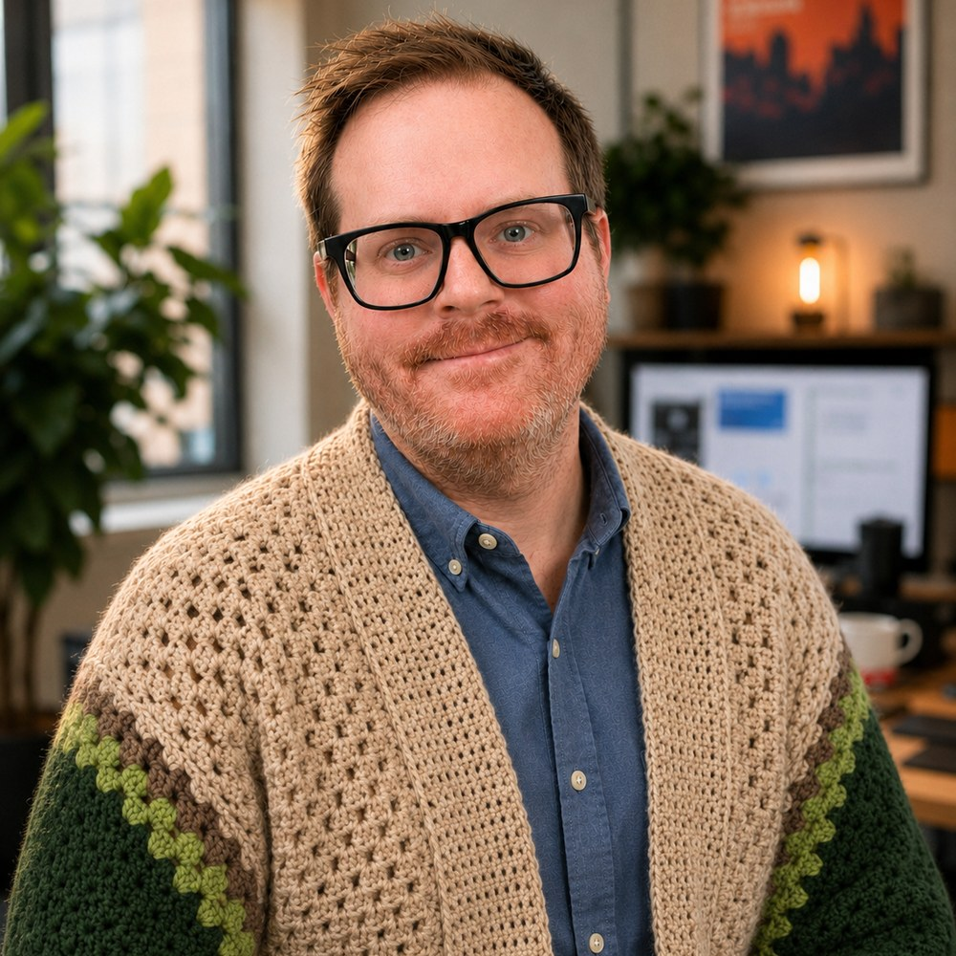
PROPOSED APPROACH / ASU EDPLUS
One learner decision
to investigate
Choose one learner decision with the product team. Study how learners understand their options, where they lose context, and what they need to take a useful next step.
Combine interviews and task observation with relevant survey or product signals. Discuss interpretations with the team, test a focused concept, and document what the evidence leaves open.
11
Notes:
Proposed direction informed by the ASU EdPlus UX Researcher Senior vacancy JR126787: https://edplus.asu.edu/careers/ and https://asu.wd1.myworkdayjobs.com/en-US/ASUStaffCareers/job/UX-Researcher-Senior_JR126787 . The role supports enterprise initiatives and ASU Online learner experiences. Methods depend on the actual product decision, ethical review, access and recruitment. This is a proposed approach, not a completed EdPlus study. No participants, timetable, outcomes or compensation acceptance are promised. The portrait is user supplied.

Slide 12
KYLE HOBSON / ASU EDPLUS · UX RESEARCHER SENIOR
Let’s make the next
decision clearer
Interested in EdPlus’s UX Researcher Senior role. Based in Mesa, Arizona and open to hybrid work in Scottsdale.
JonathanKyleHobson@gmail.com
jonathankhobson.github.io/application-portfolios/asu-edplus-ux-researcher
12
Notes:
Prepared for ASU EdPlus’s UX Researcher Senior role. The portfolio destination is configured as a hyperlink. No compensation acceptance or particular weekly office schedule is promised.

