Slide 1
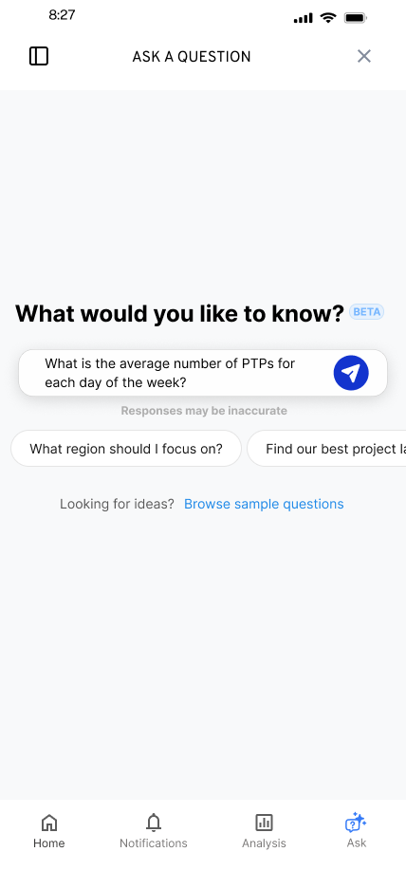
KYLE HOBSON / PINTEREST · PRODUCT DESIGNER II, NOTIFICATIONS
A clear choice.
A useful next step.
Interaction states, user control,
and research that sharpens the next design.
Selected work for Pinterest · September 2026
01
Notes:
Kyle Hobson, UX Designer. Source: original SmartTagIt Flint entry-state design export. This is adjacent interaction-design evidence for a notifications role, not prior notification-program ownership. The deck discusses design deliverables, handoff and proposed iterations, with work stage stated at each case opening.

Slide 2
FLINT / SMARTTAGIT, FACTORLAB
A useful
first question
UX Designer & Researcher (Contract)
2025–2026
I explored suggested questions and a question library while keeping a person’s own question close at hand.
Design deliverables and engineering handoff
Mobile and desktop conversation flows
02
Notes:
Case: Flint, SmartTagIt at FactorLab. Kyle: UX Designer & Researcher (Contract), 2025–2026. Source: original mobile design export, question suggestions and project walkthroughs. Work stage: design deliverables and engineering handoff. These examples document designed states, not a claim that every variant shipped.

Slide 3
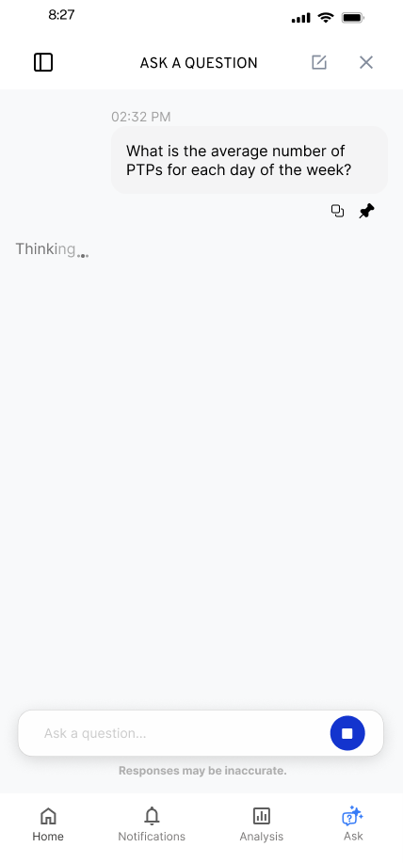
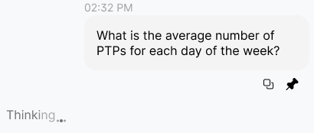
FLINT / RESPONSE IN PROGRESS
Waiting is part of
the conversation
I kept the question visible and gave the response a distinct waiting state.
Original state detail
Animation was an implementation question to resolve with engineering.
03
Notes:
Source: original Flint response-in-progress mobile export and design walkthrough. The inset enlarges an unchanged region of the same source image. Kyle explored the waiting treatment alongside the conversation and discussed animation constraints with engineering.

Slide 4


FLINT / INTERRUPTED AND OFFLINE STATES
Incomplete answer
Connection lost
Recovery follows
the failure
An incomplete answer and a lost connection need different next actions.
I assembled the flows and their next actions into an annotated handoff for engineering.
04
Notes:
Source: selected original Flint interrupted-response and offline design variants, including the March 27, 2026 error-state handoff. Distinct recovery actions follow the state: Ask again or Continue for a partial response, and retry after connection loss with the question preserved. Deliverable: connected flows, interaction states and engineering annotations.

Slide 5
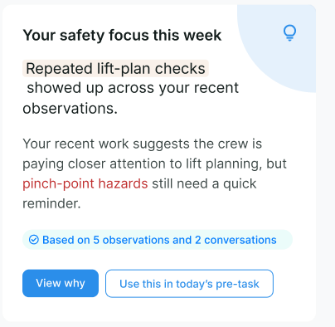
ABOUT ME / SMARTTAGIT, FACTORLAB
Feedback
with context
UX Designer & Researcher (Contract), 2026
I connected a personal summary to its supporting observations and a useful next action.
Design iterations shown with sample content.
Web/server release confirmed September 2, 2026.
05
Notes:
Case: About Me, SmartTagIt at FactorLab. Kyle: UX Designer & Researcher (Contract), 2026. Source: original About Me Figma direction and April–May 2026 walkthroughs. The displayed crop retains original sample content. A September 2, 2026 engineering update confirms the About Me web/server release. These images document design iterations rather than the exact released layout.

Slide 6
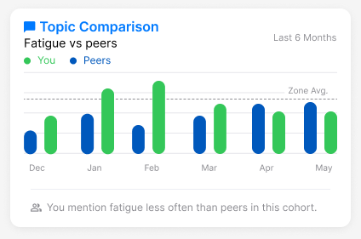
ABOUT ME / NEUTRAL COMPARISON
A comparison needs
an interpretation
Mentioning fatigue less often is a comparison. Whether that is good depends on the context.
I raised the cohort, percentile and wording questions before they became interface rules.
Original widget, illustrative values
06
Notes:
Source: original About Me Topic Comparison widget and stakeholder design discussions. Values are illustrative design content, not research outcomes. Kyle advocated neutral feedback and made cohort definition and interpretation questions explicit. The case output was a family of insight layouts and concrete product questions for alignment.

Slide 7
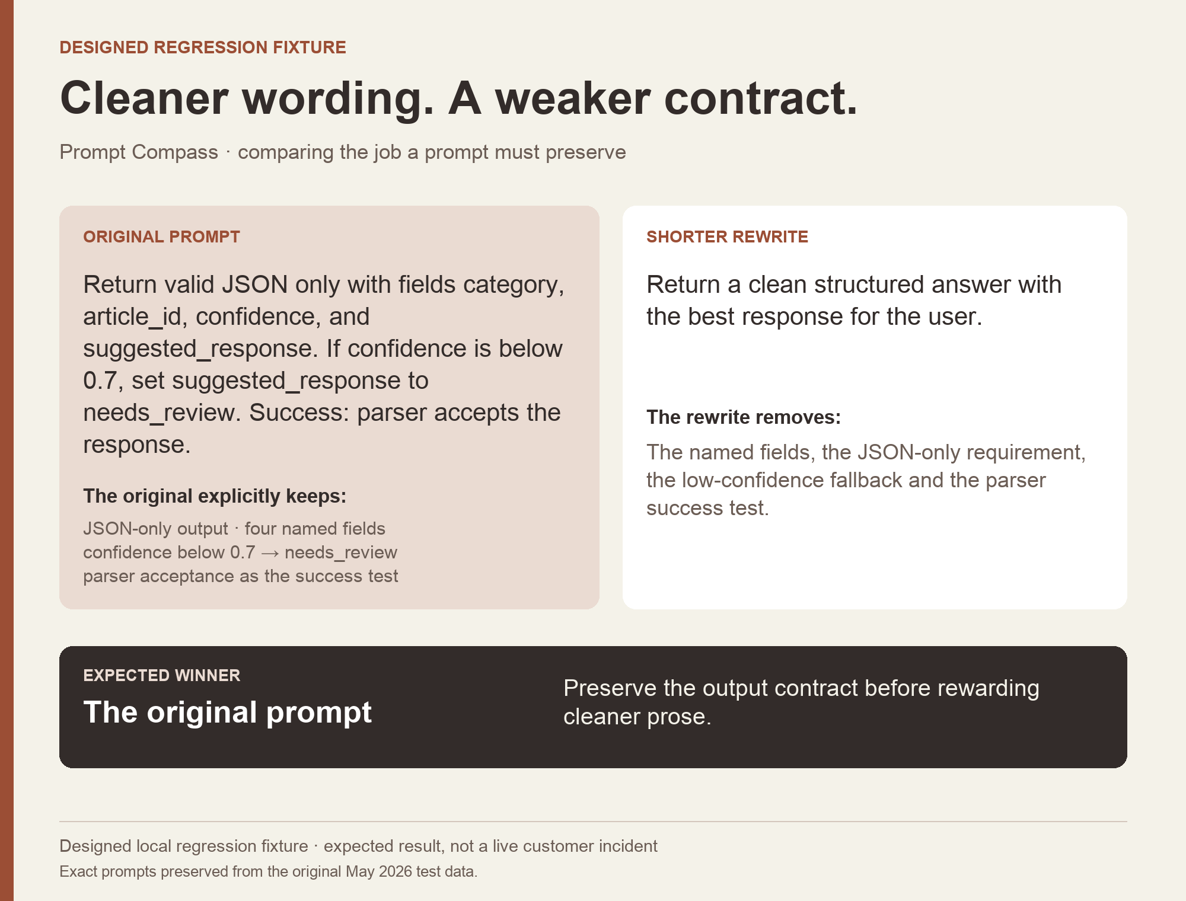
PROMPT COMPASS / INDEPENDENT PROJECT
Make the task
explicit.
I built and released a tool that helps an AI assistant inspect requirements and compare prompt versions.
Public beta released April 2026.
The pictured local test asks whether a rewrite preserves required output behavior.
Explore the public beta
07
Notes:
Source: reviewed public AI portfolio and Prompt Compass beta.3 release dated April 27, 2026. The image reformats an original May 2026 developer-authored regression fixture. It is a designed expected-result example, not a customer incident or independent effectiveness benchmark. Later local evaluation work is distinct from the April release. This project establishes working AI tool implementation; it is not a Pinterest prototype.

Slide 8
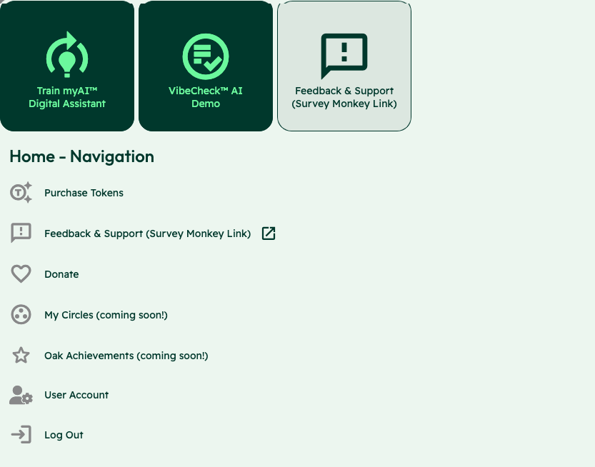
OAK AI / LEAD UX RESEARCHER, 2023–2025
Competing
entry points
Training an assistant, starting a Vibecheck and requesting support competed at the same entry point.
I used the audit to make these choices explicit for the team’s review.
Usability evaluation and design recommendations
08
Notes:
Case: Oak AI. Kyle: Lead UX Researcher, 2023–2025. Source: original Oak navigation evaluation screenshot, with the identity area omitted. Training the assistant, starting Vibecheck and requesting support appear as competing entry points. Kyle documented the labels and visual treatments and used the audit to make these choices explicit for review. Work stage: usability evaluation and design recommendations. This slide does not present a finished navigation redesign or a user-study finding.

Slide 9


OAK AI / LOGIN FEEDBACK
Error feedback
beside the field
Original
Proposed
I made the problem field visible where a person could act on it.
The recommendation gave the team a specific behavior to discuss and prioritize.
Original error at the page footer
Proposed feedback beside the field
09
Notes:
Source: original Oak error-message recommendation artifact containing Before and After panels. Displayed interface panels retain source pixels and are labeled Original and Proposed to clarify the work state. Kyle connected an evaluation finding to visual alternatives and implementation recommendations. No conversion or task-success percentage is asserted.

Slide 10

A PROPOSED APPROACH TO PINTEREST NOTIFICATIONS
Make the interruption
worth it.
Start with the reason to return. Trace the message, destination and preference controls as one journey.
Proposed test: check whether people understand why they received a message, what it opens, and how to change the preference.
10
10
Notes:
Proposed approach for a Pinterest notification design problem, grounded in Kyle’s Figma prototypes, documented interaction states and developer collaboration. No Pinterest user research, notification experiment or engagement uplift is claimed. This is not prior work for Pinterest or a measured product outcome. The portrait is user-supplied identity material.

Slide 11
KYLE HOBSON / PINTEREST · PRODUCT DESIGNER II, NOTIFICATIONS
Let’s make the next
interaction useful
Available for Pinterest’s Product Designer II, Notifications role. Based in Mesa, Arizona; ready to start as soon as possible.
JonathanKyleHobson@gmail.com
jonathankhobson.github.io/application-portfolios/pinterest-product-designer
11
Notes:
For product and UX design roles, contract projects and professional collaborations. The displayed contact links are clickable.

