Slide 1

KYLE HOBSON / Kong · SENIOR AI ENABLEMENT SPECIALIST - FE
Start with the work.
Make the AI useful.
Local AI tools, practical teaching
and research-informed workflow design.
Senior AI Enablement Specialist - FE application · September 2026
01
Notes:
Prepared for Kong Senior AI Enablement Specialist - FE, https://jobs.ashbyhq.com/kong/9f026472-42bb-4482-a097-f8375d9cad6e . Displayed work belongs to prior Coursera, FactorLab and Oak experience. Decorative cover is existing canonical art, not evidence.

Slide 2
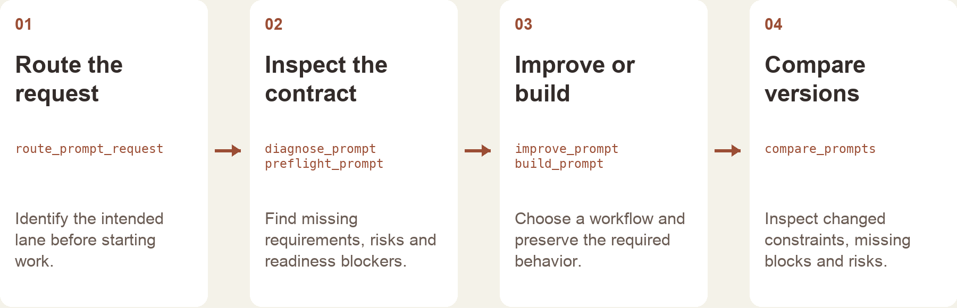
PROMPT COMPASS / RELEASED TOOL AND WORKFLOW DESIGN
Give the tool a clear role
The local tool returns structured checks and routing.
The host assistant handles the conversation and final wording.
Implementation-based portfolio diagram · public beta release, April 2026
02
Notes:
Source: canonical prompt-compass case and public beta3 release. Kyle built and released the tool with installable packages and source downloads. Diagram is reconstructed from implementation, not an original product screenshot. Does not establish customer adoption, employee use, or daily mastery of every Claude product.

Slide 3
COURSERA / ASSESSMENT REVIEW, OCTOBER 2024
Make the review change the material
Review finding | My documented revision
Choices were easy to eliminate | Reworked distractors, especially Questions 7, 8 and 10.
Question 7 tested only a definition | Added application of the concept alongside the definition.
Retry feedback revealed answers | Made feedback more neutral and referred learners to the lesson task.
Task references were incorrect | Corrected references across the assessment.
Paraphrased original review and instructor-response notes · revisions, not final QA signoff
03
Notes:
Source: original October 1,2024 Course Shell Feedback rows16,19,20,22 and instructor-response notes. Four rows summarize actual concerns and recorded revisions. Completed appears in instructor-response status; separate QA ID Approval remains false. No final row-level signoff or measured learner gain claimed. Native editable two-column table.

Slide 4
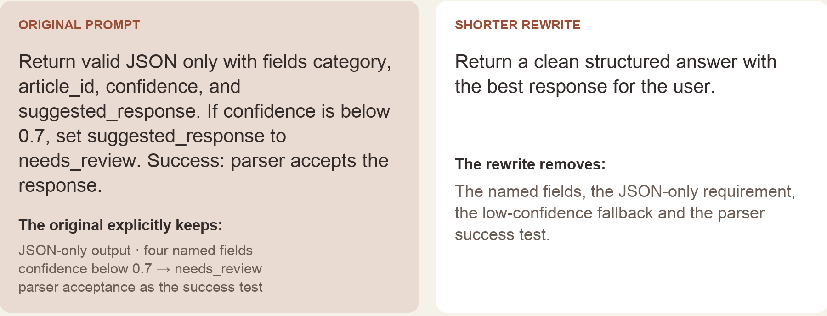
PROMPT COMPASS / LOCAL REGRESSION EXAMPLE, MAY 2026
A cleaner rewrite can lose the task
Original test inputs, excerpted from the portfolio rendering · expected winner: original prompt
04
Notes:
Canonical ai.json prompt-compass case. Original developer-authored regression fixture, reformatted for the portfolio. May2026 local work is separate from the April27 public beta. Deterministic literal-term checks report missing fields in the rewrite; they do not execute an LLM, parse its output or establish model accuracy. The low-confidence threshold is a test instruction, not a deployed enterprise policy.

Slide 5


FLINT / INTERRUPTED AND OFFLINE STATES
Incomplete answer
Connection lost
Recovery follows
the failure
An incomplete answer and a lost connection need different next actions.
I assembled the flows and their next actions into an annotated handoff for engineering.
05
Notes:
Source: selected original Flint interrupted-response and offline design variants, including the March 27, 2026 error-state handoff. Distinct recovery actions follow the state: Ask again or Continue for a partial response, and retry after connection loss with the question preserved. Deliverable: connected flows, interaction states and engineering annotations.

Slide 6
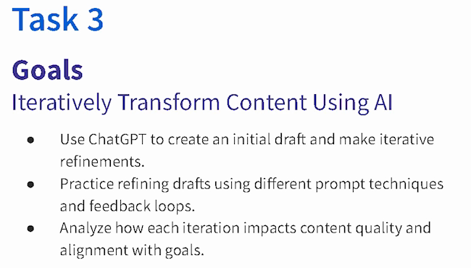
COURSERA · GUIDED PROJECT / ORIGINAL TEACHING, 2024
Make revision
something the
learner can see
I created a beginner project around drafting, reviewing and refining content against a goal.
Published teaching activity. Learner improvement is not measured here.
Original 2024 lesson material · goals excerpt
06
Notes:
Source: canonical ai.json teaching-ai case, original 2024 lesson material and https://www.coursera.org/projects/chatgpt-beginners . Kyle created and taught the published project ChatGPT 4o for Beginners: Create Social Media Content. The crop preserves all original Task 3 goal text without changing source pixels: ai-course-goals.png x80 y85 w650 h370. Learning sequence and teaching materials are direct evidence; enrollment is not a learning-gain measure.

Slide 7

COURSERA / RECORDED PRACTICE SEQUENCE
Review added detail
before accepting it
The lesson made an instruction visible beside the result it changed. That gave learners something concrete to inspect.
The revised answer added detail. In my retrospective, I would make factual checks and length limits more explicit.
Original 2024 recording, Task 3 · 03:35
Fictional practice brand · unchanged source excerpt
07
Notes:
Source: canonical teaching-ai case and original recorded revision instruction at 03:35. The screenshot preserves the historical interface and original text, including typos. Brew Bliss is fictional practice material. This slide shows teaching judgment, not a school deployment, controlled experiment or measured learner result. The retrospective check is a later reflection, not an assessment reported as run.

Slide 8
ASU · FACTORLAB · COURSERA / RELATED EXPERIENCE
Bring the task and
the technical work together
IT support · 2020–2022
Campus systems and hybrid transitions
Learning design · 2022–2024
My ASU work spans IT support, digital learning and voice/chat evaluation. Product research adds practice clarifying the task before proposing a tool.
Digital materials and workshops
Related UX work · 2023 onward
Research, decisions and engineering handoff
Evaluation to propose
My next step would be to test a teaching approach with staff doing real work and measure what changes.
Completion, correction and repeat use
08
Notes:
Experience synthesis, not a new case study. ASU IT Specialist Oct2020–Dec2022; Instructional Designer Apr2022–Oct2024; AI Analyst Feb–Oct2024. Related UX work begins2023. Overlapping roles are not summed, and technical/cross-functional experience is not five years solelyAI orUX. Last row is a proposed measure, not an observed enterprise adoption result.

Slide 9
PROPOSED APPROACH / KONG IT TEAM
Build one workflow with the team using it
Map the actual work
Build a small working version
Ask about the task, data and current effort.
Agree on a safe practice example and what
a useful result must preserve.
Keep required outputs and review visible.
Test ordinary cases and likely failures with
the people doing the task.
Coach and document
Evaluate before expanding
Let a colleague try without step-by-step help.
Document setup, limits and recovery actions.
Revise what remains hard to follow.
Compare completion and correction effort.
Ask whether people use the workflow again.
Separate self-reports from observed use.
09
Notes:
Proposed approach for discussion, informed by Kong Senior AI Enablement Specialist - FE requirements. Not prior Kong work, an agreed rollout, a time-savings guarantee or reported adoption result. Work within company data, permissions and tool-use rules; validate task-specific methods with the IT team.

Slide 10
KYLE HOBSON / Kong · SENIOR AI ENABLEMENT SPECIALIST - FE
Let’s make AI workflows
useful beyond the first demo
Mesa, Arizona. Full U.S. work authorization. Available to start as soon as possible.
JonathanKyleHobson@gmail.com
jonathankhobson.github.io/application-portfolios/kong-ai-enablement
10
Notes:
Tailored Senior AI Enablement Specialist - FE packet. Related experience spans ASU learning design, Coursera teaching and assessment revisions, Prompt Compass and product research. No enterprise adoption metrics, company-wide training ownership, financial-domain expertise or mastery of each Claude product asserted. Mesa disclosed; Arizona payroll remains unconfirmed.

