Slide 1

KYLE HOBSON / APPLICATION TO INOVALON
Product learning
for Inovalon
Selected work in guided practice
and accurate software explanations
Instructional Designer
01
Notes:
Prepared for the Inovalon Instructional Designer role. Job source: https://www.inovalon.com/careers/job/?gh_jid=7919353003 . The approved paper-path illustration is decorative, not project evidence.

Slide 2

ARIZONA STATE UNIVERSITY / INSTRUCTIONAL DESIGNER
Learning design
grounded in the task
At ASU Knowledge Enterprise, I developed digital learning materials and workshops with accessibility improvements and AI-supported content workflows.
April 2022–October 2024
MS in User Experience · BS in Technical Communication
02
Notes:
Reviewed career evidence: ASU Knowledge Enterprise, Instructional Designer, April 2022–October 2024. MS User Experience with UX Research concentration, ASU, May 2024; BS Technical Communication with UX concentration, ASU, May 2023. The concise role scope is reviewed evidence; this slide does not claim specific SCORM/LMS production tools or measured learning gains. Public profile: https://www.linkedin.com/in/jonathankylehobson/ .

Slide 3
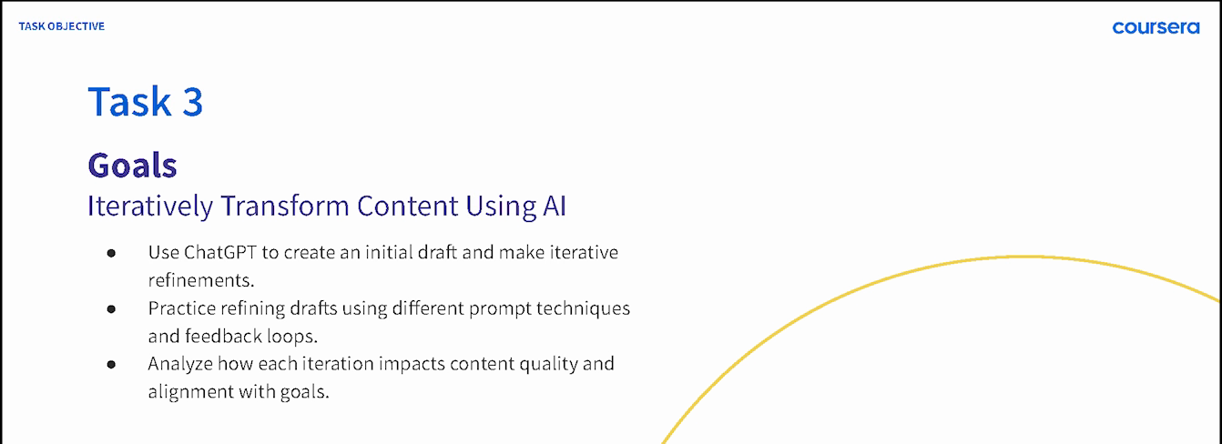
COURSERA / GUIDED PROJECT INSTRUCTOR, 2024
A practical sequence for beginners
ChatGPT 4o for Beginners: Create Social Media Content
Published in 2024 · 4,700+ enrollments as of September 2026
03
Notes:
Source: original 2024 lesson materials and the official Coursera page https://www.coursera.org/projects/chatgpt-beginners . The image is an original course slide. Enrollments describe reach, not course completion or measured skill improvement.

Slide 4
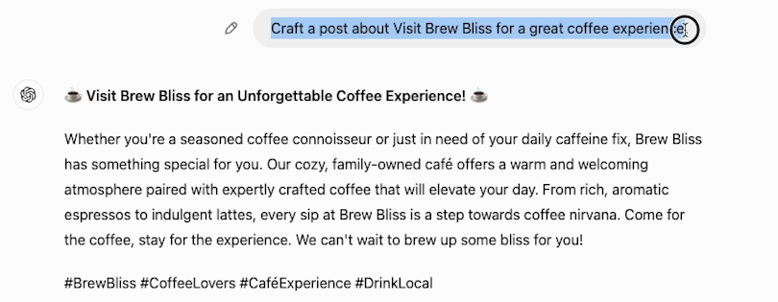
COURSERA / ORIGINAL DEMONSTRATION
A first attempt gives learners
something to revise
The next step is to make the request more specific and compare the result.
04
Notes:
Source: original 2024 Task 3 recording at 02:30. This initial fictional Brew Bliss cafe draft gives learners material to inspect and revise. Later lesson steps demonstrate a more specific instruction and its resulting draft. It is not a client campaign or evidence of measured learner proficiency. Official course: https://www.coursera.org/projects/chatgpt-beginners .

Slide 5


FACTORLAB / SMARTTAGIT FLINT DESIGN
Recovery guidance
has to describe
the real state
An interrupted answer and a lost connection needed different messages and actions. I organized those states in Figma and annotated the behavior for engineering.
Relevant to software documentation: explain what happened and what the person can do next.
05
Notes:
FactorLab UX Designer & Researcher (Contract), October 2025–Present. Original Kyle-authored Figma designs and engineering annotations, reviewed in the September 2026 portfolio. Design and handoff evidence; exact pictured state is not claimed to be shipped. Its relevance to end-user documentation is adjacent: Kyle is explaining product behavior, not claiming this is a Inovalon implementation guide. Public case: https://jonathankhobson.github.io/portfolio/design/case/flint/ .

Slide 6
PROMPT COMPASS / DESIGNED LOCAL REGRESSION CASE
A rewrite must preserve the requirement
ORIGINAL FIXTURE PROMPT
SHORTER REWRITE
Return valid JSON only with fields category, article_id, confidence, and suggested_response. If confidence is below 0.7, set suggested_response to needs_review. Success: parser accepts the response.
Return a clean structured answer with the best response for the user.
Expected winner: the original
The rewrite loses named fields, JSON-only output and the review condition.
06
Notes:
Original developer-authored Prompt Compass local regression fixture, May 2026. Both prompts are exact fixture values. This is a designed evaluation example, not a client incident, production-model benchmark, or measured ROI. The public beta release is https://github.com/JonathanKHobson/prompt-compass/releases/tag/v0.1.0-beta.3 . The example shows why instructional and technical wording must preserve the operational requirement.

Slide 7
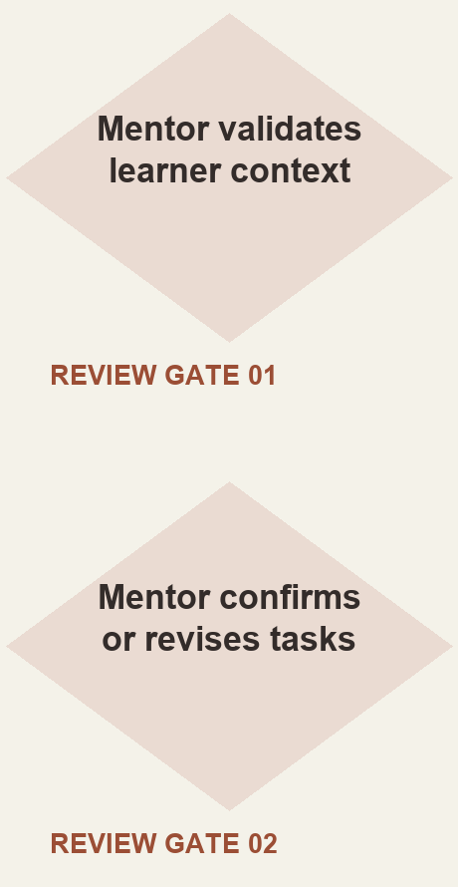
ASU LEARNING INNOVATIONS / AI ANALYST, FEB–OCT 2024
Mentor review shaped
the learner workflow
I proposed staged generation of personalized learner tasks, with a mentor checking the context and the output.
Simplified reconstruction of my 2024 proposal. Deployment and time savings were not established.
07
Notes:
Original ASU for Life collaborative prompt architecture attributes the displayed proposed approach to Kyle. The reconstruction shows the mentor review steps without claiming production deployment, model training, or measurable savings. Reviewed AI case: https://jonathankhobson.github.io/portfolio/ai/ .

Slide 8
INOVALON / PROPOSED FIRST CONTRIBUTION
A product task becomes
a learning activity
For an on-demand module, I would work with your subject matter experts to connect the product task with practice and a measurable learning goal.
Agree on the starting state and a successful result.
Show a worked example, including a recovery path.
Ask the learner to complete a different example and explain a decision.
Review errors with the expert and revise the material.
Proposed approach for discussion; no Inovalon product or client access is implied.
08
Notes:
Proposed approach for discussion. The Inovalon role involves audience-appropriate learning methodologies, assessments, measurement and collaboration with subject matter experts. This slide does not report past work for Inovalon, access to healthcare data, or measured learning gains. Primary source: https://www.inovalon.com/careers/job/?gh_jid=7919353003 . SCORM/LMS production experience is not claimed.

Slide 9
KYLE HOBSON / INOVALON APPLICATION
Instructional Designer
Based in Mesa, Arizona. Available for U.S. remote work.
Authorized to work without sponsorship. Available ASAP.
JonathanKyleHobson@gmail.com
View the tailored Inovalon portfolio
09
Notes:
Contact and work-authorization statements are candidate-confirmed for this application. Portfolio link targets the separately prepared Inovalon site.

