Slide 1

KYLE HOBSON / Coder · AI ENABLEMENT ENGINEER
AI workflows
people can use
Released MCP tooling, recovery design
and original AI teaching.
AI Enablement Engineer application · September 2026
01
Notes:
Selected work for Coder AI Enablement Engineer: https://jobs.ashbyhq.com/coder/44d219cc-c54f-48f6-a118-17909461ed30 . Prior work shown includes independent Prompt Compass development, FactorLab interaction design and Coursera instruction.

Slide 2
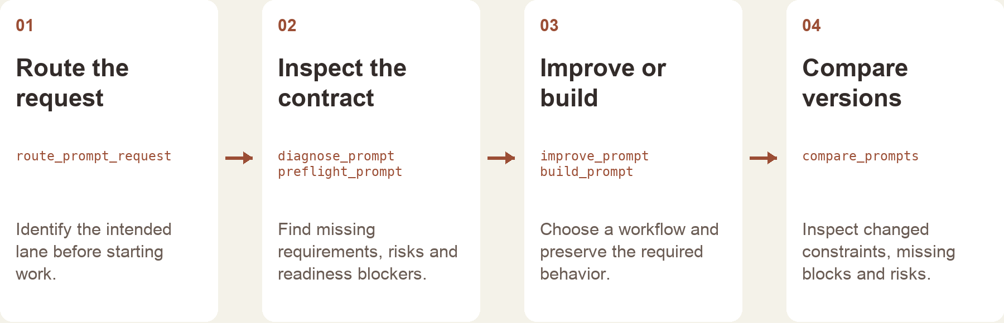
PROMPT COMPASS / RELEASED TOOL AND WORKFLOW DESIGN
Prompt Compass workflow
The local tool returns structured checks and routing.
The host assistant handles the conversation and final wording.
Implementation-based portfolio diagram · public beta release, April 2026
02
Notes:
Prompt Compass public beta: https://github.com/JonathanKHobson/prompt-compass/releases/tag/v0.1.0-beta.3 . The diagram explains a selected workflow reconstructed from the implementation. The local tool returns structured analysis and routing; the host assistant supplies conversation and final wording. Later local features are distinct from the April 2026 beta. No employee or customer adoption is claimed.

Slide 3
COURSERA / ASSESSMENT REVIEW, OCTOBER 2024
Assessment review and revision
Review finding | My documented revision
Choices were easy to eliminate | Reworked distractors, especially Questions 7, 8 and 10.
Question 7 tested only a definition | Added application of the concept alongside the definition.
Retry feedback revealed answers | Made feedback more neutral and referred learners to the lesson task.
Task references were incorrect | Corrected references across the assessment.
Paraphrased original review and instructor-response notes · revisions, not final QA signoff
03
Notes:
Original October 1, 2024 Course Shell Feedback and instructor responses. These four rows summarize actual review concerns and Kyle’s recorded revisions. Completed revision status does not establish separate final QA approval or measured learner improvement. Published course: https://www.coursera.org/projects/chatgpt-beginners .

Slide 4
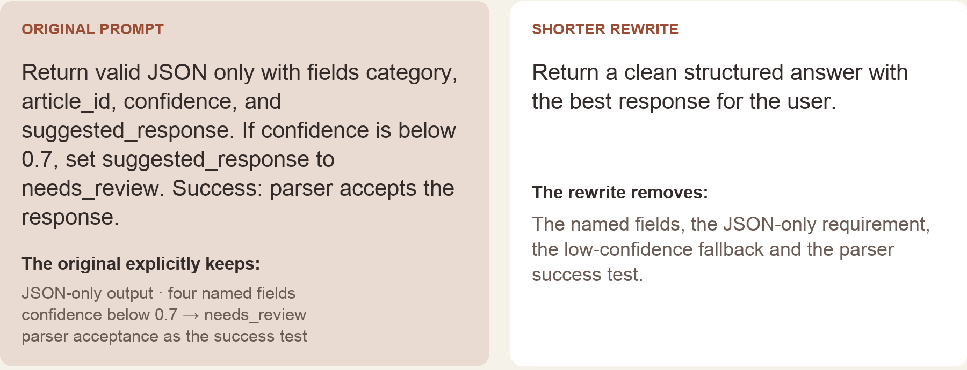
PROMPT COMPASS / LOCAL REGRESSION EXAMPLE, MAY 2026
Requirements lost in a rewrite
Original test inputs, excerpted from the portfolio rendering · expected winner: original prompt
04
Notes:
Prompt Compass local regression example, May 2026. Exact test instructions appear in an implementation-grounded portfolio rendering. The literal-term checks report missing requirements in the shorter prompt. They do not execute an LLM, parse generated output or validate the confidence threshold. This later local example is separate from the public April beta.

Slide 5


FLINT / INTERRUPTED AND OFFLINE STATES
Incomplete answer
Connection lost
Recovery from
interrupted answers
An incomplete answer and a lost connection need different next actions.
I assembled the flows and their next actions into an annotated handoff for engineering.
05
Notes:
Original FactorLab Flint incomplete-answer and offline design variants. The March 27, 2026 handoff separates partial response, stopped response and connection loss, with different next actions. Work shown is interaction design and annotated engineering handoff; no deployed adoption result is claimed.

Slide 6
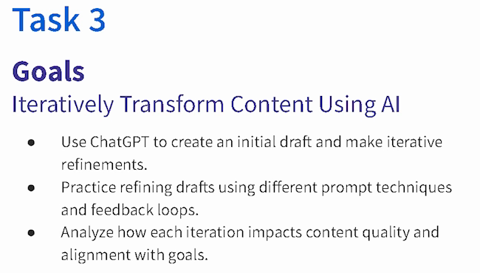
COURSERA · GUIDED PROJECT / ORIGINAL TEACHING, 2024
AI revision as
guided practice
I created a beginner project around drafting, reviewing and refining content against a goal.
Published teaching activity. Learner improvement is not measured here.
Original 2024 lesson material · goals excerpt
06
Notes:
Original 2024 teaching material for ChatGPT 4o for Beginners: Create Social Media Content. Kyle created and taught this published Guided Project. The displayed Task 3 goals connect drafting, revision, feedback and goal alignment. https://www.coursera.org/projects/chatgpt-beginners . No measured learning gain is asserted.

Slide 7

COURSERA / RECORDED PRACTICE SEQUENCE
Original lesson
revision sequence
The lesson made an instruction visible beside the result it changed. That gave learners something concrete to inspect.
The revised answer added detail. In my retrospective, I would make factual checks and length limits more explicit.
Original 2024 recording, Task 3 · 03:35
Fictional practice brand · unchanged source excerpt
07
Notes:
Original Coursera Task 3 teaching recording, 2024, at 03:35. The displayed revision instruction preserves historical wording and typos. Brew Bliss is fictional practice material. The reflection about checking added facts and length is a retrospective recommendation, not a reported assessment result.

Slide 8
RELATED EXPERIENCE
Support, research
and implementation
ASU IT support · 2020–2022
Campus updates and hybrid transitions
FactorLab Flint · 2026
I have worked on the technical system and on the explanation someone needs to use it. That includes ASU IT support, product research and an independently released AI tool.
Failure conditions and recovery actions
Coursera · 2024
Guided practice and assessment revision
Prompt Compass · 2026
For Coder, I would connect employee feedback to a small, inspectable change and test how another person uses it.
Explicit requirements and local checks
08
Notes:
Selected related experience: ASU IT Specialist October 2020–December 2022; FactorLab contract since October 2025; Coursera Guided Project instructor 2024; Prompt Compass independent creation and public beta 2026. ASU instructional design April 2022–October 2024 and AI Analyst February–October 2024 overlap. These roles are not added to claim extra tenure. Coder contribution described here is proposed.

Slide 9
PROPOSED CONTRIBUTION / CODER SMART AI
A blocked task becomes a reusable path
Work through the blocked task
Choose the right level of fix
Watch the employee try the task.
Identify the expected output and the point
where instructions or tooling stop helping.
Separate a one-time issue from a pattern.
Review examples with the Smart AI lead
before changing a shared workflow.
Build a small reusable example
Try it with another person
Make the required inputs and outputs clear.
Document setup, access and recovery.
Keep a failure example beside the working one.
Ask someone to use it without the author.
Record where they need help or correction.
Use that evidence to revise the path.
09
Notes:
Proposed discussion approach for Coder AI Enablement Engineer, https://jobs.ashbyhq.com/coder/44d219cc-c54f-48f6-a118-17909461ed30 . The role connects employee blockers, recurring needs, reusable skills and journeys with an existing Smart AI roadmap. This is not prior Coder work or a committed program. Any access, infrastructure or shared workflow change would follow Coder permissions and review practices. No measured adoption or savings is asserted.

Slide 10
KYLE HOBSON / Coder · AI ENABLEMENT ENGINEER
Let’s work through
the blocked task
Mesa, Arizona. Full U.S. work authorization. Available to start as soon as possible.
JonathanKyleHobson@gmail.com
jonathankhobson.github.io/application-portfolios/coder-ai-enablement
10
Notes:
Related work includes released local MCP tooling, product interaction design and technical teaching. Available in Mesa, Arizona with full United States work authorization. No prior Coder platform operation, production infrastructure ownership or enterprise adoption is asserted.

