Slide 1

KYLE HOBSON · SELECTED WORK FOR WIKIMEDIA
Learning for
participation
Published instruction.
Learning workflows.
Research in a volunteer community.
Lead Learning Experience Designer application
September 2026
01
Notes:
Selected portfolio for Wikimedia Foundation Lead Learning Experience Designer, requisition 1139, job 8136610. Current role verified September 8, 2026 via https://boards-api.greenhouse.io/v1/boards/wikimedia/jobs/8136610. Candidate sources: portfolio-suite/evidence/career/claim-map.md and evidence/ai/source-ledger.md. Portrait is user-supplied identity material.

Slide 2
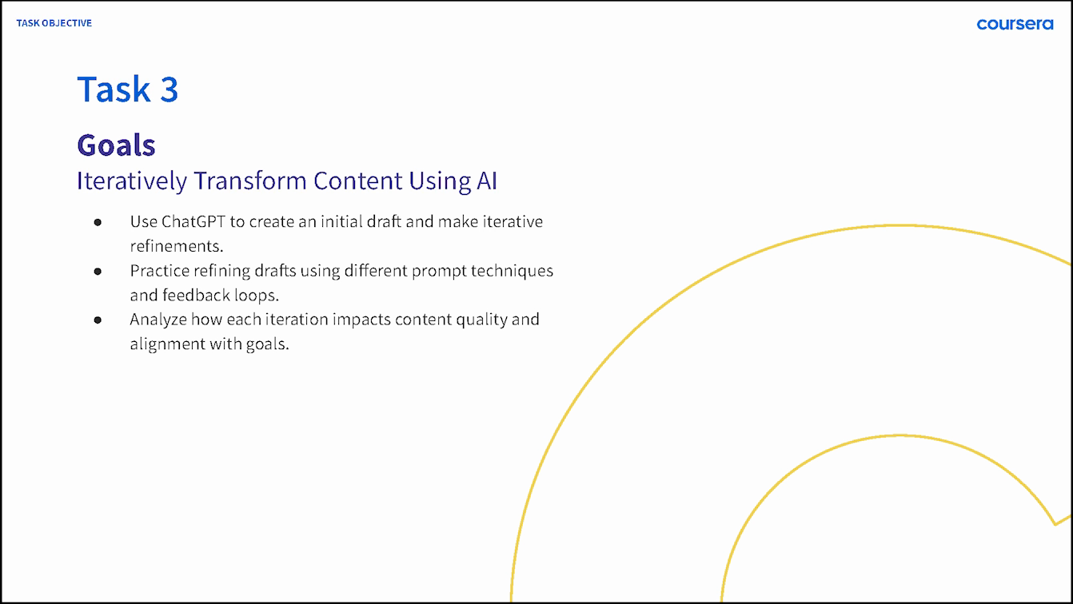
COURSERA · GUIDED PROJECT INSTRUCTOR, 2024
A beginner can
practice the decision
I built a one-hour guided project around a familiar content task: draft a social post, inspect the result, and make a purposeful revision.
4,700+ enrollments
as of September 2026
02
Notes:
Original Coursera lesson goals and published project: https://www.coursera.org/projects/chatgpt-beginners. Kyle created and taught ChatGPT 4o for Beginners: Create Social Media Content in 2024. Official September 2026 page reports over 4,700 enrollments. Enrollment is not completion or demonstrated learning improvement. Source: portfolio-suite/content/ai.json teaching-ai and evidence/ai/source-ledger.md.

Slide 3
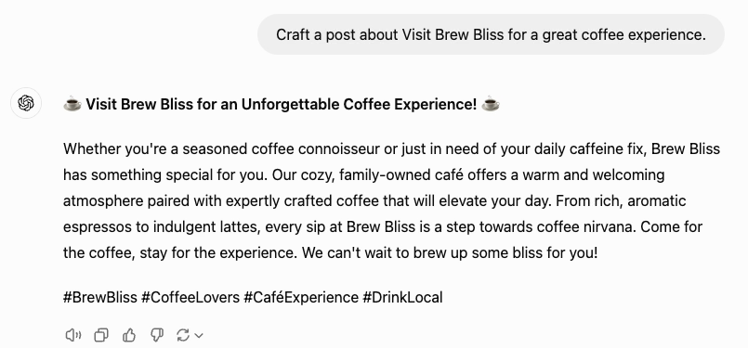
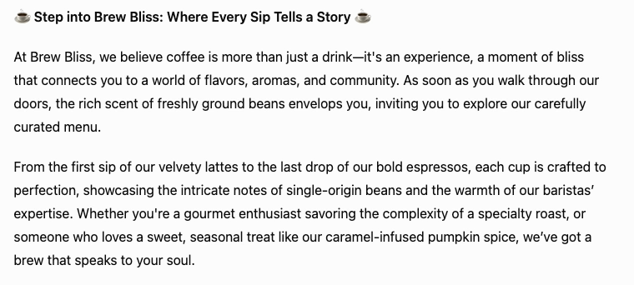
COURSERA · ORIGINAL TEACHING DEMONSTRATION
The revision is visible
Initial café-post draft
Later draft after a more specific request
The second draft adds detail. Learners still need to check that the details fit the brief.
Original 2024 recording excerpts · fictional practice brand · historical interface
03
Notes:
Original Task 3 recording at 03:35 and 04:00; unchanged historical pixels. The revision requests sensory details, engaging language, and a friendly tone. Later output adds coffee descriptions not established by the brief. This is a teaching demonstration, not a client campaign, controlled experiment, or learner outcome measurement. Source: portfolio-suite/content/ai.json teaching-ai and its original-recording evidence.

Slide 4
COURSERA · RETROSPECTIVE ASSESSMENT PROPOSAL
Checking transfer
I would give learners a different task and ask them to explain the next revision.
01 Which detail is unsupported?
02 What would you change in the instruction?
03 How will you judge the next answer?
Proposed follow-up assessment; these questions were not a reported learner study.
04
Notes:
Retrospective proposal from the reviewed teaching-ai case reflection and transfer assessment, portfolio-suite/content/ai.json. This slide does not claim these exact questions were used in the original Coursera course, or that transfer was measured. It connects a limitation visible in the actual recorded teaching example to a concrete next evaluation.

Slide 5
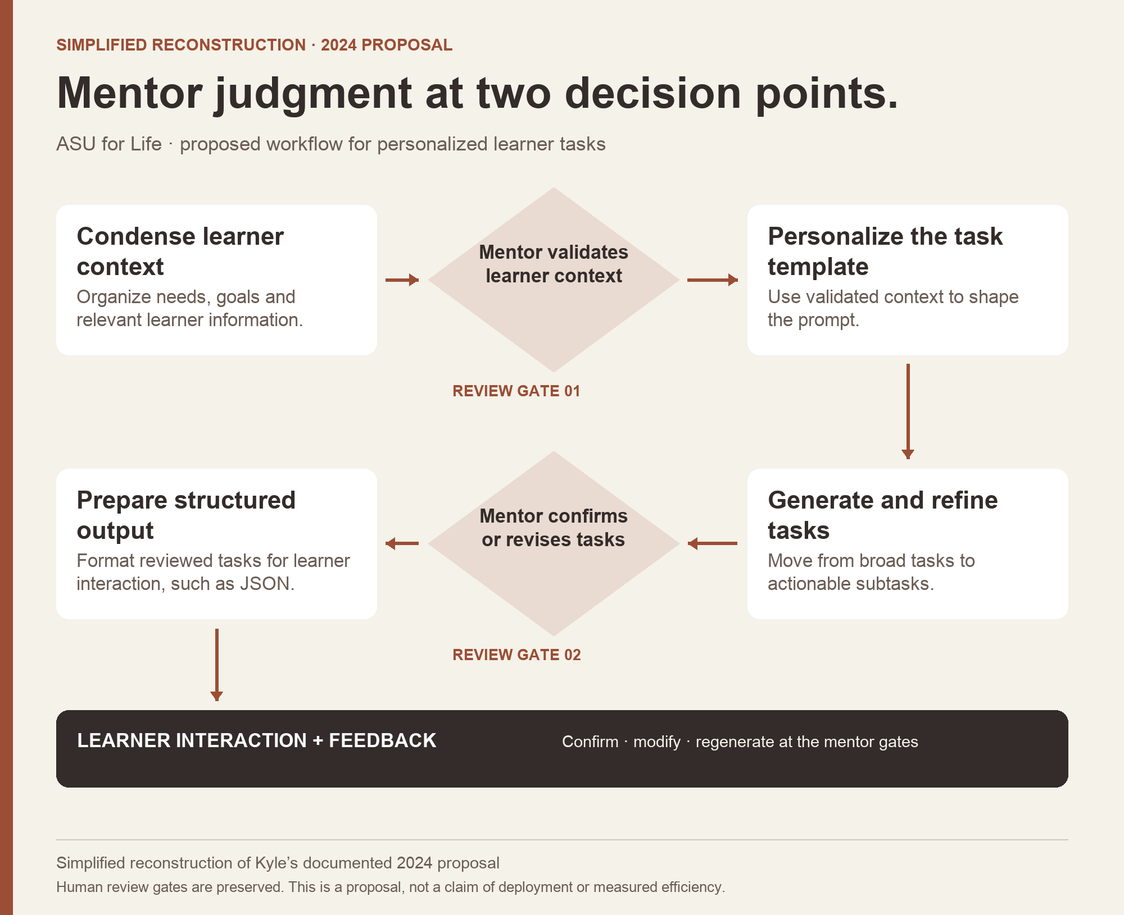
ASU · AI ANALYST, 2024
Mentor review
before learner
delivery
I proposed review of learner context and generated tasks at two points in the workflow.
Documented proposal
Simplified reconstruction
05
Notes:
ASU Learning Innovations AI Analyst, February–October 2024. The original collaborative architecture source explicitly labels Kyle’s proposed section. The displayed diagram is a reviewed simplified portfolio reconstruction. Deployment, learner outcomes, and time savings are not established. Source: portfolio-suite/evidence/career/claim-map.md C14/S18 and public/assets/ai-asu-workflow.png.

Slide 6
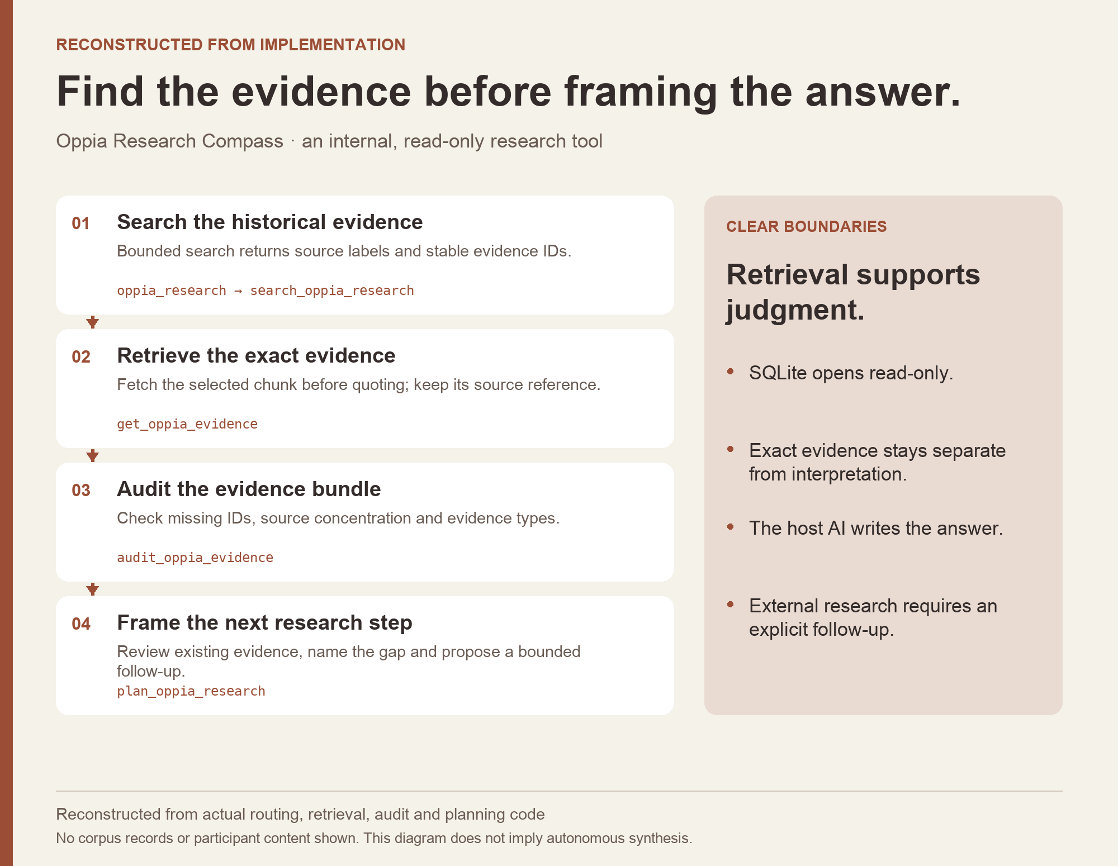
OPPIA · CURRENT UX RESEARCH LEAD, VOLUNTEER
Research that
keeps its source
I review lesson-player behavior with the team, including what happens to progress when a learner leaves.
I also built an internal research tool that keeps source references and flags evidence gaps.
06
Notes:
Oppia volunteer since September 2025; current signature establishes UX Research Lead in September 2026, not the exact lead appointment date. Lesson-player review source: portfolio-suite/evidence/career/claim-map.md C13/S13. Internal tool source: C21/S26, evidence/ai/source-ledger.md, content/ai.json research-compass. Diagram is a public-safe implementation reconstruction with no private corpus records. Tool availability and packaging are not team adoption or improved learner outcomes.

Slide 7
WIKIMEDIA · PROPOSED APPROACH
A first learning experiment
Choose one contributor task with the volunteers who support it.
Observe the attempt
Build the smallest useful aid
Check independent use
Find the point where people hesitate, get stuck, or need help.
Observe the next attempt and listen to contributor feedback.
Try a demonstration, WikiLearn activity, or guidance in the workflow.
The task and format would be chosen with contributors; this is an approach, not prior Wikimedia work.
07
Notes:
Proposed approach informed by the current Wikimedia job description, which covers contributor needs, WikiLearn, multimedia, embedded learning, prototyping, and evaluation. Primary source: https://job-boards.greenhouse.io/wikimedia/jobs/8136610, verified September 8, 2026. Kyle does not claim prior Wikimedia employment, community membership, or WikiLearn administration.

Slide 8
LEAD LEARNING EXPERIENCE DESIGNER APPLICATION
Kyle Hobson
MS User Experience · BS Technical Communication
BS Electronic Media
Mesa, Arizona · U.S. remote work · Available ASAP
JonathanKyleHobson@gmail.com
Portfolio selected for Wikimedia
08
Notes:
Candidate education and public identity from portfolio-suite/evidence/career/claim-map.md. Current availability confirmed by candidate September 8, 2026. Contact links are clickable. The portfolio URL is the intended application destination; publication is a separate action controlled by the campaign owner.

