Slide 1

KYLE HOBSON / APPLICATION TO WELO DATA
Clear instructions.
Attentive facilitation.
Teaching, conversational AI
and live group experience
Hydrus - Session Director — English (US) · U.S. remote
01
Notes:
Prepared for Hydrus - Session Director — English (US), Welo Data / Welo Global. Job: https://jobs.lever.co/weloglobal/a0d8ec0f-0912-4c77-a726-03510ba76b8a . The approved paper-path illustration is decorative, not project evidence. Kyle does not claim professional recording-session direction or audio-engineering tenure.

Slide 2
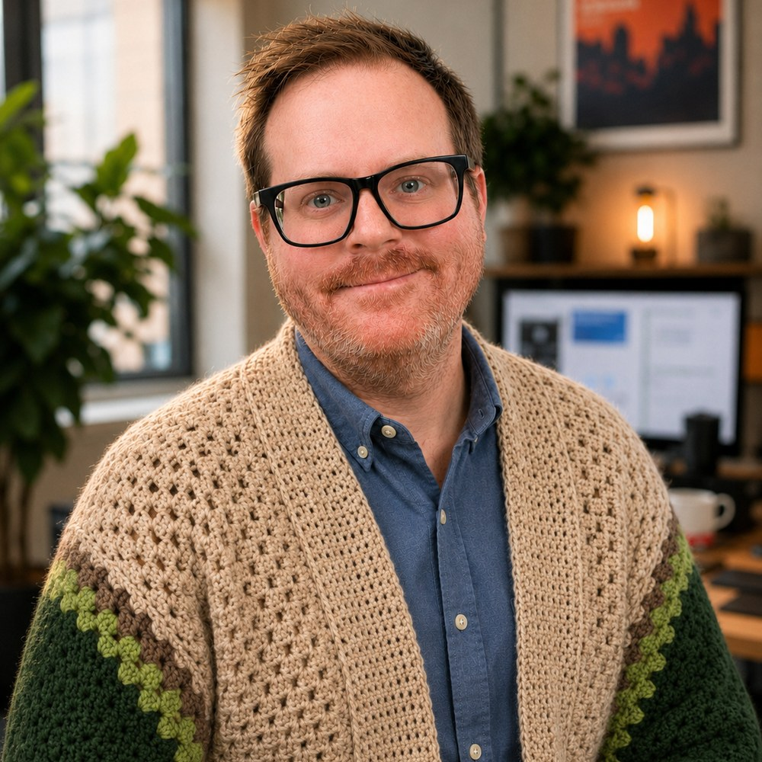
KYLE HOBSON / RELEVANT BACKGROUND
Teaching and
live facilitation
At ASU, I developed learning materials and workshops. For Coursera, I created original recorded demonstrations for a beginner AI project.
I also prepare and run 3–4-hour tabletop role-playing sessions for mixed-experience groups, online and in person.
02
Notes:
Reviewed career profile: ASU Knowledge Enterprise Instructional Designer, April 2022–October 2024; Coursera Guided Project Instructor, 2024. GM evidence: Pro GM/resume_build/src/content.js and candidate clarification of approximately five professional years, with longer personal experience. No public tenure estimate is needed here. A GM table is adjacent facilitation experience, not a professional recording-session credit. Public GM portfolio: https://jonathankhobson.github.io/shareables/s/gamemasterkyle-professional-game-master-portfolio/ .

Slide 3
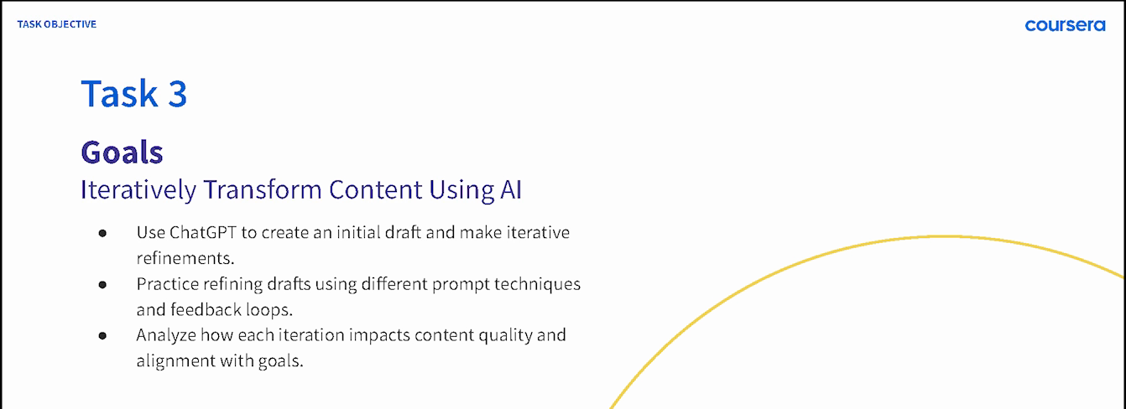
COURSERA / GUIDED PROJECT INSTRUCTOR, 2024
A practice sequence people can follow
ChatGPT 4o for Beginners: Create Social Media Content
Original lesson material · Published Coursera Guided Project, 2024
03
Notes:
Source: original 2024 lesson materials and official Coursera page https://www.coursera.org/projects/chatgpt-beginners . Kyle created the course demonstrations and revised quiz content. The image is an original course slide. No measured learning gain is claimed.

Slide 4
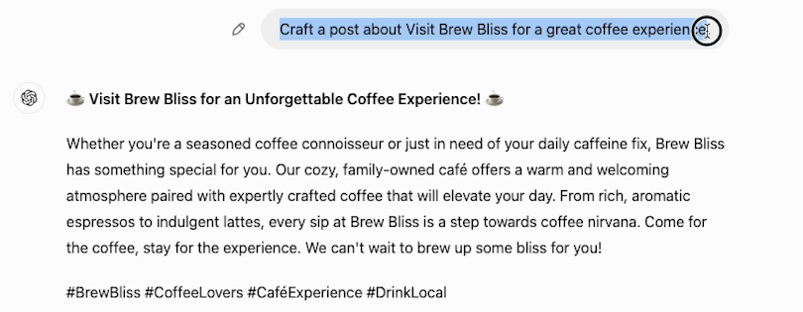
COURSERA / ORIGINAL DEMONSTRATION
Feedback tied to a specific task
The learner makes the request more specific, then compares the resulting draft.
04
Notes:
Original 2024 Task 3 recording excerpt, initial fictional Brew Bliss draft. Subsequent lesson steps add a more specific instruction and inspect the resulting draft. This supports clear demonstration and revision, not proof of recording-session direction or measured learner proficiency. Official course: https://www.coursera.org/projects/chatgpt-beginners .

Slide 5


FACTORLAB / SMARTTAGIT FLINT DESIGN
Different failures
need different
instructions
An interrupted answer and a lost connection needed different messages and actions. I organized those states in Figma and annotated the behavior for engineering.
For a live session, the connection is practical: identify the issue before asking someone to repeat a task.
05
Notes:
FactorLab UX Designer & Researcher (Contract), October 2025–Present. Original Kyle-authored Figma designs and engineering annotations. Design/handoff evidence; exact pictured state is not claimed to be shipped. Relevance to recording-session troubleshooting is adjacent, not direct audio-production experience. Public case: https://jonathankhobson.github.io/portfolio/design/case/flint/ .

Slide 6
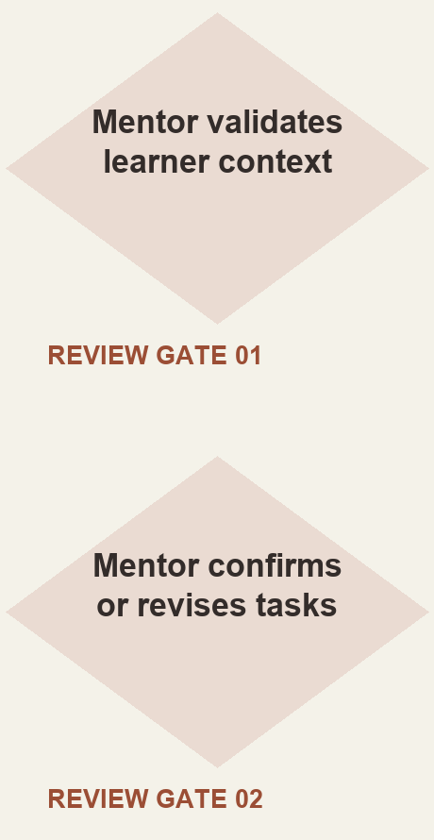
ASU LEARNING INNOVATIONS / AI ANALYST, FEB–OCT 2024
Human review in
a proposed AI workflow
I proposed staged generation of personalized learner tasks, with a mentor checking the context and the output.
Simplified reconstruction of my 2024 proposal. Deployment and time savings were not established.
06
Notes:
Original ASU for Life collaborative prompt architecture attributes the proposed approach to Kyle. The approved source reconstruction makes mentor checkpoints visible without claiming deployment, model training or savings. Reviewed AI portfolio: https://jonathankhobson.github.io/portfolio/ai/ .

Slide 7
WELO DATA / PROPOSED SESSION APPROACH
A clear brief and focused feedback
I would begin with your calibration process and approved recording requirements.
Brief the participant and confirm the task is understood.
Coach one specific adjustment while preserving natural delivery.
Pause to check a technical issue against the project requirements.
Log the issue, repeat decision and any question for the lead.
Proposed approach; Welo’s calibration, equipment and procedures would guide the work.
07
Notes:
Proposed approach, not a completed Hydrus engagement or claim of audio-engineering expertise. Employer specifications and calibration are needed before independent work. Native US English, recording-session experience and real-time technical monitoring appear in the role requirements. Source: https://jobs.lever.co/weloglobal/a0d8ec0f-0912-4c77-a726-03510ba76b8a .

Slide 8
KYLE HOBSON / WELO DATA APPLICATION
Hydrus
Session Director
Mesa, Arizona · Available for U.S. remote work
BS Electronic Media · ASU learning and conversational AI work
JonathanKyleHobson@gmail.com
View the tailored Hydrus portfolio
08
Notes:
Candidate confirmed Mesa location, U.S. work authorization without sponsorship and ASAP start. BS Electronic Media, Northern Arizona University, May 2014. Portfolio link targets the separately prepared Hydrus site.

