Slide 1

KYLE HOBSON / APPLICATION TO GROW WITH TREES
Learning for
Grow With Trees
Instructional design, mobile workflows
and AI-assisted web content
Contract Instructional Designer
01
Notes:
Prepared for the Grow With Trees Contract Instructional Designer role. Job source: https://www.linkedin.com/jobs/view/contract-instructional-designer-at-grow-with-trees-4451414354 . The approved paper-path illustration is decorative, not project evidence.

Slide 2
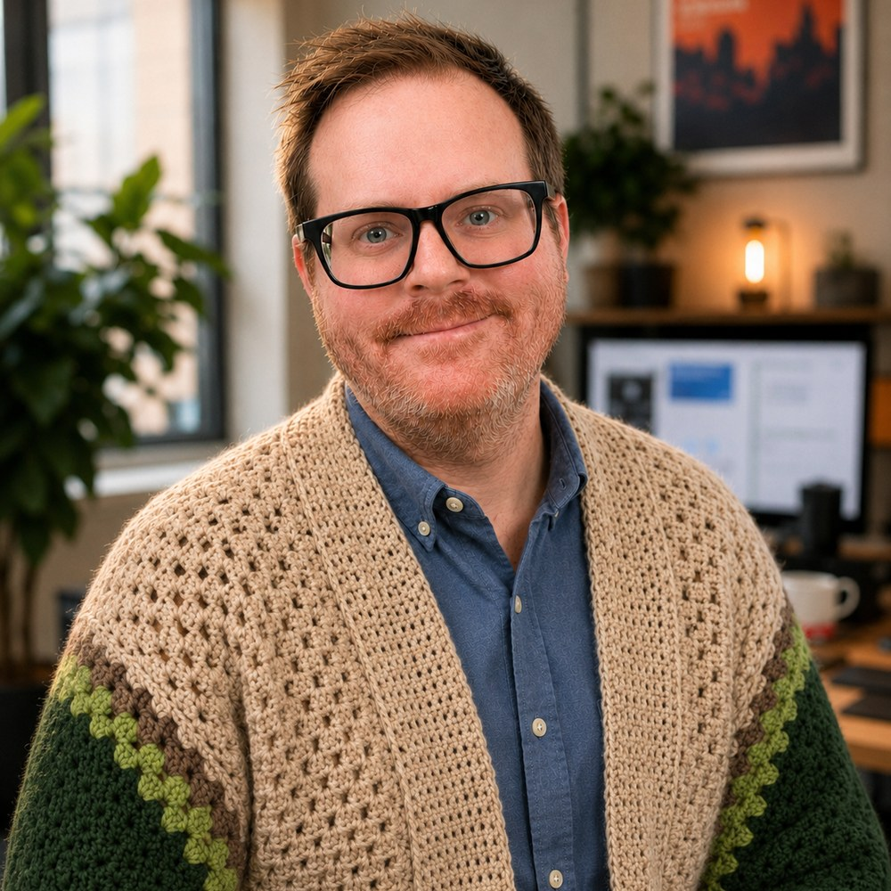
ARIZONA STATE UNIVERSITY / INSTRUCTIONAL DESIGNER
Learning design
grounded in the task
At ASU Knowledge Enterprise, I developed digital learning materials and workshops with accessibility improvements and AI-supported content workflows.
April 2022–October 2024
MS in User Experience · BS in Technical Communication
02
Notes:
Reviewed career evidence: ASU Knowledge Enterprise, Instructional Designer, April 2022–October 2024. MS User Experience with UX Research concentration, ASU, May 2024; BS Technical Communication with UX concentration, ASU, May 2023. The concise role scope is reviewed evidence; this slide does not claim specific SCORM/LMS production tools or measured learning gains. Public profile: https://www.linkedin.com/in/jonathankylehobson/ .

Slide 3
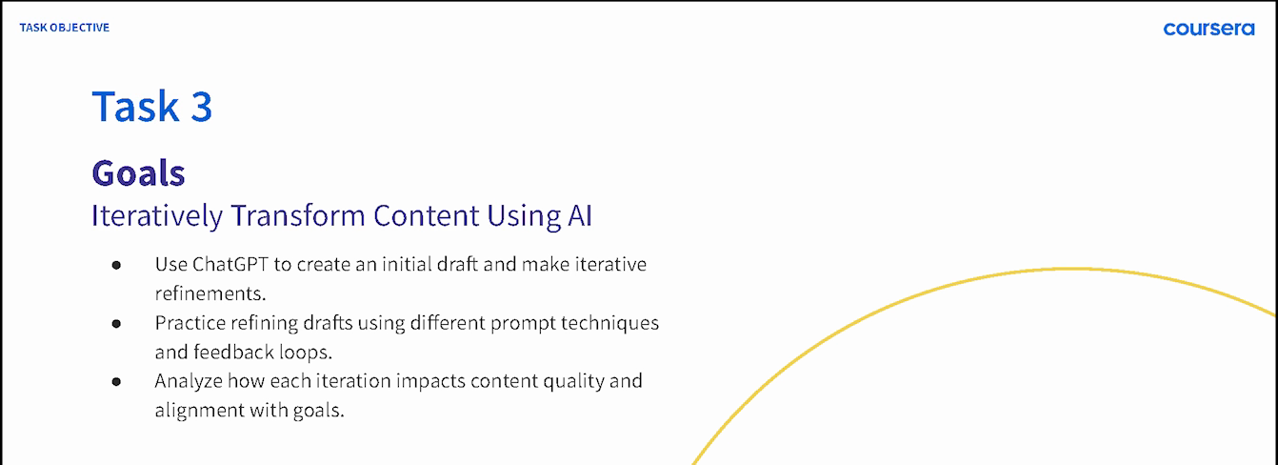
COURSERA / GUIDED PROJECT INSTRUCTOR, 2024
A practical sequence for beginners
ChatGPT 4o for Beginners: Create Social Media Content
Published in 2024 · 4,700+ enrollments as of September 2026
03
Notes:
Source: original 2024 lesson materials and the official Coursera page https://www.coursera.org/projects/chatgpt-beginners . The image is an original course slide. Enrollments describe reach, not course completion or measured skill improvement.

Slide 4
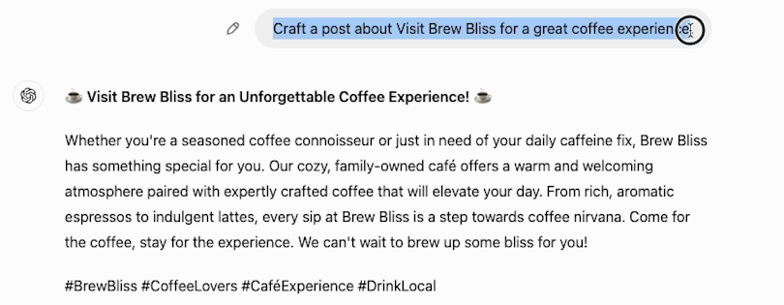
COURSERA / ORIGINAL DEMONSTRATION
A first attempt gives learners
something to revise
The next step is to make the request more specific and compare the result.
04
Notes:
Source: original 2024 Task 3 recording at 02:30. This initial fictional Brew Bliss cafe draft gives learners material to inspect and revise. Later lesson steps demonstrate a more specific instruction and its resulting draft. It is not a client campaign or evidence of measured learner proficiency. Official course: https://www.coursera.org/projects/chatgpt-beginners .

Slide 5


FACTORLAB / SMARTTAGIT FLINT DESIGN
Mobile guidance
needs a clear
recovery path
An interrupted answer and a lost connection needed different messages and actions. I organized those states in Figma and annotated the behavior for engineering.
Relevant to mobile learning: give people a clear next step when the expected flow breaks.
05
Notes:
FactorLab UX Designer & Researcher (Contract), October 2025–Present. Original Kyle-authored Figma designs and engineering annotations, reviewed in the September 2026 portfolio. Design and handoff evidence; exact pictured state is not claimed to be shipped. Its relevance to end-user documentation is adjacent: Kyle is explaining product behavior, not claiming this is a Grow With Trees implementation guide. Public case: https://jonathankhobson.github.io/portfolio/design/case/flint/ .

Slide 6
PROMPT COMPASS / DESIGNED LOCAL REGRESSION CASE
A rewrite must preserve the requirement
ORIGINAL FIXTURE PROMPT
SHORTER REWRITE
Return valid JSON only with fields category, article_id, confidence, and suggested_response. If confidence is below 0.7, set suggested_response to needs_review. Success: parser accepts the response.
Return a clean structured answer with the best response for the user.
Expected winner: the original
The rewrite loses named fields, JSON-only output and the review condition.
06
Notes:
Original developer-authored Prompt Compass local regression fixture, May 2026. Both prompts are exact fixture values. This is a designed evaluation example, not a client incident, production-model benchmark, or measured ROI. The public beta release is https://github.com/JonathanKHobson/prompt-compass/releases/tag/v0.1.0-beta.3 . The example shows why instructional and technical wording must preserve the operational requirement.

Slide 7
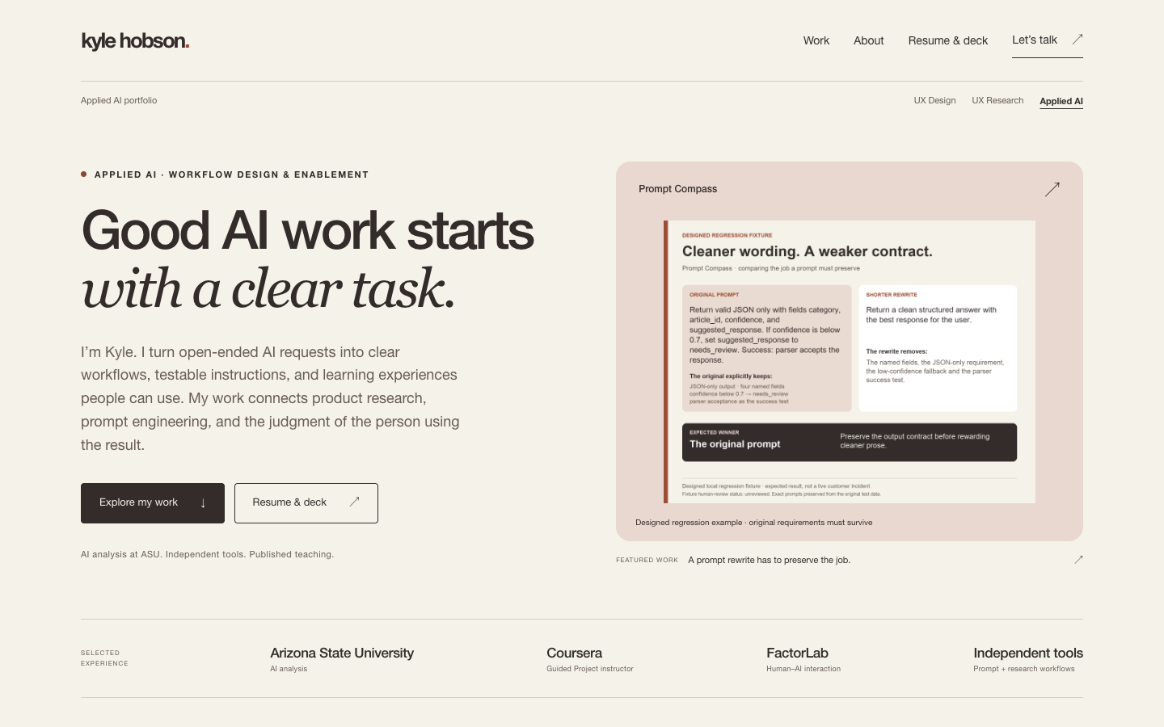
INDEPENDENT PORTFOLIO / AI-ASSISTED DEVELOPMENT
Web content with
editable source
I use Codex and GitHub to build and maintain custom HTML/CSS portfolio pages, alongside local AI tools.
The workflow includes desktop and mobile review, keyboard focus, source-image viewing, and download checks.
Source: github.com/JonathanKHobson/portfolio
07
Notes:
The current independently owned portfolio uses custom HTML/CSS with source and version history on GitHub. It was built with AI assistance. This is direct current project evidence, not a claim of years of unassisted frontend engineering or SCORM production. Public repository: https://github.com/JonathanKHobson/portfolio . The screenshot is a reviewed 2026 desktop capture from the original portfolio.

Slide 8
GROW WITH TREES / PROPOSED APPROACH
Build a short practice module
I would begin with the field task a utility professional needs to perform and the evidence that they understood it.
Define the task and review source material with a subject expert.
Pair an approved example with a short practice decision.
Test the learning flow on a phone and review the feedback.
Agree on SCORM packaging and LMS acceptance requirements.
Proposed approach. SCORM packaging and LMS validation remain a development area.
08
Notes:
This proposed approach responds to the employer’s custom mobile web training, subject-matter collaboration, assessments, and SCORM delivery needs. It is not a completed GWT module or a claim of utilities domain expertise. SCORM is a stated skills gap. Primary role source: https://www.linkedin.com/jobs/view/contract-instructional-designer-at-grow-with-trees-4451414354 .

Slide 9
KYLE HOBSON / GROW WITH TREES APPLICATION
Contract
Instructional Designer
Based in Mesa, Arizona. Available for U.S. remote work.
Authorized to work without sponsorship. Available ASAP.
JonathanKyleHobson@gmail.com
View the Grow With Trees application portfolio
09
Notes:
Contact and work-authorization statements are candidate-confirmed for this application. Portfolio link targets the separately prepared Grow With Trees site.

