Slide 1
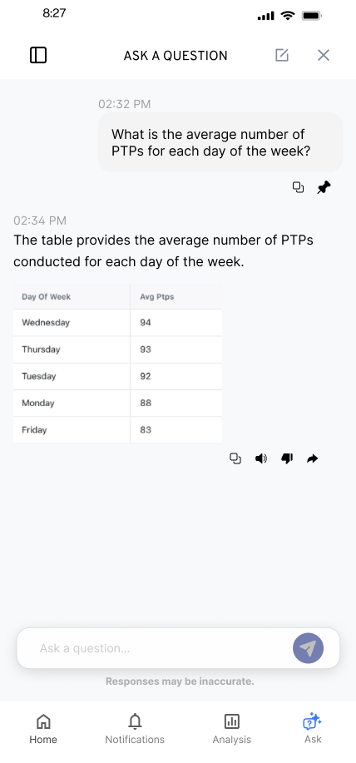
KYLE HOBSON / COINBASE DESIGN SYSTEMS APPLICATION
Patterns people can
use consistently
Reusable interfaces, connected states,
and the decisions behind them.
Selected work for Coinbase
September 2026
01
Notes:
Coinbase Product Designer II, Design Systems, P77346 / 8126896. Employer source: https://www.coinbase.com/careers/positions/8126896, verified September 8, 2026. This is a selection of product-level pattern and handoff work, not a claim of prior Coinbase work or company-wide consumer design-system ownership.

Slide 2
ABOUT ME / SMARTTAGIT, FACTORLAB
Five families,
one starting point
01
Summaries
02
Recommendations
03
Simple 7
I developed insight widgets around recurring information needs, then explored their order and content density.
04
Comparisons
05
Accomplishments
Summary of the reviewed structure
Original screen iterations in the linked case
02
Notes:
About Me April-May 2026 design walkthroughs, especially May 15, and original refined screen. The five groups are summaries, recommendations, Simple 7, comparisons and accomplishments. This native diagram summarizes their organization; it is not an original interface screenshot. Customization and final policy remained open in the walkthrough.

Slide 3
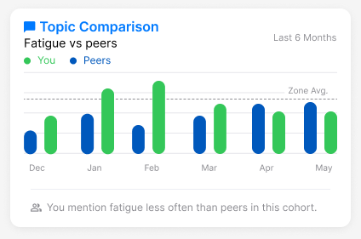
ABOUT ME / A PATTERN CARRIES MEANING
A comparison
needs context
Mentioning fatigue less often is a comparison. Whether that is good depends on the context.
I raised the cohort and wording questions while developing reusable insight widgets.
Original design iteration with sample values
03
Notes:
Original About Me comparison widget and April-May 2026 walkthroughs. About Me web/server release was confirmed September 2, 2026, but the exact pictured layout and completed mobile rollout are not established. No customer result is inferred from illustrative values.

Slide 4
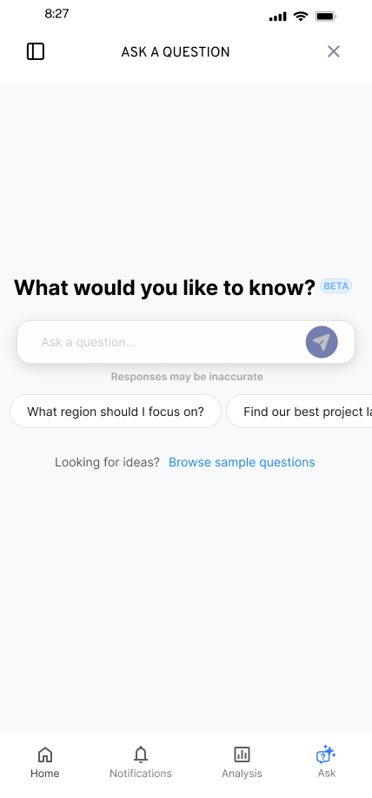
FLINT / SMARTTAGIT, FACTORLAB
A useful
first question
UX Designer & Researcher (Contract)
2025-2026
I explored suggested questions and a question library while keeping a person’s own question close at hand.
Design deliverables and engineering handoff
04
Notes:
Original FactorLab Flint mobile design and design walkthroughs. These are designed states, not a claim that every pictured variant shipped. Original interface content is sample data.

Slide 5


FLINT / INTERRUPTED AND OFFLINE STATES
Incomplete answer
Connection lost
Recovery follows
the failure
An incomplete answer and a lost connection need different next actions.
I assembled the connected flows and their next actions into an annotated handoff for engineering.
05
Notes:
Original SmartTagIt Flint interrupted-response and offline variants, including the March 27, 2026 error-state handoff. This documents design decisions and engineering annotations. Sample interface content.

Slide 6
FACTORLAB / DESIGN AND ENGINEERING HANDOFF
A pattern needs
a shared explanation
My walkthroughs make the state, the next action, and the unresolved choice available for review.
01 Connect the normal path to waiting and recovery
02 Explain what should stay consistent across variants
03 Revise with developers as constraints become clear
06
Notes:
Summary of Kyle’s original FactorLab design walkthroughs and annotated handoff work. Supported by Flint flows and About Me layout discussions. This does not establish a formal enterprise design-system governance process, broad adoption measures, or a finished release for every variant.

Slide 7
PROMPT COMPASS / INDEPENDENT CREATOR, 2026
A prompt rewrite can
lose requirements
Original request
Shorter rewrite
Valid JSON, four named fields, and a low-confidence review rule.
A clean structured answer with the best response for the user.
My tool compares requirements as well as wording. This developer-authored test exposes what the shorter request leaves out.
Public beta product; this example comes from later local evaluation work.
07
Notes:
Public beta.3: https://github.com/JonathanKHobson/prompt-compass/releases/tag/v0.1.0-beta.3, April 27, 2026. Example paraphrases a later May developer-authored regression fixture. Fields are category, article_id, confidence and suggested_response; confidence below 0.7 should yield needs_review. Later evaluation is separate from the April release and is not measured customer effectiveness.

Slide 8
COINBASE / PROPOSED APPROACH
A first contribution to CDS
I would begin with one recurring pattern and the product contexts that expose its limits.
01 Review existing usage and constraints with the team
02 Prototype the states inside real product screens
03 Test the behavior and document implementation choices
Proposed approach for this role; no prior Coinbase work is claimed.
08
Notes:
Proposed collaboration approach, informed by Coinbase Product Designer II, Design Systems, P77346 / 8126896, https://www.coinbase.com/careers/positions/8126896. Specific product constraints, technical interfaces, contribution process and measures would need to be established with the team.

Slide 9
COINBASE DESIGN SYSTEMS APPLICATION
Kyle Hobson
Reusable patterns, research-informed design,
and clear engineering handoffs.
Mesa, Arizona / U.S. remote work / Quarterly travel available
JonathanKyleHobson@gmail.com
Portfolio selected for Coinbase
09
Notes:
Candidate contact and travel availability are confirmed. Intended isolated portfolio route: https://jonathankhobson.github.io/application-portfolios/coinbase-design-systems/. Publication is a separate campaign action.

