Slide 1

KYLE HOBSON / AFFIRMEDRX · BUSINESS ANALYST
Making an issue
clear enough to act
Selected work in issue analysis,
technical collaboration and documentation.
Business Analyst, Data Operations · September 2026
01
Notes:
Prepared for the AffirmedRx Business Analyst, Data Operations application. Kyle’s evidence comes from product research, operational UX and independent research tooling. Pharmacy-benefit data operations is a new domain. The paper-path cover is decorative and does not document a project.

Slide 2
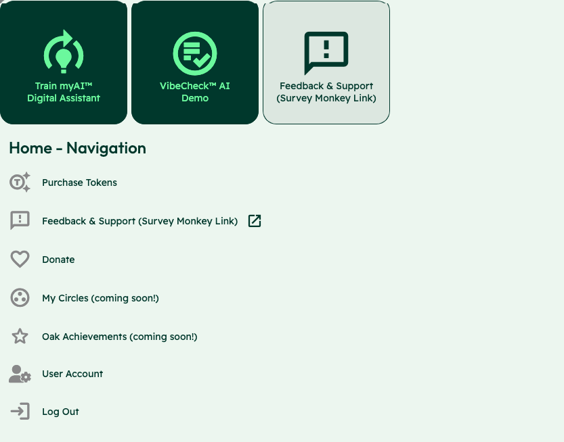
OAK AI / LEAD UX RESEARCHER, 2023–2025
Competing
entry points
Training an assistant, starting a Vibecheck and requesting support competed at the same entry point.
I recorded findings, presented recommendations and began an improvement list for backlog planning.
Usability evaluation and design recommendations
02
Notes:
Case: Oak AI. Kyle: Lead UX Researcher, 2023–2025. Source: original Oak navigation evaluation screenshot, with the identity area omitted. Training the assistant, starting Vibecheck and requesting support appear as competing entry points. Kyle documented the labels and visual treatments and used the audit to make these choices explicit for review. Work stage: usability evaluation and design recommendations. This slide does not present a finished navigation redesign or a user-study finding.

Slide 3
OAK AI / FINDING AND FOLLOW-UP
A concrete mismatch
starts the investigation
DOCUMENTED IN THE ORIGINAL EVALUATION
“User Account” opened a page headed “User Pages.”
The label and destination could leave a person unsure whether they reached the right place.
I compared labels and sitemap alternatives, then used documentation and walkthroughs to clarify work tickets.
03
Notes:
Source: original November 22, 2023 desktop heuristic evaluation and December contribution log. The User Account/User Pages mismatch is documented in the report. Its task impact is an expert interpretation, not a participant quotation or measured failure rate. Kyle initiated an improvement list and clarified tickets; the record does not establish sustained incident-dashboard ownership or an effort-ranked production backlog.

Slide 4


OAK AI / LOGIN FEEDBACK
Error feedback
beside the field
Original
Proposed
I made the problem field visible where a person could act on it.
The recommendation gave the team a specific behavior to discuss and prioritize.
Original error at the page footer
Proposed feedback beside the field
04
Notes:
Source: original Oak error-message recommendation artifact containing Before and After panels. Displayed interface panels retain source pixels and are labeled Original and Proposed to clarify the work state. Kyle connected an evaluation finding to visual alternatives and implementation recommendations. No conversion or task-success percentage is asserted.

Slide 5
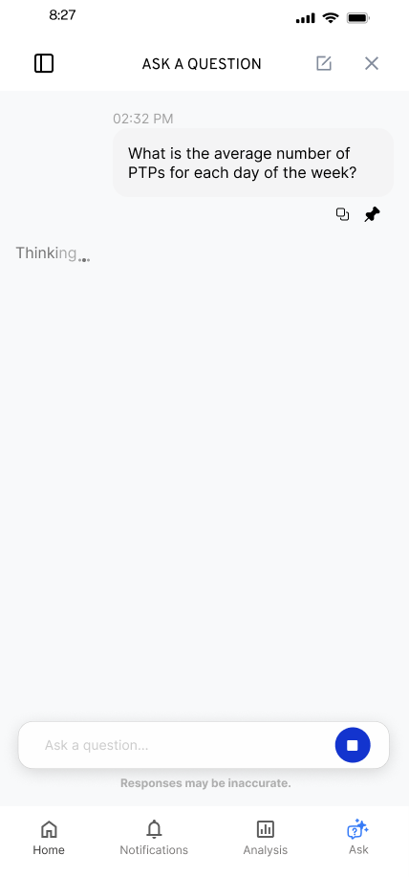
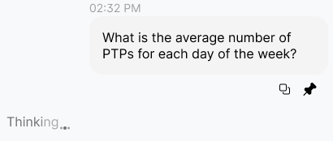
FLINT / RESPONSE IN PROGRESS
Waiting is part of
the conversation
I kept the question visible and gave the response a distinct waiting state.
Original state detail
Animation was an implementation question to resolve with engineering.
05
Notes:
Source: original Flint response-in-progress mobile export and design walkthrough. The inset enlarges an unchanged region of the same source image. Kyle explored the waiting treatment alongside the conversation and discussed animation constraints with engineering.

Slide 6


FLINT / INTERRUPTED AND OFFLINE STATES
Incomplete answer
Connection lost
Recovery follows
the failure
An incomplete answer and a lost connection need different next actions.
I assembled the flows and their next actions into an annotated handoff for engineering.
06
Notes:
Source: selected original Flint interrupted-response and offline design variants, including the March 27, 2026 error-state handoff. Distinct recovery actions follow the state: Ask again or Continue for a partial response, and retry after connection loss with the question preserved. Deliverable: connected flows, interaction states and engineering annotations.

Slide 7
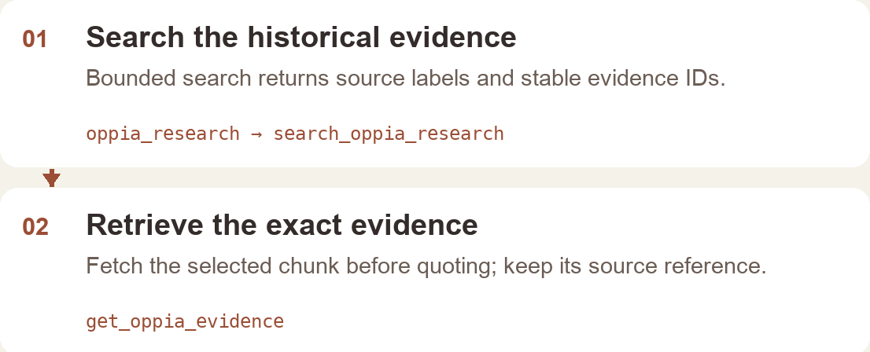
OPPIA RESEARCH COMPASS / INDEPENDENT INTERNAL TOOL, 2026
An answer needs a path back to evidence
I built a read-only tool that helps an AI assistant find historical research, keep source references and identify evidence gaps.
Implementation reconstruction · internal v0.4.0 package · 10 read-only tools
07
Notes:
Sources: actual Oppia Research Compass internal edition README, repository and service code; existing September 4, 2026 package manifest. This is an independently built internal tool, separate from Kyle’s formal volunteer role. Ten read-only tools support evidence retrieval, planning and audit. The workflow image is a labeled implementation reconstruction with no private corpus records. No team-adoption or productivity result is asserted, and the internal corpus is not authorized for public distribution.

Slide 8
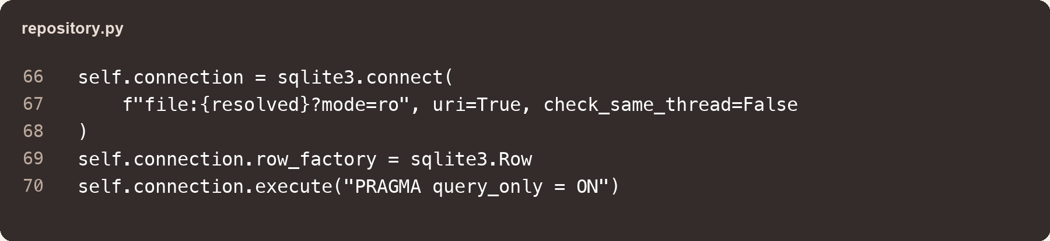
OPPIA RESEARCH COMPASS / IMPLEMENTATION DECISIONS
Retrieval stays bounded and traceable
SQLite full-text search ranks matches with BM25. Results keep stable record and evidence IDs.
The assistant can fetch exact evidence before quoting it. Evidence gaps remain visible.
Original code excerpt · database protections
08
Notes:
Source: actual repository.py and service.py in the internal Oppia Research Compass edition. The repository opens SQLite with mode=ro and sets PRAGMA query_only=ON. Full-text search uses BM25 ranking and returns stable evidence and record IDs. This is deterministic SQLite retrieval integrated with an AI host, not vector/embedding retrieval or autonomous model-generated synthesis. Service audits include missing IDs, concentration in one record and limited evidence types. Existing automated integration-test and privacy reports were inspected; no new runtime or adoption test is asserted here. A next evaluation would ask reviewers whether returned evidence supports a proposed research claim.

Slide 9

ARIZONA STATE UNIVERSITY / SUPPORT, ANALYSIS AND LEARNING
Explaining technical work
to the people using it
As an IT Specialist, I supported campus system updates and the transition to hybrid work.
Later AI analysis and instructional-design work involved translating learner needs into prototypes, findings and accessible materials.
09
Notes:
Reviewed career profile: ASU Fulton School of Engineering IT Specialist, October 2020–December 2022; ASU Knowledge Enterprise Instructional Designer, April 2022–October 2024; ASU Learning Innovations AI Analyst, February–October 2024. Roles overlap. No incident-volume, service-level, healthcare-system or production data-operations claim is made. The portrait is identity material, not evidence of a work outcome.

Slide 10
PROPOSED APPROACH / AFFIRMEDRX
A status record answers
the next question
What needs attention?
What is confirmed?
Capture the reported problem, affected scope and supporting evidence under the team’s access rules.
Check impact and open questions with the technical specialist responsible for the issue.
Who owns the next step?
What closes the loop?
Keep the owner, action and next update time visible to the people waiting on the work.
Confirm resolution, record what changed and flag recurring problems for review.
10
Notes:
Proposal for discussion with AffirmedRx based on the live Business Analyst, Data Operations listing. This is not a prior engagement, an implemented dashboard or a claim about the company’s actual policies. Begin by learning existing intake, privacy, escalation and resolution practices. Kyle would need onboarding in PBM eligibility, accumulator and claims data.

Slide 11
KYLE HOBSON / AFFIRMEDRX · BUSINESS ANALYST
Let’s make issue
follow-through easier
Mesa, Arizona. Full U.S. work authorization. Available to start as soon as possible and travel 10–20%.
JonathanKyleHobson@gmail.com
jonathankhobson.github.io/application-portfolios/affirmedrx-business-analyst
11
Notes:
The tailored portfolio contains selected case studies and all six application materials. Remote role location rules and compensation remain to be confirmed by the employer. No salary, relocation expense or employment terms are accepted by this presentation.

