Slide 1

KYLE HOBSON / NSC · LEARNING CONTENT EDITOR
Make the instruction clear.
Keep the review visible.
Instructional revision, clear feedback
and a documented response to review.
Learning Content Editor application · September 2026
01
Notes:
Prepared for National Safety Council Learning Content Editor, https://nationalsafetycouncil.applytojob.com/apply/gSev8CNceH/Learning-Content-Editor . Displayed work belongs to prior Coursera, FactorLab and Oak experience. Decorative cover is existing canonical art, not evidence.

Slide 2
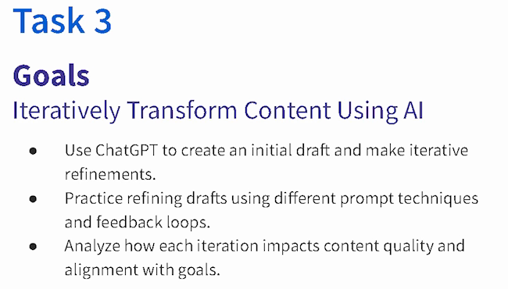
COURSERA · GUIDED PROJECT / ORIGINAL TEACHING, 2024
Make revision
something the
learner can see
I created a beginner project around drafting, reviewing and refining content against a goal.
Published teaching activity. Learner improvement is not measured here.
Original 2024 lesson material · goals excerpt
02
Notes:
Source: canonical ai.json teaching-ai case, original 2024 lesson material and https://www.coursera.org/projects/chatgpt-beginners . Kyle created and taught the published project ChatGPT 4o for Beginners: Create Social Media Content. The crop preserves all original Task 3 goal text without changing source pixels: ai-course-goals.png x80 y85 w650 h370. Learning sequence and teaching materials are direct evidence; enrollment is not a learning-gain measure.

Slide 3
COURSERA / ASSESSMENT REVIEW, OCTOBER 2024
Make the review change the material
Review finding | My documented revision
Choices were easy to eliminate | Reworked distractors, especially Questions 7, 8 and 10.
Question 7 tested only a definition | Added application of the concept alongside the definition.
Retry feedback revealed answers | Made feedback more neutral and referred learners to the lesson task.
Task references were incorrect | Corrected references across the assessment.
Paraphrased original review and instructor-response notes · revisions, not final QA signoff
03
Notes:
Source: original October 1,2024 Course Shell Feedback rows16,19,20,22 and instructor-response notes, privately reviewed in evidence/learning/coursera-assessment-review-excerpt.json. Four rows summarize actual concerns and recorded revisions. Completed appears in instructor-response status; separate QA ID Approval remains false. No final row-level signoff or measured learner gain claimed. Native editable two-column table.

Slide 4

COURSERA / RECORDED PRACTICE SEQUENCE
Review added detail
before accepting it
The lesson made an instruction visible beside the result it changed. That gave learners something concrete to inspect.
The revised answer added detail. In my retrospective, I would make factual checks and length limits more explicit.
Original 2024 recording, Task 3 · 03:35
Fictional practice brand · unchanged source excerpt
04
Notes:
Source: canonical teaching-ai case and original recorded revision instruction at 03:35. The screenshot preserves the historical interface and original text, including typos. Brew Bliss is fictional practice material. This slide shows teaching judgment, not a school deployment, controlled experiment or measured learner result. The retrospective check is a later reflection, not an assessment reported as run.

Slide 5


OAK AI / LOGIN FEEDBACK
Error feedback
beside the field
Original
Proposed
I made the problem field visible where a person could act on it.
The recommendation gave the team a specific behavior to discuss and prioritize.
Original error at the page footer
Proposed feedback beside the field
05
Notes:
Source: original Oak error-message recommendation artifact containing Before and After panels. Displayed interface panels retain source pixels and are labeled Original and Proposed to clarify the work state. Kyle connected an evaluation finding to visual alternatives and implementation recommendations. No conversion or task-success percentage is asserted.

Slide 6


FLINT / INTERRUPTED AND OFFLINE STATES
Incomplete answer
Connection lost
Recovery follows
the failure
An incomplete answer and a lost connection need different next actions.
I assembled the flows and their next actions into an annotated handoff for engineering.
06
Notes:
Source: selected original Flint interrupted-response and offline design variants, including the March 27, 2026 error-state handoff. Distinct recovery actions follow the state: Ask again or Continue for a partial response, and retry after connection loss with the question preserved. Deliverable: connected flows, interaction states and engineering annotations.

Slide 7
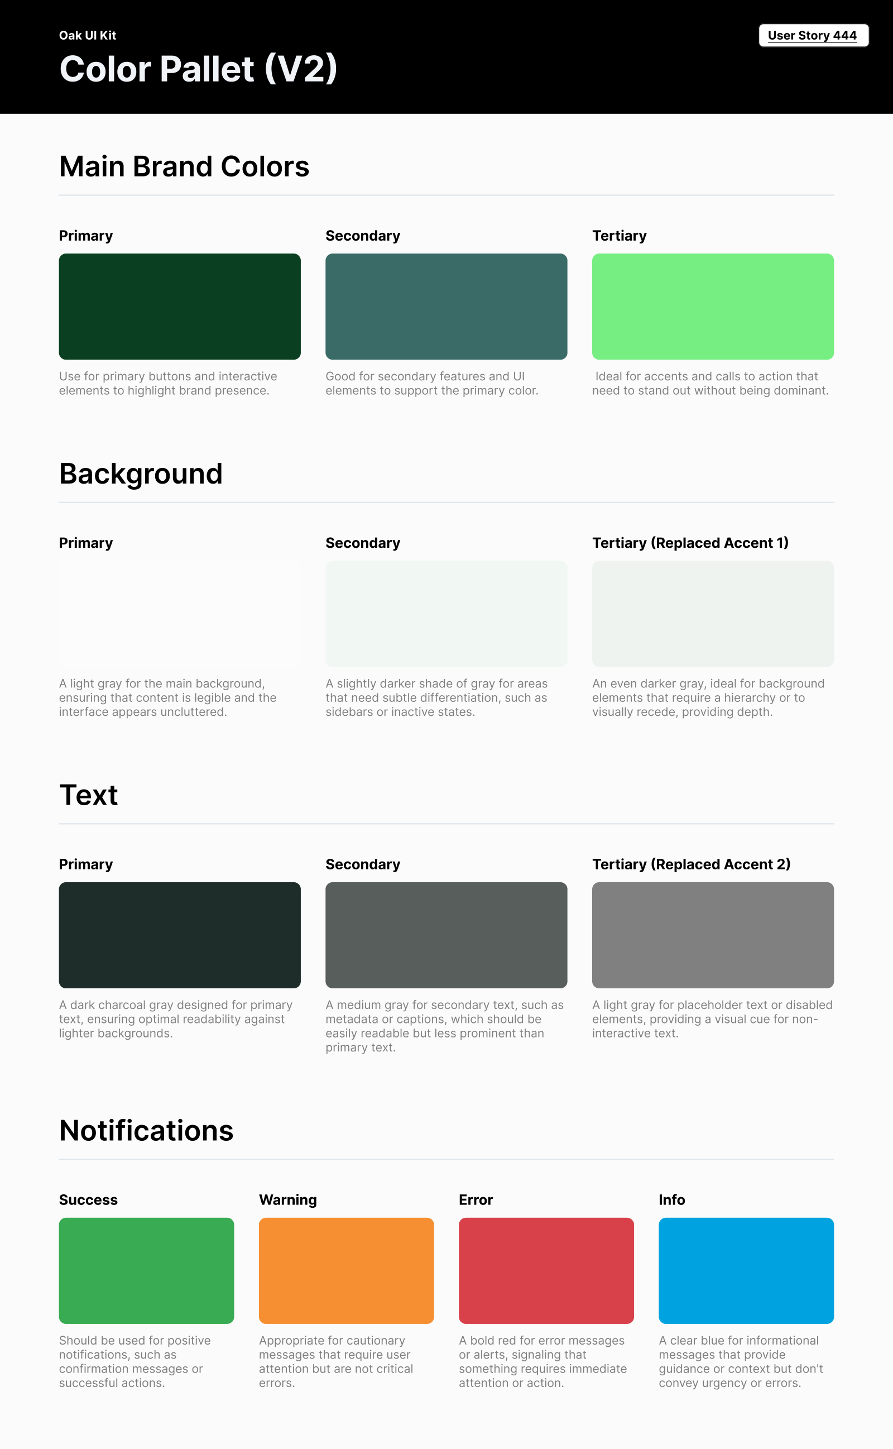
OAK AI / VISUAL GUIDANCE
Give color
a defined job
Brand, backgrounds, text and feedback needed consistent roles across the interface.
I documented those roles for the next design iteration. This focused guide did not establish a complete component library.
07
Notes:
Source: original Oak UI Kit V2 export tied to User Story 444 and canonical design.json. Focused color specification; no complete design-system coverage or accessibility-compliance claim.

Slide 8
COURSERA / REVISION RECORD AND WORK STAGE
Keep an edit separate
from its approval
Review finding
What needed attention
Instructor response
My response notes describe the changes I made. The workbook retains the review finding and a separate QA-approval field.
What I recorded changing
QA approval
A separate decision
The published course establishes publication. It does not establish that each recorded change received final approval.
Published course
A public release checkpoint
08
Notes:
Direct distinction from the original course review workbook and public course listing. Instructor changes marked Completed are not the separate QA approval. No print-proof approval, publisher production gate or learner outcome is invented. These labels summarize existing evidence, not a new client workflow.

Slide 9
PROPOSED APPROACH / NSC TRAINING CONTENT
Review one training unit from end to end
Start with the learning task
Apply the agreed style
Check objectives, instructions and practice.
Resolve factual questions with the relevant
subject specialist.
Check terminology, grammar and references.
Use NSC’s conventions and record exceptions
that need a decision.
Inspect the rendered material
Keep the revision traceable
Review hierarchy, captions and callouts.
Learn the team’s print-proof process and
check references after layout changes.
Record edits and unresolved questions.
Confirm who reviews the content and what
constitutes approval before release.
09
Notes:
Proposed approach based on the live NSC Learning Content Editor responsibilities. No prior NSC work, print-production mastery, final-proof ownership, Chicago style mastery or accessibility certification is claimed. Subject experts retain domain accuracy decisions. This is an approach for discussion, not an existing NSC process or committed plan.

Slide 10
KYLE HOBSON / NSC · LEARNING CONTENT EDITOR
Let’s make training content
easier to follow
Mesa, Arizona. Full U.S. work authorization. Available to start as soon as possible.
JonathanKyleHobson@gmail.com
jonathankhobson.github.io/application-portfolios/nsc-learning-content-editor
10
Notes:
Tailored Learning Content Editor packet. Related experience spans ASU learning design, Coursera instruction and assessment revisions, product writing and research. No four years employed as an editor, InDesign/Chicago mastery or final print ownership claimed. Salary is $70,000-$75,000 annually, below preferred target; preparing material does not accept an offer. Root handles the information-release declaration before any submission.

