Slide 1

KYLE HOBSON / UNITEK LEARNING · INSTRUCTIONAL DESIGN
Learning with a
clear next step
Published teaching, higher-education work,
and research that helps refine an experience.
Selected for Unitek Learning · Higher Ed · September 2026
01
Notes:
Prepared for Unitek Learning’s Full Time Instructional Designer — Higher Ed opening. Cover artwork is a reviewed decorative image, not evidence. Selected proof comprises a published 2024 Coursera Guided Project, formal ASU instructional-design/AI roles, a documented ASU proposal and adjacent Oak research. No Canvas, Articulate, LMS reporting or healthcare curriculum expertise is claimed.

Slide 2
EXPERIENCE / LEARNING MATERIALS AND GUIDED PRACTICE
Higher-education work
and published teaching
APR 2022–OCT 2024
2024
FEB–OCT 2024
ASU Knowledge Enterprise
Coursera Guided Project
ASU Learning Innovations
Instructional Designer
Instructor
AI Analyst
Digital learning materials, workshops and accessibility improvements.
Beginner task sequence, prompt examples and original lesson demonstrations.
Voice/chat flows and a proposed mentor-reviewed learner-task workflow.
02
Notes:
Formal roles and dates follow the current reviewed career materials. ASU Knowledge Enterprise: Instructional Designer, April 2022–October 2024. ASU Learning Innovations: AI Analyst, February–October 2024. The official Coursera page attributes the published Guided Project to Jonathan “Kyle” Hobson; original materials are from 2024. These overlapping activities are not summed into additional years. ASU instructional-material work is not relabeled as verified Canvas publishing, full-course LMS ownership, healthcare curriculum design or a four-year online-course record.

Slide 3
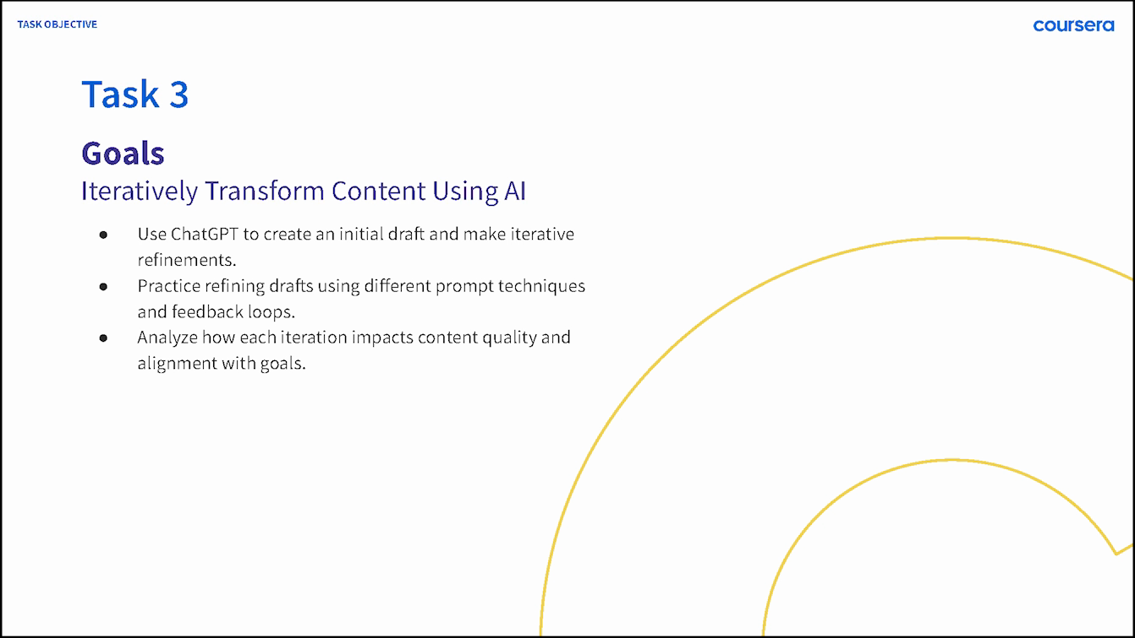
COURSERA / PUBLISHED GUIDED PROJECT, 2024
Give beginners a task
they can practice
I created and taught a one-hour beginner project on AI-assisted social content.
Learners draft, compare and revise content, then organize a weekly calendar.
Original lesson goals · Published teaching, not measured learner improvement
03
Notes:
Source: official Coursera project, ChatGPT 4o for Beginners: Create Social Media Content, https://www.coursera.org/projects/chatgpt-beginners , checked September 8, 2026; original 2024 Task 3 lesson material. The course is beginner level, approximately one hour and publicly attributed to Jonathan “Kyle” Hobson. The original teaching slide is preserved with Coursera credit. It communicates learning goals; it does not establish completion, transfer or causal improvement. Moving enrollment/review counts are omitted.

Slide 4
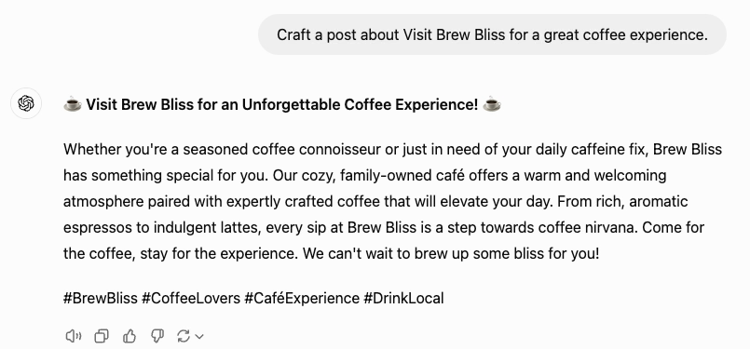
COURSERA / RECORDED PRACTICE SEQUENCE
Start with a draft a learner can inspect
A familiar café task gives the learner something concrete to examine.
The model adds business details that the prompt did not establish. Those details need judgment.
Original recording · Task 3 at 03:35 · Brew Bliss is fictional practice material
04
Notes:
Original 2024 Coursera Task 3 recording at 03:35, preserved in the reviewed public source crop. The short prompt and initial draft are historical demonstration content. Brew Bliss is a fictional practice brand; model-generated business details are not verified client facts. This is a teaching artifact, not a marketing campaign, research finding or student outcome.

Slide 5
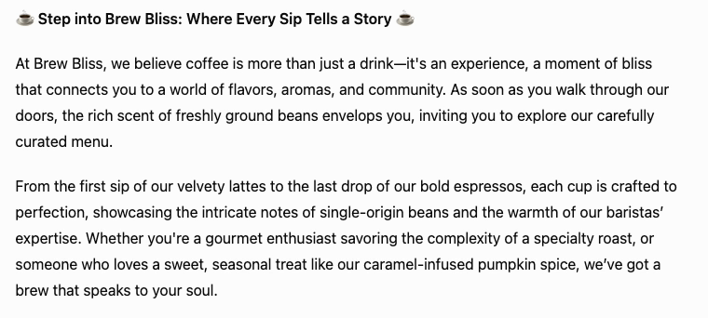
COURSERA / REVISION AND REVIEW
Make the revision visible
Recorded revision: ask for sensory detail and a friendly invitation.
The next draft is richer—and longer.
Review the added claims, the audience and the length before deciding what to change next.
05
Notes:
Sources: original 2024 Task 3 revision instruction at 03:35 and subsequent output at 04:00. The native prompt description paraphrases the visible instruction; the website retains the full original instruction including typos. The output crop shows the heading and first two paragraphs, not the complete answer. This retrospective interpretation discusses added detail and length. It is not a controlled experiment, verified marketing claim or proof of learner transfer.

Slide 6
ASU LEARNING INNOVATIONS / 2024 WORKFLOW PROPOSAL
Human review before learner-facing tasks
A staged prompt workflow for personalized learner tasks.
01
02
03
Condense learner context
→
Mentor validates context
→
Personalize task template
Prepare context for review.
Check the interpretation.
Use the reviewed context.
↓
06
05
04
Prepare learner-facing output
←
Mentor confirms tasks
←
Generate and refine tasks
Structured output and feedback.
Approve or revise the tasks.
Prepare candidate tasks.
Simplified reconstruction · Documented proposal; no deployment or measured efficiency claimed.
06
Notes:
Source: reviewed 2024 ASU Learning Innovations proposal and accompanying source brief. Kyle proposed a prompt workflow that condensed learner context, included mentor validation of context, personalized a task template, generated and refined tasks, included mentor confirmation or revision, and prepared structured learner-facing output and feedback. This editable reconstruction groups the original steps into six stages while retaining both mentor review gates. It is a proposal, not a deployed clinical system or a measured efficiency or learning outcome. The human review pattern is adjacent evidence for discussing learning workflows at Unitek Learning; no prior Unitek Learning engagement is claimed.

Slide 7
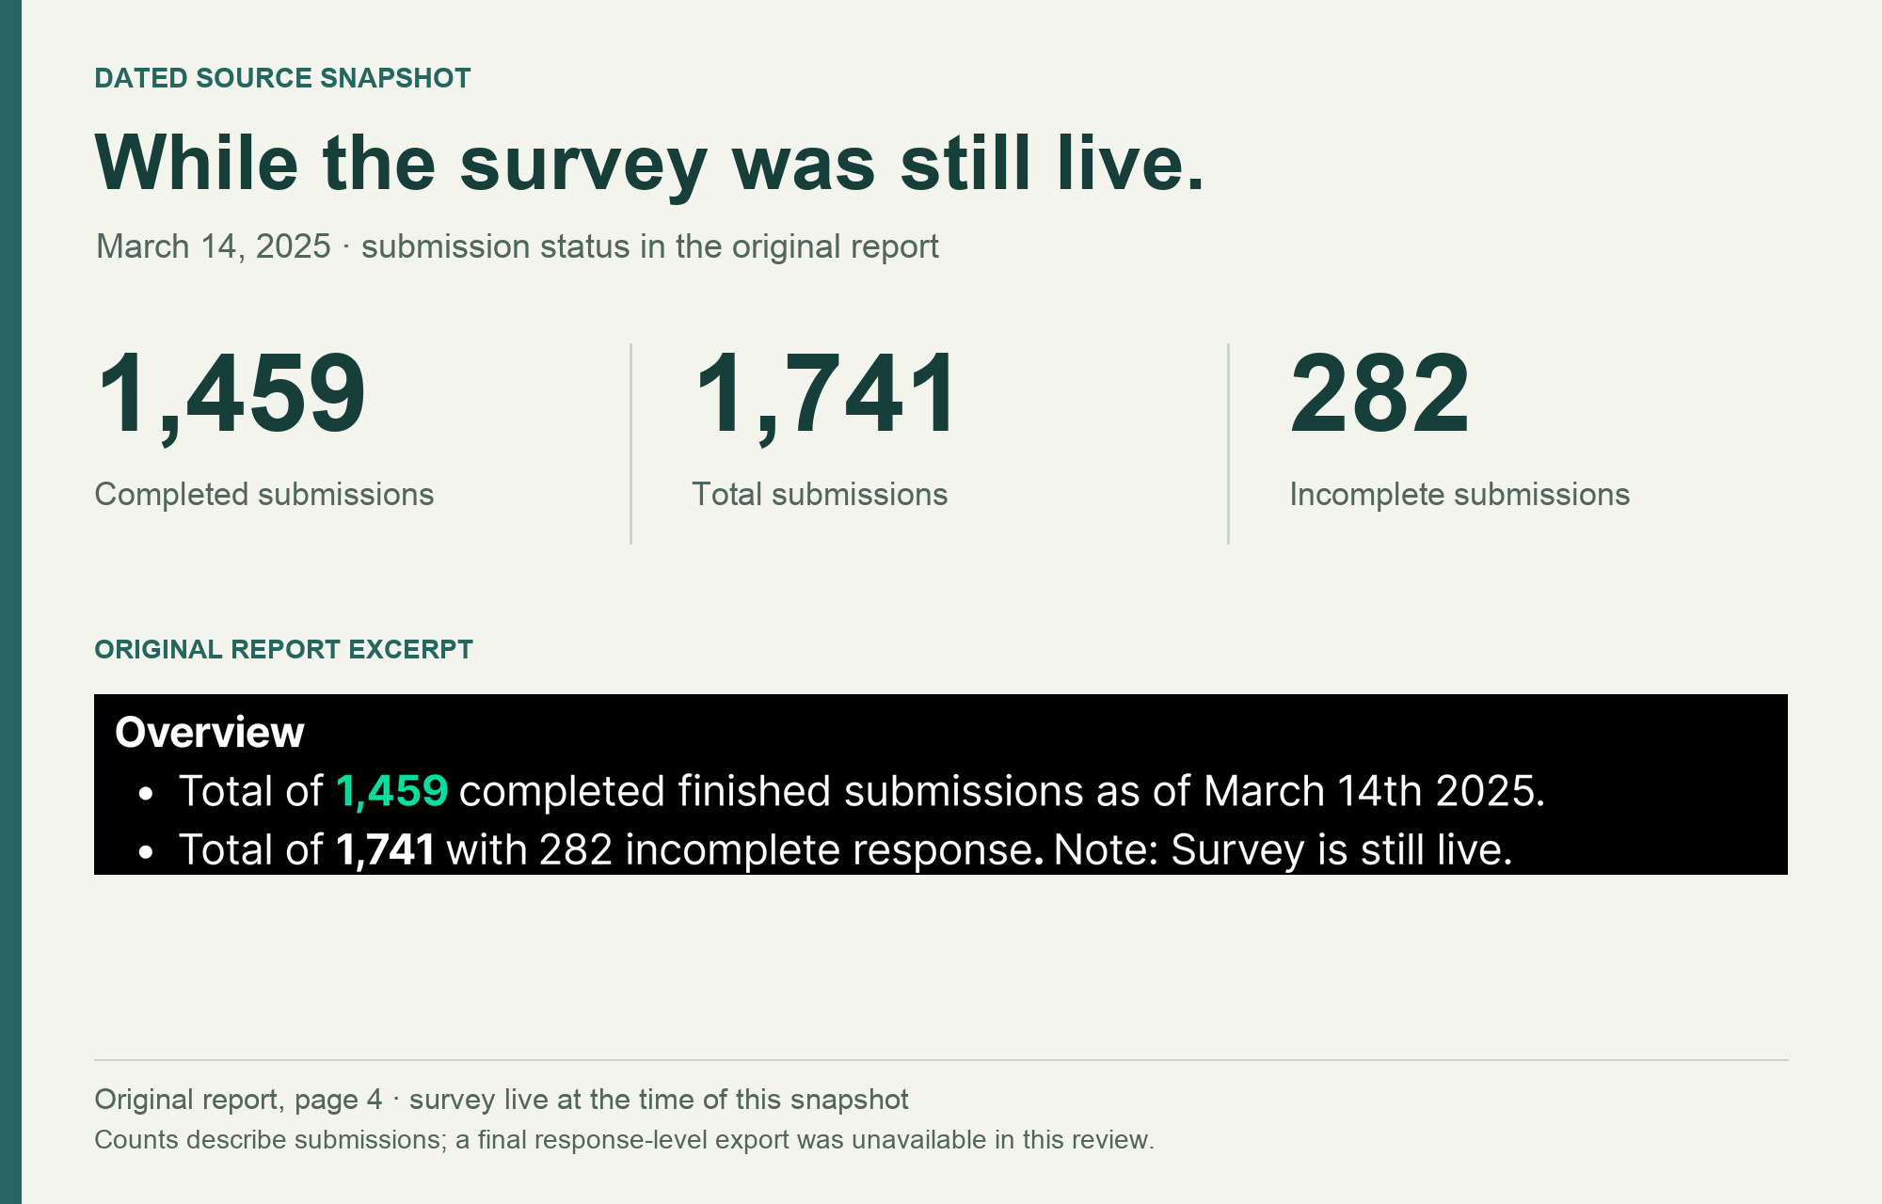
OAK + QASIM / AUDIENCE SURVEY, MARCH 2025
What keeps interest
from becoming action?
I led survey design, launch and analysis.
I combined structured questions about barriers with open responses about what would help.
A voluntary audience sample surfaced reported needs. It could not establish future use or purchase.
1,459 complete submissions
March 14, 2025 · survey still live
07
Notes:
Case: Oak + Qasim audience survey, March 2025. Kyle’s reviewed portfolio identifies his role as leading survey design, launch and analysis. Original source: Survey #1 Phase 2 — Findings Report: Understanding Audience Pain Points & Value-Aligned Actions, page 4. The report records 1,459 complete submissions as of March 14, 2025 while the survey remained live. This is a voluntary creator/advocacy audience sample, with predominantly older, female and highly educated respondents. Self-reported needs and preferences do not establish future behavior.

Slide 8
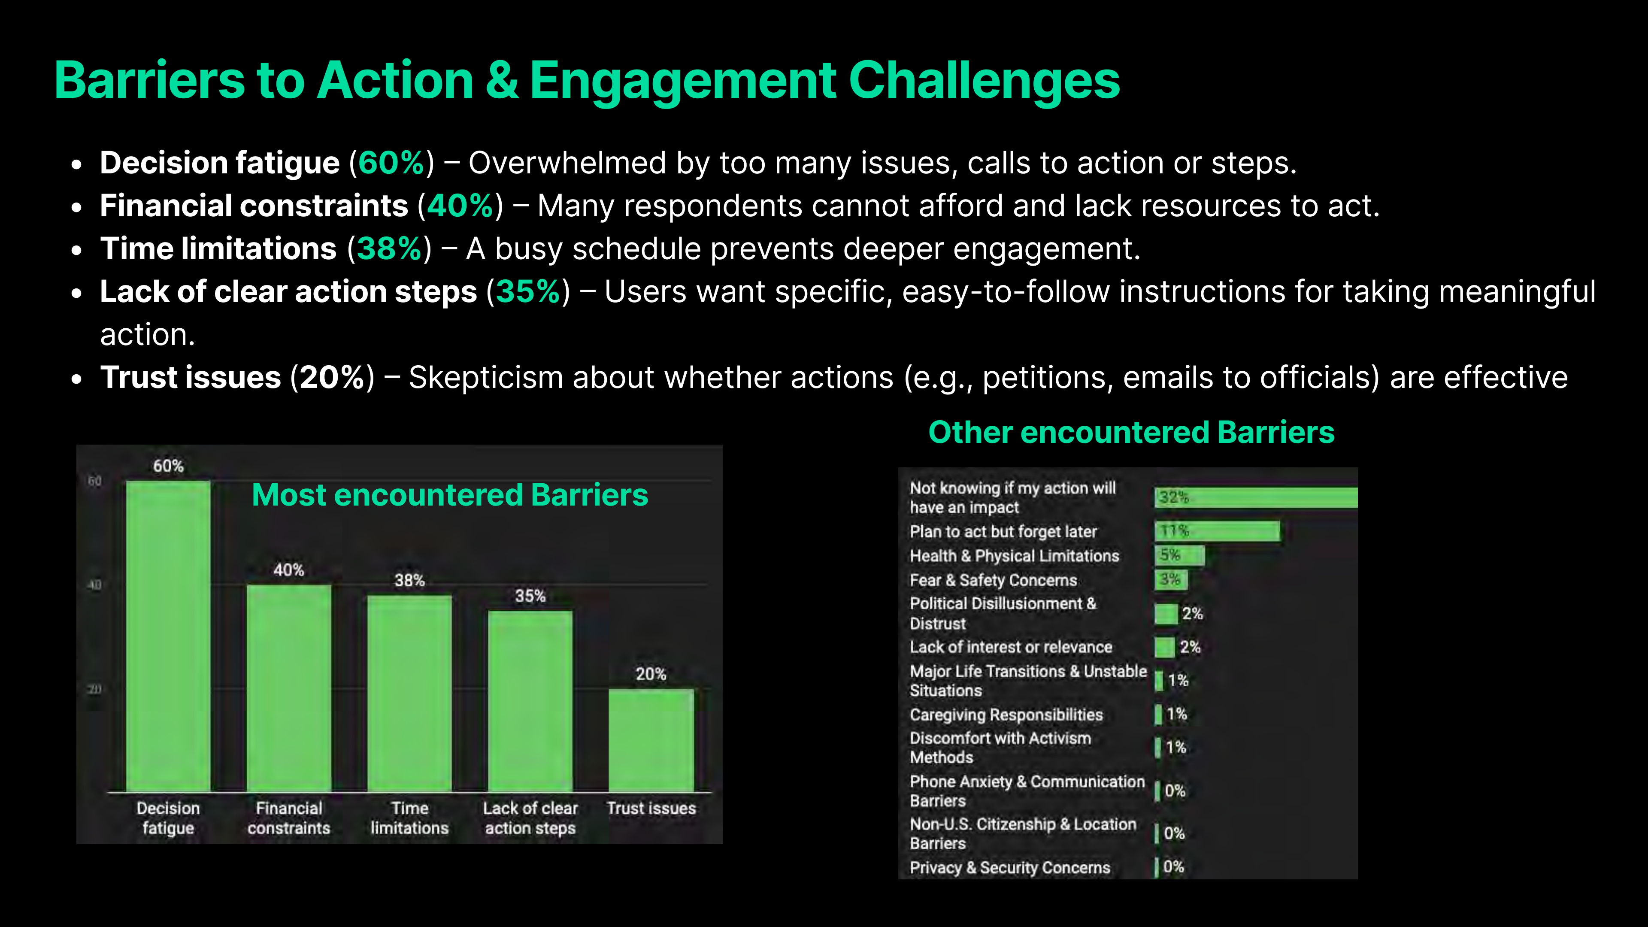
OAK + QASIM / REPORTED BARRIERS
Reported barriers to taking action
Original findings report · March 2025
Reported percentages · per-item response base unavailable · voluntary audience sample
08
Notes:
Source: original Oak + Qasim March 2025 findings report, page 14, shown unchanged at left. Native editable chart reproduces the report’s values: decision fatigue 60%; financial constraints 40%; time limitations 38%; lack of clear action steps 35%; trust issues 20%. The chart workbook is a new snapshot of these literal reported values, not the original response data. Per-item denominators, skip logic and response-level quality checks were not recovered. These are reported survey percentages, not independently recalculated estimates or population prevalence.

Slide 9


OAK AI / ERROR RECOVERY RECOMMENDATION
Recovery feedback
needed a clearer location
Original
Proposed
The existing error appeared at the page footer, away from the login fields.
I recommended placing the correction beside the field where someone could act.
Original page-footer error
09
Notes:
Sources: original Oak desktop evaluation and error-messaging recommendation artifact. The shown crops retain original interface pixels and exclude the identity-bearing example field. Original and Proposed labels distinguish the existing interface from the recommendation. The evaluation identified error feedback that did not explain recovery, and the recommendation made a specific correction visible near the password field. This is a recommendation, not a measured usability improvement or a claim that the exact variant shipped.

Slide 10
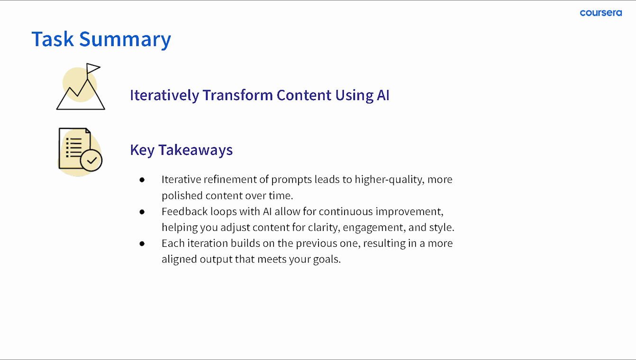
COURSERA / ORIGINAL SUMMARY AND PROPOSED NEXT CHECK
Check whether
the skill transfers
For a different task, I would ask a learner to identify an unsupported detail, choose a revision, and explain why the next draft serves the goal.
This is a proposed assessment drawn from the lesson, not a reported learner study.
10
Notes:
Original Task 3 summary slide from the 2024 Coursera lesson, with credit and historical wording preserved. The transfer check is a retrospective proposal from the reviewed portfolio: use a new task and ask the learner to explain the weakness, chosen revision and acceptance decision. These exact assessment questions are not claimed as administered in the course. The original summary’s general teaching claims are not presented as measured course outcomes.

Slide 11

PROPOSED APPROACH / UNITEK LEARNING
Review one course unit
with the team
Start with a faculty-approved unit. Clarify the learner outcome, the practice activity, and what would show understanding.
Work with subject matter experts on accuracy. Review instructions, navigation, media and feedback, then use learner and faculty input to choose specific revisions.
11
Notes:
Proposed approach informed by the official Unitek Learning Full Time Instructional Designer — Higher Ed listing, posting 744000147045639, checked September 8, 2026. This is a course-review direction, not a completed Unitek engagement, healthcare curriculum or compliance certification. Faculty and institutional requirements govern the scope. No LMS tool expertise, clinical content, learner outcome, promised production schedule or salary acceptance is invented.

Slide 12
KYLE HOBSON / UNITEK LEARNING · INSTRUCTIONAL DESIGN
Let’s talk about
the next course
Based in Mesa, Arizona. Open to the Tempe hybrid role and ready to start as soon as possible.
JonathanKyleHobson@gmail.com
jonathankhobson.github.io/application-portfolios/unitek-instructional-designer
12
Notes:
Prepared for the Unitek Learning higher-education instructional-design opening. The portfolio destination is configured as a hyperlink. The employer lists three office days per week in Tempe. No salary range is published and no rate acceptance is promised.

