Slide 1

KYLE HOBSON / APPLICATION TO NIMBLE GRAVITY
AI workflow design
and practical teaching
An independent build, original lessons
and reviewable workflow decisions
AI Enablement & Adoption Manager · Remote, United States
01
Notes:
Prepared for Nimble Gravity AI Enablement & Adoption Manager, current U.S. remote job 4727000005. Client-facing AI adoption consulting, including business users and leaders. Job source: https://job-boards.greenhouse.io/nimblegravity/jobs/4727000005 . The approved paper-path illustration is decorative, not project evidence.

Slide 2
PROMPT COMPASS / MY INDEPENDENT BUILD, PUBLIC BETA
A prompt rewrite can lose requirements
ORIGINAL FIXTURE PROMPT
SHORTER REWRITE
Return valid JSON only with fields category, article_id, confidence, and suggested_response. If confidence is below 0.7, set suggested_response to needs_review. Success: parser accepts the response.
Return a clean structured answer with the best response for the user.
Expected winner: the original
The rewrite loses named fields, JSON-only output and the review condition.
02
Notes:
Original developer-authored Prompt Compass local regression fixture, May 2026. Both prompts are exact fixture values. This is a designed evaluation example, not a client incident, production-model benchmark, or measured ROI. The public beta release is https://github.com/JonathanKHobson/prompt-compass/releases/tag/v0.1.0-beta.3 . I built and released Prompt Compass for diagnosing, improving, comparing and reusing prompts. This designed local regression case is one inspectable example from that work; it does not establish enterprise adoption, production guardrail deployment or measured model performance.

Slide 3

ARIZONA STATE UNIVERSITY / INSTRUCTIONAL DESIGNER
Learning materials
and workshops
At ASU Knowledge Enterprise, I developed digital learning materials and workshops with accessibility improvements and AI-supported content workflows.
April 2022–October 2024
MS in User Experience · BS in Technical Communication
03
Notes:
Reviewed career evidence: ASU Knowledge Enterprise, Instructional Designer, April 2022–October 2024. MS User Experience with UX Research concentration, ASU, May 2024; BS Technical Communication with UX concentration, ASU, May 2023. The concise role scope is reviewed evidence; this slide does not claim specific SCORM/LMS production tools or measured learning gains. Public profile: https://www.linkedin.com/in/jonathankylehobson/ .

Slide 4
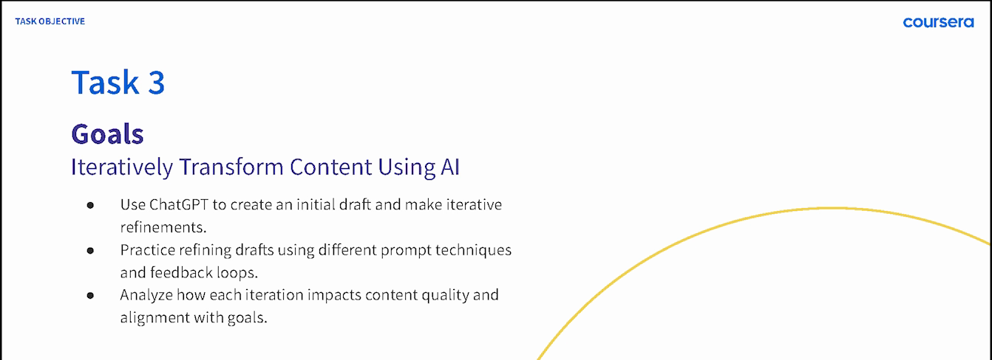
COURSERA / GUIDED PROJECT INSTRUCTOR, 2024
A practice sequence people can follow
ChatGPT 4o for Beginners: Create Social Media Content
Published in 2024 · 4,700+ enrollments as of September 2026
04
Notes:
Source: original 2024 lesson materials and the official Coursera page https://www.coursera.org/projects/chatgpt-beginners . The image is an original course slide. Enrollments describe reach, not course completion or measured skill improvement.

Slide 5
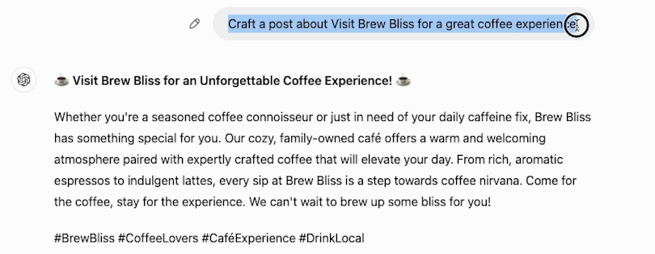
COURSERA / ORIGINAL DEMONSTRATION
A visible change
in a beginner lesson
The next step is to make the request more specific and compare the result.
05
Notes:
Source: original 2024 Task 3 recording at 02:30. This initial fictional Brew Bliss cafe draft gives learners material to inspect and revise. Later lesson steps demonstrate a more specific instruction and its resulting draft. It is not a client campaign or evidence of measured learner proficiency. Official course: https://www.coursera.org/projects/chatgpt-beginners .

Slide 6


FACTORLAB / SMARTTAGIT FLINT DESIGN
Recovery guidance
has to describe
the real state
An interrupted answer and a lost connection needed different messages and actions. I organized those states in Figma and annotated the behavior for engineering.
For client enablement: explain the failure condition and the next action clearly.
06
Notes:
FactorLab UX Designer & Researcher (Contract), October 2025–Present. Original Kyle-authored Figma designs and engineering annotations, reviewed in the September 2026 portfolio. Design and handoff evidence; exact pictured state is not claimed to be shipped. Its relevance to end-user documentation is adjacent: Kyle is explaining product behavior, showing product-design evidence with adjacent application to learning materials. Public case: https://jonathankhobson.github.io/portfolio/design/case/flint/ .

Slide 7
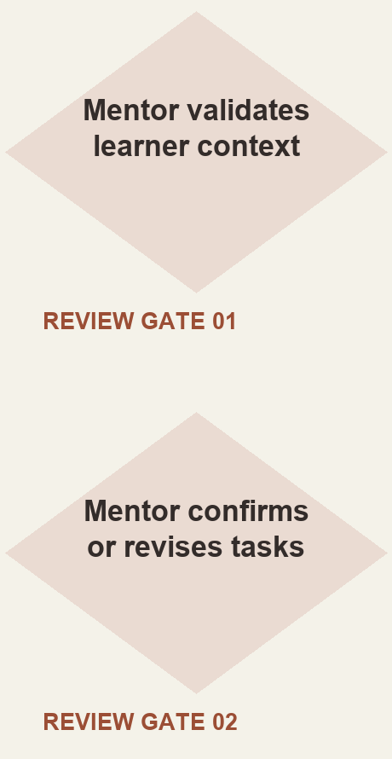
ASU LEARNING INNOVATIONS / AI ANALYST, FEB–OCT 2024
Mentor review in
a proposed workflow
I proposed staged generation of personalized learner tasks, with a mentor checking the context and the output.
Simplified reconstruction of my 2024 proposal. Deployment and time savings were not established.
07
Notes:
Original ASU for Life collaborative prompt architecture attributes the displayed proposed approach to Kyle. The reconstruction shows the mentor review steps without claiming production deployment, model training, or measurable savings. Reviewed AI case: https://jonathankhobson.github.io/portfolio/ai/ .

Slide 8
NIMBLE GRAVITY / PROPOSED FIRST CONTRIBUTION
A proposed client
enablement engagement
For Nimble Gravity, I would work with the client to define one process, its review boundaries and evidence of useful repeated work.
Map the task, approved sources and review responsibilities.
Build a demonstration around representative inputs and failure cases.
Agree on baseline task success, rework and repeated use.
Use observed performance and workshop feedback to revise guidance.
Proposed approach for discussion with the client and delivery team.
08
Notes:
Proposed client enablement engagement. Establish a baseline, task-level criteria and evidence of repeat use with the business owner. Kyle does not claim a completed Nimble Gravity rollout, enterprise adoption metrics, regulated-industry governance ownership or solo executive architecture facilitation. Primary source: https://job-boards.greenhouse.io/nimblegravity/jobs/4727000005 .

Slide 9
KYLE HOBSON / NIMBLE GRAVITY APPLICATION
AI Enablement
& Adoption Manager
Based in Mesa, Arizona. Available for U.S. remote work.
Authorized to work without sponsorship. Available ASAP.
JonathanKyleHobson@gmail.com
View the tailored Nimble Gravity portfolio
09
Notes:
Contact and work-authorization statements are candidate-confirmed for this application. Portfolio link targets the separately prepared Nimble Gravity site.

