Slide 1
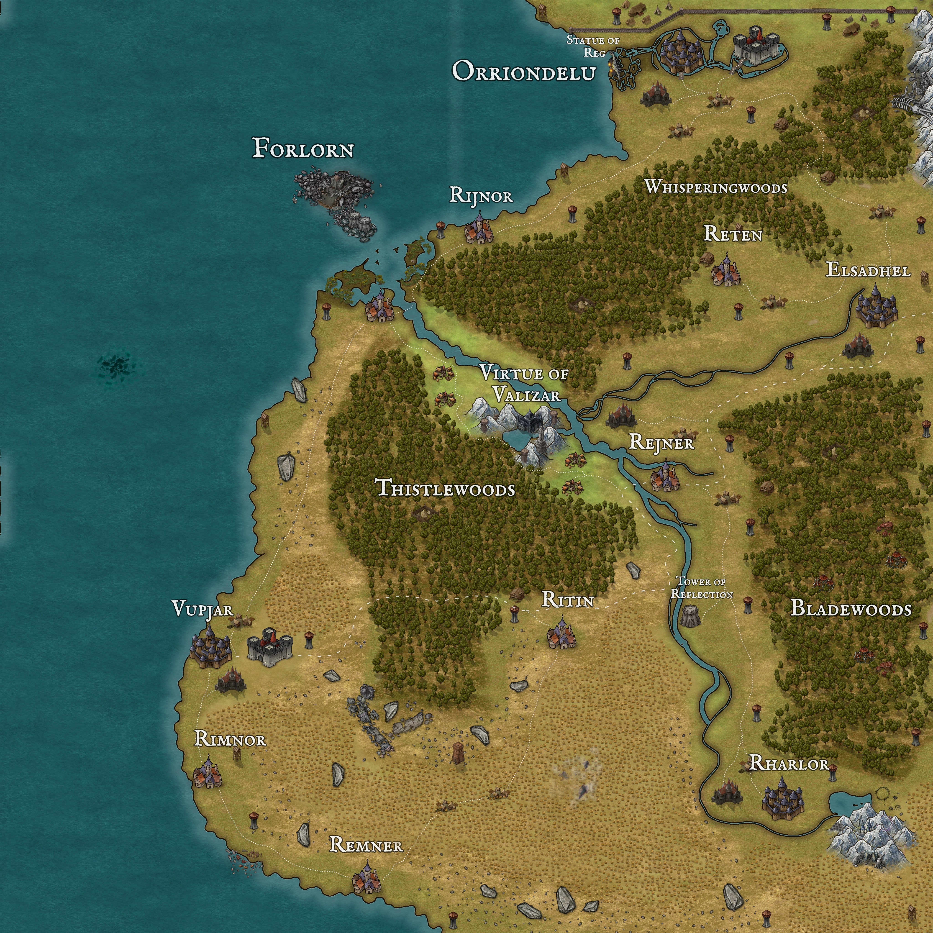
SELECTED WORK FOR BIGSBY GAMES
Kyle Hobson
Game Master
Original adventures, player references,
and a world that remembers.
Remote contract roster
Mesa, Arizona · September 2026
Peasants to Kings · Valizar campaign map
01
Notes:
Selected Game Master work by Kyle Hobson for the Bigsby Games remote contract roster. Cover image: existing Valizar map from the public Peasants to Kings portfolio, https://jonathankhobson.github.io/gm/games/peasants-to-kings.html . This deck is a candidate portfolio, not commissioned Bigsby work.

Slide 2
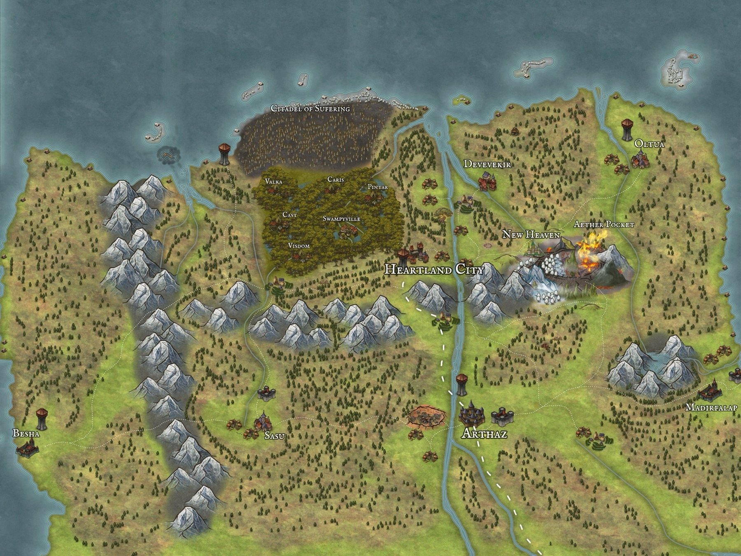
PEASANTS TO KINGS
A campaign
with continuity
I connect character arcs, factions, and places through a shared body of lore.
Campaign maps, session recaps,
and faction records give the story
a reference point as it grows.
02
Notes:
Source: https://jonathankhobson.github.io/gm/games/peasants-to-kings.html . Existing long-running homebrew campaign with persistent lore, linked character arcs, faction records, maps and recaps. The source artifact shows a campaign region; it is not a measured player outcome or evidence of paid session volume.

Slide 3
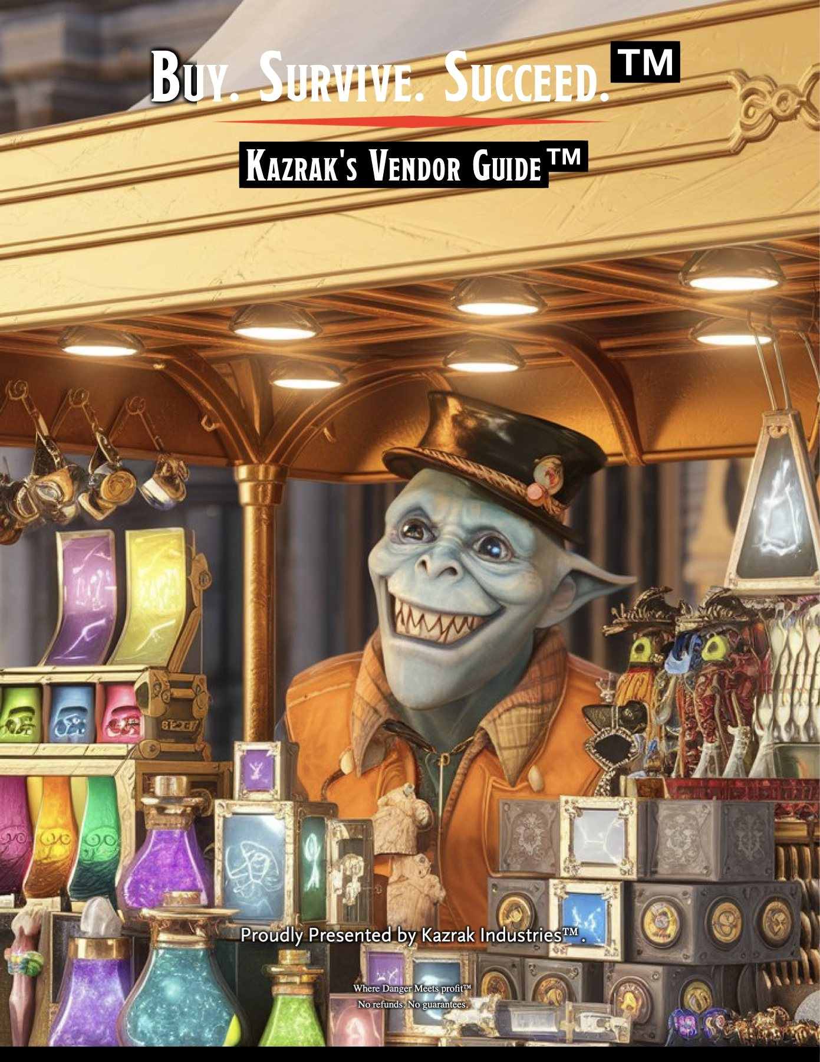
PERIL TO PROFIT / DAGGERHEART
A one-shot with
a clear premise
A corporate fantasy adventure designed for six players and three to four hours.
I prepared characters, handouts, maps, and pacing guidance around that session scope.
The original physical tower mechanic needs an agreed online adaptation before remote delivery.
Original fictional vendor guide
03
Notes:
Source: https://jonathankhobson.github.io/gm/games/peril-to-profit.html . Original Daggerheart one-shot designed for six players and a three-to-four-hour session, with character and GM references. The original Jenga-based Fear mechanic is physical. A remote adaptation has not been represented as completed or tested. Vendor-guide content is fictional satire.

Slide 4
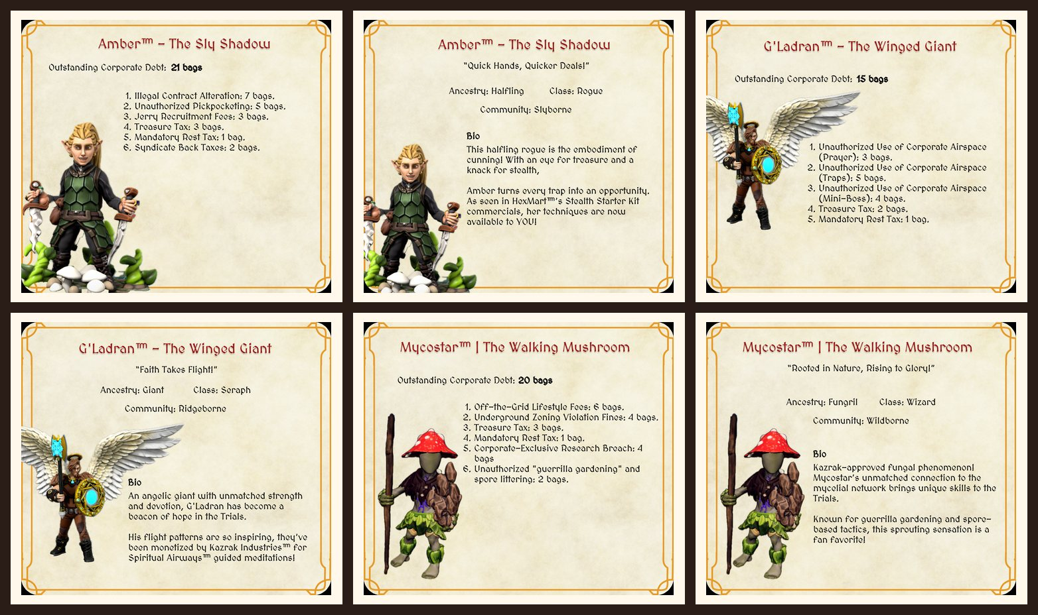
PERIL TO PROFIT / CHARACTER HANDOUTS
Give the character a reason to act
Character biographies and fictional debt cards put a personal hook beside the premise.
Existing player-facing artifacts · fictional characters and accounts
04
Notes:
Source: https://jonathankhobson.github.io/gm/games/peril-to-profit.html . Contact sheet of existing character biographies and fictional debt cards, reproduced from the public candidate portfolio without altering content. The financial amounts and names belong to fictional characters, not customer or candidate account information. No real player names, photographs, or testimonials appear.

Slide 5
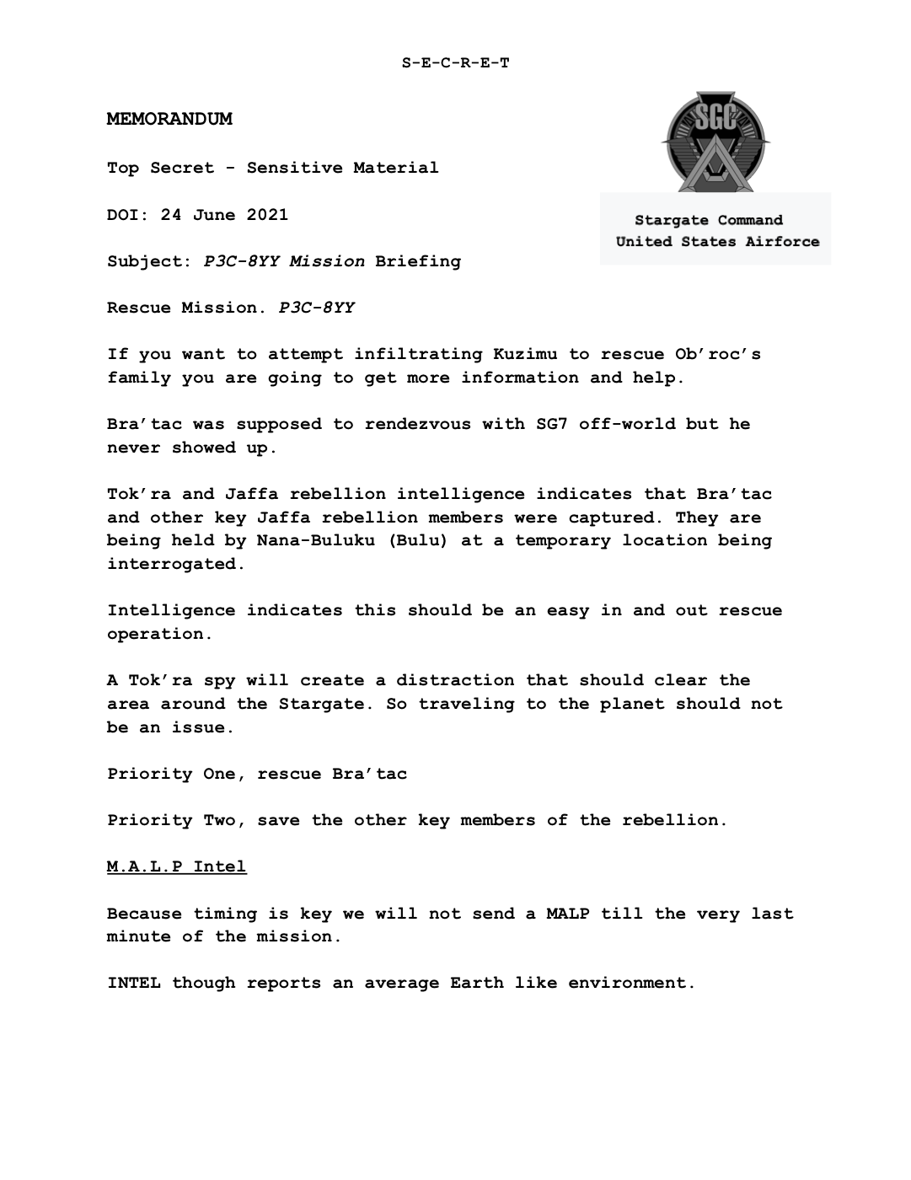
ECHOES OF STARGATE / PERSONAL FAN CAMPAIGN
Put the mission
within reach
I organize objectives, character roles, and mission references so players can find their next choice.
Existing fictional mission briefing.
Personal fan-campaign material;
no official franchise affiliation.
05
Notes:
Source: https://jonathankhobson.github.io/gm/games/echoes-of-stargate.html . Existing mission briefing from a personal fan campaign, used to illustrate mission and reference preparation. Classified-style labels, military emblems, dates, and scenario names are fictional game presentation; no actual classified information or official franchise endorsement is claimed.

Slide 6
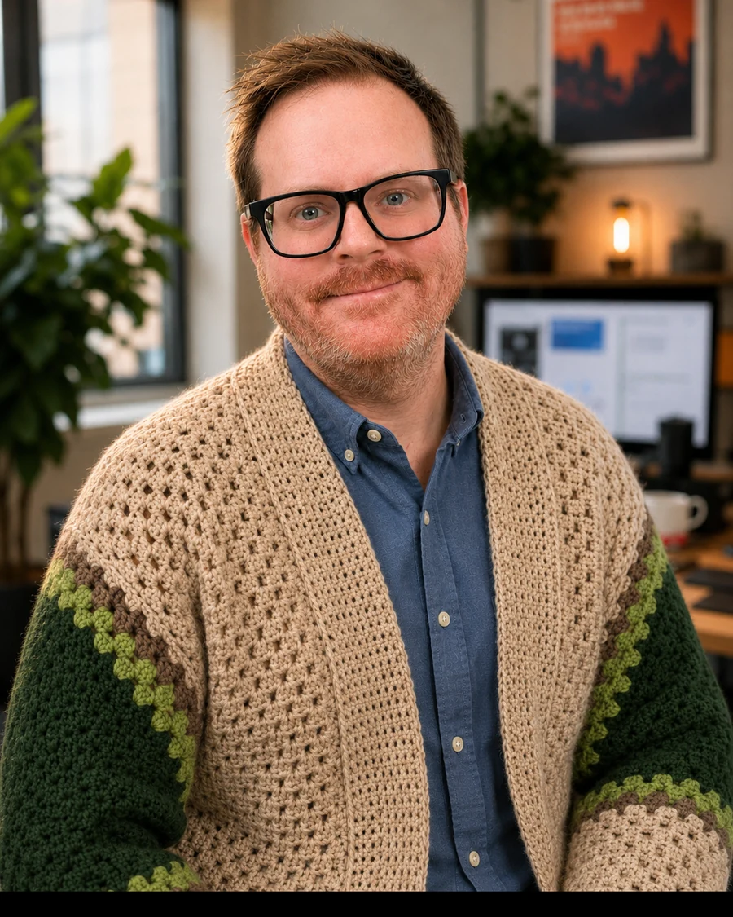
REMOTE TABLE FACILITATION
A clear start for
the online table
Discord · Owlbear Rodeo · Zoom
For a Bigsby session, I would agree on tone and boundaries first, explain the first few choices, and make it easy to pause or ask a rules question.
Proposed session approach;
schedule and preparation scope agreed together.
06
Notes:
Systems and online platforms are listed in Kyle’s public StartPlaying profile: https://startplaying.games/gm/gamemasterkyle . That profile supports a focus on plain rules explanations, player choices, spotlight, and comfort at the table. Current application scope is remote work. Session approach is proposed for Bigsby rather than represented as its policy or a completed Bigsby session. Portrait is identity material.

Slide 7
RELEVANT PROFESSIONAL EXPERIENCE
Facilitation beyond the game
Arizona State University
Digital learning materials and workshops, with attention to accessibility and clear explanations.
Instructional Designer · 2022–2024
Atria Park of Sierra Pointe
Activities, outings, and technology tutoring for older adults.
Engage Life Coordinator · 2017–2019
FactorLab
Research and design work that makes the next step in complex workflows understandable.
UX Designer and Researcher
Contract · Oct 2025–Present
07
Notes:
Relevant adjacent professional experience: Arizona State University Knowledge Enterprise, Instructional Designer, April 2022–October 2024; Atria Park of Sierra Pointe, Engage Life Coordinator, 2017–2019; FactorLab, UX Designer and Researcher (Contract), October 2025–present. These are learning, community activity and UX roles, not claims of corporate GM clients or paid game volume. Education and fuller details are in the accompanying resume.

Slide 8
KYLE HOBSON / GAME MASTER
Working with Bigsby
D&D 5e and Daggerheart sessions,
original adventures, and campaign continuity.
Remote from Mesa, Arizona · Available to start ASAP
Compensation negotiable per session; scheduling by agreement.
JonathanKyleHobson@gmail.com
View the portfolio prepared for Bigsby
08
Notes:
Bigsby Careers and application sources: https://bigsbygames.com/careers and https://bigsbygames.com/apply , verified September 8, 2026. Bigsby advertises a remote/in-person contract GM roster, supported systems including D&D 5e and Daggerheart, and per-session Stripe Express payouts. Candidate offers remote work from Mesa, Arizona. No pay amount, accepted contract, fixed hours, or guaranteed session volume is implied. Links are clickable; publication and application status are tracked outside this portfolio.

