Slide 1

KYLE HOBSON / APPLICATION TO TRANSPERFECT
Technical learning
for TransPerfect
Selected work in guided practice,
technical clarity and careful AI use
Learning Experience Designer · U.S. remote contract
01
Notes:
Prepared for the TransPerfect Learning Experience Designer contract role supporting Amazon’s low-Earth-orbit satellite broadband program. Job source: https://transperfect.recruitee.com/o/learning-experience-designer . The approved paper-path illustration is decorative, not project evidence.

Slide 2

ARIZONA STATE UNIVERSITY / INSTRUCTIONAL DESIGNER
Learning design
grounded in the task
At ASU Knowledge Enterprise, I developed digital learning materials and workshops with accessibility improvements and AI-supported content workflows.
April 2022–October 2024
MS in User Experience · BS in Technical Communication
02
Notes:
Reviewed career evidence: ASU Knowledge Enterprise, Instructional Designer, April 2022–October 2024. MS User Experience with UX Research concentration, ASU, May 2024; BS Technical Communication with UX concentration, ASU, May 2023. The concise role scope is reviewed evidence; this slide does not claim specific SCORM/LMS production tools or measured learning gains. Public profile: https://www.linkedin.com/in/jonathankylehobson/ .

Slide 3
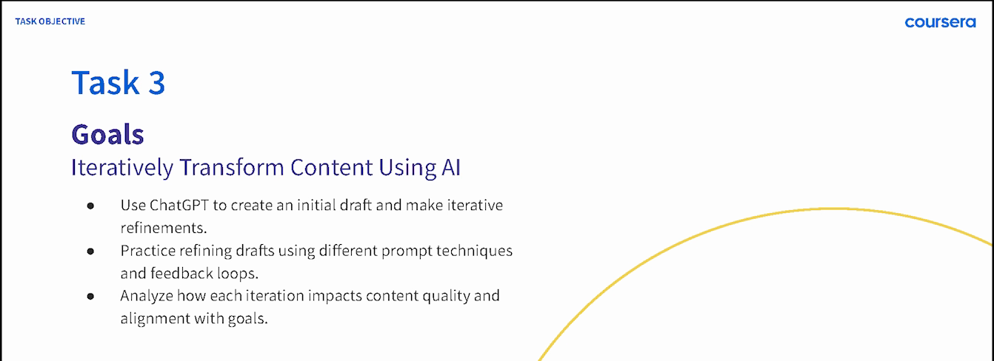
COURSERA / GUIDED PROJECT INSTRUCTOR, 2024
A practical sequence for beginners
ChatGPT 4o for Beginners: Create Social Media Content
Published in 2024 · 4,700+ enrollments as of September 2026
03
Notes:
Source: original 2024 lesson materials and the official Coursera page https://www.coursera.org/projects/chatgpt-beginners . The image is an original course slide. Enrollments describe reach, not course completion or measured skill improvement.

Slide 4
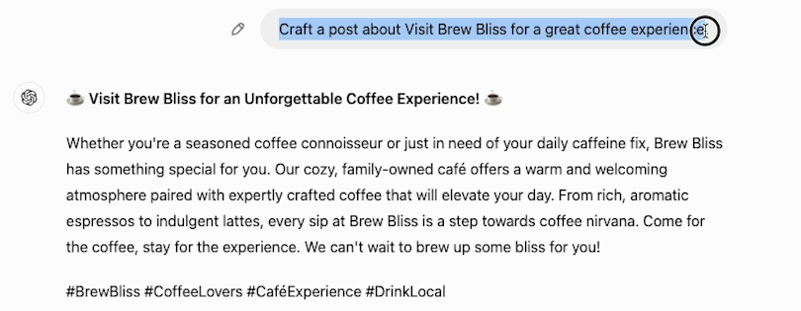
COURSERA / ORIGINAL DEMONSTRATION
A first attempt gives learners
something to revise
The next step is to make the request more specific and compare the result.
04
Notes:
Source: original 2024 Task 3 recording at 02:30. This initial fictional Brew Bliss cafe draft gives learners material to inspect and revise. Later lesson steps demonstrate a more specific instruction and its resulting draft. It is not a client campaign or evidence of measured learner proficiency. Official course: https://www.coursera.org/projects/chatgpt-beginners .

Slide 5


FACTORLAB / SMARTTAGIT FLINT DESIGN
Recovery guidance
has to describe
the real state
An interrupted answer and a lost connection needed different messages and actions. I organized those states in Figma and annotated the behavior for engineering.
For technical learning: distinguish the condition before explaining the recovery action.
05
Notes:
FactorLab UX Designer & Researcher (Contract), October 2025–Present. Original Kyle-authored Figma designs and engineering annotations, reviewed in the September 2026 portfolio. Design and handoff evidence; exact pictured state is not claimed to be shipped. Its relevance to end-user documentation is adjacent: Kyle is explaining product behavior, not claiming this is satellite-industry training or a TransPerfect implementation guide. Public case: https://jonathankhobson.github.io/portfolio/design/case/flint/ .

Slide 6
PROMPT COMPASS / DESIGNED LOCAL REGRESSION CASE
A rewrite must preserve the requirement
ORIGINAL FIXTURE PROMPT
SHORTER REWRITE
Return valid JSON only with fields category, article_id, confidence, and suggested_response. If confidence is below 0.7, set suggested_response to needs_review. Success: parser accepts the response.
Return a clean structured answer with the best response for the user.
Expected winner: the original
The rewrite loses named fields, JSON-only output and the review condition.
06
Notes:
Original developer-authored Prompt Compass local regression fixture, May 2026. Both prompts are exact fixture values. This is a designed evaluation example, not a client incident, production-model benchmark, or measured ROI. The public beta release is https://github.com/JonathanKHobson/prompt-compass/releases/tag/v0.1.0-beta.3 . Relevant to updating technical training: a clearer or shorter instruction still needs to preserve conditions and review requirements.

Slide 7
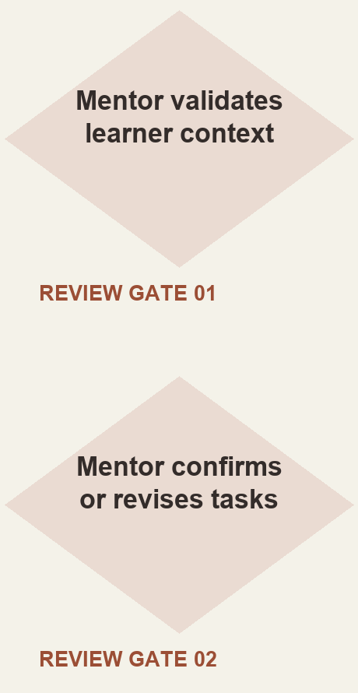
ASU LEARNING INNOVATIONS / AI ANALYST, FEB–OCT 2024
Mentor review shaped
the learner workflow
I proposed staged generation of personalized learner tasks, with a mentor checking the context and the output.
Simplified reconstruction of my 2024 proposal. Deployment and time savings were not established.
07
Notes:
Original ASU for Life collaborative prompt architecture attributes the displayed proposed approach to Kyle. The reconstruction shows the mentor review steps without claiming production deployment, model training, or measurable savings. Reviewed AI case: https://jonathankhobson.github.io/portfolio/ai/ .

Slide 8
TRANSPERFECT / PROPOSED FIRST CONTRIBUTION
One procedure.
A consistent learning set.
For a technical procedure, I would work from approved source material with your subject matter expert to define the task and its success conditions.
Storyboard the steps and the decisions learners must make.
Connect the example to a job aid and a facilitator activity.
Check a different scenario and explain the recovery choice.
Record the source owner and the materials affected by each update.
Proposed approach for discussion; no satellite production experience or client access is implied.
08
Notes:
Proposed approach for discussion. The TransPerfect role involves new and updated eLearning, ILT materials, job aids, assessments and collaboration with SMEs. This slide does not report past work for TransPerfect, satellite-industry production experience, or measured learning gains. Primary source: https://transperfect.recruitee.com/o/learning-experience-designer . SCORM/LMS production experience is not claimed.

Slide 9
KYLE HOBSON / TRANSPERFECT APPLICATION
Learning Experience
Designer
Based in Mesa, Arizona. Available for U.S. remote contracts.
Authorized to work without sponsorship. Available ASAP.
JonathanKyleHobson@gmail.com
View the tailored TransPerfect portfolio
09
Notes:
Contact and work-authorization statements are candidate-confirmed for this application. Portfolio link targets the separately prepared TransPerfect site.

