Slide 1

KYLE HOBSON / APPLIED AI
Good AI work starts
with a clear task
I connect task design, evaluation
and teaching to the people
doing the work.
AI workflows · prompt engineering
Teaching and enablement
01
Notes:
Kyle Hobson: applied AI workflow design, prompt engineering and enablement. Selected implementations, published teaching and a professional proposal. The cover portrait was supplied by Kyle. The following case slides contain the project evidence and source-status notes.

Slide 2
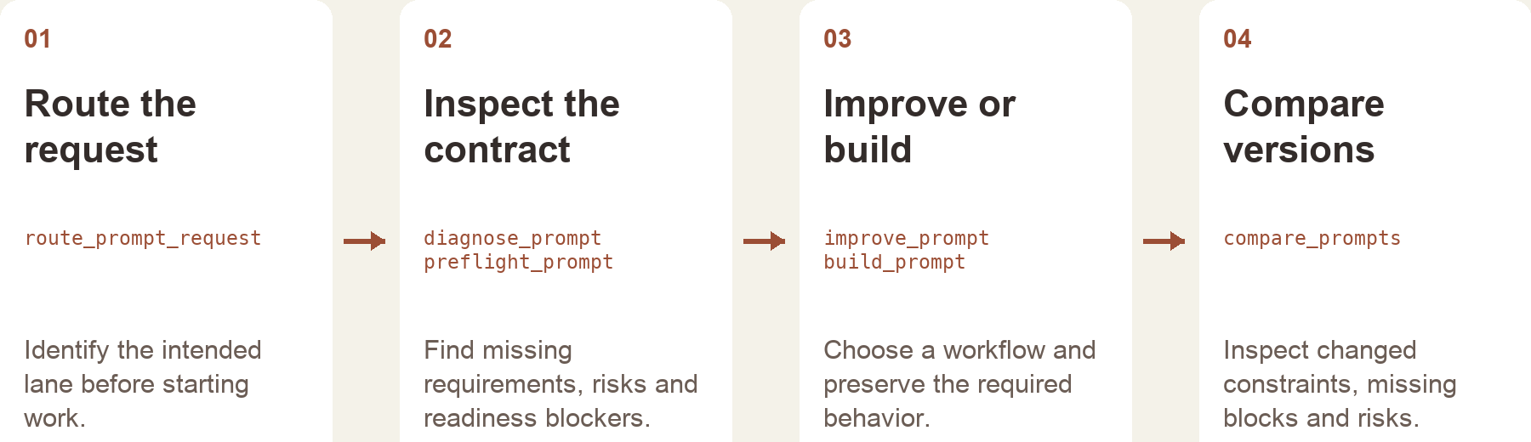
PROMPT COMPASS / INDEPENDENT PROJECT, 2026
A useful prompt preserves the job
I built Prompt Compass to turn rough requests into inspectable workflows, with clear requirements and comparison points.
Public beta available · reconstruction includes later local development
02
Notes:
Independent project. Sources: actual Prompt Compass README, server.py and service.py. The public v0.1.0-beta.3 prerelease was published April 27, 2026 and its assets refreshed May 18; local development includes later work. Public release: https://github.com/JonathanKHobson/prompt-compass/releases/tag/v0.1.0-beta.3 . This workflow plate is reconstructed from implementation, not a product screenshot. The host AI handles conversation and final wording; the tool provides structured diagnosis, contracts, routing and comparison.

Slide 3
PROMPT COMPASS / DESIGNED LOCAL REGRESSION CASE
Cleaner language can lose the task
ORIGINAL FIXTURE PROMPT
SHORTER REWRITE
Return valid JSON only with fields category, article_id, confidence, and suggested_response. If confidence is below 0.7, set suggested_response to needs_review. Success: parser accepts the response.
Return a clean structured answer with the best response for the user.
Expected winner: the original
The rewrite loses named fields, JSON-only output and the low-confidence fallback.
03
Notes:
Source: actual May 2026 developer-authored Prompt Compass Eval Studio fixture phase2t-schema-regression-cleaner-but-worse. The two displayed prompts are exact fixture values. The expected winner is the original because the shorter rewrite removes the output contract. This is a designed regression case, not a customer incident or a production-model benchmark. Human-review metadata in the fixture is unreviewed. No new runtime test is claimed in this deck.

Slide 4
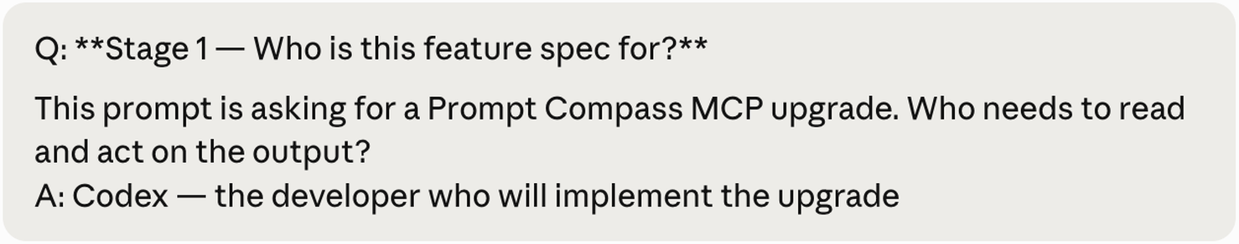
PROMPT COMPASS / HOST AND TOOL RESPONSIBILITIES
Structured checks support the conversation
The host AI handles the dialogue and final language. My tool makes task requirements and tradeoffs available for review.
Original public example session · proposed feature specification
Next test: compare realistic prompt revisions against an agreed task rubric and human review.
04
Notes:
Source: the original packaged public Prompt Compass real-session snapshot. This is a selected example conversation about an autopilot feature proposal. It does not establish that the proposed feature shipped. Implementation sources show prompt contracts, missing-block checks, anti-pattern checks and comparison deltas. Existing local May 9 evaluation reports document deterministic fixture checks; these do not measure user effectiveness, and this deck does not claim a new test run. A prospective human-reviewed comparison is stated as the next test.

Slide 5
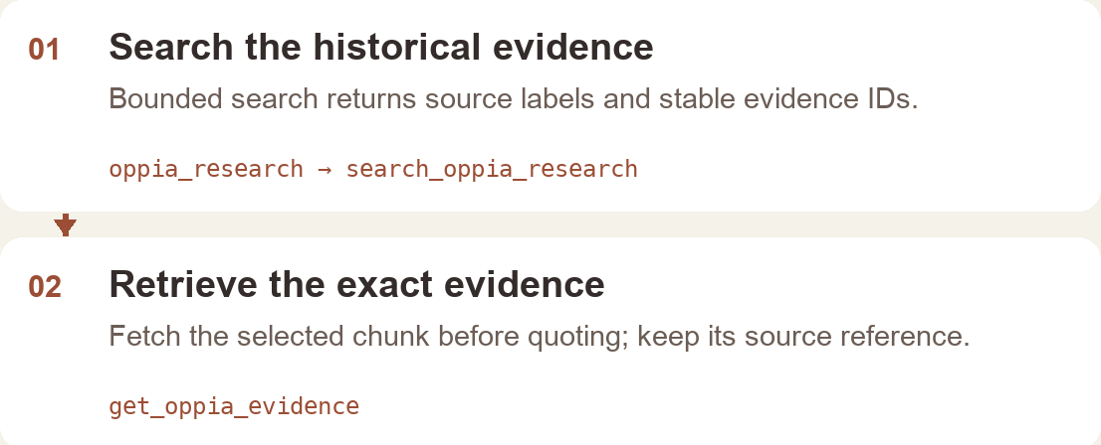
OPPIA RESEARCH COMPASS / INDEPENDENT INTERNAL TOOL, 2026
An answer needs a path back to evidence
I built a read-only tool that helps an AI assistant find historical research, keep source references and identify evidence gaps.
Implementation reconstruction · internal v0.4.0 package · 10 read-only tools
05
Notes:
Sources: actual Oppia Research Compass internal edition README, repository and service code; existing September 4, 2026 package manifest. This is an independently built internal tool, separate from Kyle’s formal volunteer role. Ten read-only tools support evidence retrieval, planning and audit. The workflow image is a labeled implementation reconstruction with no private corpus records. No team-adoption or productivity result is asserted, and the internal corpus is not authorized for public distribution.

Slide 6
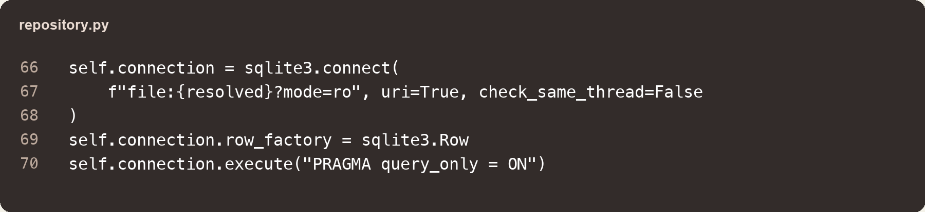
OPPIA RESEARCH COMPASS / IMPLEMENTATION DECISIONS
Retrieval stays bounded and traceable
SQLite full-text search ranks matches with BM25. Results keep stable record and evidence IDs.
The assistant can fetch exact evidence before quoting it. Evidence gaps remain visible.
Original code excerpt · database protections
06
Notes:
Source: actual repository.py and service.py in the internal Oppia Research Compass edition. The repository opens SQLite with mode=ro and sets PRAGMA query_only=ON. Full-text search uses BM25 ranking and returns stable evidence and record IDs. This is deterministic SQLite retrieval integrated with an AI host, not vector/embedding retrieval or autonomous model-generated synthesis. Service audits include missing IDs, concentration in one record and limited evidence types. Existing automated integration-test and privacy reports were inspected; no new runtime or adoption test is asserted here. A next evaluation would ask reviewers whether returned evidence supports a proposed research claim.

Slide 7
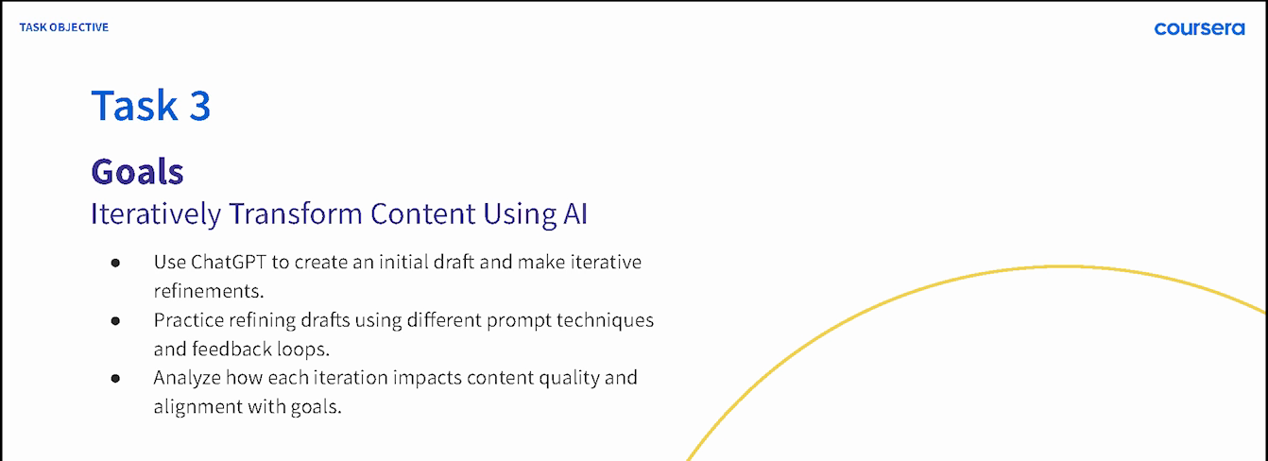
COURSERA / GUIDED PROJECT INSTRUCTOR, 2024
Teaching a repeatable AI workflow
ChatGPT 4o for Beginners: Create Social Media Content
Published in 2024 · 4,700+ enrollments as of September 2026
07
Notes:
Kyle is the named instructor of the public Coursera Guided Project ChatGPT 4o for Beginners: Create Social Media Content. Official source: https://www.coursera.org/projects/chatgpt-beginners . The one-hour beginner project teaches prompt specificity, output comparison, iteration and a weekly social-content calendar. The displayed crop is from the original 2024 Task 3 lesson recording at 01:30; letterboxing and unused lower artwork are omitted, while Coursera branding and all displayed learning goals remain intact. The official page showed more than 4,700 enrollments when reviewed in September 2026. Enrollment is not completion or demonstrated improvement.

Slide 8
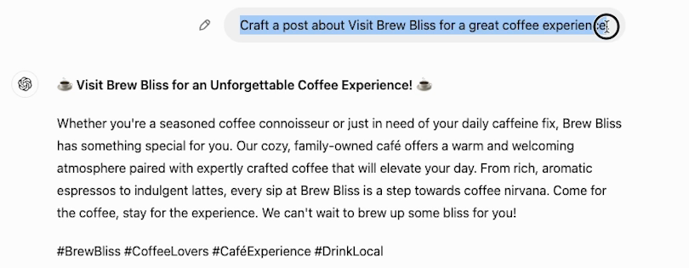
COURSERA / DEMONSTRATION AND ITERATION
An initial draft gives us something to inspect
Original lesson example · initial draft for refinement against a goal
Next assessment: can learners repeat the process with a new task?
08
Notes:
Source: original 2024 Task 3 lesson recording at 02:30, cropped to the simple Brew Bliss demonstration prompt and initial output. Account identity, blank surrounding interface and lower utility controls are omitted. The text is a demonstration draft, not successful client copy or an approved final asset. The lesson teaches learners to inspect vague areas, add context, compare output and iterate toward a clear goal. These are curriculum activities, not measured competency gains. The next assessment is proposed: test transfer to a new task, without following the original example.

Slide 9
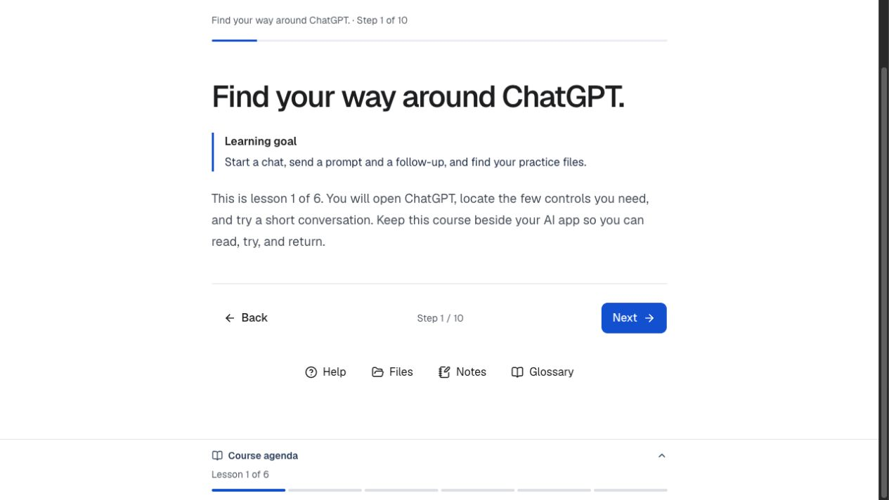
AI WORKSHOP STUDIO / PUBLISHED APPLICATION, 2026
AI Workshop Studio gives
learners a visible path
One learning goal and one next action keep a course step clear. Help, files, notes and the agenda stay within reach.
The published video workspace adds chapters, a synchronized transcript, a written guide and step materials.
View the case →
09
Notes:
Source image: public/assets/ai-studio-learner.png, copied from the approved learner-design capture in the AI Workshop Studio integration source. It shows the older published six-lesson learner view, not the unfinished Intro to ChatGPT Desktop course. The application is public at https://ai-workshop-studio.jkylehobson.chatgpt.site/ . The shared four-tab video workspace was published in application v37 on September 26, 2026; hosted playback and transcript seeking were checked. Source: integration/docs/pm/workstreams/lesson-workspace-september26.md. Case page: https://jonathankhobson.github.io/portfolio/ai/case/workshop-studio/ . The current Intro to ChatGPT Desktop course remains a private draft at revision 176; app publication did not publish that course. No learning-gain claim is made.

Slide 10
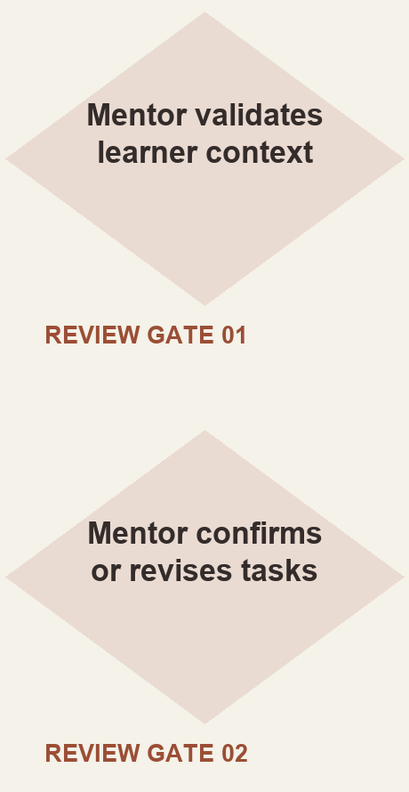
ASU LEARNING INNOVATIONS / AI ANALYST, FEB–OCT 2024
Mentor review shaped
the learner workflow
I proposed staged generation of personalized learner tasks, with a mentor checking the context and the output.
Two mentor checkpoints from the simplified 2024 proposal. Deployment and time savings were not established.
10
Notes:
Sources: original collaborative ASU for Life prompt-architecture document, which explicitly identifies Kyle’s proposal, and the original 2024 Figma flowchart. Formal role: AI Analyst, ASU Learning Innovations, February–October 2024. The simplified reconstruction retains context summarization, mentor review, task generation/refinement and output confirmation. It does not reproduce legacy speculative components from the collaborative artifact or claim model training, fine-tuning, deployment or measured time savings. This supporting case demonstrates workflow-design judgment. A next validation would test the mentor checkpoints with realistic learner contexts before piloting the flow.

Slide 11
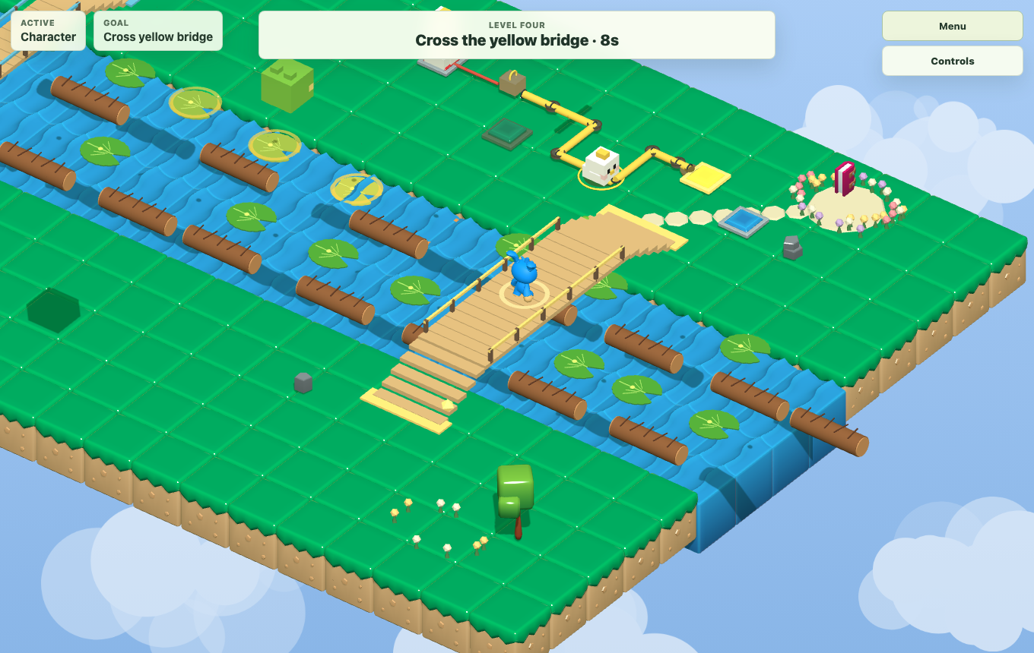
LUMINA3D / LOCAL PLAYABLE CANDIDATE, 2026
Spatial context guides
AI-assisted edits
I capture the selected object, position and collision context before asking AI to diagnose a scene bug.
The AI proposes a small source change. I check it with a build, scene tests and play.
View the case →
11
Notes:
Source image: public/assets/ai-lumina-river.png, a local Lumina3D screenshot showing the playable river candidate and timed bridge objective. Source workflow: Lumina3D docs/ai-prompt-workflow/README.md. A human captures selected-object, transform, collision and visual context; AI diagnoses and proposes a minimal source patch; the developer verifies with build, scene checks and play. Case page: https://jonathankhobson.github.io/portfolio/ai/case/lumina/ . The screenshot is gameplay evidence, not proof of an autonomous game-playing agent. The current local candidate is separate from the older public repository. No public release, success-rate or model capability result is claimed.

Slide 12
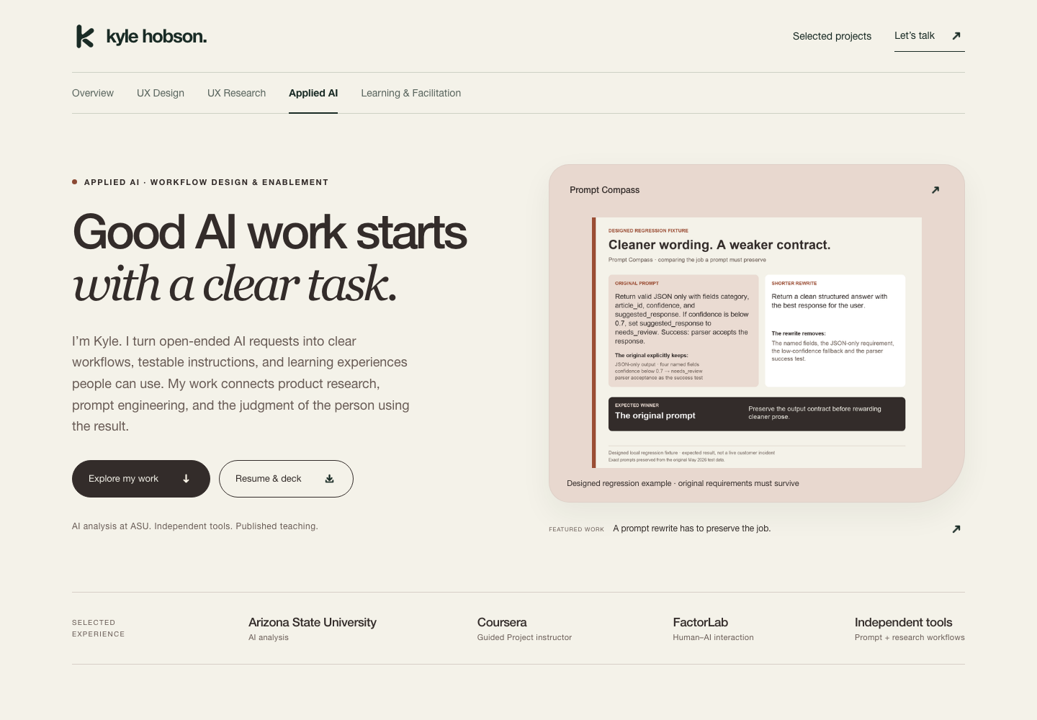
PORTFOLIO MAKING / ORIGINAL PUBLIC SITE, 2026
The portfolio is part
of the AI workflow
I use AI to organize source material and test drafts, then check each public claim against its evidence.
The result connects a working example to its case, context and next action.
Earlier portfolio presentation, before visual case refinements
View the case →
12
Notes:
Source image: case-library/ai-assisted-web-evolution/site/assets/portfolio-2026-09.png, an original screenshot of Kyle’s earlier public portfolio presentation. Public Applied AI destination: https://jonathankhobson.github.io/portfolio/ai/ . Case page: https://jonathankhobson.github.io/portfolio/ai/case/making-the-portfolio/ . The workflow is evidence selection, AI-assisted drafting and integration into the public site with human claim review. This image predates the current visual case refinements; it is not a screenshot of an autonomous publishing system or a measured conversion result.

Slide 13
THE THREAD THROUGH MY WORK
The person using
the system matters
Documentary filmmaking taught me to listen closely. Learning design taught me to make the next step teachable.
That perspective carries into my AI work: understand the task, make the output inspectable, and leave room for human judgment.
13
Notes:
This editorial connection draws on Kyle’s self-described documentary filmmaking background, reviewed learning-design roles and published AI instruction. It frames his applied-AI approach without claiming production machine-learning engineering or measured client ROI. The portrait is a user-supplied personal image.

Slide 14
KYLE HOBSON / APPLIED AI
Let’s make AI useful
in your workflow
For applied AI consulting, AI analysis, prompt design, enablement, and human–AI product work.
JonathanKyleHobson@gmail.com
jonathankhobson.github.io/portfolio/ai
14
Notes:
For applied AI workflow consulting, prompt engineering, business analysis and enablement. The intended portfolio destination is configured as a hyperlink.

