Slide 1
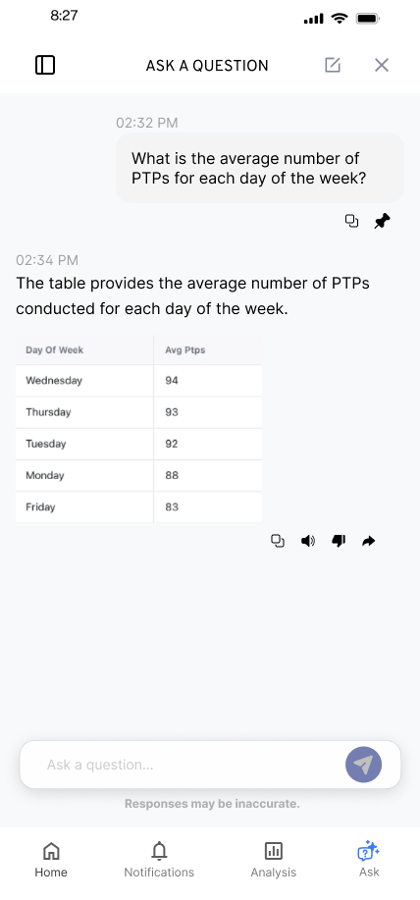
KYLE HOBSON / UX DESIGN
Complex products.
Clear next steps.
I make AI and information-rich products
easier to understand.
Selected design work, 2023–2026
01
Notes:
Kyle Hobson, UX Designer. Source: selected original SmartTagIt Flint design export. Interface content and values are illustrative design content. The deck discusses design deliverables, handoff and proposed iterations, with work stage stated at each case opening.

Slide 2
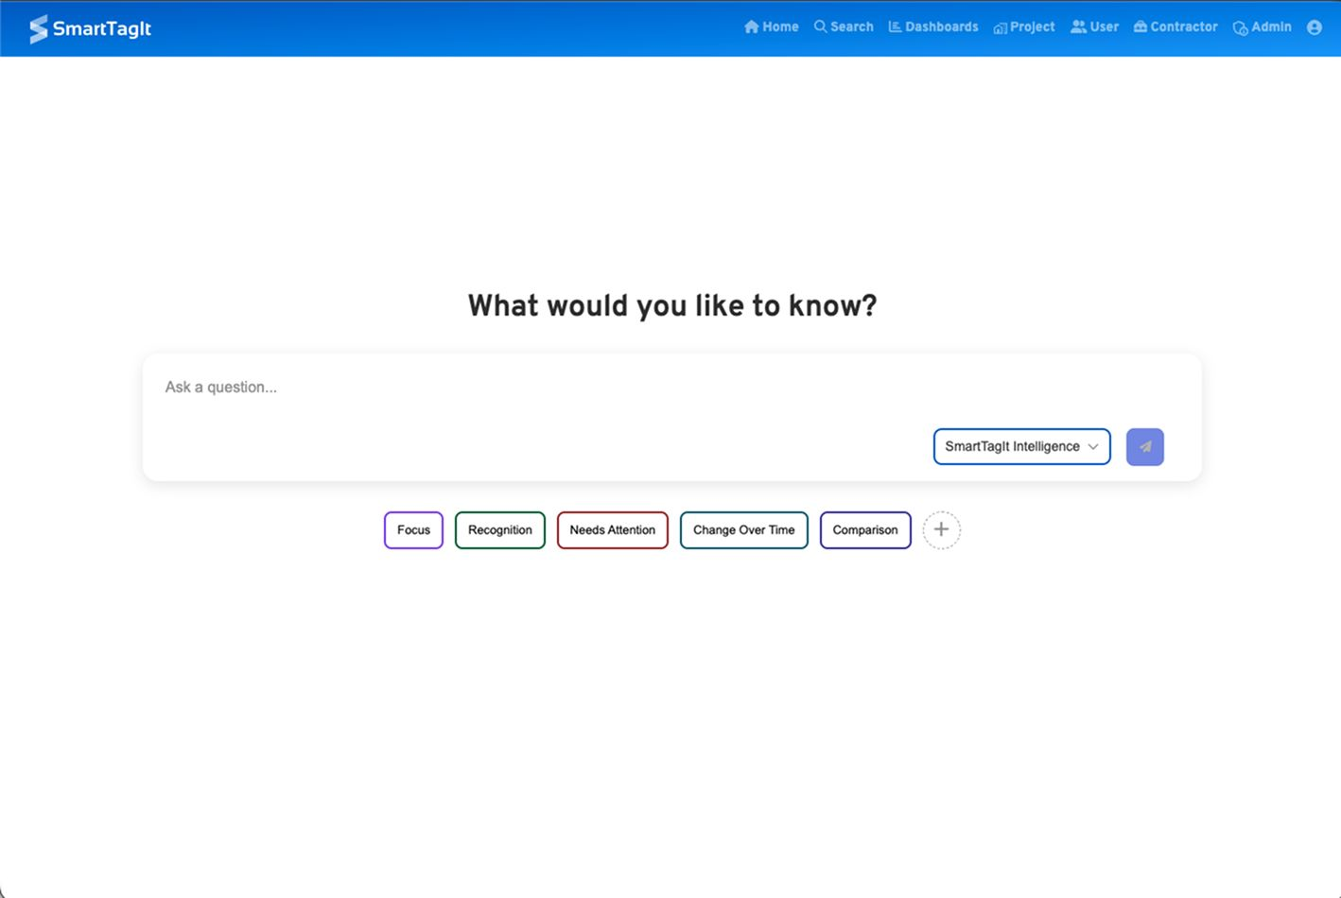
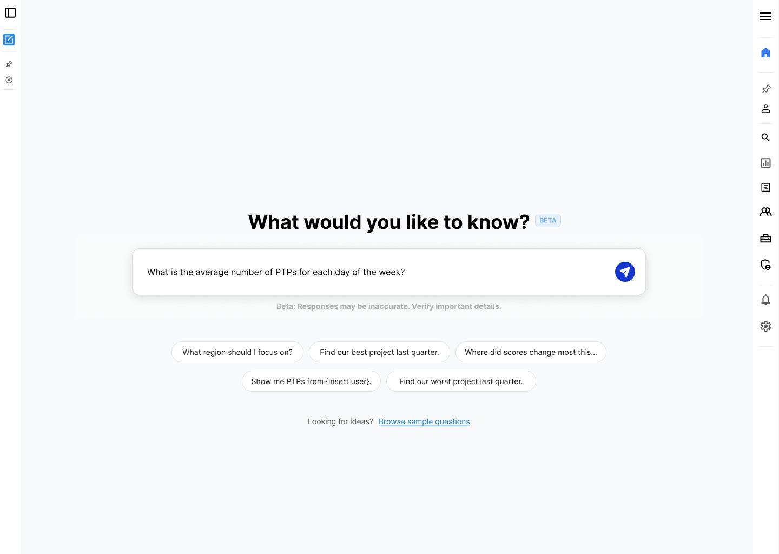
FLINT / SMARTTAGIT, FACTORLAB
A useful first question
BEFORE
MY DESIGN EXPLORATION
An empty field and broad categories.
Specific suggestions, ready to edit.
Original interface and revised design · UX Designer & Researcher, 2025–2026 · user impact unmeasured
02
Notes:
Case: Flint, SmartTagIt at FactorLab. Kyle: UX Designer & Researcher (Contract), 2025–2026. Source: original embedded screenshots from factorlab-slides-v1-2, page 4, visually compared with the current Google Slides source. The older interface uses an empty question field and category controls. My revised design shows concrete suggested questions and an example filled into the input for review or editing. The broader question library remains available. This comparison shows a design decision, not a measured gain or proof of the released navigation layout. The companion mobile entry remains in the website case study.

Slide 3
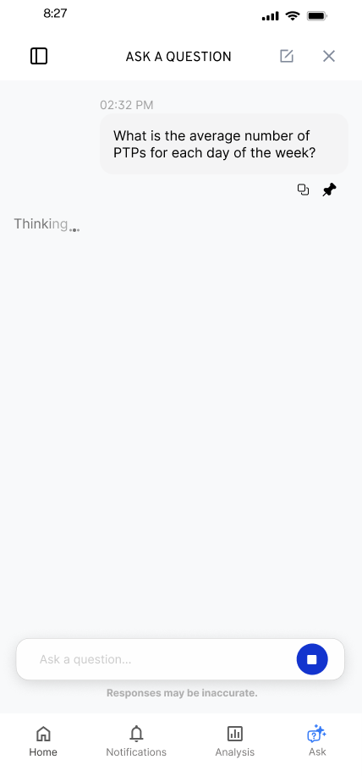
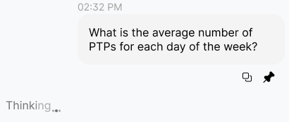
FLINT / RESPONSE IN PROGRESS
Waiting is part of
the conversation
I kept the question visible and gave the response a distinct waiting state.
Original state detail
Animation was an implementation question to resolve with engineering.
03
Notes:
Source: original Flint response-in-progress mobile export and design walkthrough. The inset enlarges an unchanged region of the same source image. Kyle explored the waiting treatment alongside the conversation and discussed animation constraints with engineering.

Slide 4


FLINT / INTERRUPTED AND OFFLINE STATES
Incomplete answer
Connection lost
Recovery follows
the failure
An incomplete answer and a lost connection need different next actions.
An August 2026 engineering reply confirmed implementation of the approved error states. The exact pictured variants remain unverified.
04
Notes:
Source: selected original Flint interrupted-response and offline design variants, including the March 27, 2026 error-state handoff. Distinct recovery actions follow the state: Ask again or Continue for a partial response, and retry after connection loss with the question preserved. Deliverable: connected flows, interaction states and engineering annotations. An August 3, 2026 engineering reply reports Ask a Question error states implemented to approved Figma; AI Assist still used older patterns. This is an implementation report, not independent behavior testing or a measured recovery improvement.

Slide 5
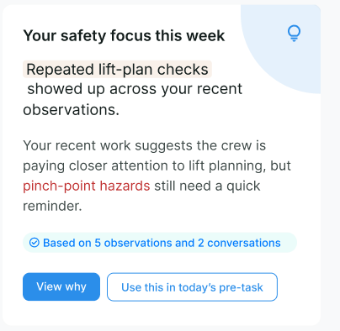
ABOUT ME / SMARTTAGIT, FACTORLAB
Feedback
with context
UX Designer & Researcher (Contract), 2026
I connected a personal summary to its supporting observations and a useful next action.
Design iterations shown with sample content.
Web/server release confirmed September 2, 2026.
05
Notes:
Case: About Me, SmartTagIt at FactorLab. Kyle: UX Designer & Researcher (Contract), 2026. Source: original About Me Figma direction and April–May 2026 walkthroughs. The displayed crop retains original sample content. A September 2, 2026 engineering update confirms the About Me web/server release. These images document design iterations rather than the exact released layout.

Slide 6
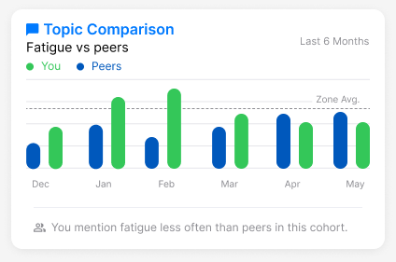
ABOUT ME / NEUTRAL COMPARISON
A comparison needs
an interpretation
Mentioning fatigue less often is a comparison. Whether that is good depends on the context.
I raised the cohort, percentile and wording questions before they became interface rules.
Original widget, illustrative values
06
Notes:
Source: original About Me Topic Comparison widget and stakeholder design discussions. Values are illustrative design content, not research outcomes. Kyle advocated neutral feedback and made cohort definition and interpretation questions explicit. The case output was a family of insight layouts and concrete product questions for alignment.

Slide 7
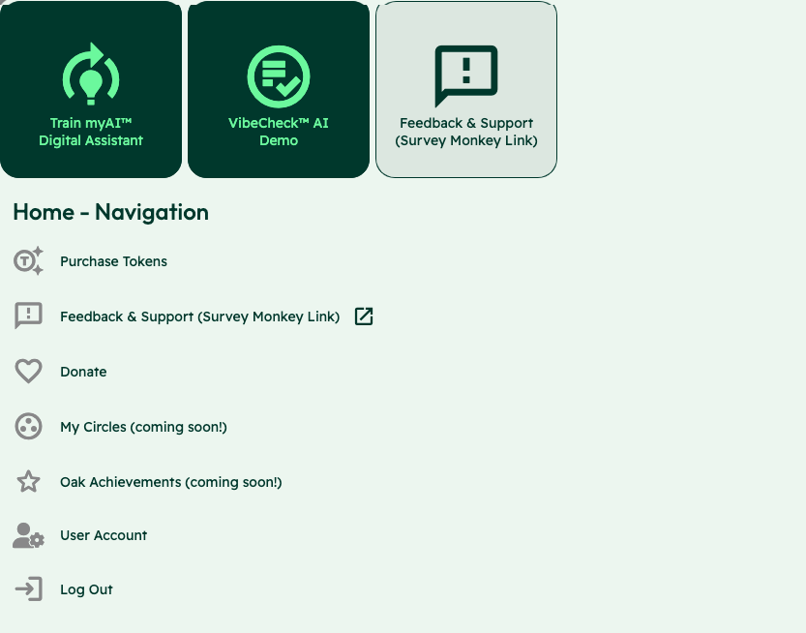
OAK AI / LEAD UX RESEARCHER, 2023–2025
Competing
entry points
Training an assistant, starting a Vibecheck and requesting support competed at the same entry point.
I used the audit to make these choices explicit for the team’s review.
Usability evaluation and design recommendations
07
Notes:
Case: Oak AI. Kyle: Lead UX Researcher, 2023–2025. Source: original Oak navigation evaluation screenshot, with the identity area omitted. Training the assistant, starting Vibecheck and requesting support appear as competing entry points. Kyle documented the labels and visual treatments and used the audit to make these choices explicit for review. Work stage: usability evaluation and design recommendations. This slide does not present a finished navigation redesign or a user-study finding.

Slide 8


OAK AI / ERROR RECOVERY RECOMMENDATION
Error feedback beside the field
ORIGINAL
MY RECOMMENDATION
The error sat away from the login fields.
Place the correction beside the field.
Separate page-footer message:
Original recommendation artifact.
Exact shipped variant and usability impact unverified.
08
Notes:
Sources: original Oak desktop evaluation and error-messaging recommendation artifact. The shown crops retain original interface pixels and exclude the identity-bearing example field. Original and Proposed labels distinguish the existing interface from the recommendation. The evaluation identified error feedback that did not explain recovery, and the recommendation made a specific correction visible near the password field. This is a recommendation, not a measured usability improvement or a claim that the exact variant shipped.

Slide 9

THE THREAD THROUGH MY WORK
I started by listening
to people’s stories
Documentary filmmaking taught me to listen closely and find the thread in a complicated story.
Those habits stayed with me in research and design. Outside work, I run tabletop games, where listening and helping a group find its way matter too.
09
09
Notes:
Personal story is based on Kyle’s self-described documentary filmmaking, digital storytelling and game facilitation background. It is an editorial connection, not a measured business-outcome claim. The portrait is a user-supplied personal image, used for identity rather than as project evidence.

Slide 10
KYLE HOBSON / UX DESIGN
Let’s make the
next step clearer
For product and UX design roles, contract projects, and collaborations.
JonathanKyleHobson@gmail.com
jonathankhobson.github.io/portfolio/design
10
Notes:
For product and UX design roles, contract projects and professional collaborations. The displayed contact links are clickable.

