Slide 1
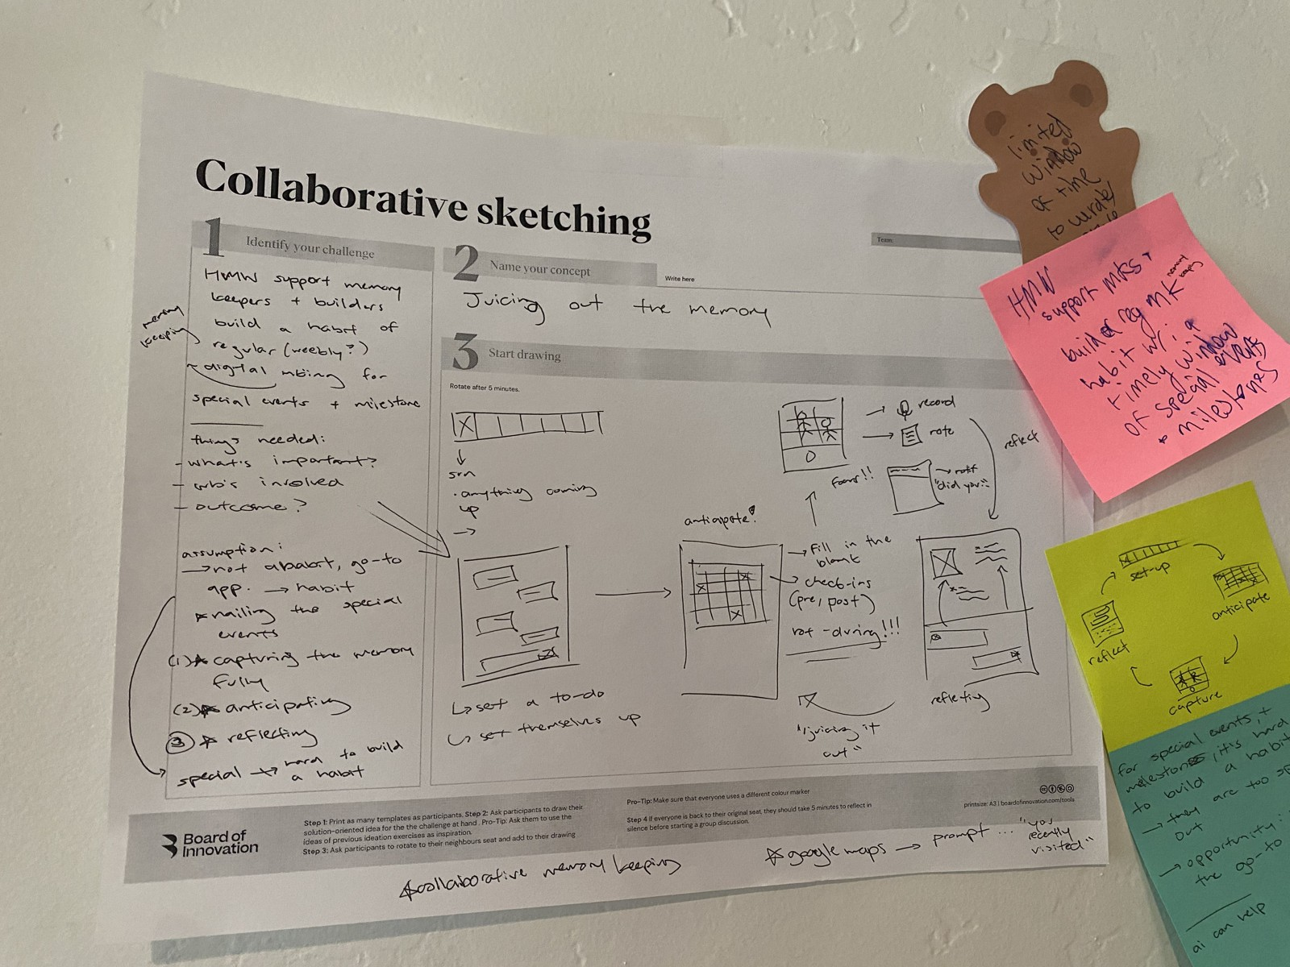
KYLE HOBSON / LEARNING & FACILITATION
Make the next step
something people
can do
Instructional design, hands-on AI teaching,
and workshops that leave a team
something to build on.
Team workshop artifact · KeepMake, 2025
Worksheet: Board of Innovation
Coursera instructor
ASU learning design · KeepMake workshops
01
Notes:
Selected learning-design and facilitation work by Jonathan Kyle Hobson. Sources: published Coursera Guided Project and original course artifacts, 2025 KeepMake workshop records and original collaborative-sketching photo, and a 2024 ASU learner-support proposal. The cover shows team-generated work on a Board of Innovation worksheet. My contribution was the activity sequence, documentation and synthesis support; the team generated the ideas.

Slide 2
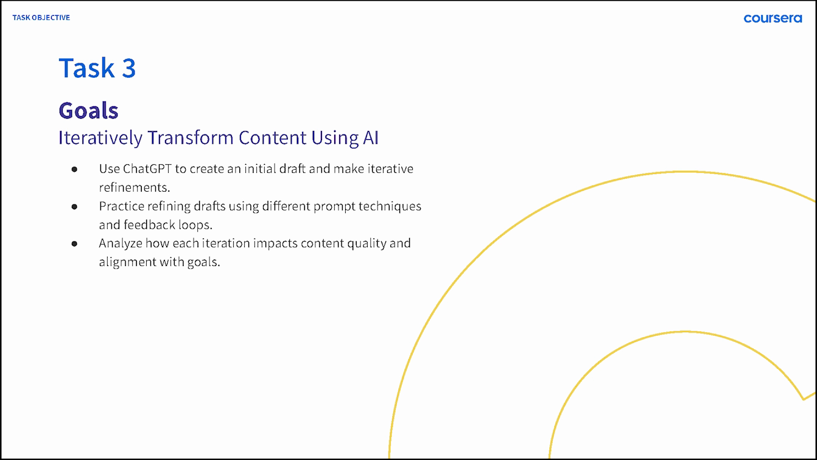
COURSERA / GUIDED PROJECT, 2024
Begin with a task
the learner can recognize
A fictional café gives a beginner an audience, a message, and a reason to revise an AI-generated post.
My work: objectives, practice tasks, lesson materials, demonstrations, and production revisions.
Original lesson slide · fictional Brew Bliss scenario
02
Notes:
I created and taught ChatGPT 4o for Beginners: Create Social Media Content. The original Task 3 slide aligns the activity with drafting, refining, and evaluating goal alignment. The broader course uses learner practice and a weekly content-calendar deliverable. This describes instructional design, not measured learning gains.

Slide 3
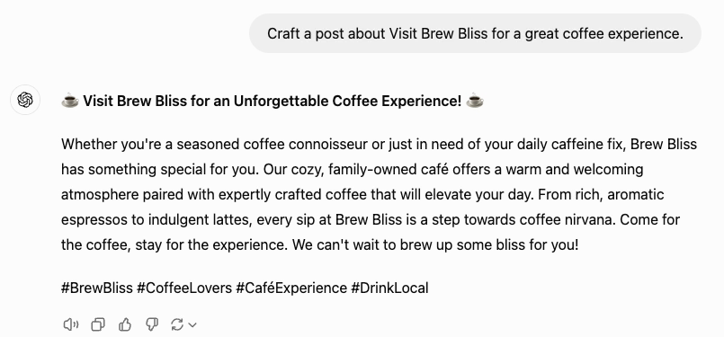

THE TEACHING / ORIGINAL RECORDING EXCERPTS
Make a revision visible enough to judge
01 Initial request and draft
02 A specific instruction to refine it
Watch the 1:24 teaching excerpt
03
Notes:
Original 2024 course recording crops preserve historical UI and wording. Brew Bliss is fictional practice material. The next output is more detailed and longer; additional claims still require review. The linked edited teaching excerpt is a separate Task 2 segment, not footage of a live workshop. Production correspondence documents narration enhancement with Adobe tools and ElevenLabs. The website includes a written summary and the full course-video link.

Slide 4
COURSE REVIEW / OCTOBER 2024
The assessment improved
through specific critique
REVIEW FINDING
MY DOCUMENTED REVISION
Distractors were easy to eliminate
Reworked answer choices, especially Q7, Q8, and Q10.
Question 7 tested a definition
Added application of the concept in context.
Retry feedback revealed the answer
Made feedback neutral and corrected lesson references.
Original expert-review record and instructor responses. Learning gains were not measured here.
04
Notes:
Paraphrased from the original Course Shell Feedback, October 1, 2024, and my October 4 review reply. The reviewer also identified incorrect task references, including an optional cumulative task. My response notes document corrected references, less obvious distractors, application-based wording, and neutral retry feedback. The separate QA approval fields do not establish individual final signoff. These are formative revisions, not a learner outcome study.

Slide 5
KEEPMAKE / TEAM WORKSHOP, 2025
Give a team something
concrete to think with
I designed an in-person sequence combining opportunity statements, individual sketches, gallery sharing, and planned prioritization.
The ideas were collaborative. My contribution was the activity sequence, documentation, and synthesis support.
Original team material · Board of Innovation worksheet
05
Notes:
Original photograph recovered from page 21 of my earlier portfolio; its content matches the May 2025 workshop record and correspondence. The camera date was not independently verified. I sent the in-person agenda on May 30. Broader preparation and all workshop ideas were collaborative. The worksheet template is by Board of Innovation; I do not claim authorship of that blank template.

Slide 6
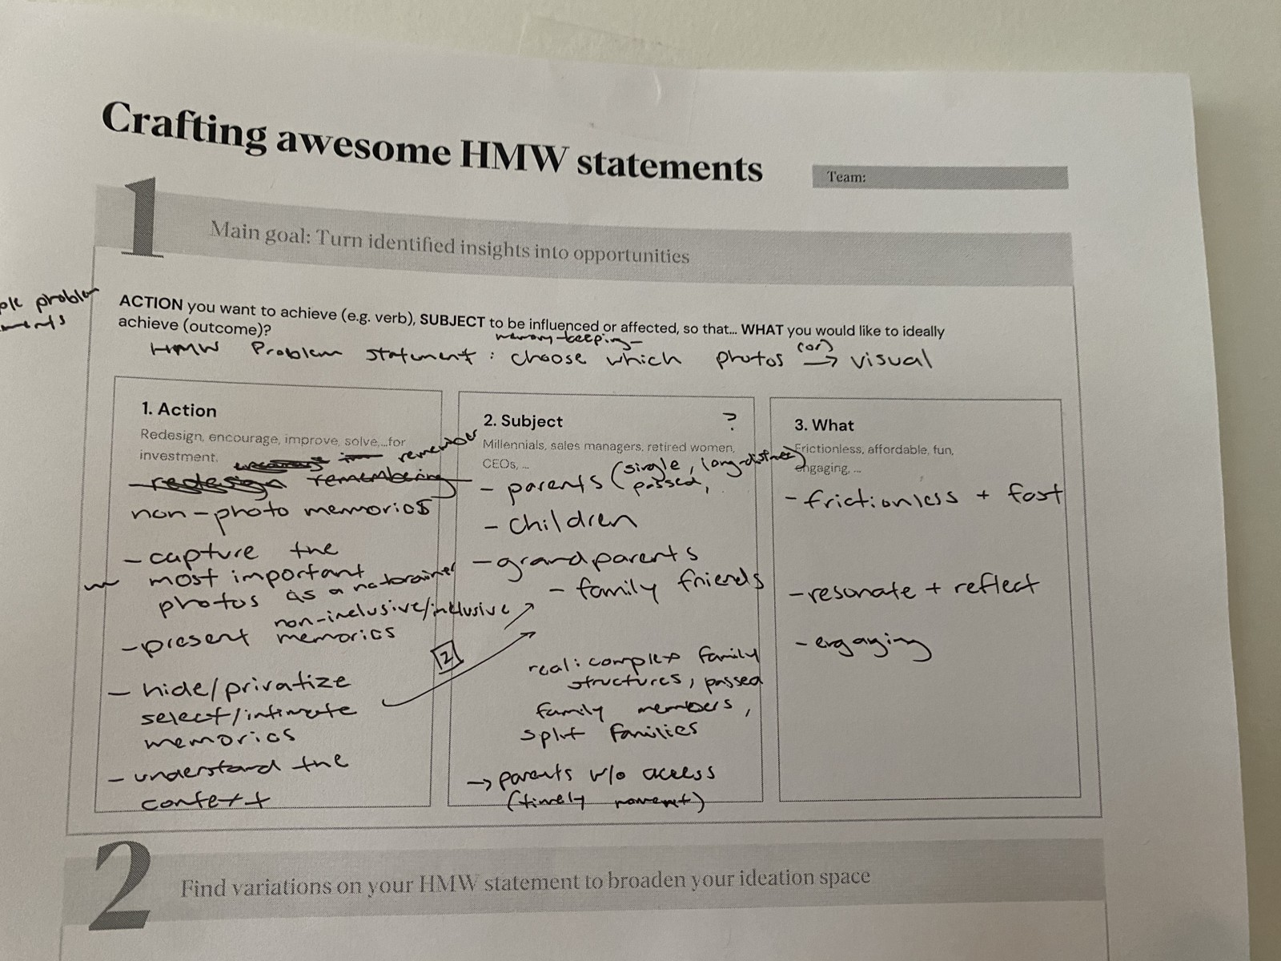
THE ACTIVITY SEQUENCE / ORIGINAL AGENDA
Frame the question
before choosing a feature
01
Frame
Opportunity statements + How Might We
02
Make
Individual Year in Review sketches
03
Compare
Planned sequence, not verified actual timings.
Photo: team worksheet; template by Board of Innovation.
Gallery sharing + themes + Now / Next / Later
06
Notes:
Selected stages from my original May 2025 agenda, reformatted. The agenda allowed drawing, writing, Figma, and storyboarding for the same ideal end-state task. It proposed timed sharing, affinity mapping, and Now/Next/Later prioritization. The record does not establish that every stage ran exactly to schedule. The photographed HMW worksheet contains collaborative exploratory framing, not verified user findings.

Slide 7
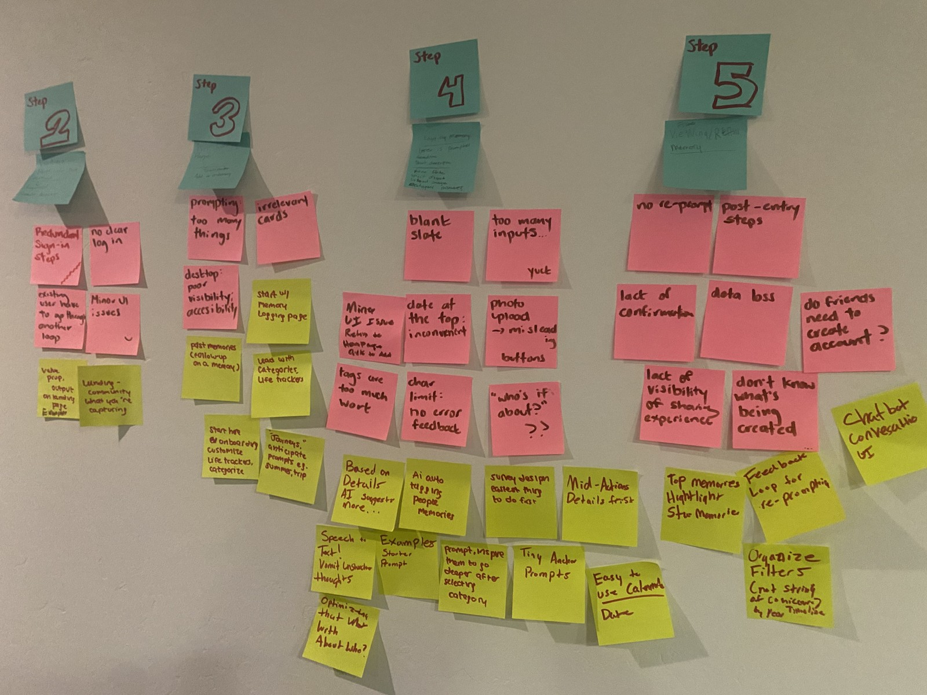
WORKSHOP OUTPUT / ORIGINAL KEEPMAKE MATERIAL
Keep the ideas and their context together
Pink notes capture concerns.
Yellow notes suggest directions.
The retained workshop record and June follow-on discussion gave the team material to revisit, question, and develop.
These are team-generated ideas, not user-validated findings or proof of shipped features.
07
Notes:
Original photograph recovered from page 22 of my earlier portfolio. The source workshop record preserves raw problems and How Might We variants separately from later synthesis. It explicitly distinguishes workshop-derived iteration from past research. Photo includes no participant faces or personal worksheets. Product-stage labels and handwritten ideas are original collaborative material.

Slide 8
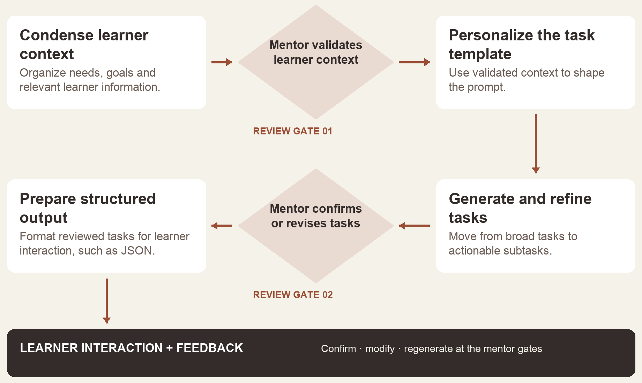
ARIZONA STATE UNIVERSITY / AI ANALYST, 2024
Keep a mentor in the learning loop
I proposed two human reviews: first the learner context, then the generated task.
2024 design proposal.
Deployment and learner outcomes were not established.
Simplified reconstruction of my documented proposal
08
Notes:
Original 2024 ASU for Life collaborative prompt-architecture document identifies my proposal. The original Figma flowchart and simplified portfolio reconstruction show human review of learner context and generated tasks. This selected reconstruction is not a deployed product screenshot. A next evaluation would ask mentors to judge realistic learner scenarios before a pilot.

Slide 9
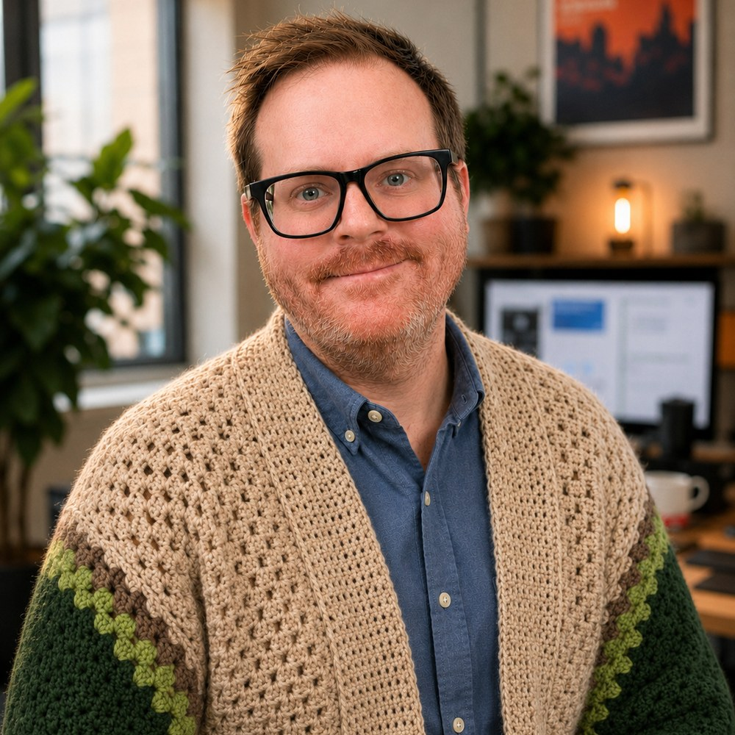
THE THREAD THROUGH MY WORK
Listen closely.
Make room to try.
Documentary storytelling taught me to listen. Learning design and UX taught me to notice where an explanation stops helping.
I bring that attention to a learner comparing two drafts, a team sketching an idea, and a group finding its next step together.
09
Notes:
Personal framing based on my documentary storytelling, technical communication, learning-design and UX background. Tabletop facilitation is an adjacent personal practice; this deck does not represent it as corporate training delivery. Education includes MS User Experience, ASU 2024. See the linked resume for the full role history.

Slide 10
KYLE HOBSON / LEARNING & FACILITATION
What should people
be able to do next?
Instructional design · AI literacy · learning experiences
customer education · workshop facilitation
JonathanKyleHobson@gmail.com
jonathankhobson.github.io/portfolio/learning
10
Notes:
Explore the live instructional design and facilitation portfolio for three case studies, the edited teaching excerpt, the full public course video, original workshop photos, and resume downloads. Contact via email or the website form.

