Slide 1

Database
Database Schema
PHPMyAdmin

Slide 2
Database Schema
Creation
Tables
Attributes

Slide 3
MyPHPAdmin
Xampp
SQL Database
SQL Queries

Slide 4
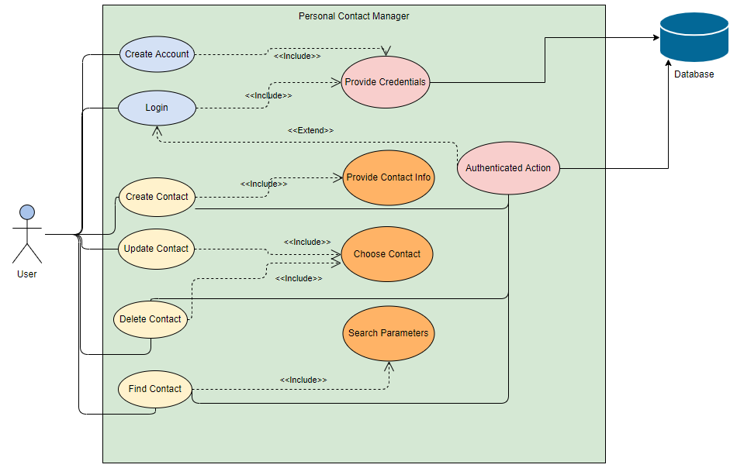
Use Case Diagram

Slide 5
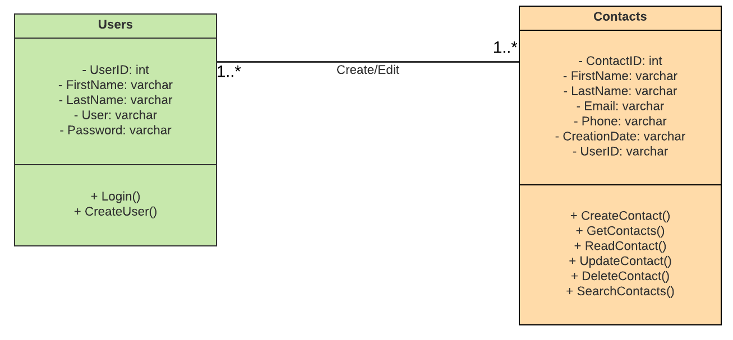
ERD (UML STYLE)

