Slide 1

Summertime Contacts
Small Project – Group #21
Contacts21.us

Slide 2
Team Members (and timeline)
Database Administration and Design:
Liderma Guerry
API Development and Testing:
Alex Varga
Dakota Downing
Front-End Development and Testing:
Idel Ramos
Mason Benell

Slide 3
Technology Used (Infrastructure):
LAMP Stack:
Operating System Layer:
Linux (CloudLinux 6)
Web Server Layer:
Apache (2.4.33)
Administration via cPanel
Database Layer
MySQL (5.6.39)
Administration via PhpMyAdmin (4.7.7)
Scripting Layer
Back-end: PHP (7.2)
Front-end: HTML/CSS/ReactJS (15.4.2)

Slide 4
Technology Used:
Project:
Communication:
Project Management:
Task Management/Tracking:
Hosting:
Personal:
API Testing:
Development, Testing, FTP:
Repo Management:
ARC (Advanced Rest Client) & CURL
IntelliJ PHPStorm
Atlassian Sourcetree, TortoiseGit
GoDaddy for webhosting
Google for domain management
Kanban (GitHub ‘Projects’)
GitHub
Discord

Slide 5
What I did: Project Manager
Setting up GitHub repo and Project board
Providing clearly defined tasks and instructions
Assisting with learning new topics
Helping with development whenever requested or necessary.

Slide 6
The good...
For the project manager, I would feel like I fixed everything that could be a problem.
So I made an anonymous survey for the team to share their opinions.
What went well:
(4 responses) Teamwork (help learning or completing tasks)
(4 responses) Fair distribution of tasks
(2 responses) Learning a lot (new languages and software tools)
(1 response) Prior knowledge saved time learning new things/fixing bugs

Slide 7
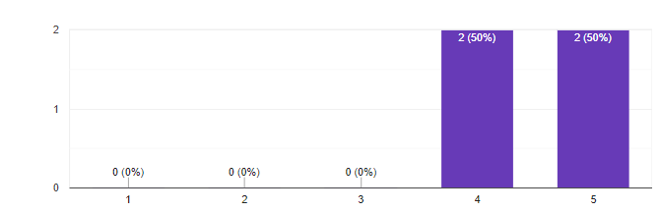
The good
Average difficulty completing this project alone: 4.5/5

Slide 8
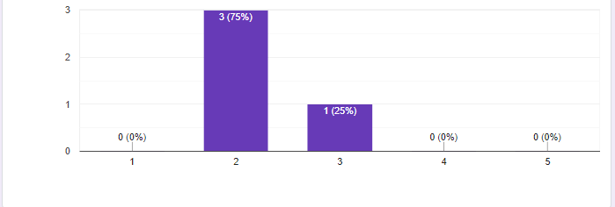
The good
Average difficulty completing this project together: 2.25/5

Slide 9
... and the bad
(2 Responses) Nothing
(1 Response) Difficult to learn new material, more information would help.
(1 Response) Development choices lead to a more difficult and time-consuming project.
Personally?
Great team! Good communication, even with limited availability.
For the future?
More up-front resources
More frequent communication
Better guidelines for Github utilization
More definitive deadlines (as schedules permit)

Slide 10
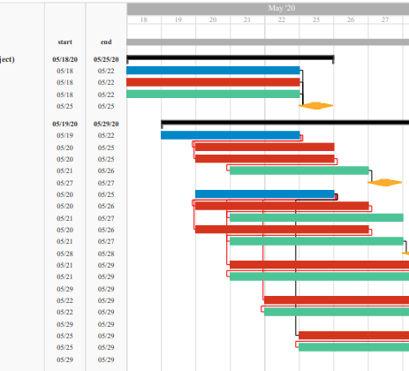
Gantt Chart
Gantt chart created, but not heavily utilized (seemed to be a poor fit)
Condensed schedule, limited availability
Seems like a great fit for teams in a professional environment (shows task dependencies)

Slide 11
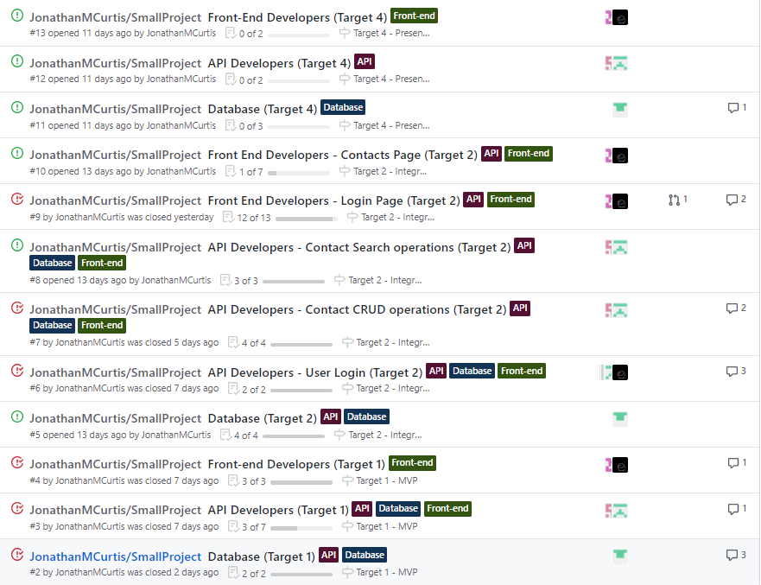
Project Planning
Primarily utilized the Kanban style of task management available on Github (Projects)
1. Tasks separated out into Github issues (for tracking and discussion)

Slide 12
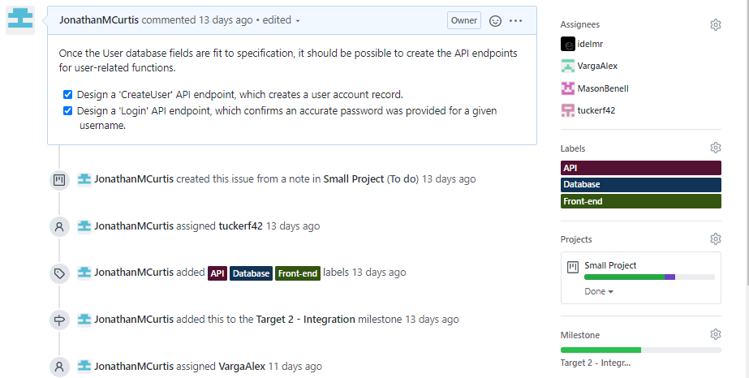
Project Planning
Primarily utilized the Kanban style of task management available on Github (Projects)
1. Tasks separated out into Github issues (for tracking and discussion)
2. Issues are assigned to the relevant team members, and to a particular milestone.

Slide 13
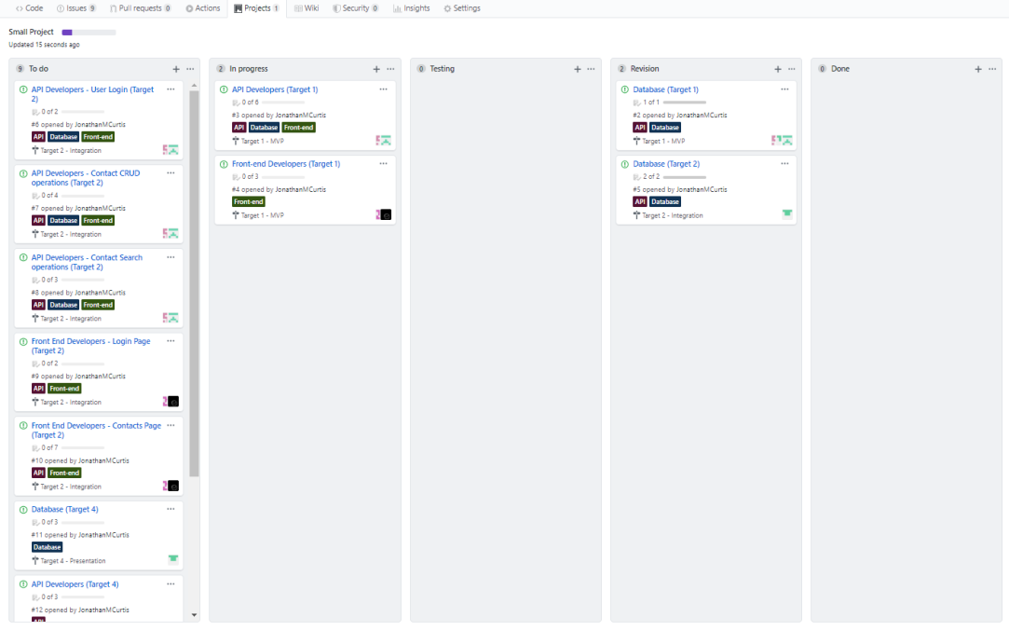
Project Planning
Primarily utilized the Kanban style of task management available on Github (Projects)
1. Tasks separated out into Github issues (for tracking and discussion)
2. Issues are assigned to the relevant team members, and to a particular milestone.
3. All issues tracked via cards that show each task’s progress (To-do, In progress, Testing, Revision)

Slide 14
Database
Liderma Guerry
Database Schema
ERD
phpMyAdmin
Use Case Diagram

Slide 15
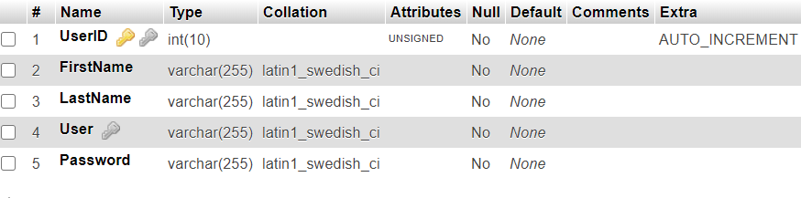
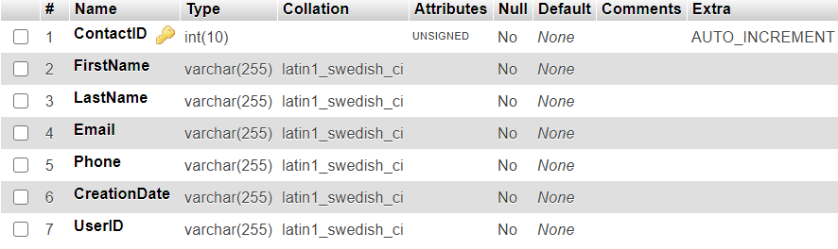
Database Schema
Users Table
Creation
Tables
Attributes
Contacts Table

Slide 16
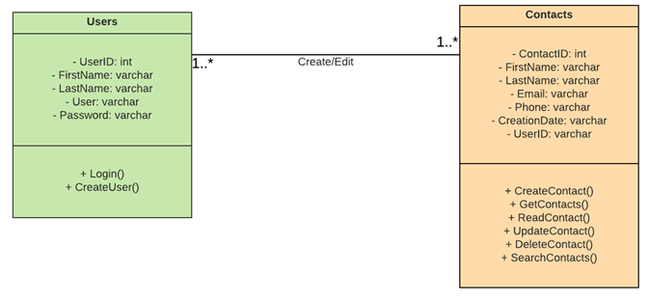
ERD(UML Style)
made with Luicdchart

Slide 17

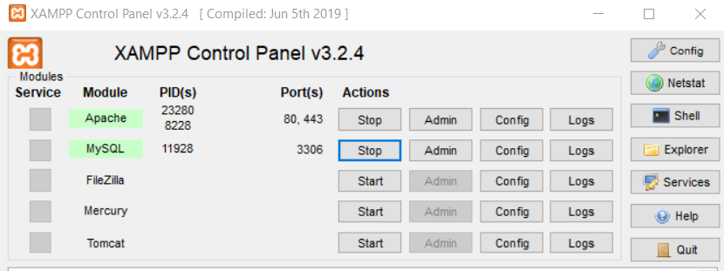
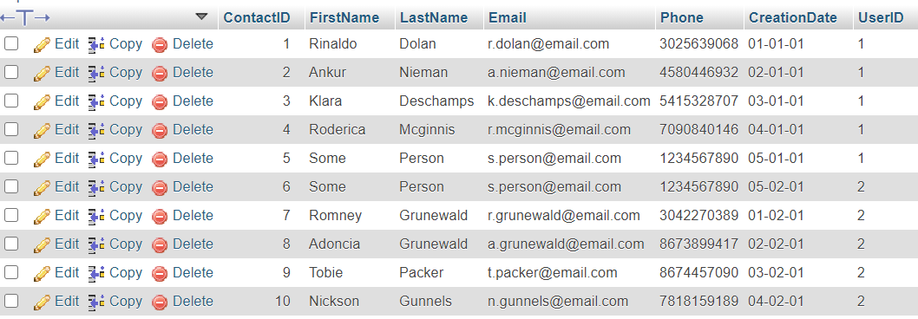
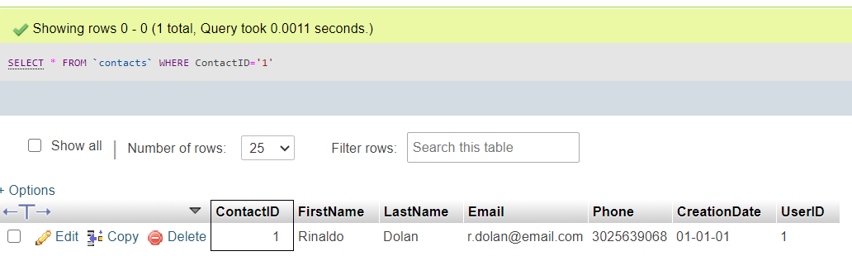
SQL Database
Xampp
SQL Queries

Slide 18
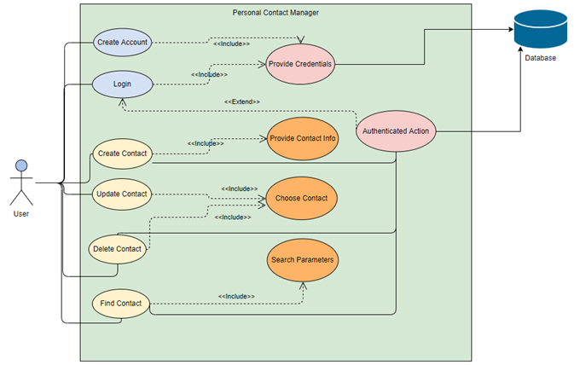
Use Case Diagram
made with Visual Paradiagm

Slide 19
Database Mistakes and Takeaways
Mistakes
Rushing phpMyAdmin
Takeaways
Flexibility of phpMyAdmin

Slide 20
API
Dakota Riediger Downing
Login.php
CreateUser.php
Alexander Varga
Contact CRUD operations

Slide 21
User Access
Login.php
CreateUser.php
These endpoints retrive the user data from the front end and run it against the database
Login returns an error if the username and password do not match in the system
CreateUser returns an error if the user already exists within the system

Slide 22
CRUD Operations
CRUD
CreateContact.php
ReadContact.php
UpdateContact.php
DeleteContact.php
The CRUD Operations access the database and allow the web application to retrieve and make changes to stored data

Slide 23
Search Operations
SearchContact.php
The Search Operations use the user's input to search for anything within the database that contains the query as a substring

Slide 24

Front-End
Idel Ramos and Mason Benell
API call functions
Homepage
Contacts page
Not Found page
Logo design

Slide 25
Front-End cont.
Framework: React + Bootstrap
Languages used: HTML, CSS, and JavaScript
Pages included: Home.js, ContactManager.js, and NotFound.js
Users.js: Fetches the API and creates easy to use functions
Router.js: Allows webpage traversal

