Slide 1



Pivot Tracing
Dynamic Causal Monitoring for Distributed Systems
Jonathan Mace, Ryan Roelke, Rodrigo Fonseca
Brown University
Notes:
Pivot Tracing is joint work between Jonathan Mace, Ryan Roelke, and Rodrigo Fonseca of Brown University.
If you are using these slides, please let me (Jon) know!

Slide 2

Pivot Tracing
Dynamic Causal Monitoring for Distributed Systems
Dynamically instrument live distributed systems
Correlate and group events across components
Jonathan Mace, Ryan Roelke, Rodrigo Fonseca
Brown University
Hadoop Stack
Notes:
Pivot Tracing is about dynamically instrumenting live distributed systems to get real-time statistics where we are able to correlate and group events across different processes, machines and applications.
We begin with an example in order to make the discussion concrete.
To begin with, imagine you are operating a cluster running the Hadoop stack

Slide 3
HBase
Machines
MapReduce
HDFS
Disk
Hadoop Stack
Notes:
A typical Hadoop deployment might comprise:
HDFS, the hadoop distributed file system
Hbase, a distributed database,
MapReduce, a data analytics framework
Let’s add some users and workloads to the cluster

Slide 4
HGET
FSREAD64M
MRSORT100G
HSCAN
FSREAD4M
MRSORT10G
HBase
Machines
MapReduce
HDFS
Disk
Hadoop Stack
How is disk bandwidth being used?
Notes:
Let’s say we have:
Two direct clients of HDFS,
Two Hbase clients, indirectly accessing HDFS
Two MapReduce jobs, sorting data that resides in HDFS
In this scenario, how might you go about monitoring the cluster’s disk usage?

Slide 5
HGET
FSREAD64M
MRSORT100G
HSCAN
FSREAD4M
MRSORT10G
DataNode
Metrics
HBase
Machines
MapReduce
HDFS
Disk
How is disk bandwidth being used?
Notes:
HDFS is a reasonable place to start because it is our underlying filesystem, and it conveniently has DataNodeMetrics which track disk (read and write) throughput on each machine.
If you ran the setup I described, as we did, then you could plot disk throughput over time, grouped by machine, like this

Slide 6
HGET
FSREAD64M
MRSORT100G
HSCAN
FSREAD4M
MRSORT10G
DataNode
Metrics
HBase
Machines
MapReduce
HDFS
Disk
Notes:
But what if you wanted to attribute disk consumption to the applications sitting on top of HDFS?
Well, HDFS doesn’t provide such a grouping, and neither does it report disk consumption statistics back to its clients.
However, Pivot Tracing can capture this type of grouping, and we plot the data in this figure, where we can see disk throughput attributed to the applications directly accessing HDFS.

Slide 7
HGET
FSREAD64M
MRSORT100G
HSCAN
FSREAD4M
MRSORT10G
DataNode
Metrics
HBase
Machines
MapReduce
HDFS
Disk
Notes:
Now suppose you are interested in disk throughput grouped by top level client application.
That is a particularly useful grouping – it tells you which workloads and users are the ones ultimately consuming the disk.
For the same reasons as before, HDFS doesn’t provide this metric grouping, because it doesn’t have visibility into any of the other applications running on the cluster.
We can query this relation with Pivot Tracing though, and this figure shows the HDFS disk throughput grouped by top-level client application.

Slide 8
HGET
FSREAD64M
MRSORT100G
HSCAN
FSREAD4M
MRSORT10G
DataNode
Metrics
HBase
Machines
MapReduce
HDFS
Missed!
Disk
IOStream
How is disk bandwidth being used?
Notes:
Now, the original question was about how disk bandwidth was being used across the cluster, not just from within HDFS.
DataNodeMetrics will miss, for example, the disk accesses made by MapReduce jobs to spill intermediary outputs.
Where else could you get disk metrics? Well, cluster managers typically expose disk statistics broken down by process.
An equivalent strategy would be to instrument Java’s IO streams within all Java processes to intercept all disk consumption.<click>
In this scenario, you would be able to capture the extra disk consumption made from these three constituent MapReduce processes,
But now you lack visibility within the processes

Slide 9
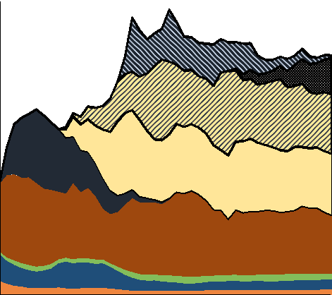
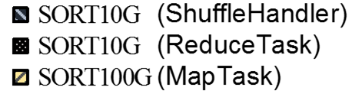
HGET
FSREAD64M
MRSORT100G
HSCAN
FSREAD4M
MRSORT10G
HBase
Machines
MapReduce
HDFS
Disk
IOStream
How is disk bandwidth being used?
Notes:
Finally, how might you be able to capture all of this disk consumption while still attributing it to top-level clients?
This figure shows not only which top-level client applications are responsible for disk access, but also from which processes.
In the rest of this talk, I’ll show how Pivot Tracing can obtain and correlate these metrics as well as any others from arbitrary points in the system.
We’ll also come back to this example and I’ll show how we we used Pivot Tracing to uncover a bug in HDFS that was seriously affecting the FSRead workload
But before that, there are two important reasons why this is hard to do today

Slide 10
Instrumentation is decided at development time
Probably not have enough info for your problem
Probably too much irrelevant info for your problem
Should every user bear the cost of a feature?
HDFS-6292 Display HDFS per user and per group usage on webUI.
https://issues.apache.org/jira/browse/HDFS-6292
Notes:
The first reason is that today, logging and monitoring tools are incorporated into the system at development time, so we have to decide a priori what to log and monitor.
When we encounter problems in a deployed system, the logging and monitoring tools in place often don’t have the right information to diagnose a problem.
Simultaneously, they probably have a lot of irrelevant information.
If the user needs information that the system doesn’t currently report, then they must go back to the developers or patch the software themselves.
We have to consider whether it is worth the cost of adding additional instrumentation to solve a problem that most users won’t need?
We’ve found ample evidence of this on Apache’s issue trackers, where users are requesting additional instrumentation or different breakdowns of information.
For example, this issue is requesting a simple breakdown of HDFS usage by user and group, similar to what I demonstrated at the beginning, but remains unresolved after more than a year

Slide 11
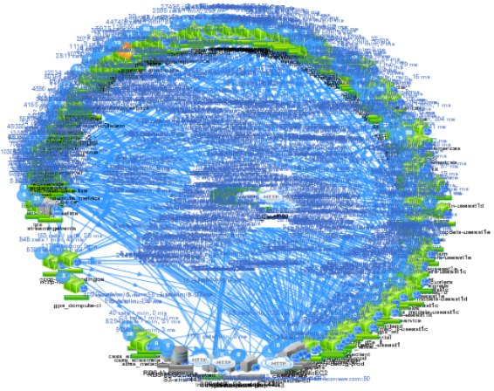
Dynamic dependencies
You often need to correlate information from different points in the system
Systems are designed to compose
Systems don’t embed monitoring that relates to other services
Netflix “Death Star” Microservices Dependencies
@bruce_m_wong
Notes:
The second reason why this is hard to do today is that we often want to correlate information from different services and applications, and there are myriad ways to break down and group even just a single metric.
As we saw, even though disk is fundamental to HDFS, it can’t account for all of the different ways an operator might want to break down and group those metrics.
Correlating events across multiple systems is especially difficult when systems are designed to compose, because it’s rare that systems embed monitoring that relate to other services
Consider Netflix’s microservices “death star”:
The global configuration is constantly changing
Dependencies aren’t going to be known in advance,
Neither are the questions asked by users and operators

Slide 12
Pivot Tracing
You don’t know the questions in advance
Dynamic instrumentation
Fay (SOSP’11), Dtrace (ATC’04), …
You often need to correlate information from different points in the system
Causal tracing
X-Trace (NSDI’07), Dapper (Google), Pip (NSDI’06), …
Notes:
Pivot Tracing addresses both of these challenges by combining two key techniques
We use dynamic instrumentation so that we can defer until runtime our choice about what to monitor
And we use techniques from causal tracing so that we can correlate events from different points in the system at runtime

Slide 13
Pivot Tracing
Model system events as tuples in a streaming, distributed dataset
Dynamically evaluate relational queries over this dataset
Happened-before Join ( )
Join based on Lamport’s happened-before relation
Notes:
A natural way to expose these two features is to first model system events as the tuples of a streaming, distributed data set, over which we can dynamically evaluate relational queries
Second, in order to express causality, we introduce the happened-before join operator, which joins tuples based on lamport’s happened-before relation
With the happened-before join we’re subsequently able to to group and filter events based on properties of any events that causally precede them in an execution.
While these are general concepts that can apply to any distributed systems, for concreteness I’ll be presenting Pivot Tracing in the context of our Java prototype and the Hadoop stack.

Slide 14
Pivot Tracing
Overview

Slide 15
DataNodeMetrics.java
Tracepoint
Class: DataNodeMetrics
Method: incrBytesRead
Exports: “delta”=delta
50 public class DataNodeMetrics {
...
266 public void incrBytesRead(int delta) {
267 ...
268 }
...
407 }
HBase
MapReduce
DataNode
Metrics
HDFS
(“DataNodeMetrics”, delta=10, host=“hop01”, …)
From incr In DataNodeMetrics.incrBytesRead
GroupBy incr.host
Select incr.host, SUM(incr.delta)
Notes:
In our previous Hadoop example we were looking at DataNodeMetrics in HDFS,
Then we view each literal invocation of this “incrementBytesRead” function as a tuple containing features of the event, e.g.,
the name of the function invoked,
the values of local or global variables at that point In time,
the hostname of the machine,
a timestamp
In the tuple shown here, for example, we have the value “Hop01” for host and the value 10 for delta
As an example of how Pivot Tracing expresses relational queries over this dataset, the very first figure in this presentation -- plotting disk throughput by host -- can be expressed as this query
This query:
Takes the tuples produced by the increment bytes read function
Groups them by hostname
And Outputs the sum of the delta variable for each group
We use the term tracepoints to refer to these places in the code where PivotTracing can add instrumentation
A tracepoint specifies, for example, a class and method signature, like aspect oriented programming, and has several variables that queries can refer to

Slide 16
Happened-before Join ( )
Client
Protocols
HBase
MapReduce
DataNode
Metrics
HDFS
Notes:
Key to Pivot Tracing is the ability to correlate with events that occur elsewhere across the system -- for example, we saw the same graph grouped by client application.
In order to produce this graph, we have to relate the DataNodeMetrics tracepoint with the client process that initiated the request.
The happened-before join enables us to express this sort of relation, with which we can write queries to join tuples from multiple tracepoints based on Lamport’s happened-before relation.

Slide 17
Happened-before Join ( )
Client
Protocols
(“ClientProtocols”, procName=“HGET”, …)
HBase
MapReduce
DataNode
Metrics
HDFS
(“DataNodeMetrics”, delta=10, host=“Hop01”, …)
Client
Protocols
DataNode
Metrics
From incr In DataNodeMetrics.incrBytesRead
Join client In First(ClientProtocols) On client -> incr
GroupBy client.procName
Select client.procName, SUM(incr.delta)
(
)
“ClientProtocols”, procName=“HGET”, …
“DataNodeMetrics”, delta=10, host=“Hop01”, …
Notes:
Suppose a request first passes through the ClientProtocols tracepoint, producing a tuple that contains, among other things, the client’s process name Hget.
Next, the request continues and subsequently passes through the DataNodeMetrics tracepoint, producing a tuple that contains, among other things, the value of the delta variable, which is 10.
Since these two invocations satisfy the happened-before relation, a happened-before join between ClientProtocols and DataNodeMetrics would produce a tuple containing all of the values from both tracepoints, including both the client’s process name HGet and the value 10 for delta.
With the happened-before join, we can write this query to join every pair of tuples from ClientProtocols and DataNodeMetrics that satisfy the happened-before relation.

Slide 18
Happened-before Join ( )
Client
Protocols
(“ClientProtocols”, procName=“HGET”, …)
HBase
MapReduce
DataNode
Metrics
HDFS
(“DataNodeMetrics”, delta=10, host=“Hop01”, …)
From incr In DataNodeMetrics.incrBytesRead
Join client In First(ClientProtocols) On client -> incr
GroupBy client.procName
Select client.procName, SUM(incr.delta)
(procName=“HGET”, delta=10, …)
Notes:
This query does the following:
It selects the tuples produced whenever DataNodeMetrics is invoked
It performs a happened-before join with earlier tuples produced by the ClientProtocols tracepoint
Groups results by the procname at ClientProtocols
Then for each group, sums up the delta variable from DataNodeMetrics
In the example shown here, this query would produce a tuple like this, containing both the process name HGet and the value 10 of delta.

Slide 19
Design & Implementation
Pivot Tracing Pre-requisites
  Dynamic instrumentation
PT Agent
Baggage
  Causal tracing
Baggage
  Causal tracing
Notes:
Pivot Tracing overcomes the aforementioned challenges by utilizing two components
First, queries are dynamically installed into a system at runtime using dynamic instrumentation.
A system needs to add a Pivot Tracing agent to perform this dynamic instrumentation.
Second, a system needs to support our Baggage abstraction.
Baggage is what enables us to implement the happened-before join and thereby causally relate events from different parts of the system.
We’ll briefly look at Baggage in more detail.

Slide 20
Process
Tenant
Workload
Request
Baggage is a Key:Value container propagated alongside a request
Generalization of metadata in end-to-end tracing
One instance per request
  Causal tracing
Baggage
Notes:
Baggage is simply a generic key-value container propagated along the execution path of a request.
It is a generalization of the metadata propagation techniques used in previous causal tracing work.
It’s implemented at the granularity of an individual request within a workload

Slide 21
Process
clientName=“FSRead”
Tenant
PACK(clientName,“FSRead”)
Workload
A
Request
UNPACK(clientName)
B
clientName=“FSRead”
Baggage is a Key:Value container propagated alongside a request
Generalization of metadata in end-to-end tracing
One instance per request
  Causal tracing
Baggage
Notes:
With baggage, we can propagate state alongside a request for use later.
For example, suppose we have two tracepoints A and B.
At tracepoint A, we can put the clientName FSRead into the baggage.
Then later at tracepoint B, we can get the clientName from the baggage, and we’ll get back FSRead.

Slide 22
Process
Tenant
Workload
Request
+
Baggage
+
PT Agent
Pivot Tracing Enabled
Notes:
This combination of a Pivot Tracing agent to perform dynamic instrumentation, and Baggage to propagate metadata is what is needed for a system to be pivot tracing enabled

Slide 23
Design & Implementation
Queries

Slide 24
Instrumented System
(+
Baggage,
+
PT Agent)
Workloads
PT Agent
PT Agent
Notes:
We start with our instrumented system, and users of the system submitting various workloads.

Slide 25
Instrumented System
(+
Baggage,
+
PT Agent)
A
PT Agent
B
PT Agent
Tracepoints
Places where PT can add instrumentation
Export identifiers accessible to queries
Defaults: host, timestamp, pid, proc name
Only references – not materialized until query is installed
Tracepoint A
Class: A
Method: A1()
Tracepoint B
Class: B
Method: B1()
Exports: “delta”=delta
Notes:
As introduced earlier, we have several tracepoints defined that refer to places in the code where Pivot Tracing can add instrumentation
Here we highlight tracepoints A and B as examples
Tracepoints export identifiers for variables in the code that queries may refer to, and pivot tracing also exports several default variables such as hostname and timestamp.
Tracepoints are only references to locations in code – they are not baked into the system and they don’t require a priori modifications.
They can be considered like recipes for how to instrument the system.
Defining and using tracepoints isn’t difficult – people do this sort of thing today with systems like D-Trace.

Slide 26
Instrumented System
(+
Baggage,
+
PT Agent)
A
PT Agent
B
PT Agent
Query Language
PT
Relational query language, similar to SQL, LINQ
Refers to tracepoint-exported identifiers
Output: stream of tuples
  e.g., (procName, delta)
From a In A
Join b In B On a -> b
GroupBy a.procName
Select a.procName, SUM(b.delta)
Selection
Projection
Filter
GroupBy
Aggregation
Happened-Before Join
Tracepoint A
Class: A
Method: A1()
Tracepoint B
Class: B
Method: B1()
Exports: “delta”=delta
Notes:
Now we can write queries about the values exported by tracepoints.
Pivot Tracing’s query language is a simple relation query language like SQL and LINQ.
Here, this user is writing a query performing a happened-before join between A and B.
The query groups by process Name from tracepoint A, and sums up delta from tracepoint B
The output of a query is a stream of tuples over time.

Slide 27
Instrumented System
(+
Baggage,
+
PT Agent)
A
PT Agent
B
PT Agent
Pivot Tracing
Front End
Advice
Query
PT
From a In A
Join b In B On a -> b
GroupBy a.procName
Select a.procName, SUM(b.delta)
Query is compiled to advice
(intermediate representation for instrumentation)
Advice will be installed at tracepoints
Limited instruction set
  OBSERVE
  PACK
  FILTER
  UNPACK
  EMIT
A
Advice A1
OBSERVE procName
PACK procName
B
Advice B1
OBSERVE delta
UNPACK procName
EMIT procName, SUM(delta)
Notes:
Users submit queries to the Pivot Tracing front end which compiles the query into advice, an intermediate representation of the instrumentation needed to evaluate the query.
Advice is ultimately installed at the tracepoints referenced by the query.
Advice has a limited instruction set; it can observe the values of tracepoint-exported variables, pack values into the baggage, filter out unwanted values, unpack values, and emit tuples for global aggregation

Slide 28
Instrumented System
(+
Baggage,
+
PT Agent)
A
A1
B
PT Agent
PT Agent
B1
Advice A1
Advice B1
Pivot Tracing
Front End
Query
A1
B1
Weaving
PT
From a In A
Join b In B On a -> b
GroupBy a.procName
Select a.procName, SUM(b.delta)
PT Agent dynamically enables advice at tracepoints
A
Advice A1
OBSERVE procName
PACK procName
B
Advice B1
OBSERVE delta
UNPACK procName
EMIT procName, SUM(delta)
Notes:
The pivot tracing front end then sends the advice to the pivot tracing agents, which dynamically add the advice to the requisite tracepoints. We call this process weaving.

Slide 29
Instrumented System
(+
Baggage,
+
PT Agent)
A1
PACK
OBSERVE
procName
PT Agent
B1
UNPACK
OBSERVE
delta
PT Agent
delta
procName
Tuples
procName
Advice A1
Advice B1
EMIT
Tuples
Tuples
Pivot Tracing
Front End
Query
Query Results
Evaluating
PT
From a In A
Join b In B On a -> b
GroupBy a.procName
Select a.procName, SUM(b.delta)
Tuples are accumulated locally in PT Agent
Periodically reported back to user
e.g., every second
Baggage explicitly follows execution
Evaluated inline during a request
(no global aggregation needed)
A
Advice A1
OBSERVE procName
PACK procName
B
Advice B1
OBSERVE delta
UNPACK procName
EMIT procName, SUM(delta)
Notes:
At this point, we can look at how happened-before join is evaluated.
When a request passes through tracepoint A, the advice A1 will be invoked. This will observe the process name and pack it into the baggage.
Subsequently, if the request passes through tracepoint B, the advice B1 will be invoked. This will observe the value of the ‘delta’ variable, unpack the previously packed process name, and emit an output tuple.
If there is no process name in the baggage, then nothing is emitted
Since baggage explicitly follows the path of a request as it executes, happened-before join can be explicitly evaluated inline with the request, avoiding a costly global evaluation.
In this demonstration we used a simple serial request as an illustration, but the paper outlines how Pivot Tracing evaluates happened-before join in the general case for executions that arbitrarily branch and rejoin.
Finally, the local pivot tracing agents aggregate output tuples locally and periodically publish tuples back to the pivot tracing front end and ultimately back to the user.

Slide 30
Pivot Tracing
Evaluation
Notes:
We implemented a pivot tracing prototype and evaluated it in the context of the Hadoop stack

Slide 31
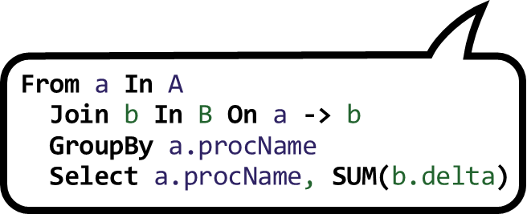
Java-Based Implementation
PT Agent
  PT agent thread that runs inside each process
    Javassist for dynamic instrumentation
    PubSub to receive commands / send tuples
  Baggage library for use by instrumented system
    Data format specified using Protocol Buffers
  Front-end client library
    Define tracepoints and write text queries
    Compile queries to advice
    Submit advice to PT agents
A
A1
B
B1
Pivot Tracing
Front End
Notes:
Our prototype has the following components
First, a pivot tracing agent thread runs inside each pivot tracing enabled process. The agent implements the advice API outlined and uses javassist to dynamically rewrite and reload classes
We use a pubsub system to receive weave commands from the front end and send back tuples produced by queries.
We implemented a baggage library with a straightforward API. The data format is specified using protocol buffers, so baggage can be propagated between systems written in different languages.
Our baggage library uses thread-local storage within a process and has methods to serialize baggage for inclusion in remote procedure calls
Finally, we implemented a pivot tracing front-end for writing queries, compiling them to advice, and submitting them to the PT agents.
The front end implements several query optimizations outlined in the paper, that let us push operations close to their source.

Slide 32


Pivot Tracing Enabled
(+
Baggage,
+
PT Agent)
HBase
YARN
ZooKeeper
HDFS
MapReduce
Adding Baggage: ~50-200 lines of code per system
Primarily modifying execution boundaries:
    Thread, Runnable, Callable, Queue
    RPC invocations
Notes:
We instrumented several systems in the Hadoop stack with Pivot Tracing, each of which only required between 50 and 200 lines of code per system for adding baggage.
Primarily, this was at the boundaries of execution
This was a one-time modification as a prerequisite to supporting pivot tracing.

Slide 33
Pivot Tracing Overheads
Pivot Tracing Enabled
  Application level benchmarks: baseline 0.3% overhead
No overhead for queries / tracepoints until installed
With queries from paper installed
  Application level benchmarks: max 14.3% overhead
  (CPU-only lookups)
  Largest baggage size: ~137 bytes
(+
Baggage,
+
PT Agent)
Notes:
With pivot tracing enabled, we recorded a baseline overhead of only 0.3% in application-level benchmarks when no queries installed.
This is because baggage propagation alone is relatively cheap, and there is no overhead for queries or tracepoints until after they’ve been installed.
On the same application level benchmarks, we recorded a maximum of 14.3% overhead incurred from queries presented in the paper.
This benchmark represents the worst case possible, where requests were sub-millisecond, CPU-only, lock-free lookups
Of all the queries in the paper, the largest baggage size was only about 137 bytes.

Slide 34
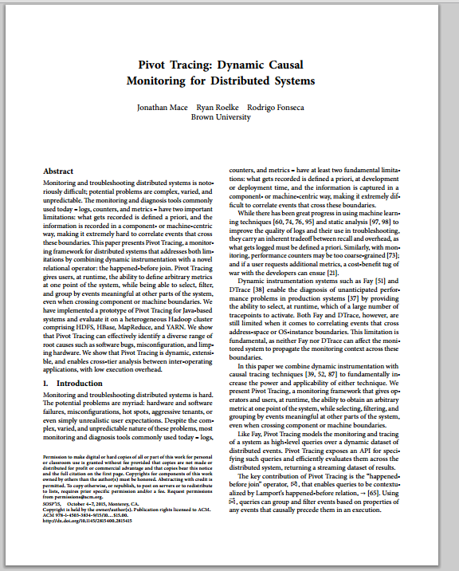
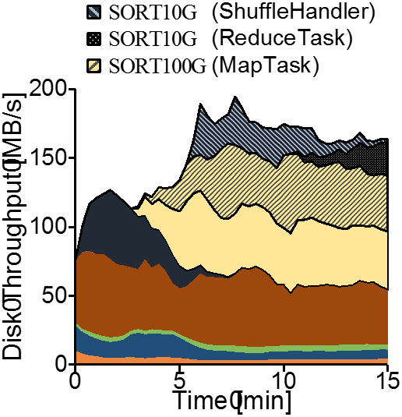
Experiments
Monitoring queries with various groupings
Notes:
In the paper we demonstrate pivot tracing in three different kinds of scenario
First, Pivot Tracing can relate arbitrary metrics at one point in the system with identifiers meaningful elsewhere.
The figures I showed early on in this talk are examples taken from this demonstration
For many types of query, the overhead is sufficiently low that long-lived health monitoring can be implemented using Pivot Tracing

Slide 35
Experiments
Monitoring queries with various groupings
Decomposing request latencies
Notes:
Second, Pivot Tracing can measure latencies by using the timestamps from two or more tracepoints.
We diagnosed a limping hardware problem that was affecting end-to-end request latencies.

Slide 36
Experiments
Monitoring queries with various groupings
Decomposing request latencies
Debugging recurring problems
Notes:
Finally, pivot tracing can be used to debug recurring problems in distributed systems where the kinds of debugging information we need is very specific to the problem and is unlikely to be included in existing system logs or metrics.
I’m going to present this problem here now, and I refer you to the paper for details on the other two
To describe this problem I’ll come back to HDFS, and describe it in a little more detail

Slide 37


Filesystem Metadata
File
File
2
3
5
HDFS NameNode
Client
GetBlockLocations
File
Same machine?
-> read local
Same rack?
-> read rack-local
Otherwise
-> select randomly
HDFS Replica
Selection Policy
File
2
3
5
File
File
File
File
File
HDFS DataNode
HDFS DataNode
HDFS DataNode
HDFS DataNode
HDFS DataNode
DataTransferProtocol
Replicated block storage
Notes:
HDFS comprises a central namenode that stores the filesystem metadata and several datanodes that store the data of the files
To store a file in HDFS, it is broken up into blocks that are replicated across the datanodes.
The HDFS namenode maintains the mapping from files to blocks and their locations
Here I’m showing the file is replicated on datanodes 2, 3, and 5.
To lookup a file, a client first contacts the hdfs namenode to find out which datanodes have the file.
To do this, the client invokes a namenode procedure called GetBlockLocations, passing the filename.
The namenode returns the list of replicas of the files.
Subsequently, the client selects one of the replicas to read from, according to HDFS’s replica selection policy.
The goal of the policy is to minimize network load by selecting topologically close replicas.
First, if the client is running on the same machine as a datanode that has a replica, then that local replica is selected
Second, if there are any replicas on the same rack of machines, then a random rack-local replica is selected. The policy uses randomization to break ties in order to spread load.
Finally, if there are no local or rack-local replicas, then a random off-rack replica is selected.
Once a replica is selected, the client contacts the replica to read the file.
The client invokes the DataNode’s DataTransferProtocol, which subsequently returns the contents of the file.

Slide 38

Host A
Host B
Host C
Host D
Host E
Host F
Host G
Host H
+ HDFS NameNode
8 Worker Hosts
Client Workload Generator
Randomly read from large dataset
HDFS DataNode
Notes:
In this scenario, I was setting up an 8-node cluster with a simple benchmark workload
I had set up 8 identicial machines, each running an HDFS datanode and the same client workload generator.
The workload generators were all reading randomly from the same large set of files
The HDFS namenode was running on a separate machine.

Slide 39
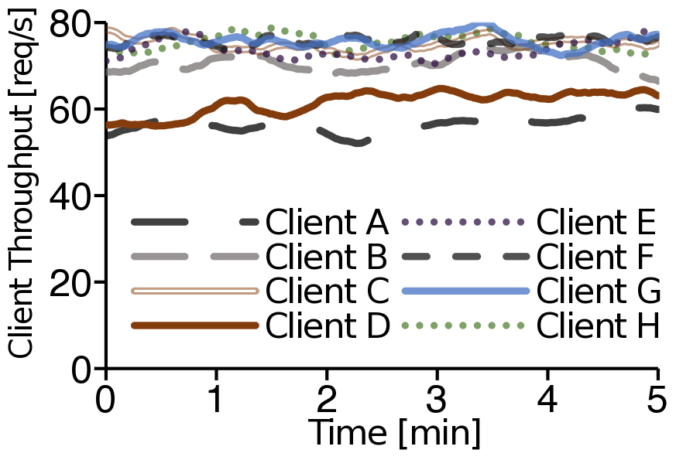
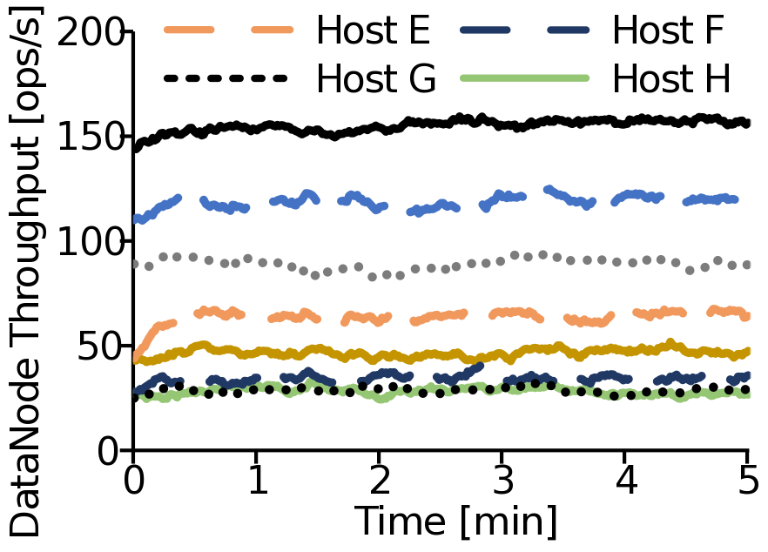
Same machines, same processes, same workloads
  I expected uniform throughput from workload generators
  I expected uniform throughput on DataNodes
Large variations in
DataNode throughput
Consistently lower
throughput
Notes:
Given that I was running the same simple workload on all of my machines, I was expecting to see more or less uniform throughput across my workload generators.
But this wasn’t the case, as I show in this figure here, each line is the throughput of one workload generator
We see that two of the workload generators were seeing consistently lower throughput
Furthermore, I was also expecting to see uniform throughput on the datanodes, since the workload generators were just reading at random.
In this case, the HDFS datanodes were seeing drastically different throughput – each line here is the throughput of one datanode
So clearly, there is something very suspicious going on, and we’ll walk through the steps of figuring out what it was.

Slide 40
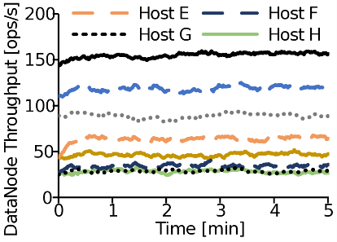
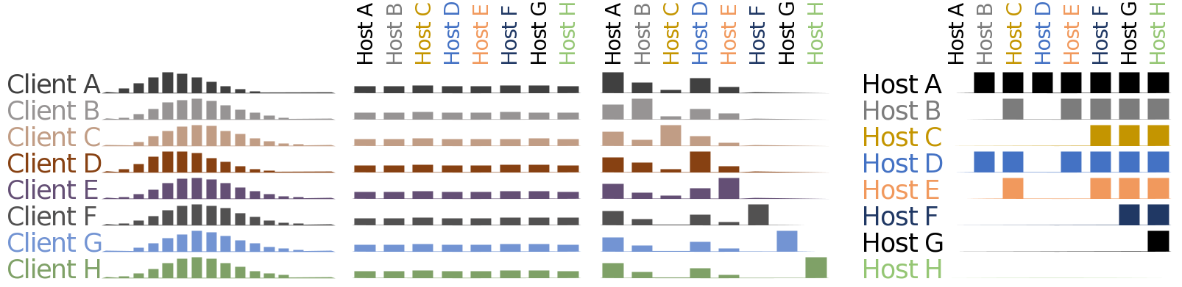
?
It’s probably a bug in the workload generator I wrote
My hypothesis:
  Workload generator is not randomly looking up files
Client
From blockLocations In NameNode.GetBlockLocations
GroupBy blockLocations.fileName
Select blockLocations.fileName, COUNT
From blockLocations In NameNode.GetBlockLocations
Join cl In Client.DoRandomRead On cl -> blockLocations
GroupBy cl.host, blockLocations.fileName
Select cl.host, blockLocations.fileName, COUNT
DoRandomRead
A
HDFS NameNode
GetBlockLocations
B
C
Frequency
D
E
F
Number of times accessed
G
H
Notes:
My initial hypothesis here is that the simple workload generator I wrote probably just has a few bugs and isn’t actually behaving as I intended it to.
In particular, since the throughput was so skewed across the HDFS datanodes, maybe I wasn’t actually randomly selecting files
To debug this, I wrote a query to look at the HDFS namenode and ask the question: which files are the ones that are actually being looked up?
The query shown here simply counts how many times each file is looked up, at the NameNode’s GetBlockLocations tracepoint.
We can aggregate over a period of time and plot a frequency distribution like this
A binomial distribution is indicative that files are being randomly selected for read.
However, we specifically want this distribution for each of our clients.
We can expand the query and write a happened-before join with a tracepoint within each client
We first join to the tuples from the client’s tracepoint,
Add the client hostname to the groupby
And add the client hostname to the output tuple
The output data is now broken down by each client, so
We can plot the same frequency distribution but now individually for each client.
These distributions all have the same shape, meaning each client is indeed randomly selecting files.
So this is not the cause for the drastically skewed DataNode throughput

Slide 41

?
Maybe skewed DataNode throughput is because some DataNodes store more files than others
How often was each DataNode a replica host?
Client
From blockLocations In NameNode.GetBlockLocations
Join cl In Client.DoRandomRead On cl -> blockLocations
GroupBy cl.host, blockLocations.replicas
Select cl.host, blockLocations.replicas, COUNT
From blockLocations In NameNode.GetBlockLocations
GroupBy blockLocations.replicas
Select blockLocations.replicas, COUNT
DoRandomRead
A
B
HDFS NameNode
GetBlockLocations
C
Count
D
Client
A
E
B
C
D
E
F
G
H
F
G
Replica Location
H
A
B
C
D
E
F
G
H
Replica Location
Notes:
Maybe it’s because the files themselves are skewed across the DataNodes.
If some DataNodes store more replicas than others, and we’re reading files uniformly at random, then that would likely lead to heavier load on those DataNodes
So we ask the question – how often is each datanode a replica host?
We ran this query over a period of time and counted the frequency that each DataNode appears as a replica.
This figure shows that, barring minor variations, replicas are mostly distributed evenly across the DataNodes.
As with the previous query, we want to check that this is individually the case for each client,
So just like before we modify the query to join with and group by the Client.
We can now plot the results individually for each client
This result is still the expected behavior for HDFS – that replicas are distributed evenly – and thereby doesn’t account for our weird throughput problem

Slide 42
?
Conclusions so far:
  Clients are selecting files uniformly at random
  Files are distributed across DNs uniformly at random
Hypothesis: choice of replica isn’t random?
Same machine?
-> read local
Same rack?
-> read rack-local
Otherwise
-> select randomly
HDFS Replica
Selection Policy
Client
DoRandomRead
When a file is read from a DataNode, where else could it have been read from?
HDFS NameNode
GetBlockLocations
From readBlock In DataNode.DataTransferProtocol
Join blockLocations In NameNode.GetBlockLocations
On blockLocations -> readBlock
GroupBy blockLocations.replicas, readBlock.host
Select blockLocations.replicas, readBlock.host, COUNT
From readBlock In DataNode.DataTransferProtocol
Join blockLocations In NameNode.GetBlockLocations
On blockLocations -> readBlock
Join cl In Client.DoRandomRead
On cl -> blockLocations
Where cl.host != readBlock.host
GroupBy blockLocations.replicas, readBlock.host
Select blockLocations.replicas, readBlock.host, COUNT
HDFS DataNode
DataTransferProtocol
Notes:
So clients are selecting files uniformly at random, and those files are distributed across DataNodes uniformly at random.
Yet, the HDFS load is ultimately highly skewed.
So perhaps the issue lies in the client’s selection of which replica to read from?
As mentioned before, the HDFS replica selection policy will perform a local read if it’s able to, but if not then it should randomly select from replicas on the same rack.
So let’s ask the following question: when a file is read from a DataNode, where else could it have been read from?
To answer this, we can a query that relates the initial NameNode invocation of GetBlockLocations, with the subsequent invocation of the DataTransferProtocol on the replica that the client ends up selecting.
This query performs a happened-before join between the two tracepoints, then counts how often each pair occurs, of candidate replica and actual replica.
We’re going to make our query a little bit more specific.
We know that clients will try to first read locally. What we care about is when client’s can’t read locally and have to choose some random other replica.
So we’re going to expand our query to also take into account the initiating client
We’re only going to produce tuples if the hostname of the client is different to the hostname of the datanode where the data is read.
So we ran this query, and I’ll pull up a figure showing the query results in a moment.
The result that we expect to see is along the lines of:

Slide 43


A
B
C
D
E
F
G
H
?
A
B
C
D
E
F
Same machine?
-> read local
Same rack?
-> read rack-local
Otherwise
-> select randomly
G
HDFS Replica
Selection Policy
B
D
Client
When both and host replicas,
H
B
Clients choose this often: (~50%)
A
C
B
D
When both and host replicas,
When both and host replicas,
D
DoRandomRead
Clients choose this often: (~50%)
B
Clients choose this often: (0%)
A
Clients choose this often: (100%)
D
Clients choose this often: (100%)
C
Clients choose this often: (0%)
HDFS NameNode
GetBlockLocations
From readBlock In DataNode.DataTransferProtocol
Join blockLocations In NameNode.GetBlockLocations
On blockLocations -> readBlock
Join cl In Client.DoRandomRead
On cl -> blockLocations
Where cl.host != readBlock.host
GroupBy blockLocations.replicas, readBlock.host
Select blockLocations.replicas, readBlock.host, COUNT
HDFS DataNode
DataTransferProtocol
Notes:
Whenever a client gets to choose between a replica on B and a replica on D, about 50% of the time B is selected, and 50% of the time D is selected
I’m going to plot the matrix of replica selection preferences starting with DataNode A
This highlighted cell tells us that when choosing between a replica on A and a replica on C, clients are selecting A 100% of the time, … and C 0% of the time
Looking now at B, for example,
This highlighted cell tells us that when choosing between a replica on B and a replica on D, clients are selecting B 0% of the time, … and D 100% of the time.
As it turns out, there is clearly a preferred order of replicas, where A is the first preference, followed by D, then B, and so on.
This shouldn’t be the case! We are supposed to be selecting replicas randomly, and this figure should be completely uniform!

Slide 44
A
B
C
D
E
F
G
H
?
A
B
C
D
E
F
Same machine?
-> read local
Same rack?
-> read rack-local
Otherwise
-> select randomly
G
HDFS Replica
Selection Policy
H
Lack of randomization skewed workload toward certain DNs
Independently discovered. Fixed in HDFS 2.5
HDFS-6268
Seamlessly add correlations between multiple components
Very specific, one-off metrics
This experiment: 1.5% application-level overhead
Notes:
It turns out that this is the cause for the weird throughput variations we originally saw.
What was happening was that the NameNode was not randomizing the replicas list returned back to the client, and the client was always selecting the first replica from the list.
This lead to high load on some machines and very little on others
We did not know about this bug before discovering it with Pivot Tracing. It turns out another HDFS user had also discovered the bug, and since then it has been fixed in release 2.5 of HDFS.
This experiment demonstrates the kind of seamless correlations Pivot Tracing can perform at runtime, even for very specific one-off metrics
The overhead of evaluating these queries is quite low
With all of the queries from this experiment installed, we only imposed an application-level overhead of 1.5% on the workloads we were running – that overhead includes both the overhead of adding pivot tracing, and the evaluating the queries.

Slide 45

Pivot Tracing
Dynamic Causal Monitoring for Distributed Systems
Tracepoint A
Class: A
Method: A1()
Tracepoint B
Class: B
Method: B1()
Exports: “delta”=delta
Happened-Before Join
From a In A
Join b In B On a -> b
GroupBy a.procName
Select a.procName, SUM(b.delta)
Dynamic Instrumentation
Causal Tracing
A
Advice A1
OBSERVE procName
PACK procName
B
Advice B1
OBSERVE delta
UNPACK procName
EMIT procName, SUM(delta)
Acceptable overheads for production (we think)
Standing basic queries
Potential to dig deeper
Jonathan Mace
Ryan Roelke
Rodrigo Fonseca
Notes:
To conclude, with Pivot Tracing we introduced the Happened-before join, the enables queries to be contextualized by lamport’s happened-before relation.
Pivot Tracing addresses the limitations of logging and debugging in distributed systems by combining dynamic instrumentation with causal tracing techniques, to enable efficient runtime evaluation of the happened-before join.
The overheads of evaluating the happened-before join are sufficiently low that we believe Pivot Tracing is suitable for production systems, both for high-level standing queries and for digging deeper when necessary.

Slide 46
Pivot Tracing
Dynamic Causal Monitoring for Distributed Systems
Tracepoint A
Class: A
Method: A1()
Happened-Before Join
Tracepoint B
Class: B
Method: B1()
Exports: “delta”=delta
From a In A
Join b In B On a -> b
GroupBy a.procName
Select a.procName, SUM(b.delta)
Dynamic Instrumentation
Causal Tracing
A
Advice A1
OBSERVE procName
PACK procName
Acceptable overheads for production (we think)
B
Advice B1
OBSERVE delta
UNPACK procName
EMIT procName, SUM(delta)
Standing basic queries
Potential to dig deeper
Jonathan Mace
Ryan Roelke
Rodrigo Fonseca

