Slide 1
1) Energy barrier?
Energy for different angles
Energy for different magnetic fields
Energy for different shapes

Slide 2

CONSTANT SHAPE (65x100nm ellipse): SWEEP: - angle 0°-90° - abs(B_ext)=100T-0.001T
Loop:
m = Uniform(cos(angle), sin(angle), 0)
B_ext = vector(tesla*cos(angle), tesla*sin(angle), 0)
minimize()
TableSave()

Slide 3
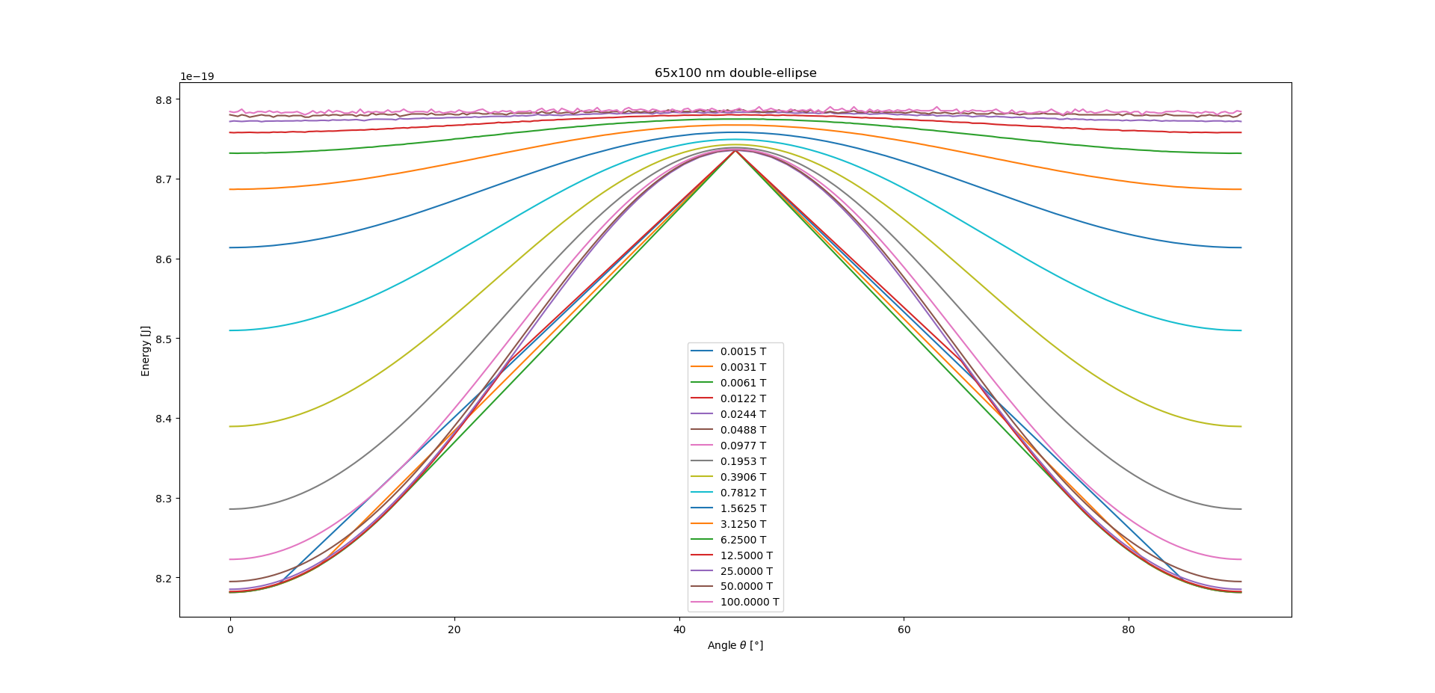
Large field: flat energy profile
Mediocre field: sinus
Low field: relaxes towards angle 0 or stays at Pi/4*k (stable even for B=0, as shown in 4 slides)
Conclusion: to determine barrier, only need to calculate energy at angle 0 and Pi/4

Slide 4
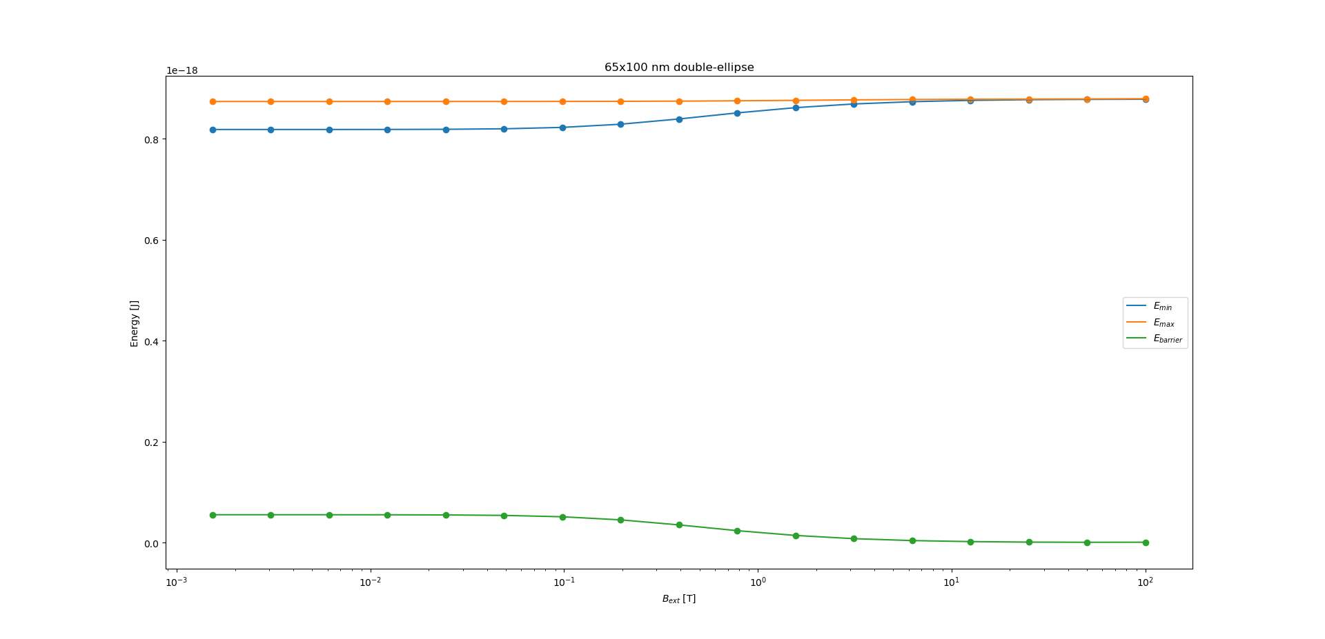
Two regimes with transition between

Slide 5
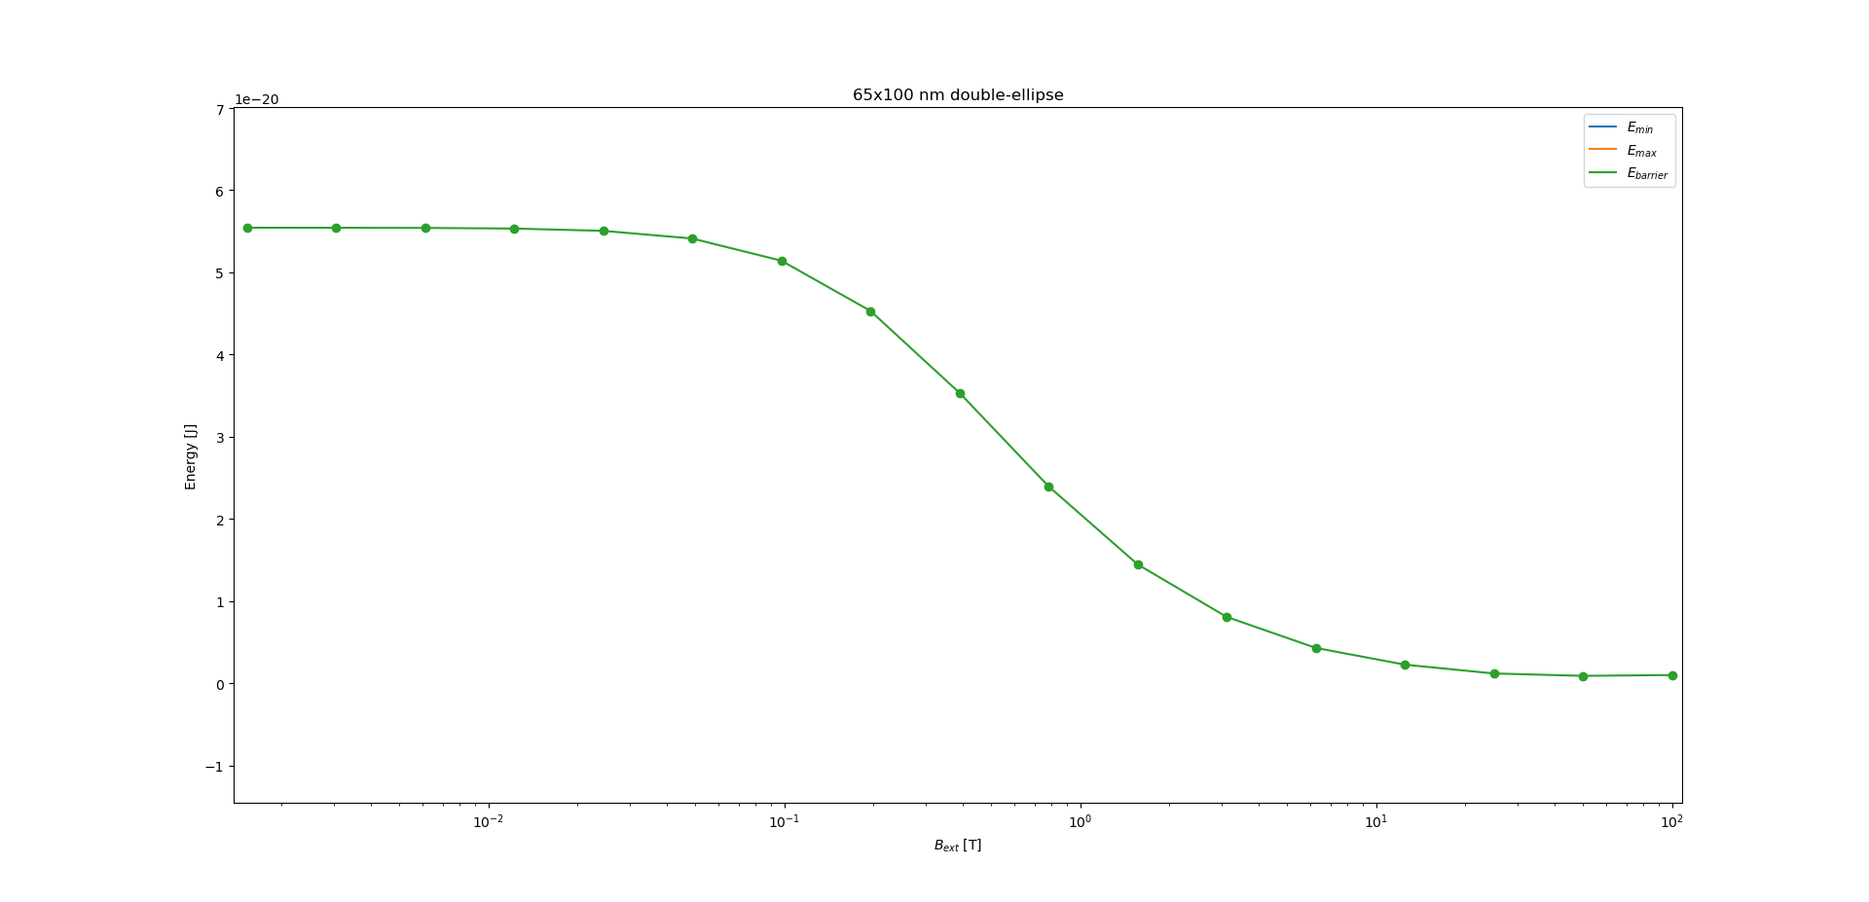
Barrier height detail

Slide 6
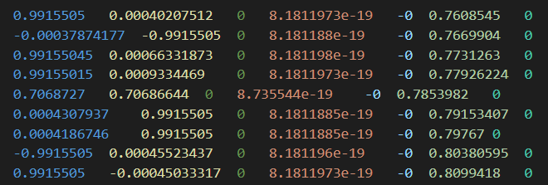
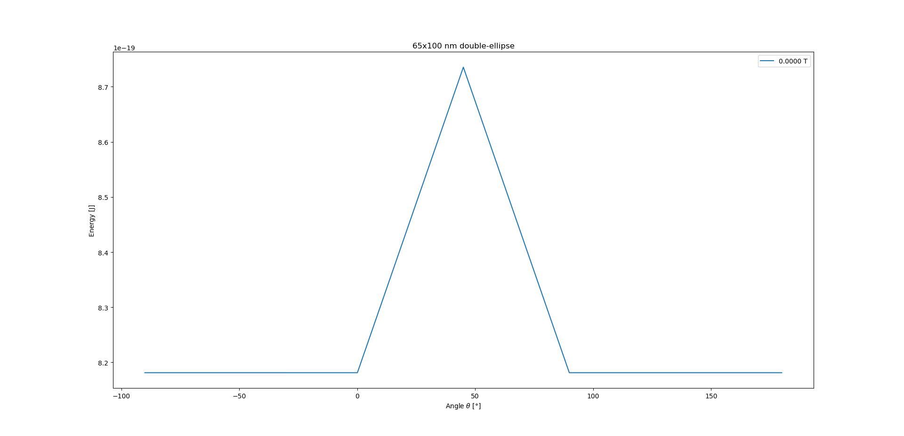
0 Tesla?
Barrier still correctly calculated for Pi/4
But for safety reasons probably best to use 0.001T anyway
Somehow initial magnetization of 0.767 and 0.8 rad stabilized to -90° and 180° respectively?
Minimize vs relax?

Slide 7


CONSTANT B_EXT (0.001T): SWEEP: - shape 100x100nm – 10x100nm ellipse - angle 0° and 45°
Loop:
geometry := Ellipse(100e-9, size*1e-9)
geometry = geometry.Add(geometry.RotZ(Pi/2))
SetGeom(geometry)
m = Uniform(cos(angle), sin(angle), 0)
B_ext = vector(0.001*cos(angle), 0.001*sin(angle), 0)
minimize()
TableSave()

Slide 8
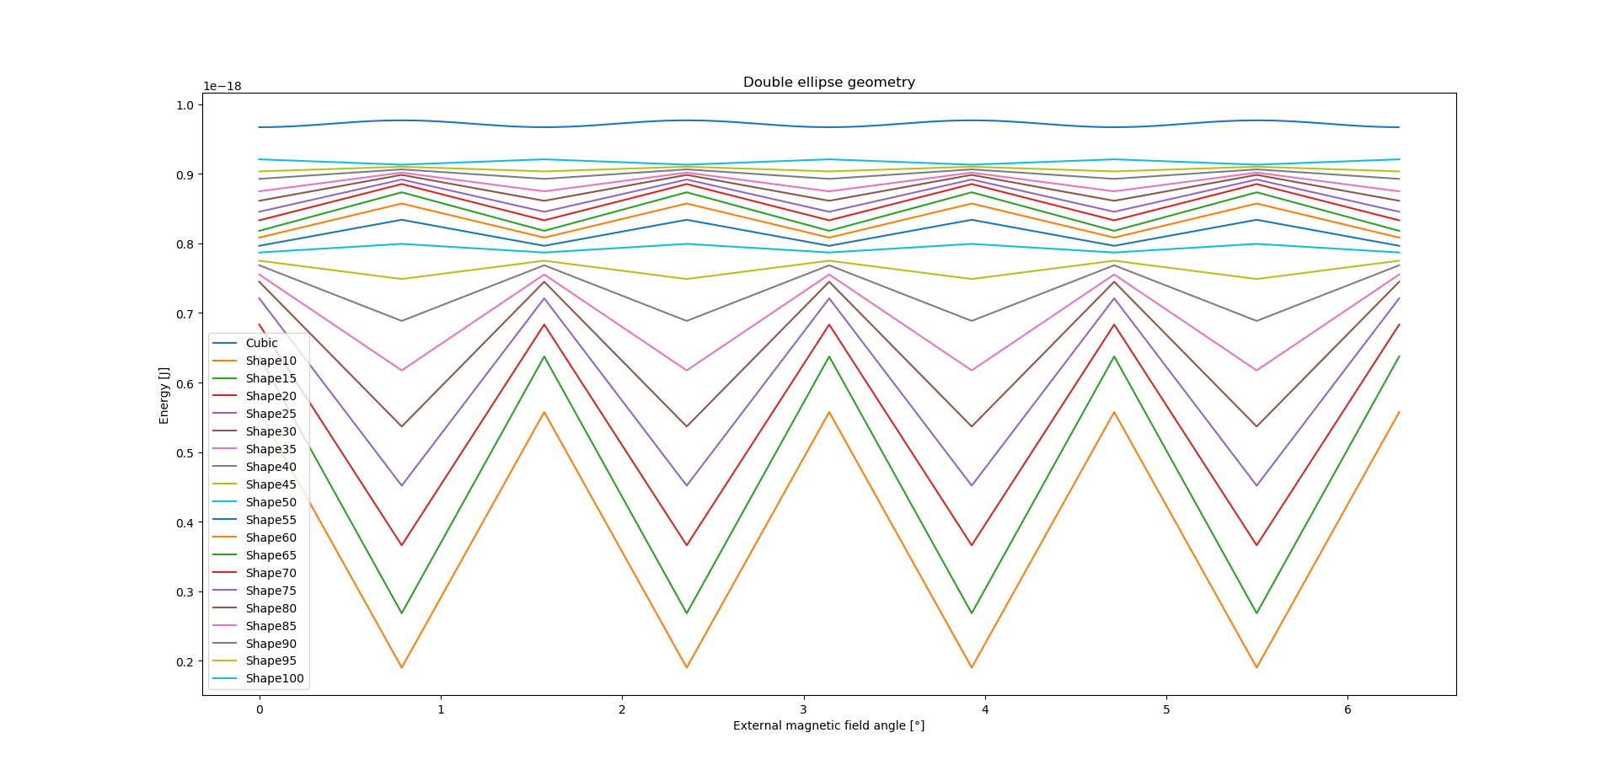
Stable direction switches around 45 nm
100x100 ellipse = circle, but there is still an energy barrier?

Slide 9
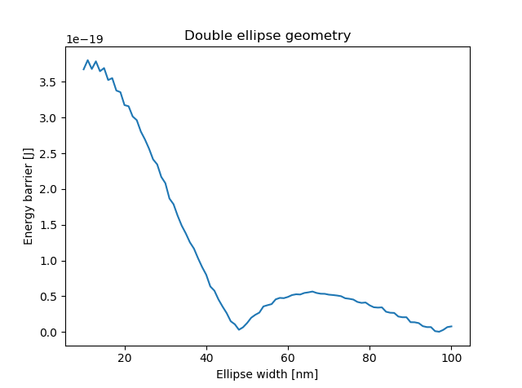
Energy barrier as function of plus-ness
At circle, there is still an energy barrier
Due to grid discretization?
Stable direction horizontal/vertical for 50-97 nm
Stable direction diagonal for 0-50 nm
Different total sizes?
Stable directions:
Diagonal
Vertical/
horizontal
Diagonal

Slide 10
CONSTANT B_EXT (0.001T): SWEEP: - shape 128x128nm – 16x1.6nm ellipse - roundness 1-0.1
Loop:
geometry := Ellipse(size*1e-9, size*roundness*1e-9)
geometry = geometry.Add(geometry.RotZ(Pi/2))
SetGeom(geometry)
m = Uniform(cos(angle), sin(angle), 0)
B_ext = vector(0.001*cos(angle), 0.001*sin(angle), 0)
minimize()
TableSave()

Slide 11
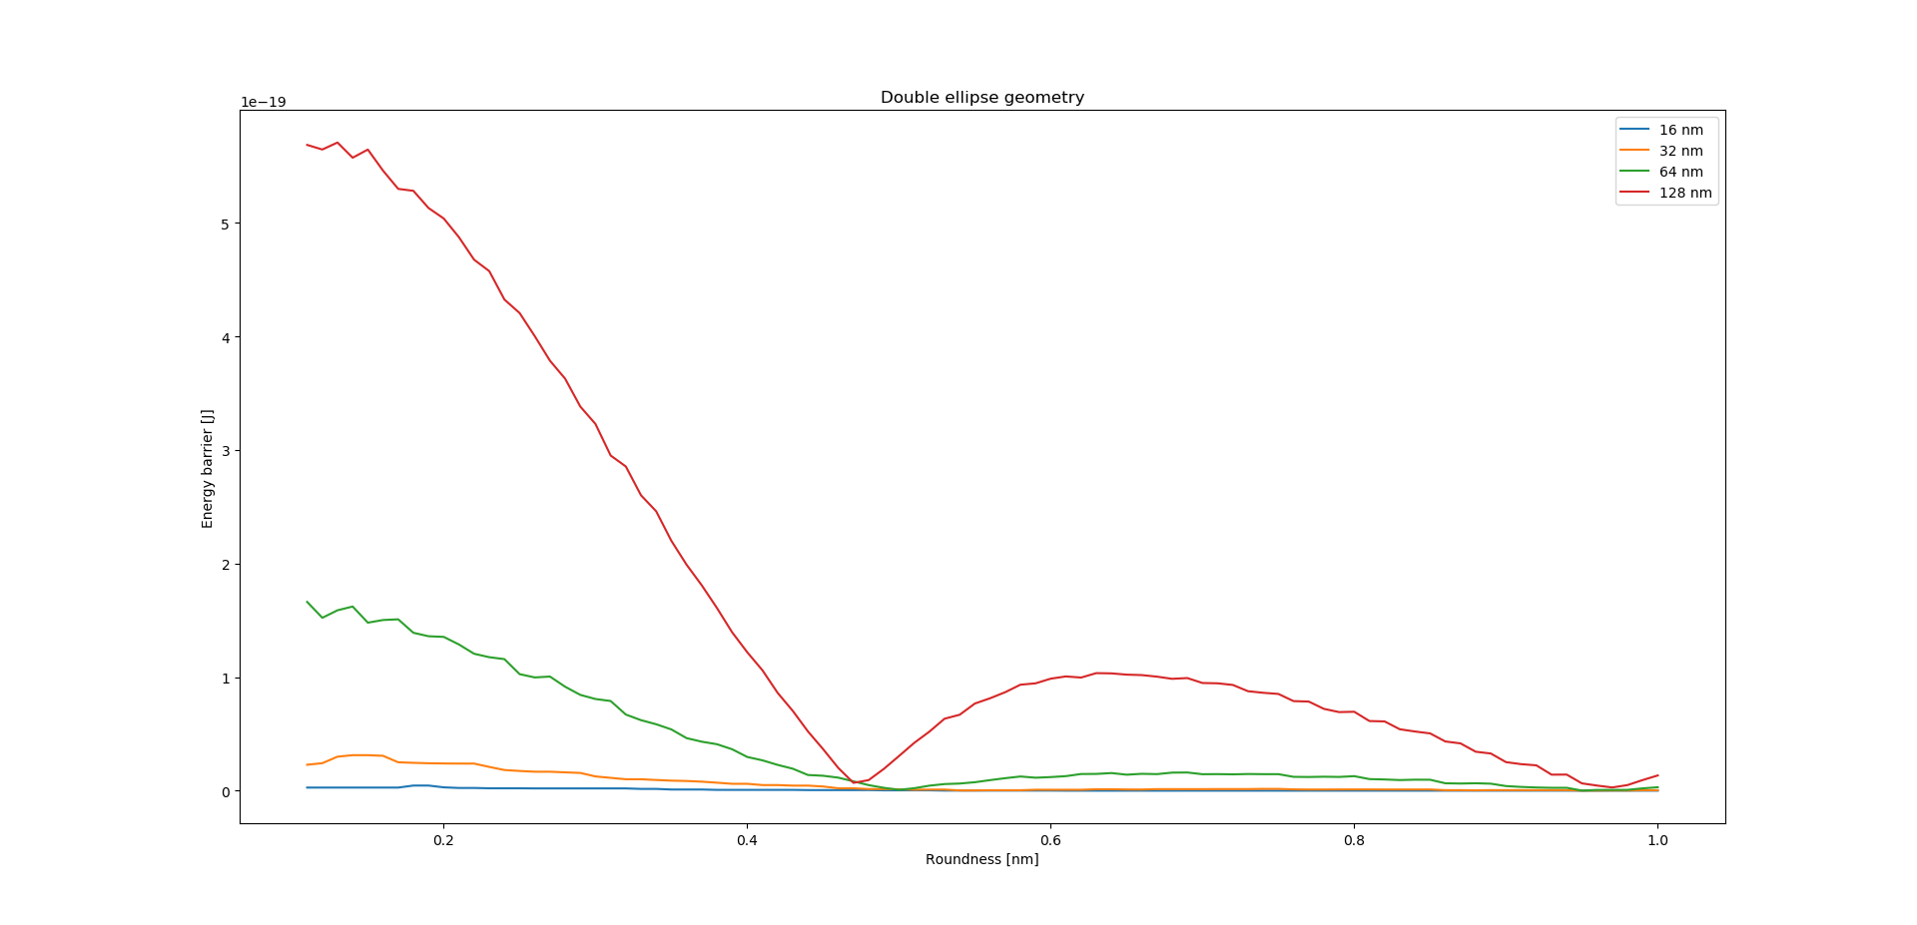
Energy barrier as function of plus-ness
Different total sizes

Slide 12
2) Longer simulation
- Different alpha

Slide 13
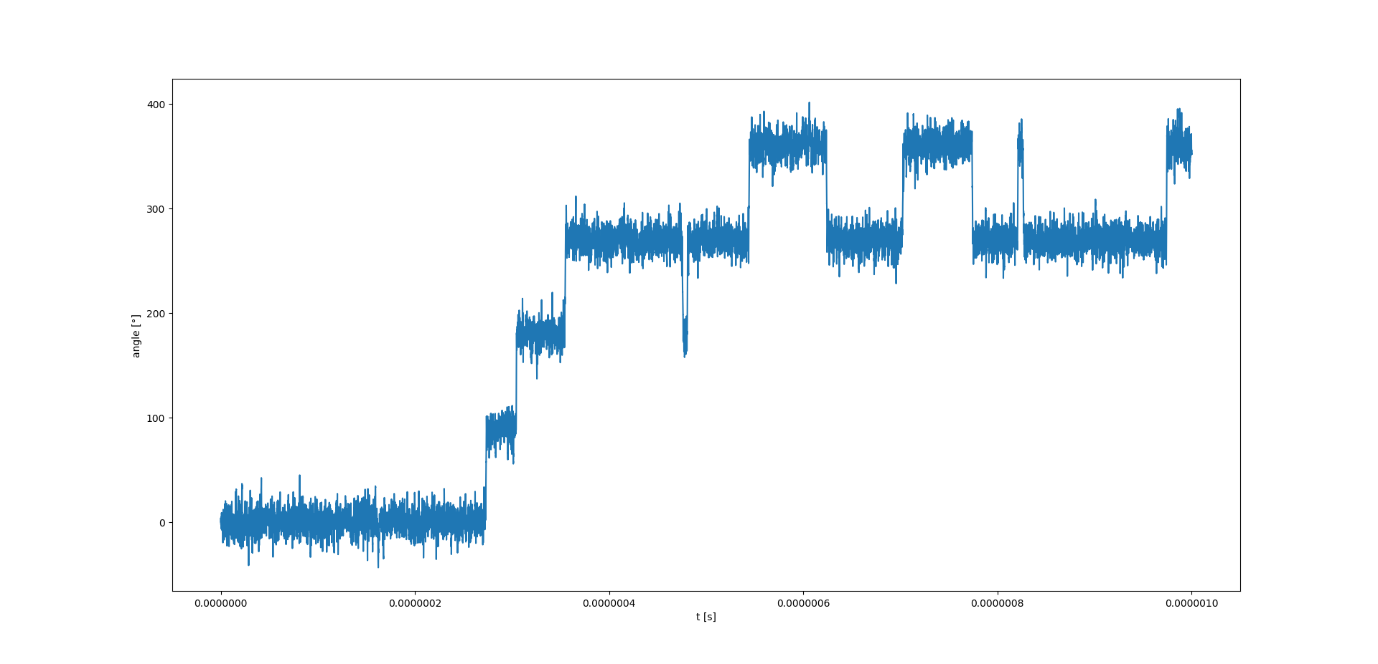
1µs with alpha=0.1, 65x100nm
~100ns switching time

Slide 14
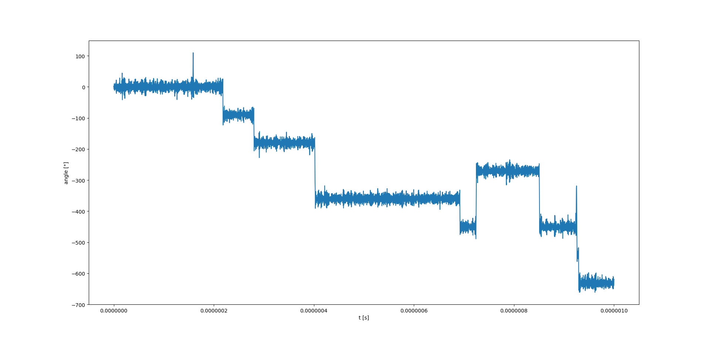
1µs with alpha = 0.01, 65x100nm
More double switches than alpha=0.1

Slide 15
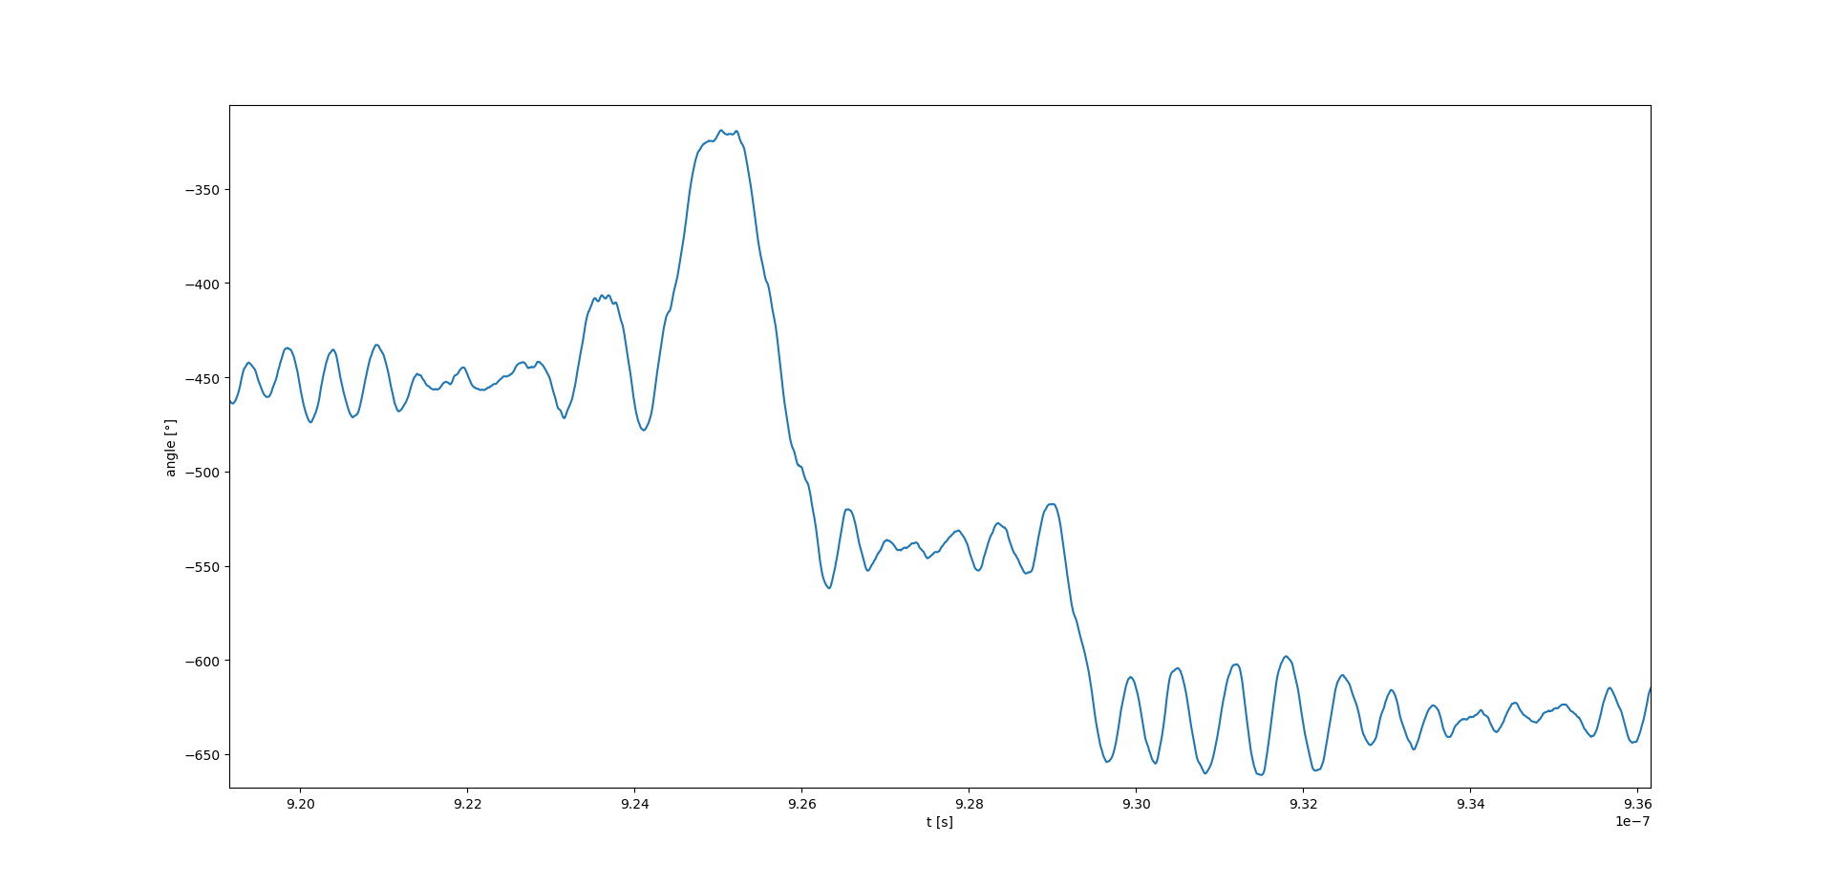
1µs with alpha = 0.01
Sinusoidal variations with period ~0.5 ns

Slide 16
3) Problems encountered
Zoom in on one switch
Small error when connecting

Slide 17
Zoom in on switch
for seed = 0; seed < 10; seed++ {
Thermseed(seed)
randSeed(0)
FixDt = 2e-13
t = 0;
m = Uniform(1, 0, 0)
relax()
Run(10e-9)
}

Slide 18
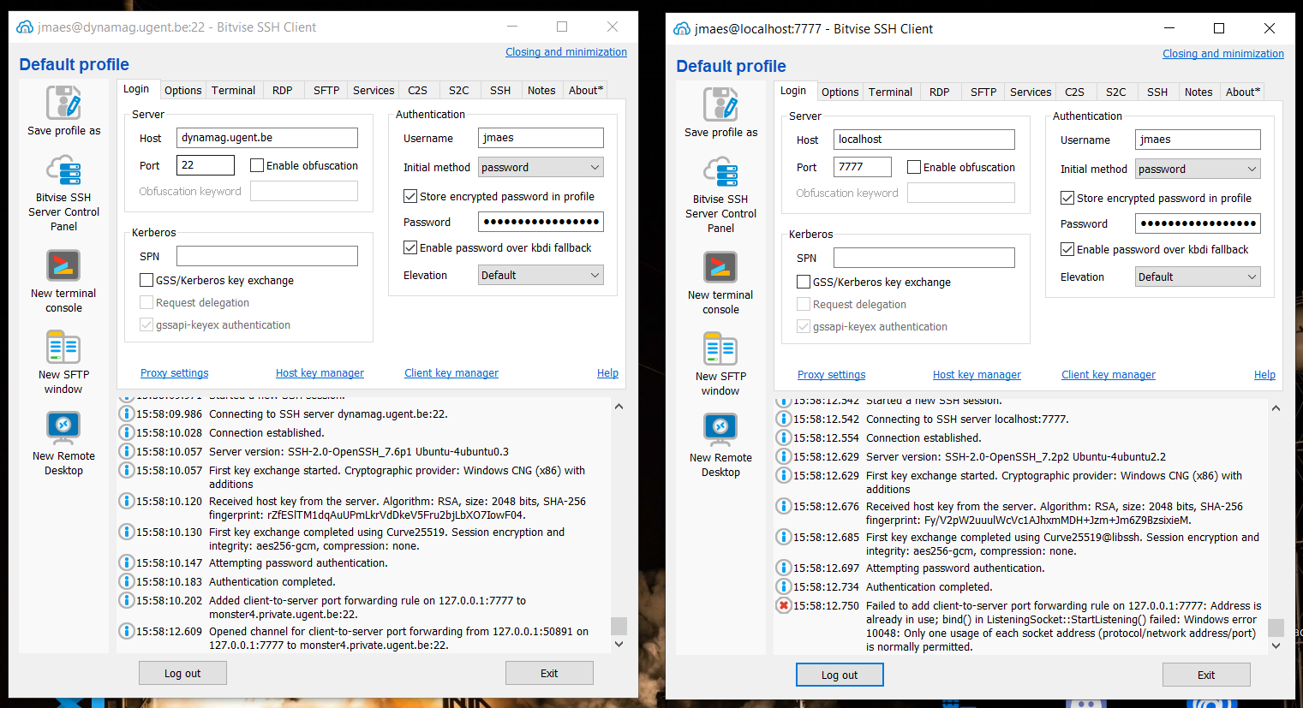
1
2

