Slide 1
Getting to know ArchUnit
Jonathan Ohara de Araujo

Slide 2
Header
Agenda
Introduction
ArchUnit;
ArchUnit vs jQAssistant (quick comparission)
ArchUnit Demo
Limitations
Conclusion

Slide 3
Introduction

Slide 4
ArchUnit

Slide 5
Header
ArchUnit
Author: Peter Gafert
First release on April 23, 2017
Current version 0.10.2
https://www.archunit.org/
Notes:
ne machine that drew particular attention implemented an algorithm that Luhn called KWIC, for Key Word in Context. Taking in a large number of texts—typically, articles from 500 to 5,000 words in length—the KWIC system could quickly and automatically construct a kind of index.
A Business Intelligence System

Slide 6
ArchUnit and jQAssitant

Slide 7
Header
ArchUnit vs jQAssistant
Structure
Scope
Difficulty
Notes:
ne machine that drew particular attention implemented an algorithm that Luhn called KWIC, for Key Word in Context. Taking in a large number of texts—typically, articles from 500 to 5,000 words in length—the KWIC system could quickly and automatically construct a kind of index.
A Business Intelligence System

Slide 8
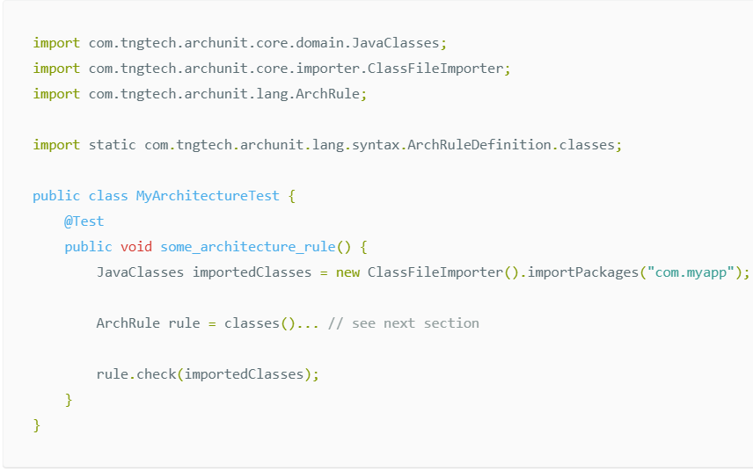
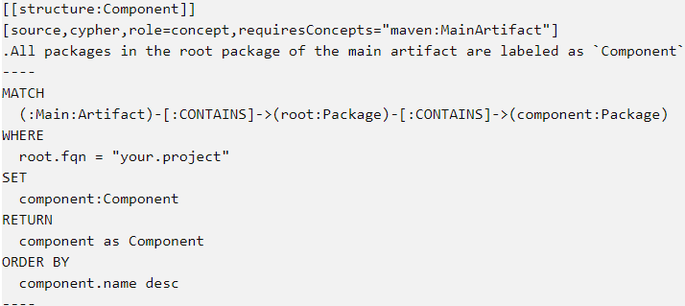
Header
ArchUnit vs jQAssistant
Notes:
ne machine that drew particular attention implemented an algorithm that Luhn called KWIC, for Key Word in Context. Taking in a large number of texts—typically, articles from 500 to 5,000 words in length—the KWIC system could quickly and automatically construct a kind of index.
A Business Intelligence System

Slide 9
ArchUnit Demo

Slide 10
Simple Demo

Slide 11
Checking name conventions

Slide 12
Checking package access

Slide 13
Optimizing basics in ArchUnit

Slide 14
Checking Annotations

Slide 15
LayeredArchitecture

Slide 16
General Coding rules

Slide 17
Creating your own ArchCondition

Slide 18
Slices

Slide 19
ArchUnit and PlantUml

Slide 20
Limitations

Slide 21
Conclusion

Slide 22
Questions?
?

Slide 23
Header
References
https://www.archunit.org/
https://jqassistant.org/

Slide 24
Thank You!

