Slide 1
Getting to know ArchUnit
Jonathan Ohara de Araujo

Slide 2
Introduction
Introduction
ArchUnit;
ArchUnit vs jQAssistant (quick comparison)
ArchUnit Demo
Limitations
Conclusion

Slide 3
Introduction

Slide 4
ArchUnit

Slide 5
ArchUnit
AArchUnit
Author: Peter Gafert
First release on April 23, 2017
Current version 0.10.2
https://www.archunit.org/
Notes:
ne machine that drew particular attention implemented an algorithm that Luhn called KWIC, for Key Word in Context. Taking in a large number of texts—typically, articles from 500 to 5,000 words in length—the KWIC system could quickly and automatically construct a kind of index.
A Business Intelligence System

Slide 6
ArchUnit and jQAssitant

Slide 7
ArchUnit vs jQAssistant
ArchUnit vs jQAssistant
Structure
Scope
Difficulty
Notes:
ne machine that drew particular attention implemented an algorithm that Luhn called KWIC, for Key Word in Context. Taking in a large number of texts—typically, articles from 500 to 5,000 words in length—the KWIC system could quickly and automatically construct a kind of index.
A Business Intelligence System

Slide 8
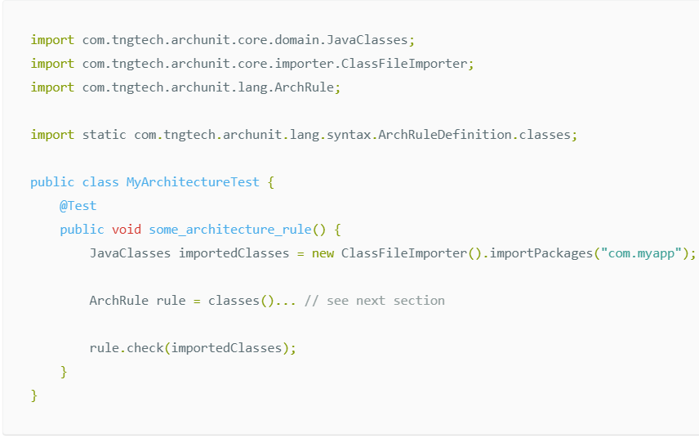
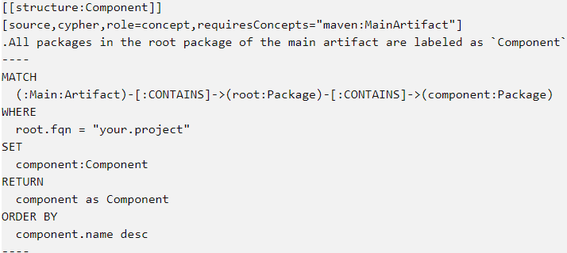
ArchUnit vs jQAssistant
ArchUnit vs jQAssistant
Notes:
ne machine that drew particular attention implemented an algorithm that Luhn called KWIC, for Key Word in Context. Taking in a large number of texts—typically, articles from 500 to 5,000 words in length—the KWIC system could quickly and automatically construct a kind of index.
A Business Intelligence System

Slide 9
ArchUnit Demo

Slide 10
01 - Simple Demo

Slide 11
02 - Checking name conventions

Slide 12
03 - Checking package access

Slide 13
04 - Optimizing

Slide 14
05 - Checking Annotations

Slide 15
06 - LayeredArchitecture

Slide 16
07 - General Coding rules

Slide 17
08 - Creating your own ArchCondition

Slide 18
09 - Slices

Slide 19
10 - ArchUnit and PlantUml

Slide 20
Limitations

Slide 21
Conclusion

Slide 22
Questions?
?

Slide 23
References
References
https://www.archunit.org/
https://jqassistant.org/
https://github.com/JonathanOhara/archunit-presentation

Slide 24
Thank You!

