Slide 1
How Java HashMap works
Jonathan Ohara de Araujo

Slide 2
Header
Agenda
Introduction
Hash
Map
HashMap
Conclusion
Questions
References

Slide 3
Introduction

Slide 4
Header
Hash
What is it for?
KWIC (Key Word in Context)
IBM engineer Hans Peter Luhn (1958)
Notes:
ne machine that drew particular attention implemented an algorithm that Luhn called KWIC, for Key Word in Context. Taking in a large number of texts—typically, articles from 500 to 5,000 words in length—the KWIC system could quickly and automatically construct a kind of index.
A Business Intelligence System

Slide 5
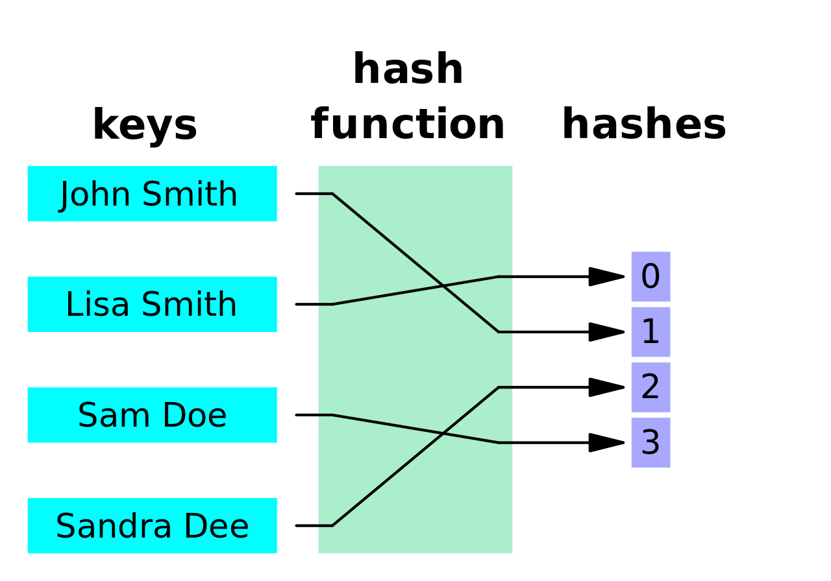
Header
HashFunction – Algorithm
https://en.wikipedia.org/wiki/Hash_function

Slide 6
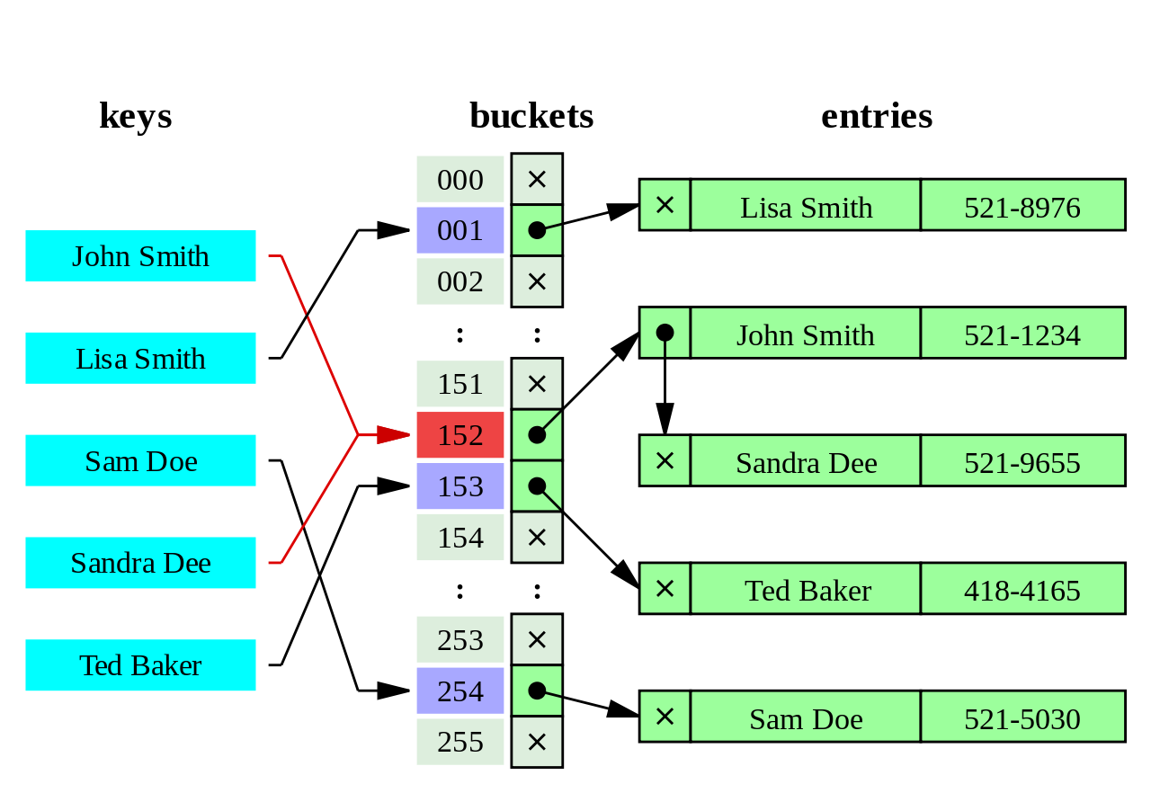
Header
HashTable – Algorithm
https://en.wikipedia.org/wiki/Hash_table

Slide 7
Map

Slide 8
Header
Map
public interface Map<K,V>
An object that maps keys to values. A map cannot contain duplicate keys; each key can map to at most one value.
Implementations:
AbstractMap, Attributes, AuthProvider, ConcurrentHashMap, ConcurrentSkipListMap, EnumMap, HashMap, Hashtable, IdentityHashMap, LinkedHashMap, PrinterStateReasons, Properties, Provider, RenderingHints, SimpleBindings, TabularDataSupport, TreeMap, UIDefaults, WeakHashMap

Slide 9
HashMap

Slide 10
Header
HashMap
Map Implementation using hash algorithm;
This implementation provides constant-time performance for the basic operations (get and put), assuming the hash function disperses the elements properly among the buckets.

Slide 11
Header
HashMap - constructor
Initial capacity
Load Factor
When the number of entries in the hash table exceeds the product of the load factor and the current capacity, the hash table is rehashed (that is, internal data structures are rebuilt)
As a general rule, the default load factor (.75) offers a good tradeoff between time and space costs. Higher values decrease the space overhead but increase the lookup cost (reflected in most of the operations of the HashMap class, including get and put).

Slide 12
Header
HashMap
HashCode and equals
Integer Hash Code
String Hash Code

Slide 13
Header
Code explanation

Slide 14
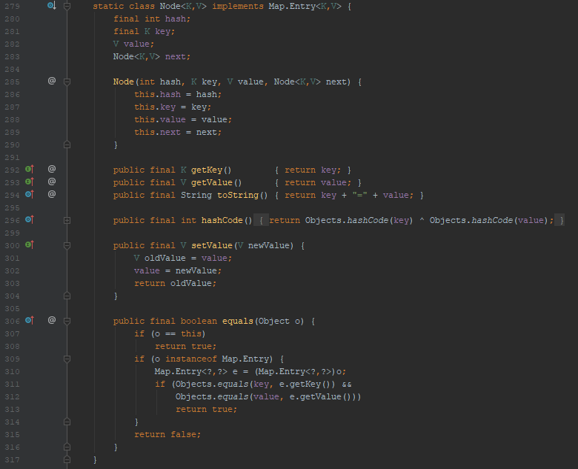
Header
HashMap – The main Object
Node
Node
Node
Node
…
Next
Next
Next
Next
Node
Node
Node
Node
Next
Next
Next
Next
Node
Node
Node
Node
…
…
…
…

Slide 15
HashMap – Java X Theory
Node
Node
Node
Node
…
Next
Next
Next
Next
Node
Node
Node
Node
Next
Next
Next
Next
Node
Node
Node
Node
…
…
…
…

Slide 16
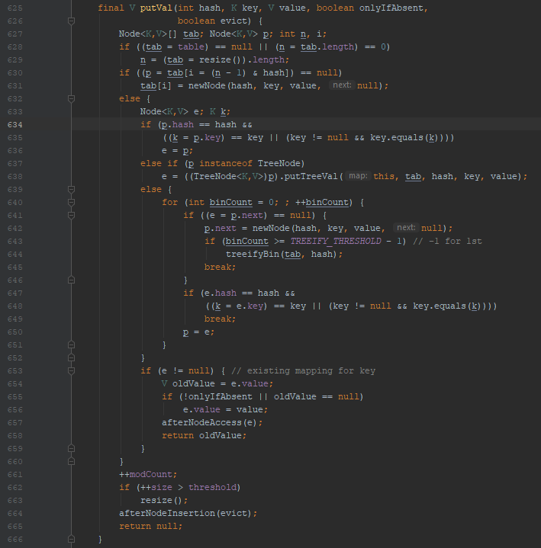
Header
HashMap – Put

Slide 17

Header
HashMap - Put

Slide 18
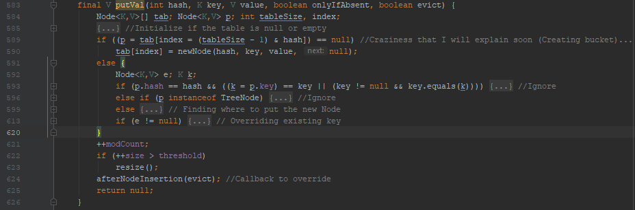
Header
HashMap - Put

Slide 19
What happen if the HashCode is greater than the number of Buckets?

Slide 20
Header
HashMap - Put

Slide 21
Header
HashMap - Put

Slide 22
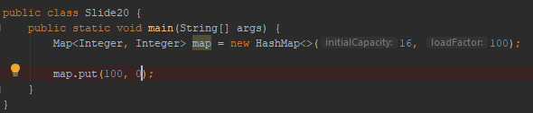
Header
HashMap – Put Example

Slide 23
Header
HashMap – Put Example
n = number of buckets
& = AND bitwise
hash = hashCode()

Slide 24
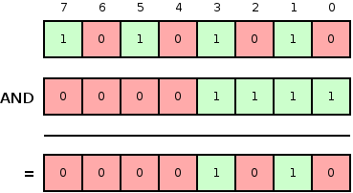
And bitwise

Slide 25
Header
HashMap – Put Example
Decimal | Binary
7 | 111
8 | 1000
15 | 1111
16 | 10000
31 | 11111
32 | 100000
63 | 111111
64 | 1000000
n = number of buckets
& = AND bitwise
hash = hashCode()

Slide 26
Header
HashMap – Put Example
Decimal | Binary
7 | 111
8 | 1000
15 | 1111
16 | 10000
31 | 11111
32 | 100000
63 | 111111
64 | 1000000
n = number of buckets
& = AND bitwise
hash = hashCode()
i = (16 - 1) & 100

Slide 27
Header
HashMap – Put Example
Decimal | Binary
7 | 111
8 | 1000
15 | 1111
16 | 10000
31 | 11111
32 | 100000
63 | 111111
64 | 1000000
n = number of buckets
& = AND bitwise
hash = hashCode()
i = 15 & 100

Slide 28
HashMap – Put Example
Decimal | Binary
100 | 1 1 0 0 1 0 0
15 | 1 1 1 1
4 | 0 0 0 0 1 0 0
i = 4

Slide 29
HashMap – Put Example
Index 0
Index 1
Index 2
Index 3
Index 4
Index 5
Index 6
Index 7
Index 8
Index 9
Index 10
Index 11
Index 12
Index 13
Index 14
Index 15
null
null
null
null
K:: 100
V: 0
null
null
null
null
null
null
null
null
null
null
null
Next
null

Slide 30

HashMap – Put Example
Decimal | Binary
90 | 1 0 1 1 0 1 0
15 | 1 1 1 1
10 | 0 0 1 0 1 0
What if?
Index 0
Index 1
Index 2
Index 3
Index 4
Index 5
Index 6
Index 7
Index 8
Index 9
Index 10
Index 11
Index 12
Index 13
Index 14
Index 15
null
null
null
null
K:: 100
V: 0
null
null
null
null
null
K: 90
V: 0
null
null
null
null
null
Next
Next
null
null

Slide 31
HashMap – Put Example
Decimal | Binary
74 | 1 0 0 1 0 1 0
15 | 1 1 1 1
10 | 0 0 1 0 1 0
What if?
Index 0
Index 1
Index 2
Index 3
Index 4
Index 5
Index 6
Index 7
Index 8
Index 9
Index 10
Index 11
Index 12
Index 13
Index 14
Index 15
null
null
null
null
K:: 100
V: 0
null
null
null
null
null
K: 90
V: 0
null
null
null
null
null
Next
Next
null
K: 74
V: 0
Next
null

Slide 32
Header
HashMap – Put Resize

Slide 33
Header
HashMap – Put Resize
Basically, Threshold is the number of buckets times the load factor
Using the default constructor, the initial capacity (number of buckets) is 16 and the load factor is 0.75 (75%). Then the threshold is 12

Slide 34
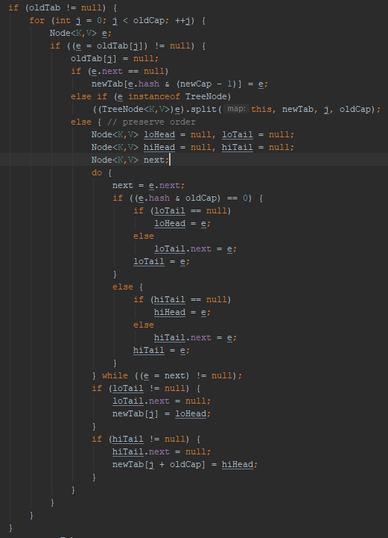
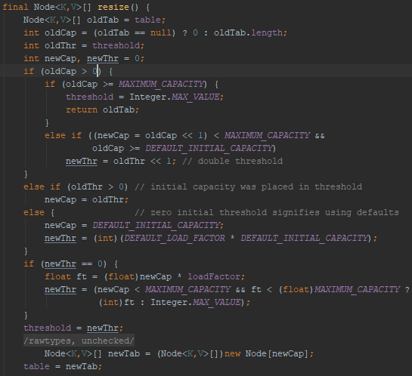
Header
HashMap – Put Resize

Slide 35
Header
HashMap – Put Resize

Slide 36
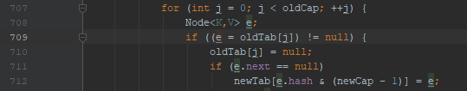
Header
HashMap – Put Resize Simplification***

Slide 37
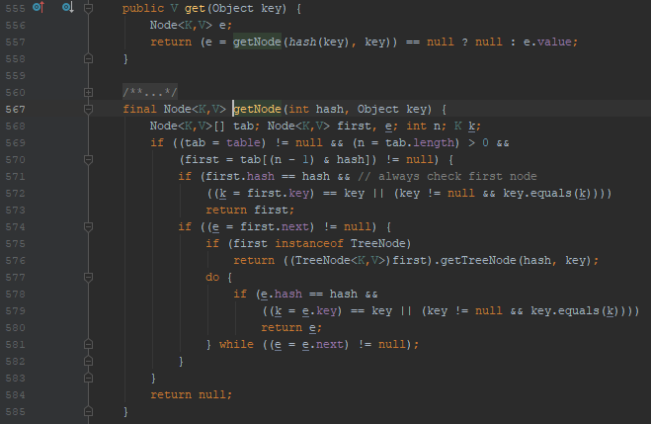
Header
HashMap – Get

Slide 38
Header
HashMap – Get

Slide 39
Header
HashMap – Get
e = table[(tableSize - 1) & hash]
Index 0
Index 1
Index 2
Index 3
Index 4
Index 5
Index 6
Index 7
Index 8
Index 9
Index 10
Index 11
Index 12
Index 13
Index 14
Index 15
null
null
null
null
K:: 100
V: 0
null
null
null
null
null
K: 90
V: 0
null
null
null
null
null
Next
Next
null
K: 74
V: 0
Next
null

Slide 40
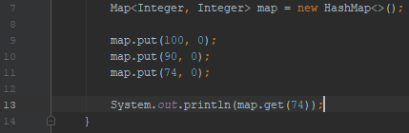
Header
HashMap – Get Example
Index 0
Index 1
Index 2
Index 3
Index 4
Index 5
Index 6
Index 7
Index 8
Index 9
Index 10
Index 11
Index 12
Index 13
Index 14
Index 15
null
null
null
null
K:: 100
V: 0
null
null
null
null
null
K: 90
V: 0
null
null
null
null
null
Next
Next
null
K: 74
V: 0
Next
null

Slide 41
Header
HashMap – Get
e = table[(tableSize - 1) & hash]
e ->
Index 10
K: 90
V: 0
Next
K: 74
V: 0
Next
null

Slide 42
Header
HashMap – Get
e = table[(tableSize - 1) & hash]
e ->
Index 10
K: 90
V: 0
e.hash | hash
74 | 74
Next
K: 74
V: 0
e.Key | key
74 | 74
Next
null

Slide 43
Conclusion

Slide 44
Questions?
?

Slide 45
Header
References
https://spectrum.ieee.org/tech-history/silicon-revolution/hans-peter-luhn-and-the-birth-of-the-hashing-algorithm
https://docs.oracle.com/javase/8

Slide 46
Thank You!

