Slide 1
Data Science Methods for Clean Energy Research
Week 9 L1: Decision Trees
Feb 26, 2017 → March 1 2017

Slide 2
Outline
Quick review from last time
Intro tree methods
Definition and properties
Regression trees
Classifier trees
Python project
Methods to improve decision trees
Bagging, boosting, random forests
Python example
Wrap up

Slide 3
Topics last time
K-fold cross validation
Subset selection
Shrinkage/regularization methods
Ridge regression
LASSO regression
Big picture concepts:
Test error can be estimated using bootstrap or approximated with known methods
Subset selection algorithms help determine a smaller set of X’s that explain more of the variance in Y
Regularization and shrinkage methods address the bias/variance tradeoff by adding a penalty that shrinks all coefficients toward zero

Slide 4
Decision trees: Example
Example of a decision tree that predicts the Y1 predictor from the UCI data set using a simple 3 level regression decision tree

Slide 5
Decision trees: Nomenclature
cutpoint
Branches
Internal nodes
Terminal nodes
or “leaves”
Nodes: a point where we make a decision (quantitative or qualitative (class) comparisons
Branch: connections between nodes

Slide 6
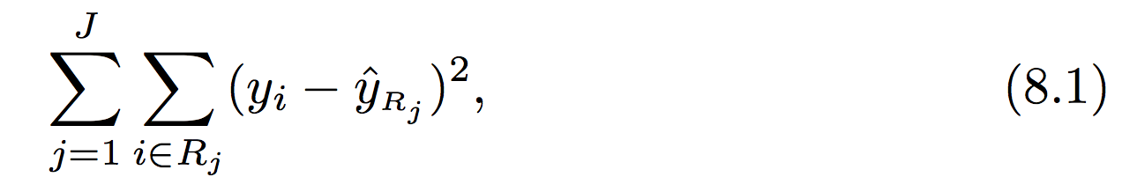
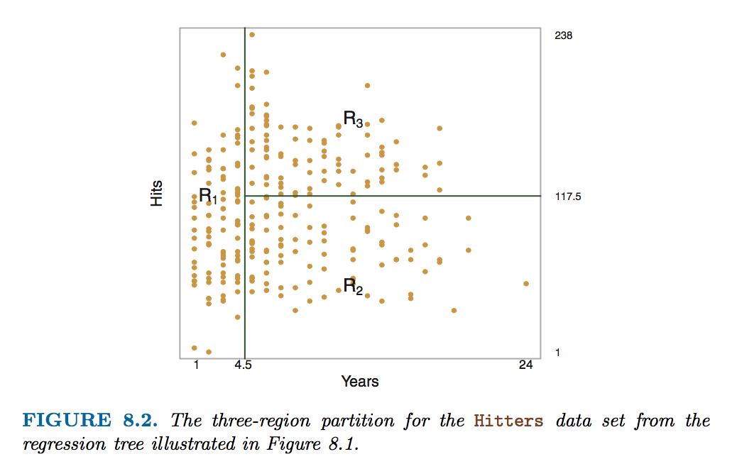

Building a regression tree
The data in ISL Fig 8.2 shows baseball player salary vs “Hits” vs “Years playing”. The regression tree is divided into three regions (R1-R3) based on sub-divisions of the feature space
The goal is to find the cutpoints (s) that minimize the RSS
This is done iteratively by first finding the biggest decreases in RSS by appropriately selecting which predictor (j) and cutpoint give the biggest decrease in RSS…
^ RSS for a single region for predictor j
^ Cutpoint breaks it into two regions
^ The total RSS is minimized (8.3)

Slide 7
Options for tree building
Approach on the last page is known as “top down” or “greedy” → goes after the biggest reductions in RSS first (recursive binary splitting)
Does not simulate all possible trees, so possible you are not finding the minimum RSS
Also possible that trees designed in this approach can lead to overfitting (too much bias)
The procedure of “tree pruning” can address this (not natively supported in sklearn)
Other options/choices in building your DT will be explored in the Python segment…

Slide 8
Regression trees vs Classification trees
Concepts are identical
Error metric is based on the classification error rate not RSS , just as in KNN and related methods
The DT leaves have your qualitative class assignment, not a quantitative prediction
Please see section 8.1.2 of ISL for further information, there are some qualitative differences between the different DT’s and assessment of their quality…

Slide 9
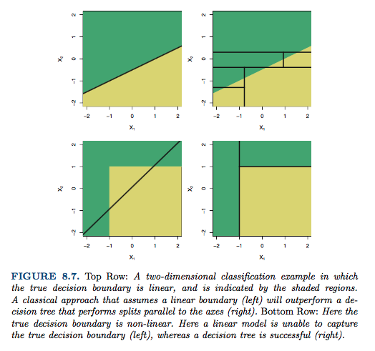
Big picture concepts in building a tree
Decision trees are constructed as an alternative to regression models we have seen
Fig 8.7 shows some extreme examples of ”regression vs. classification” and comparisons
Main advantage is ability to
handle nonlinear relationships
Main disadvantage is high
sensitivity to changes in test
set

Slide 10
In class Python project: Teams of 2
You should use the UCI data set and look to predict the Y1 (heating load) response vs all 8 predictors (X1-X8)
Break the data into 80% (training), 20% (testing)
Use a Python package that can perform decision tree regression
Make a plot of testing/training error vs. max tree depth (discuss what you expect the graph to look like first! Really. Draw a sketch!)
Don’t worry about differentiating validation vs test set data
You can hijack a lot of the code from last Wed
We will do 2 min standups every 10 mins and go for ~50 mins (I will pick teams or ask for volunteer)
If you finish early:
Study the properties of your tree at the depth you decided on
Visualize it: ask me for a code snippet
Study the sensitivity to the training test set size, random seed, etc.
Test set sensitivity is very important in DT creation!
Consider a bootstrap to enable true test MSE estimation
Compare error in DT regression to the best fits obtained from MLR, Ridge and LASSO
Discuss how you would pick a method to use in the future?

Slide 11
Building better trees with ensembles
Big picture ensemble concepts
Three common ensemble methods
Bagging
Random forests
Boosting [not covered, but similar in qualitative approach]

Slide 12
Ensemble methods (general)
A major takeaway from ISL CH8 is that the error of a DT is highly dependent on the training set used – sometimes much more than in regression
One way to avoid this is to use so-called ensemble methods
Conceptually very similar to resampling (bootstrap and cross-validation)
Recall main purpose of resampling: error estimation
In contrast, we go beyond error estimation to use ensemble methods for improved model training
Important: these methods get introduced in ISL in the context of DTs but can also be applied to other ML techniques

Slide 13
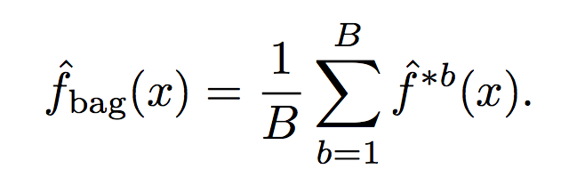
Application of ensemble methods to decision trees: Bagging
The bagging concept builds on bootstrap methods
Bagging algorithm
Build a model based on B individual bootstrap data sets
Make predictions f(x) for each model and average the predicted response
When applying bagging to the creation of DTs, you should grow trees with high bias (deep trees) as the bagging will reduce variance
Bagging classifier trees use “majority vote” (most common occurring response)

Slide 14
Application of ensemble methods to decision trees: Random Forest
Bagging methods work well, but the bootstrap sets can still be highly correlated, leading to increased training set error
To reduce correlation, the random forest method uses a random sample of predictors at each split (node) in the tree
Heuristic is that m ~= p^0.5 predictors are randomly chosen at each split
The random DT is combined with bagging to create a random forest

Slide 15
Next week plan
Unsupervised learning methods, including Python
Neural networks OR ML methods for time series data
Which do you prefer?
Course evaluation and DIRECT update
Data Science Option , course numbers , Capstone projects

