Slide 1
Data Science Methods for Clean Energy Research
SVM & Unsupervised Learning
March 1, 2017

Slide 2
Outline
Quick review from last time
A brief note on the support vector machine
Comparison of supervised vs. unsupervised learning
Principal components analysis (PCA)
Clustering
Wrap up

Slide 3
Topics last time
Decision trees
Classification and regression trees
Tree depth and relationship to bias/variance concepts
Ensemble methods
Bagging
Random forest
Visualization of DTs
Big picture concepts:
DT can outperform regression or classification, especially when relationships are complex or nonlinear
DT are highly dependent on training data used, so ensemble methods are strongly advised

Slide 4
Visualization of the DT in Python

Slide 5

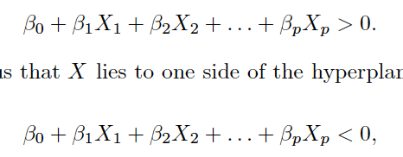
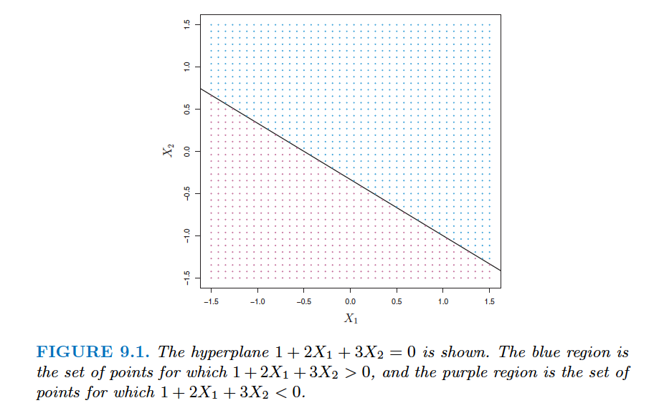
Support vector machine (SVM)
Recall that a hyperplane in a p dimensional space can be defined as follows
For any given point X = [X₁, X₂, …, X_{p}] we can determine what side of the hyperplane it is on via
How can we use this for classification?

Slide 6
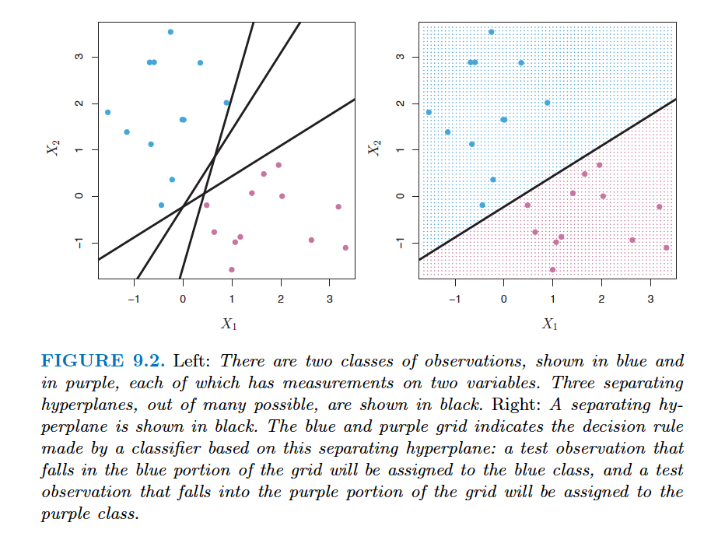
Support vector machine (SVM)
If we have p-dimensional feature, predictors, … then all we need to do is find a hyperplane that separates our classes
Easy, right?

Slide 7
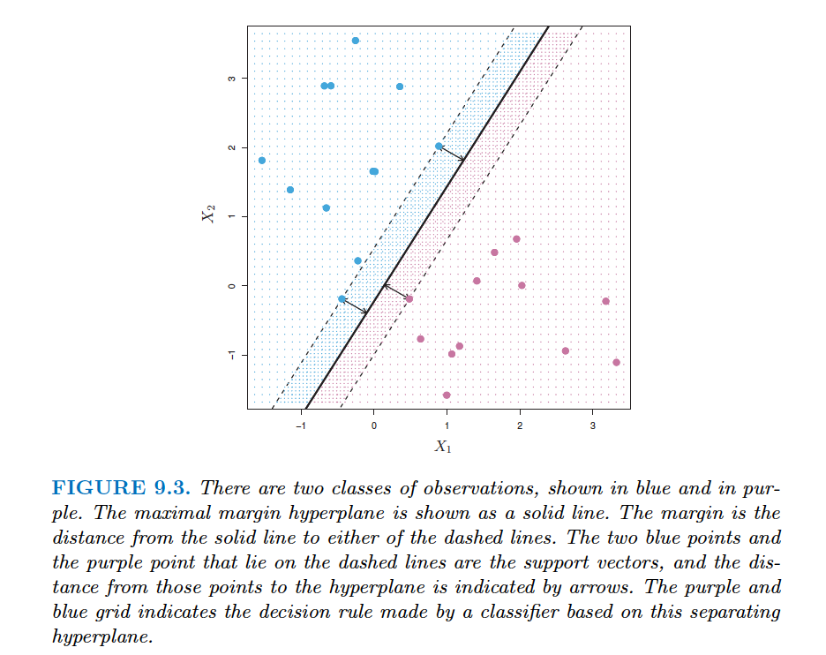
Support vector machine (SVM)
This hyperplane is our decision boundary (remember that term?)
Maximal margin classifier
Choose the decision boundary that maximizes the distance to points from both classes
We can think of distance to the decision boundary as a measure of confidence in our prediction.

Slide 8
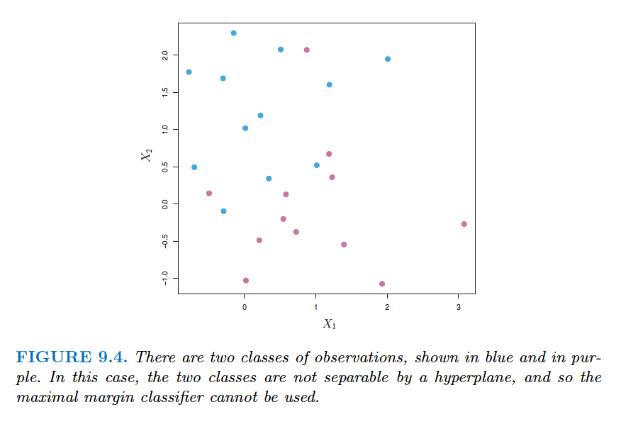
Support vector machine (SVM)
What happens when no maximal margin classifier exists?

Slide 9
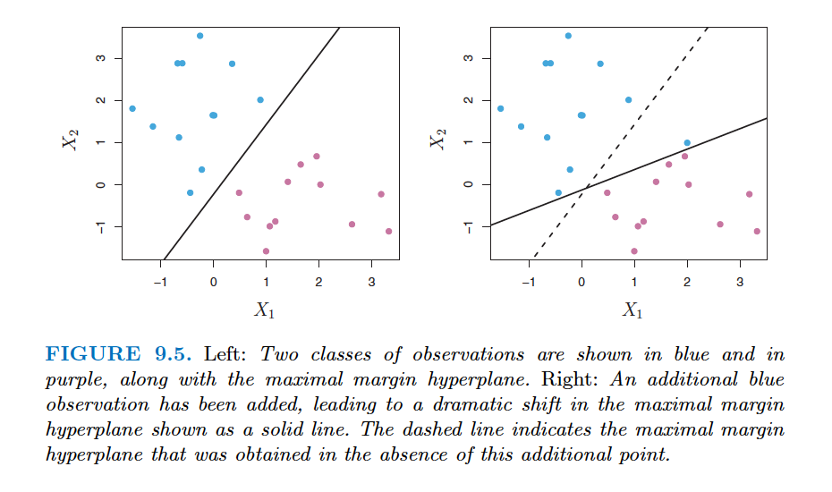
Support vector machine (SVM)
How do we fit a decision boundary?
The C parameter is the “budget” for the amount of points that can violate the decision boundary during training
When C is small or close to 0, no violates
As C increases, the extent of violates increases
Thus, C is our bias/variance tradeoff parameter
Notice how sensitive the plane fitting is when add a new observation and don’t allow violations.

Slide 10
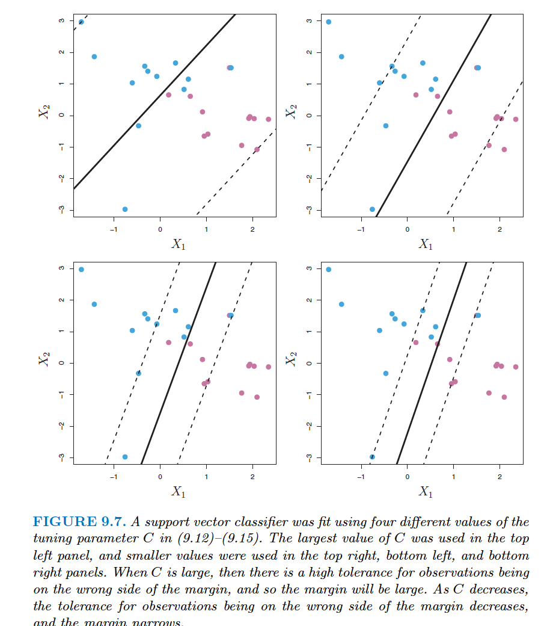
Support vector machine (SVM)
Example effect of C
This is called a support vector classifier (SVC).
class sklearn.svm.LinearSVC(penalty=’l2’, loss=’squared_hinge’, dual=True, tol=0.0001, C=1.0, multi_class=’ovr’, fit_intercept=True, intercept_scaling=1, class_weight=None, verbose=0, random_state=None, max_iter=1000)[source]¶

Slide 11
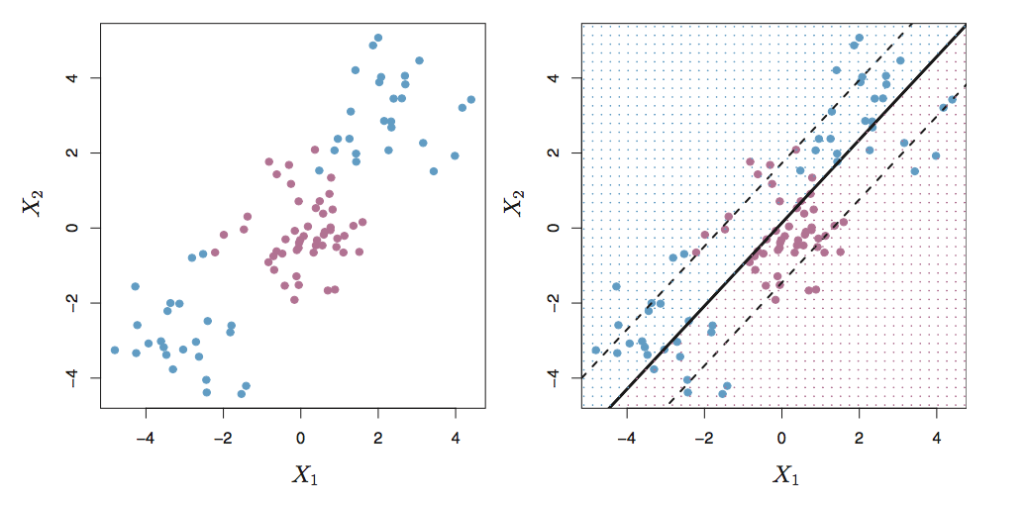
Support vector machine (SVM)
What happens when a linear boundary does not suffice?
Data from figs 9.8/9.9
2 features, 2 class
Linear boundary

Slide 12

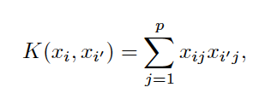
Support vector machine (SVM)
We can use the “kernel trick”
Use a kernel function K that transforms the data into a higher dimensional space (i.e. more dimensions than p)
The kernel functions are chosen such that they quantify the similar of two points in the higher dimensional space using only the inner product of the two points
What kernel is this?
Inner product

Slide 13
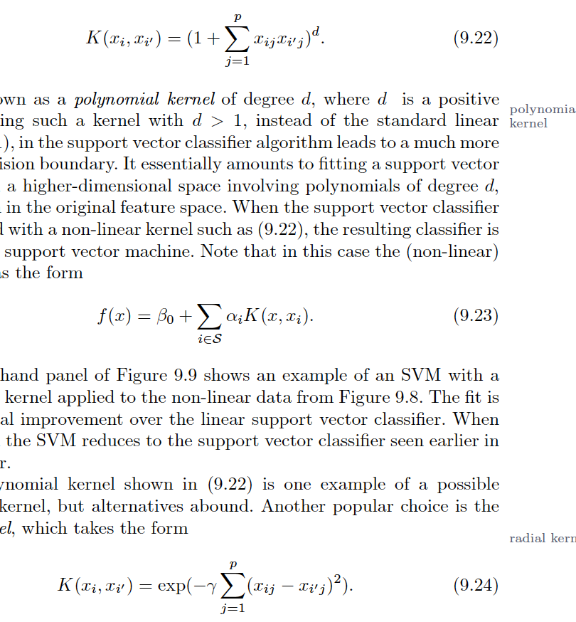
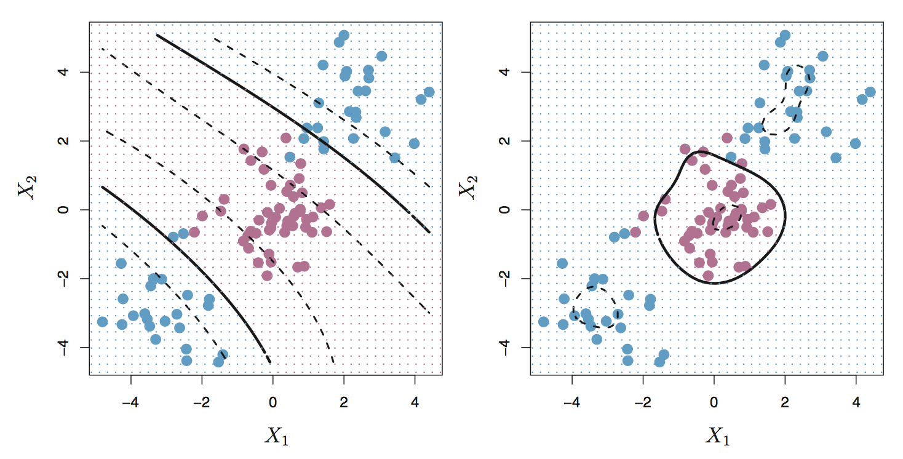
Support vector machine (SVM)
A non-linear kernel function turns the SVC into and SVM
More interesting kernels
Polynomial kernel
Radial kernel
SVM:
curved boundary
SVM:
radial boundary

Slide 14
Support vector machine (SVM)
Python time!

Slide 15
Supervised vs. unsupervised learning
Consider the X1/X2 data below. Imagine the scenario in which we did not know in advance the response Y (the color of the circle or class)
Main goal:
Use a large set of features (X) [there are no longer any responses, Y!] and determine how the data may be grouped together
Central challenge in unsupervised learning:
How to validate the data?
Or... Is there any “answer” ?

Slide 16
Two concepts in unsupervised learning
Find a way to group the data in reduced dimensionality so that sub-groups describe most of the variance: principal components analysis (PCA)
Find similar sub-groups of data within our total data set: clustering

Slide 17
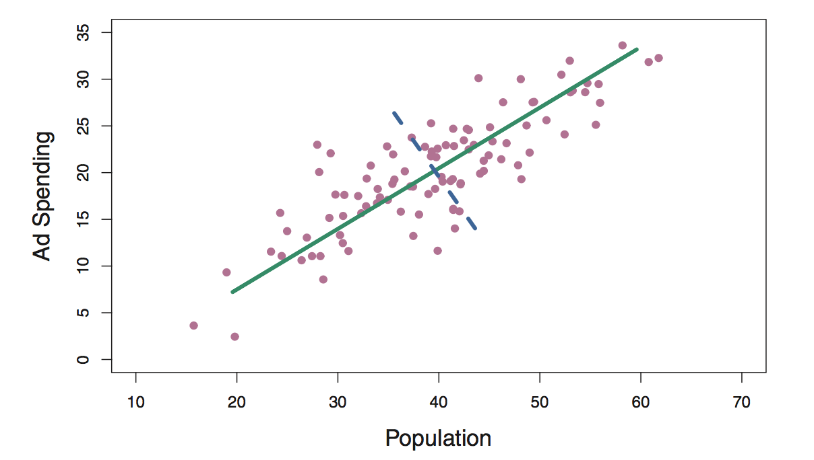
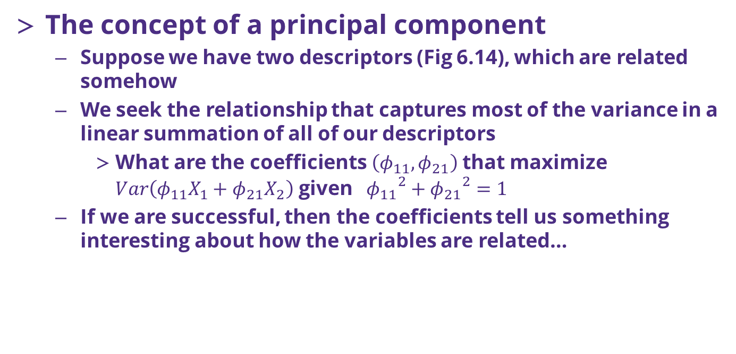
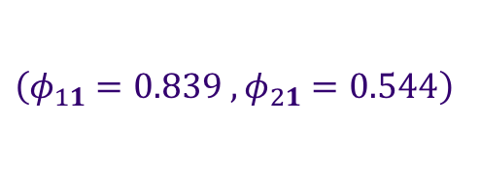
PCA analysis
The concept of a principal component
Suppose we have two descriptors (Fig 6.14), which are related somehow
We seek the relationship that captures most of the variance in a linear summation of all of our descriptors
What are the coefficients $\left(φ_{11},φ_{21}\right)$ that maximize $Var\left(φ_{11}X_{1}+φ_{21}X_{2}\right)$ given ${{ φ}_{11}}^{2}+{φ_{21}}^{2}=1$
If we are successful, then the coefficients tell us something interesting about how the variables are related…
The first principal component for this data is shown by the green line and given by :
$\left(φ_{11}=0.839 , φ_{21}=0.544\right)$
Eq 6.19 / Fig 6.14
Notes:
Warning: need to get away from thinking of this a prediction/response!

Slide 18
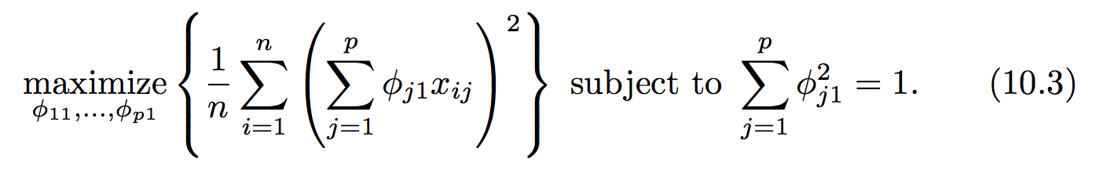
PCA definitions and concepts
One way to look for the relationship between variables that maximizes the variance is to look at the matrix of scatter plots (not feasible in high dimensionality)
The first principal component (Z₁) is determined by solving
The coefficients φ are known as loadings for each of the responses
The PC loadings are often the most informative outcome of our PCA

Slide 19
The 2nd principal component
But what if there are other variables that help describe the variance in our observables?
The 2nd PC (Z₂) is the linear combination of φ_{j2}X_{j} that has maximum variance: must be orthogonal, or totally uncorrelated to Z₁
The orthogonality of the 2nd PC comes in as an additional constraint

Slide 20
PCA summary
There are many principal components, they are usually determined through eigen decomposition of the covariance matrix of X
The eigenvalues, when ordered, often display a spectral gap, which can be useful in determining which set are the more useful to focus on
Random internet picture:

Slide 21
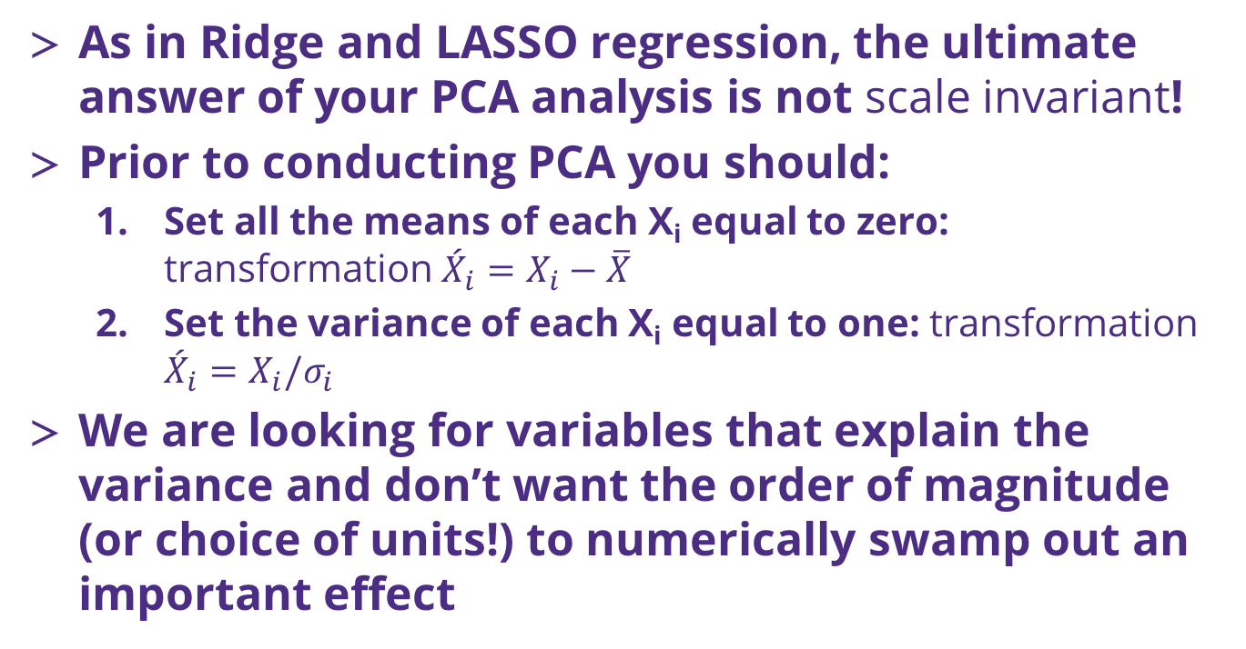
PCA analysis results may depend on the scale of X_{i}!
As in Ridge and LASSO regression, the ultimate answer of your PCA analysis is not scale invariant!
Prior to conducting PCA you should:
Set all the means of each X_{i} equal to zero: transformation ${{\acute{X}}_{i}=X}_{i}−\overline{X}$
Set the variance of each X_{i} equal to one: transformation ${{\acute{X}}_{i}=X}_{i}/σ_{i}$
We are looking for variables that explain the variance and don’t want the order of magnitude (or choice of units!) to numerically swamp out an important effect

Slide 22
How to use principal components
PCA is usually an “exploratory” method
Proportion of variance explained and what this means in practice
You could potentially bootstrap your PCA if you have enough data, but take care

Slide 23
Python implementation and tips
PCA can become expensive to calculate, especially as the data set size grows
As a result there are often many methods to pick from
Implementation is easy and many tutorials online, sklearn PCA is well supported
Advice
Go slow and use a subset of your data (if you have many points)
Use PCA as a guide and as an exploratory tool
Constantly interrogate the results and ask if they make sense! You don’t have “test set error” to fall back on, so you need to use your brain!

Slide 24
PCA questions?

Slide 25
Clustering
Our other main tool in unsupervised learning is clustering
Clustering seeks to group items by minimizing a distance metric between groups of observations or groups of features
K means
Algorithm
How to use it
What the results mean
Warnings: size K , many trials
Hierarchical clustering
Lots of other approaches // clustering vs PCA
How to implement it in Python

Slide 26
K-means clustering, a simple algorithm
One of the most common clustering methods
Requires, as an input, specification of the final number of clusters you want (K)
Rules:
Each observation must be placed in at least one of the clusters
No clusters may overlap, each observation can only be placed in a single cluster
The goal is to minimize the variance of observations within each of the clusters

Slide 27
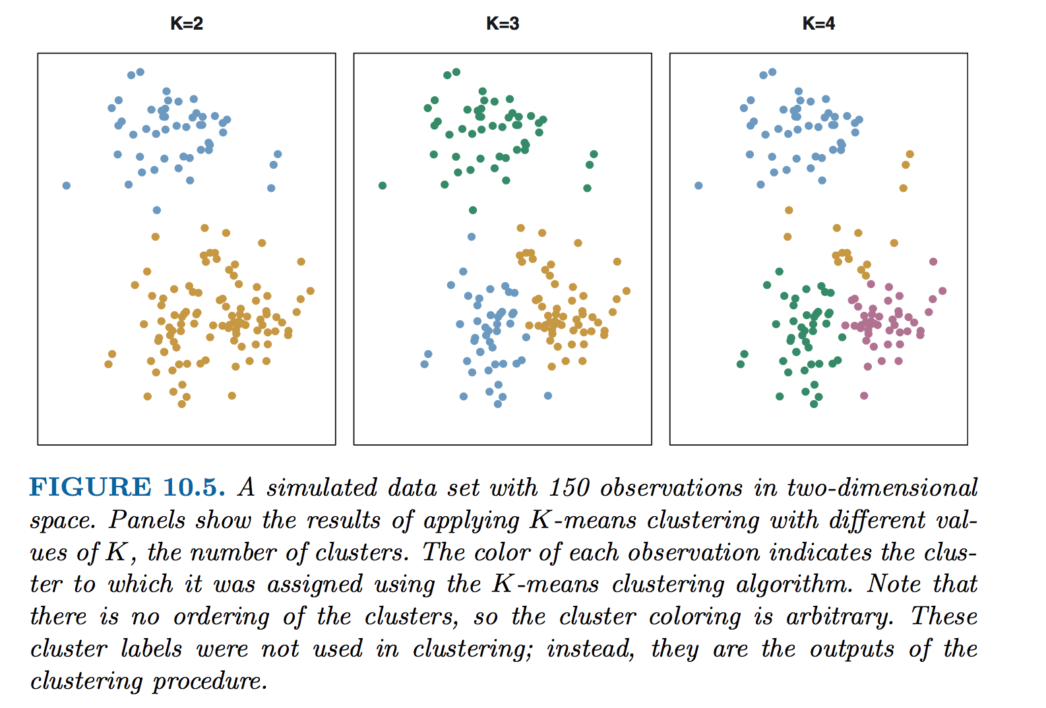
Same data, different values of K

Slide 28
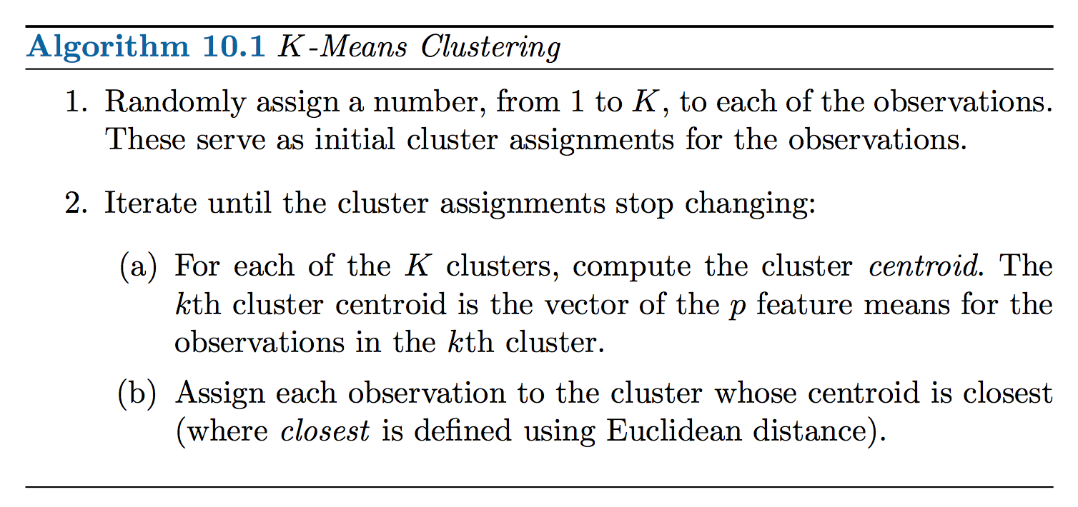
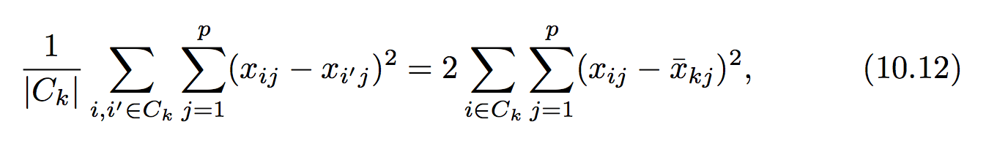
Algorithm for K-means

Slide 29
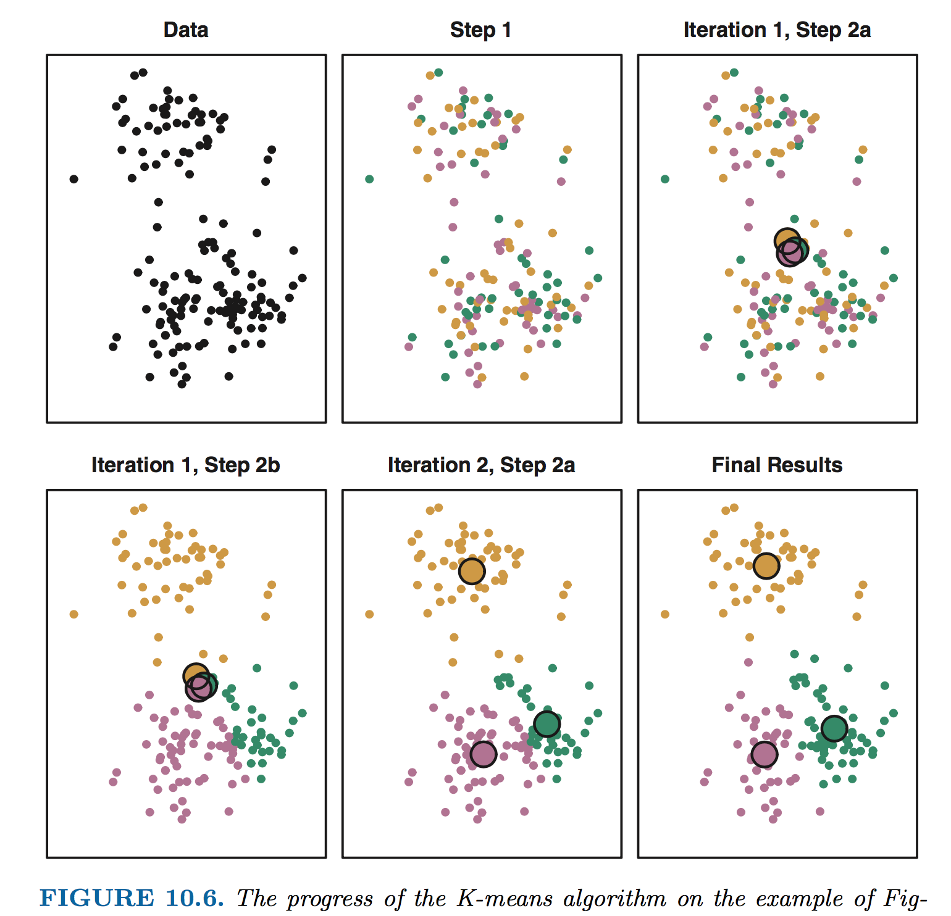
Algorithm for K-means (e.g., K=3)

Slide 30
Importance of sampling
K-means clustering is a stochastic process
Initial random assignment of data to classes
The optimization scheme leads to a local optimization , it is not guaranteed to find the global minimum
Process
Re-seed different initial clusters and repeat optimization of cluster centers / assignments
Monitor the sum of distances (each point’s distance from each cluster center) as your error metric
Choose clustering arrangement with lowest error

Slide 31
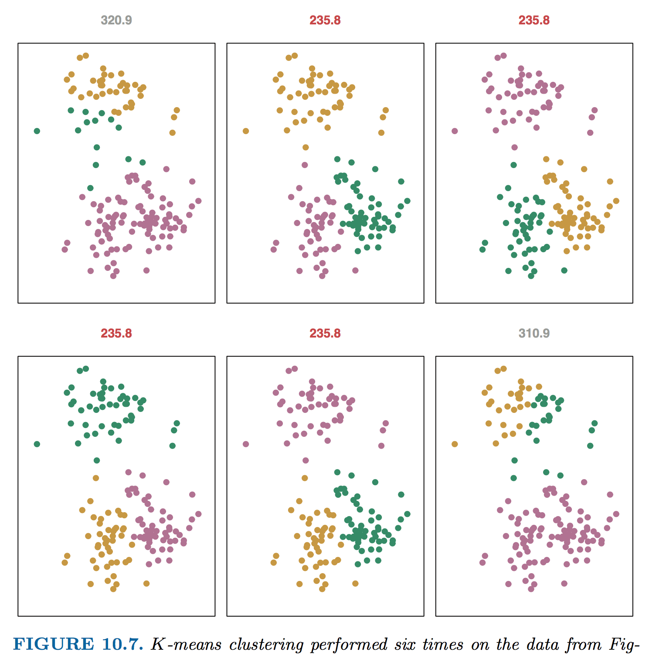
Importance of sampling

Slide 32
What to do with your clusters
As in PCA, clustering is an exploratory analysis tool
If you have clustered your observations (most common): you can interrogate the different clusters to see if they have common features
For observations with many features, you can also cluster the features and look @ common observations…
In K-means, you have to choose the number of clusters: you must assess the degree to which this choice makes an impact on your scientific conclusions!

Slide 33
Performing K-means clustering
The module sklearn.clustering can perform K-means and has many variants
Quick Q: what is a good strategy to learn how to implement a new method like K-means?
Take care as with PCA if the size of your data set grows, the computational cost to complete the clustering can become prohibitive…

Slide 34
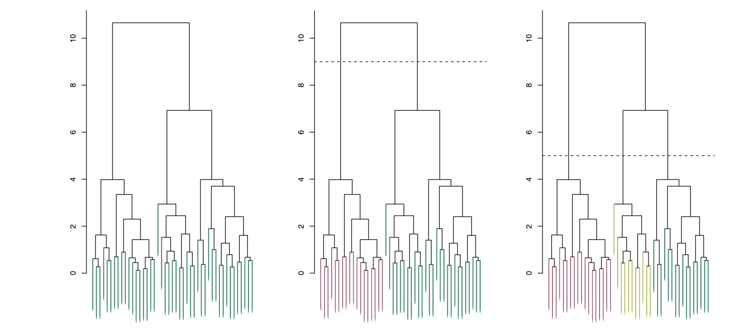
Hierarchical clustering vs K-means
The main limitation of K-means,
Section 10.3.2 discusses hierarchical clustering, an approach that clusters all the data using a tree type structure
Choice of how many clusters can be made after the clustering is completed…
See ISL for more detail

Slide 35
Clustering vs PCA
Simple definition in ISL (p385):
“PCA looks to find a low-dimensional representation of the observations that explain a good fraction of the variance”
“Clustering looks to find homogeneous subgroups among the observations”
Unsupervised learning, especially use of results, can be a bit of an art…
In some cases, it might be appropriate to look at both approaches

Slide 36
(if time) Feedback on class…

