Slide 1



Software Engineering for Data Scientists
Knowledge and solutions for a changing world
Advancing data-intensive discovery in all fields
Be boundless
UW DIRECT
()
https://uwdirect.github.io
David A. C. Beck (dacb)
Chemical Engineering & eScience Institute

Slide 2
Communcation
Communication around code
Standups
Technology reviews
Code review
Project stuff

Slide 3
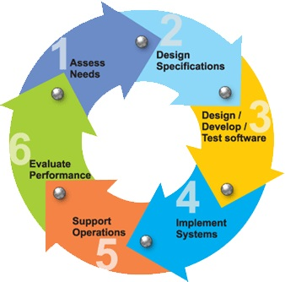
Software Development Phases

Slide 4
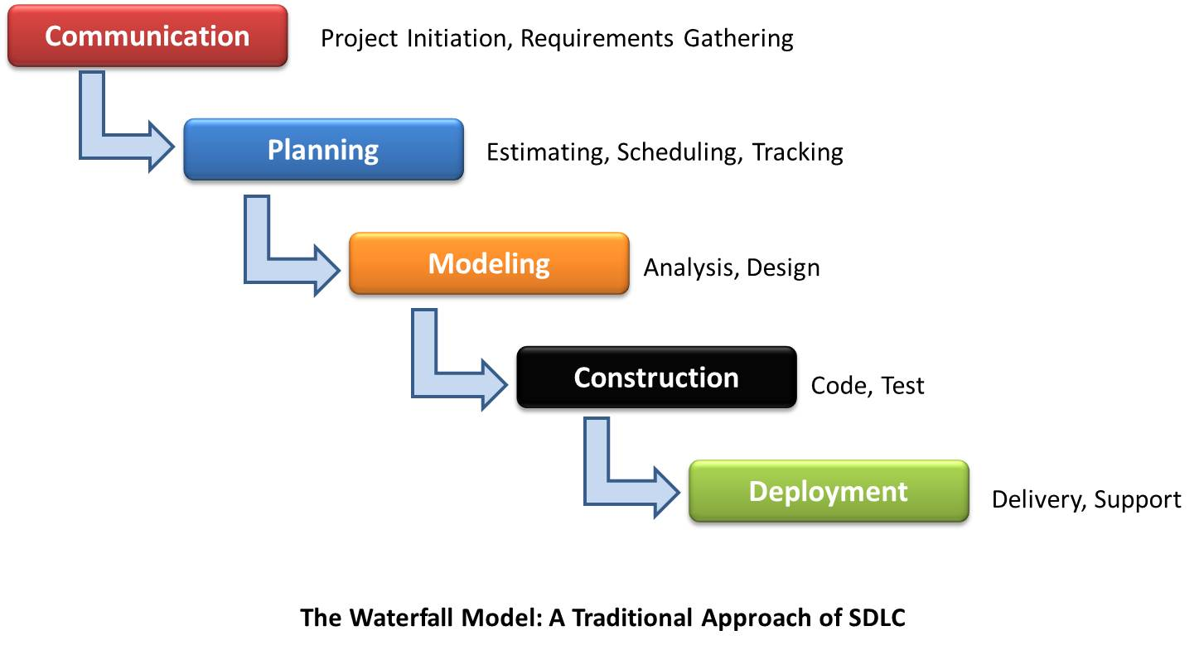
Waterfall Process Model
Software
Development
Why does this work poorly?

Slide 5
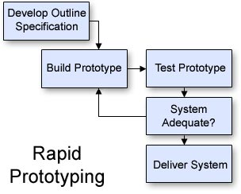
Rapid Prototyping
Cannot specify all requirements in advance
Revise the specification
Software
Development

Slide 6
Team Activities
Revise the
specification
Reqs gathering (functional spec.)
Design
Technology assessments
Write specifications
Review specification
Implementation
Code
Code review
Bug prioritization and resolution
Standups (status update)

Slide 7
Code Review Template
Why code review?
Improve code quality and find bugs
Background
Describe what the application does
Describe the role of the code being reviewed
Comment on
Choice of variable and function names
Readability of the code
How improve reuse and efficiency
How use existing python packages

Slide 8
In class exercise
Split into teams of two
~5 minutes
Partner A reviews B’s code
~5 minutes
Partner B reviews A’s code
~10 minutes
Report back on what you learned
About your code
About the process
ASK QUESTIONS!

Slide 9
In class exercise
This is a safe space
We are here to learn from and work with each other
Compliment sandwiches taste great
Follow the template and make notes

Slide 10
Technology Review Template
Why technology reviews?
Evaluate a package for deployment in a project
Background
Requirements that indicate a need for the proposed package
Discuss
How the package works
Appeal of using the package
Drawbacks of using the package

Slide 11
Technology Review: NEXT WEEK
Next Wed. every project will present
Max 15 minutes – I will cut you off
Everyone in the team will speak
Background
How it works
Appeal
Drawbacks
Things to think about, as a starting point:
Availability of relevant examples
Look at open issues on GitHub
Questions?

Slide 12
Standup Template
Why standups?
Communicate status and actions within and between teams
Should be presented in 1-2 minutes
Progress this period
How it compares with the plan
If behind plan, how compensate to make plan end date
Deliverables for next period
Challenges to making next deliverables such as:
Technology uncertainties and blockers
Team issues

Slide 13
Standups
The week after next..
Each class will have some time for standups
Everyone in class will give at least one standup
These are 1 to 2 minutes, don’t prepare too much

Slide 14
Remainder of today…
Take some time in your project team…
What open questions do you have about the project process?
About your project specifically?
We’ll resume as a class and you can ask Jim and I for clarifications.

