Slide 1



Data Science Methods for Cutting-edge Tec
Knowledge and solutions for a changing world
Advancing data-intensive discovery in all fields
Be boundless
UW DIRECT
(数据集中研究促进清洁技术)
https://uwdirect.github.io
David A. C. Beck (dacb)
Chemical Engineering & eScience Institute

Slide 2
Statistics
What is statistics?
The practice or science of collecting and analyzing numerical data in large quantities, especially for the purpose of inferring proportions in a whole from those in a representative sample.
-Wikipedia
What are the key features of this statement?

Slide 3
Statistics
Statistics does not tell us whether we are right in coming to a conclusion.
It tells us the chances of being wrong.

Slide 4


Statistics
Two key concepts:
Population
All possible values of an experimental variable
Sample
A set of data drawn from a population
Often want to know the mean (𝜇) and standard deviation (𝜎) of a population

Slide 5
Statistics
Mean and s.d. of a population
Nature, 2013. Importance of being uncertain.

Slide 6

Statistics
We often talk about variance (𝜎²). Why?
The s.d. of a population with a normal distribution:
± 0.5 𝜎 contains 39% of possible values
± 1 𝜎 contains 68% of possible values
± 2 𝜎 contains 95% of possible values
± 3 𝜎 contains 99.7% of possible values

Slide 7
Statistics
Median is often more robust than the mean in the face of skewed distributions and outliers
What is the median?

Slide 8
Statistics
Is it possible to obtain the population for an experimental variable?
Is it possible to directly measure the mean (𝜇) and standard deviation (𝜎) of a population

Slide 9
Statistics
Samples are sets of data drawn from the population
Describe a sample based on its size n
Denote a sample as X and indexed by subscripts, e.g. X₁
How to choose n?

Slide 10
Statistics
How do we sample from a population?
Do all values in a population have the same chance of being selected?
If not, we have bias.
What is an example of bias in sampling?

Slide 11
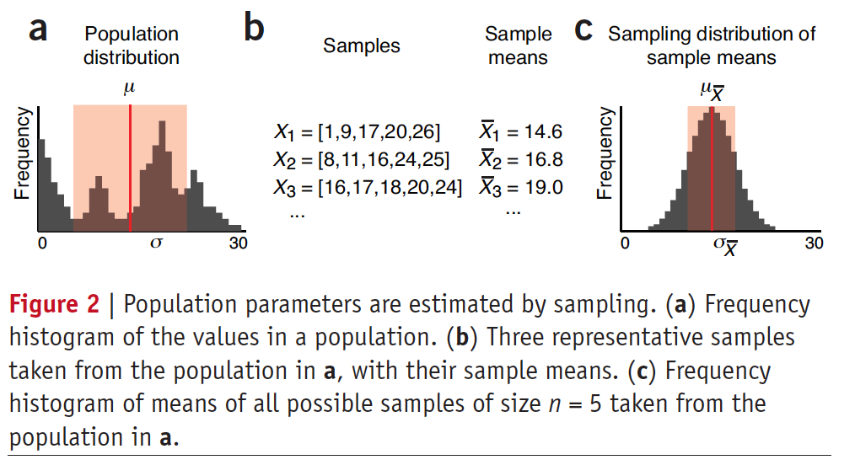
Statistics
Population: mean (𝜇) and s.d. (𝜎)
Sample: mean (X̅) and s.d. (s)
Nature, 2013. Importance of being uncertain.

Slide 12
Statistics
Sample parameters like X̅ have their own distributions – e.g. C below
Nature, 2013. Importance of being uncertain.

Slide 13
Statistics
Sampling with and without replacement
Population values = [12, 13, 14, 15, 16, 17, 18]
Sample with replacement (n=2)
First sample, each item has 1/7 probability
Second sample, each item has 1/7 probability
How many total possibilities (assuming order is important)?
49

Slide 14
Statistics
Sampling with and without replacement
Population values = [12, 13, 14, 15, 16, 17, 18]
Sample without replacement (n=2)
First sample, each item has 1/7 probability
Second sample? 1/6
How many total possibilities (assuming order is important)?
42

Slide 15
Statistics
Note that 𝜎_{X̅} < 𝜎
Also note that 𝜇 ≅ 𝜇 _{X̅}
Nature, 2013. Importance of being uncertain.

Slide 16
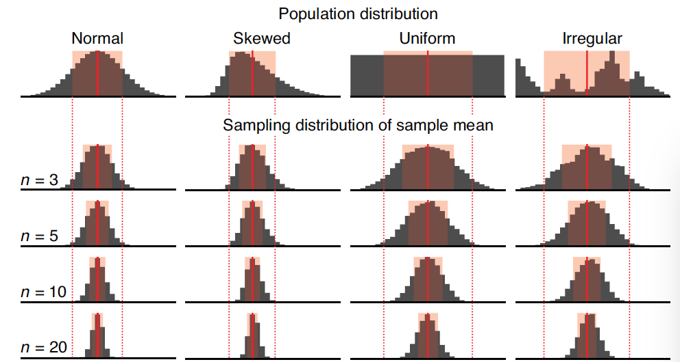
Statistics
Super important concept alert!
The central limit theorem (CLT):
As n increases, the distribution of sample means becomes more normal, regardless of population distribution shape
Nature, 2013. Importance of being uncertain.

Slide 17
Statistics
Super important concept alert!
The central limit theorem (CLT):
As n increases, 𝜇 _{X̅} decreases, i.e. we get better and better estimates of the population mean 𝜇
Thus big n makes 𝜇 ≅ 𝜇 _{X̅}
Nature, 2013. Importance of being uncertain.

Slide 18

Statistics
Super important concept alert!
The central limit theorem (CLT):
As n increases, $σ_{\overline{X}}$=$\frac{σ}{\sqrt{n}}$
Why is this super duper awesome?
Nature, 2013. Importance of being uncertain.

Slide 19
Statistics
Increasing sample size improves estimates
Nature, 2013. Importance of being uncertain.

Slide 20
Statistics
To Jupyter notebook for practical demonstration!
Download the notebook and open it in jupyter notebook.
Pair up with another individual in the class and go through the notebook.
This notebook will challenge you. It will require you use SEDS and DSMCER knowledge

