Slide 1

Data Science Methods for Clean Energy Research
k-fold cross validation + finish resampling
model selection and regularization
Feb 20, 2017
This is not my dog, but he is a really good dog…

Slide 2
Outline
Quick review from last time
Finish resampling methods
Cross-validation
Linear model selection / regularization
Subset selection
Ridge regression
LASSO regression
Python
Wrap up

Slide 3
Topics last time
Error in regression models
Multiple regression
Python example
Bootstrap and cross validation
Big picture concepts:
The training error (e.g., RSS) will always be lower than the validation set or test set error
Increasing the number of parameters (given P < N), always decreases the training error
The bias/variance tradeoff emerges when we have to make decisions about how much data to withhold for validation

Slide 4
Resampling methods (CH5, ISL)
Resampling concept
Doing more with your data
A big warning: as introduced today, the resampling schemes are not to be used to generate independent predictions (of Y) for averaging later.
This is a concept related to ‘ensemble’ methods, which we will discuss soon

Slide 5
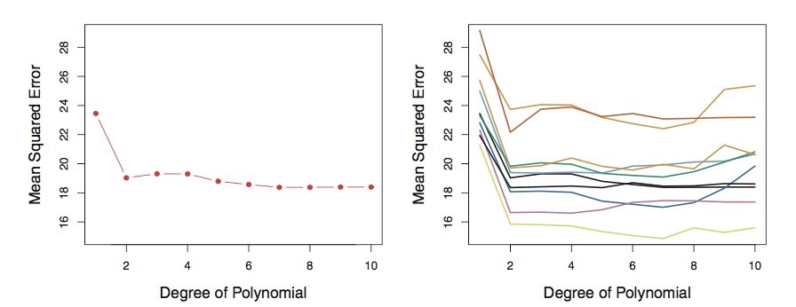
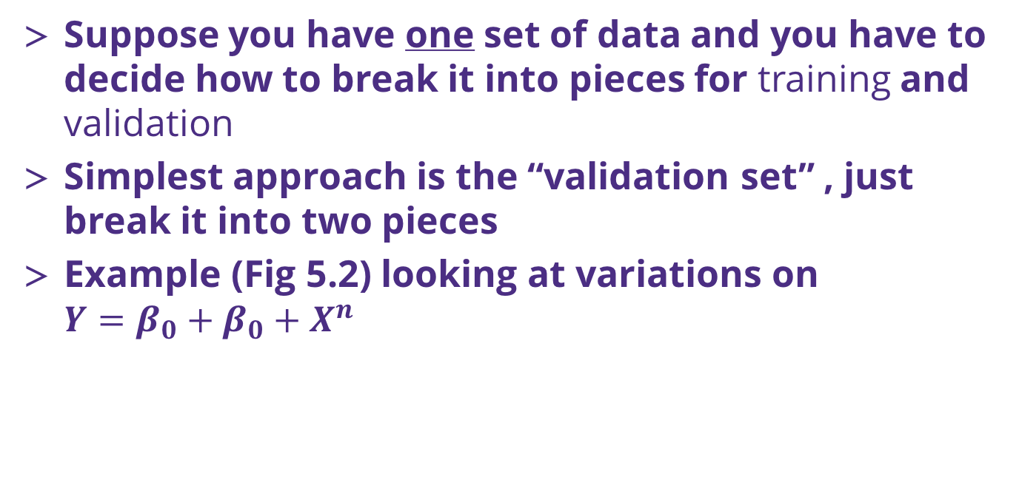
Cross Validation (k-fold)
Suppose you have one set of data and you have to decide how to break it into pieces for training and validation
Simplest approach is the “validation set” , just break it into two pieces
Example (Fig 5.2) looking at variations on $Y=β_{0}+β_{0}+X^{n}$
Left: training MSE vs n for one data set
Right: training MSE vs n for 10 validation sets
Riddle me this, how many ways are there to choose two 500 data sets from 1000?

Slide 6
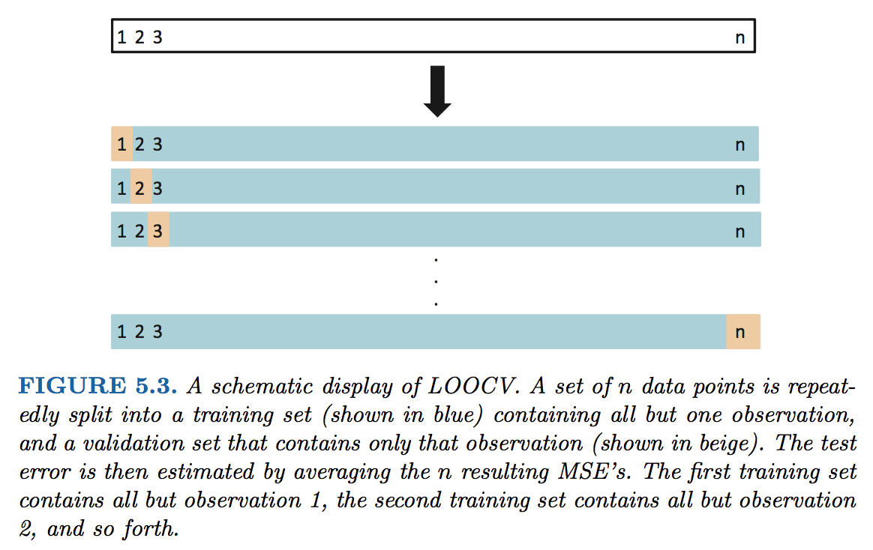
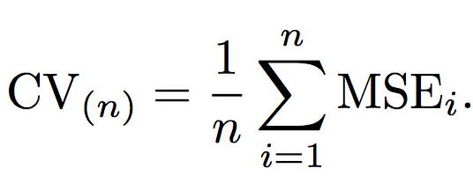
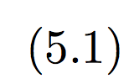
Cross Validation (k-fold)
Since you only use a portion of your data in the training, the ”validation set” approach will tend to overestimate your error!
Leave One Out Cross Validation approach

Slide 7
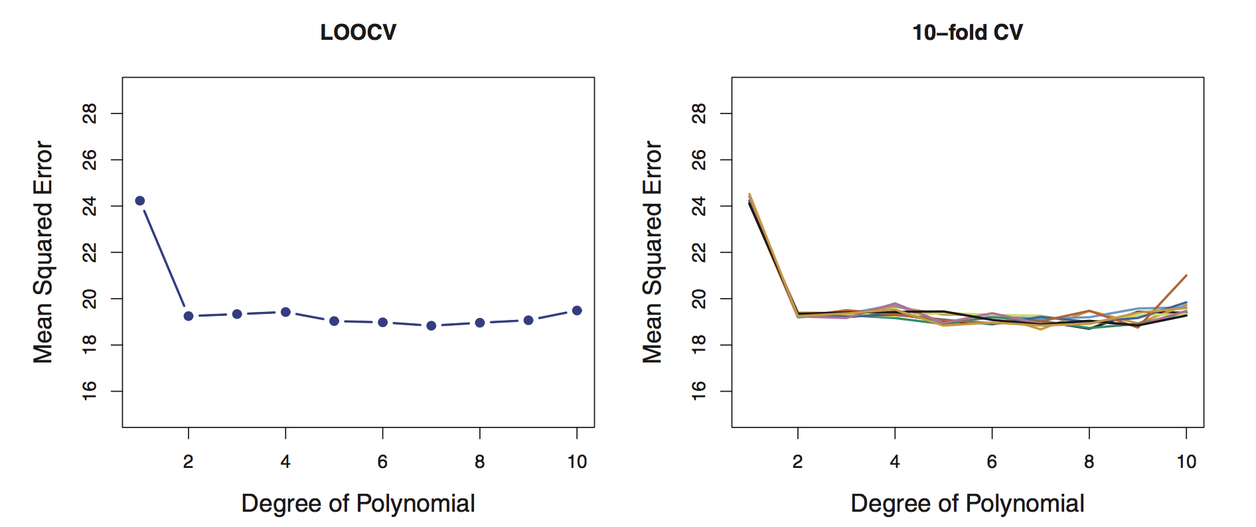
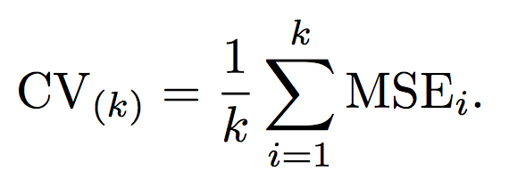

Cross Validation (k-fold)
LOOCV is way more accurate (Fig 5.4), but more computationally expensive!
An alternate is to break the data into larger pieces than n and n-1
We break it into “k” folds of data, e.g. 5-fold. The 1st set is saved for validation, remaining k-1 sets are used for training

Slide 8
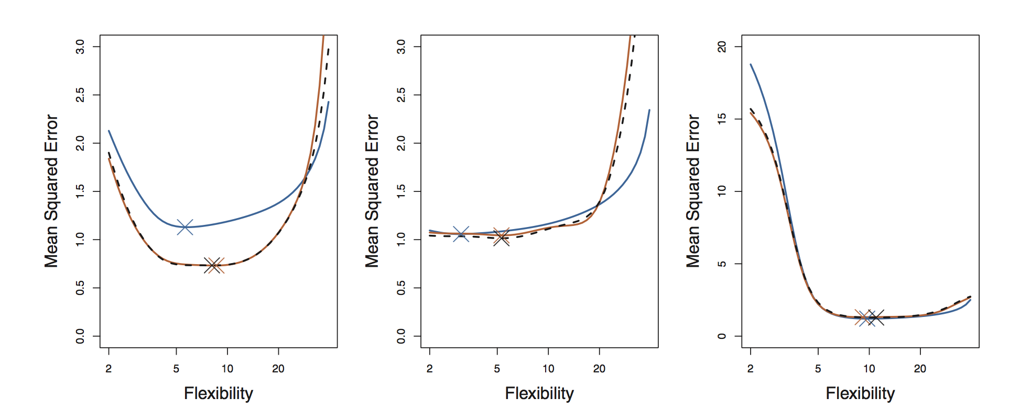
Bias/variance tradeoff: use 5 or 10 folds
Can anyone recall what we meant by the bias/variance tradeoff?
Empirically people usually use 5 or 10 folds to avoid too much bias or variance in their resampling algorithm
This is a great way to get a true estimate of your model’s MSE
Fig 5.6 revisits Fig 2.9 in the context of k-fold cross validation

Slide 9
Bootstrap
The bootstrap is one of the most versatile tools you will use in statistical analysis of data sets
It involves resampling with replacement from your data set
Algorithm:
Randomly draw, with replacement, some subset from your training data
Train your model and make an estimate of your coefficient and MSE
Rinse and repeat until the errors converge

Slide 10
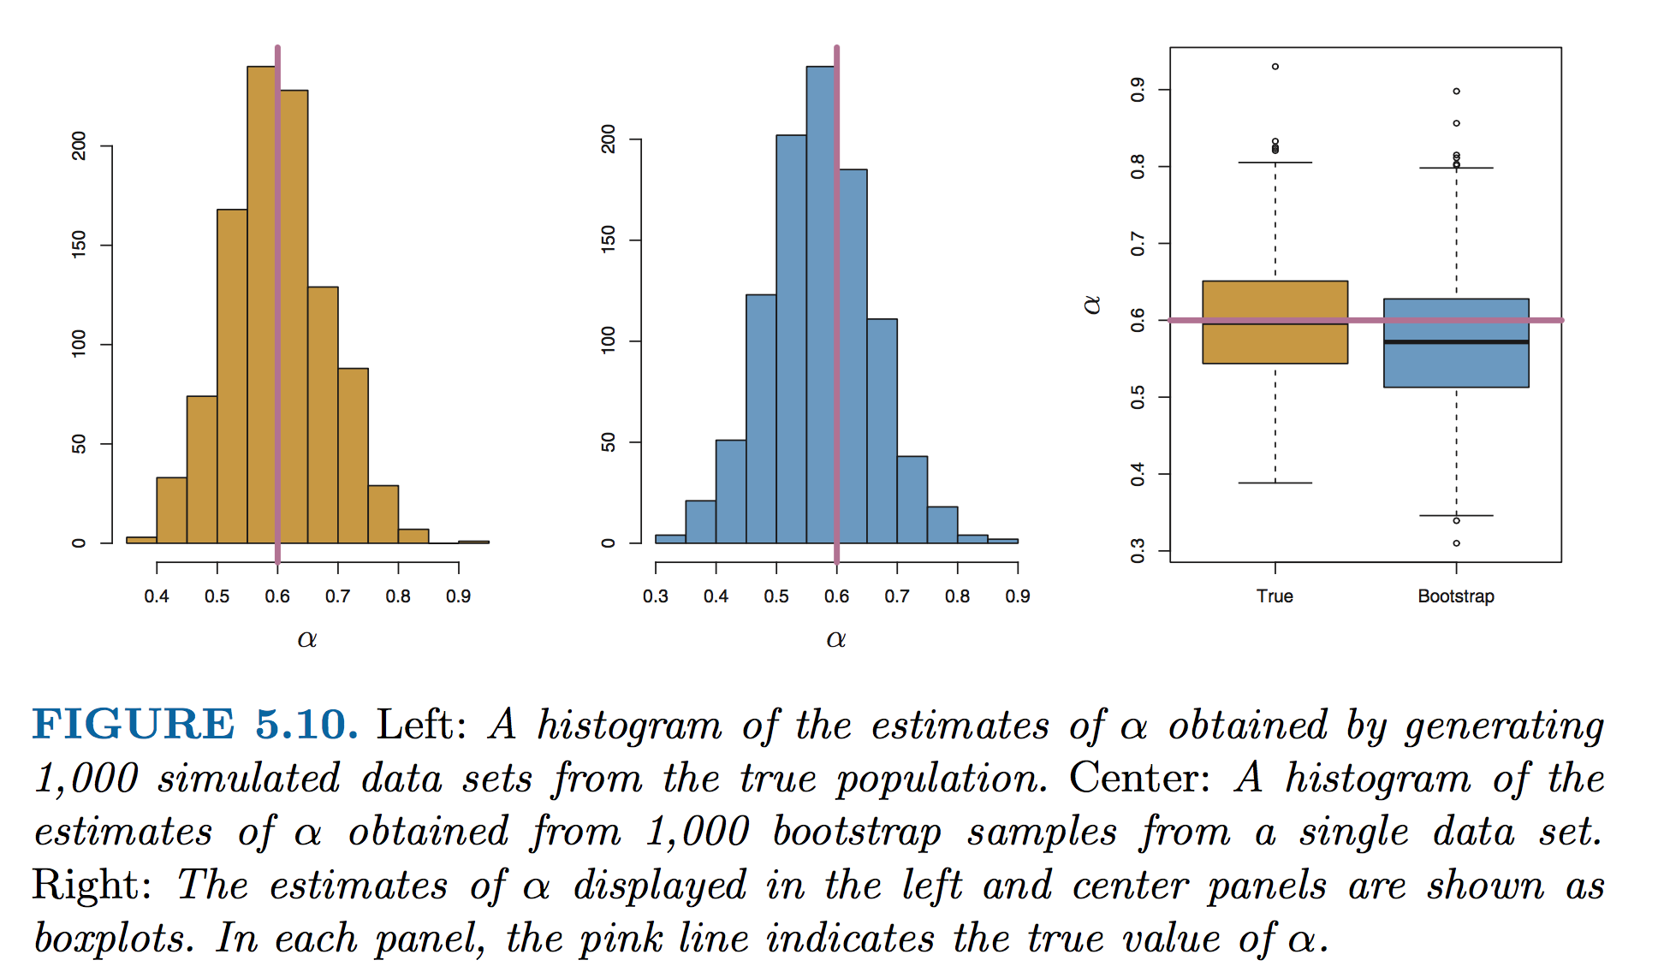
The power of the bootstrap in one figure
Fig 5.10, estimates of some parameter, α

Slide 11
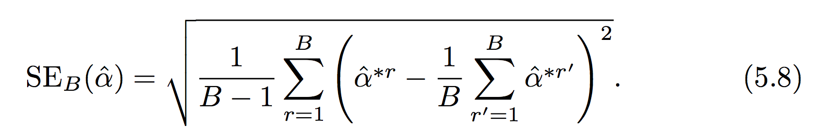
Take care
Depending on how large your bootstrap sample data set is, I recommend you avoid using the standard error formula (Eq 5.8) and instead you should use simply the standard deviation of the bootstrap estimates.
Can anyone explain why?
In this context α, could be any quantity from your training procedure (MSE, β, etc..)

Slide 12
Linear model selection and regularization (CH6 ISL)
The curse of high dimensionality and taking care with your training data
Linear model selection / regularization
Subset selection
Ridge regression
LASSO regression
Python
Dimensionality reduction approaches

Slide 13
When good models go bad
Increasing P can be seductive, especially if you “feel” like you have a large data set: In high dimension your training data may severely under sample the space of P
Supervised learning models are powerful: If you have a lot of data you can often get a model that is predictive
Can be difficult (or impossible) to make inference about important effects when P (the number of parameters) gets large..

Slide 14
The curse of dimensionality
Consider a situation in which you need n=10 in order to cover response range (in Y) for each X_{i}.
For P=1, n=1… P=2, n=100 P=3, n=1000…
Our ability to capture significant fractions of the predictor space collapses after a few dimensions
P₁
P₂
P₃

Slide 15
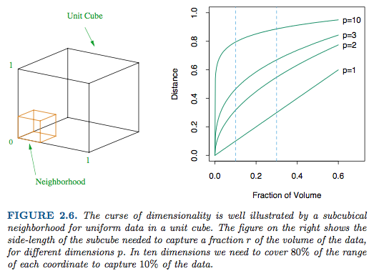
The curse of dimensionality
Figure 2.6, Elements of Statistical Learning

Slide 16
Three approaches to building a smaller model (ISL, p 204)
Subset selection: Systematically search different models created with subsets of all possible P values for an adequate model
Regularization (shrinkage): Fit a model w/all P values, but use a different error penalty to force coefficients to be smaller
Dimensional reduction: Fit a model with a reduced number of coarse parameters that represent subsets of groups of P’s

Slide 17
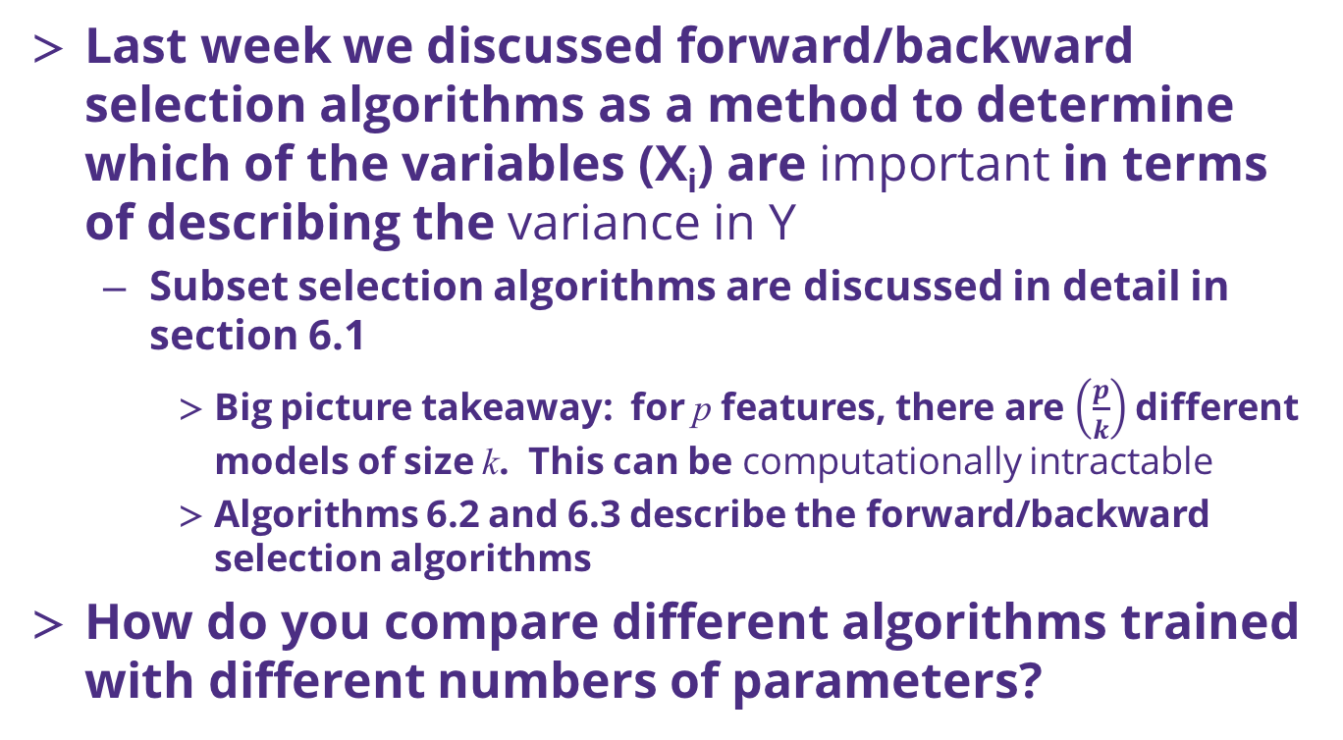
Subset selection: algorithms and challenges
Last week we discussed forward/backward selection algorithms as a method to determine which of the variables (X_{i}) are important in terms of describing the variance in Y
Subset selection algorithms are discussed in detail in section 6.1
Big picture takeaway: for p features, there are $\left(\frac{p}{k}\right)$different models of size k. This can be computationally intractable
Algorithms 6.2 and 6.3 describe the forward/backward selection algorithms
How do you compare different algorithms trained with different numbers of parameters?

Slide 18
Comparing alternative models
Key concept: The training error (RSS) will always decrease with increased number of parameters, how to evaluate different models with different number of parameters
We should therefore choose the best model considering the testing error. Two choices for this:
Use theoretical estimates of the test error. ISL offers four suggestions: Cp, AIC, BIC, adjusted R²
Use bootstrapping or cross-validation to evaluate the test error directly

Slide 19
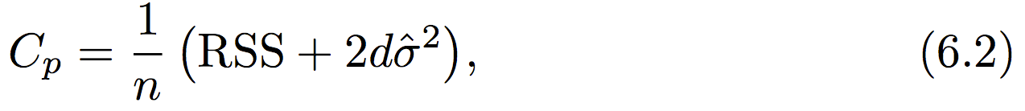
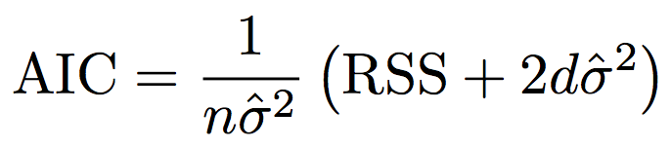
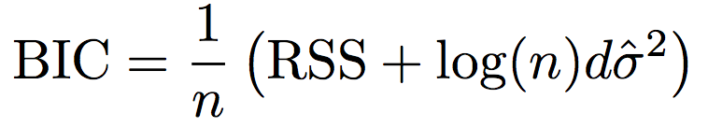
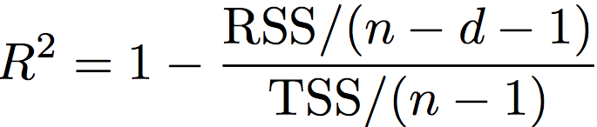
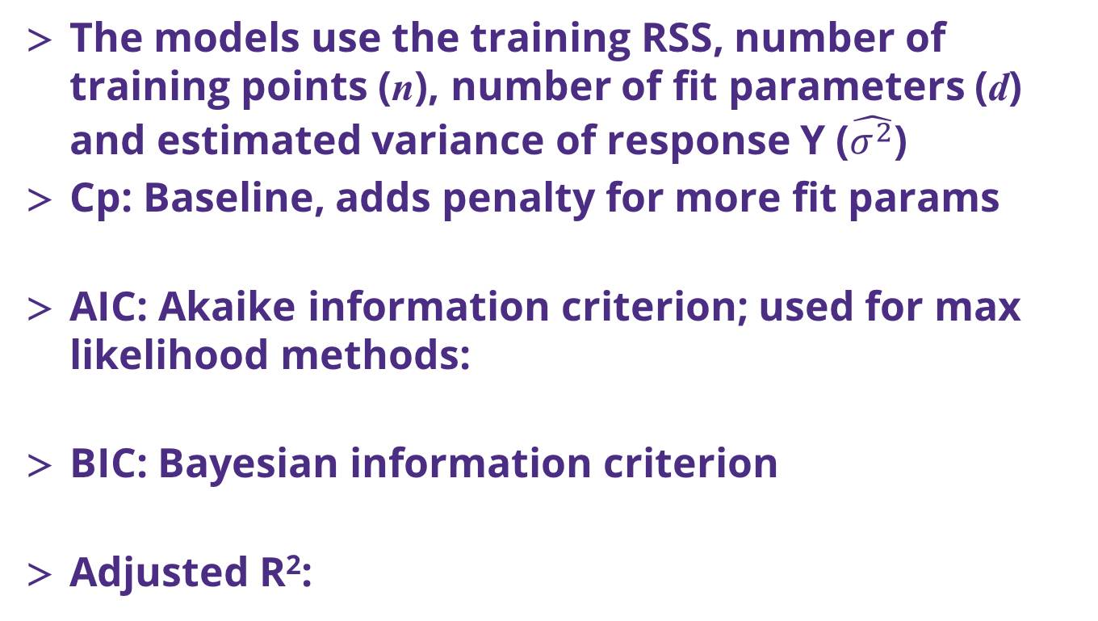
Theoretical models to estimate test error
The models use the training RSS, number of training points (n), number of fit parameters (d) and estimated variance of response Y ($\hat{σ^{2}}$)
Cp: Baseline, adds penalty for more fit params
AIC: Akaike information criterion; used for max likelihood methods:
BIC: Bayesian information criterion
Adjusted R²:

Slide 20
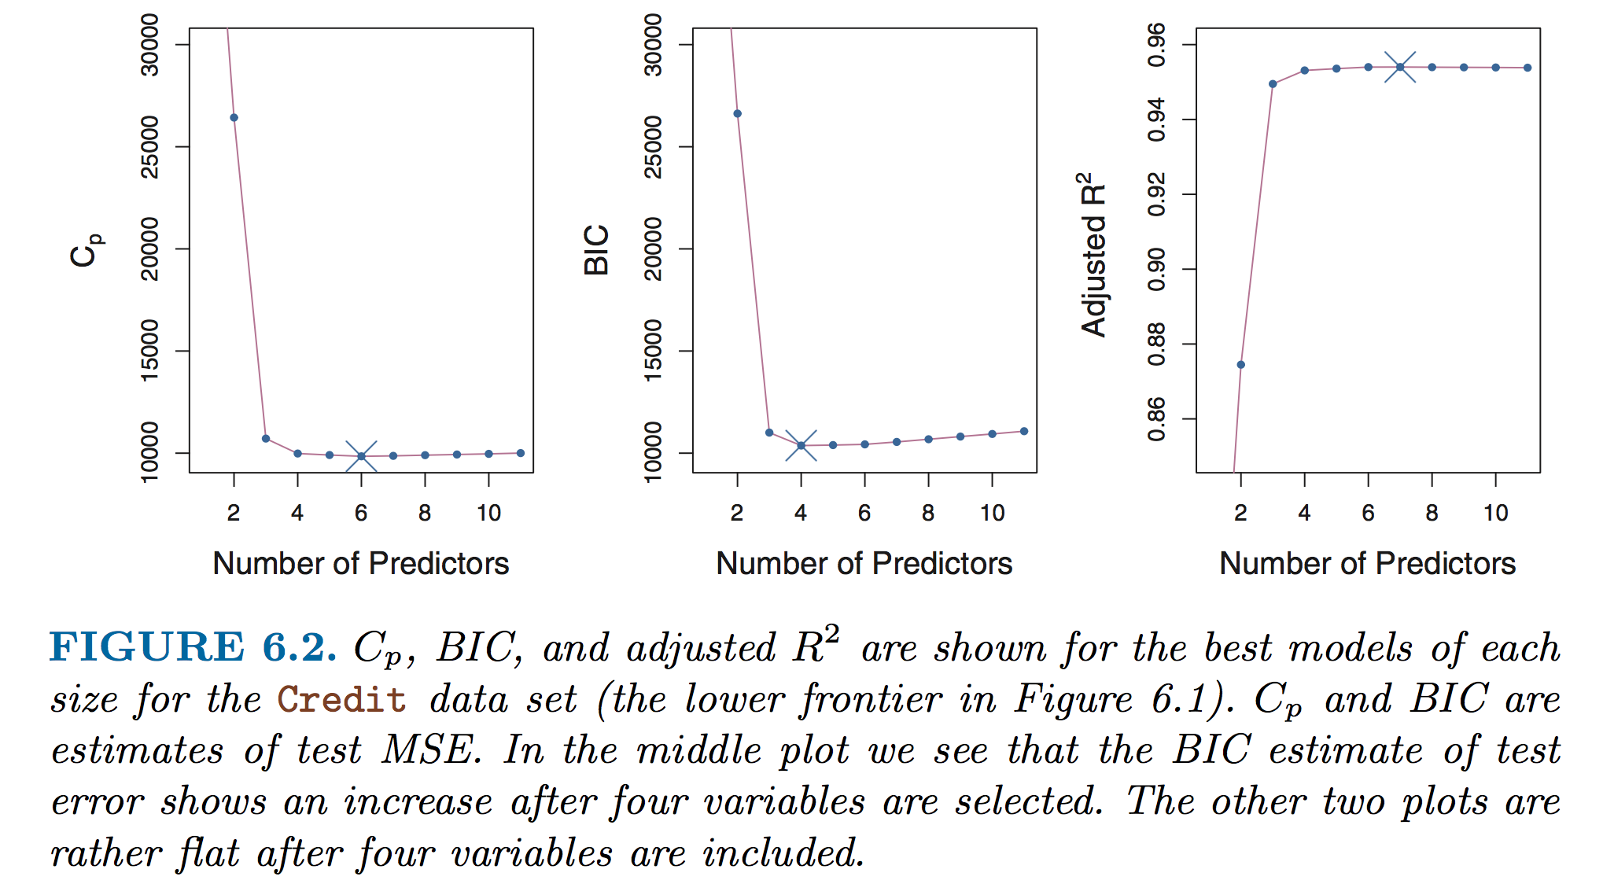
Comparison of test error estimates
This is a specific example from one of the ISL data sets!
In your own model subset exercise it is likely that you would have multiple models with same number of predictors!
Best practice is to monitor behavior of multiple test error estimates

Slide 21
Resampling and clarifying a bit of terminology…
The use of one large set of data combined with resampling yields the use of “training and validation” error estimates (in most statistical learning approaches)
Problem: In cross-validation or bootstrap, the learning algorithm “sees” all the data eventually
If possible, we often withhold a 3rd data set “the test set” that the model is totally blind to: testing error data is withheld until the final model is selected
Training data vs…
Validation data vs…
Testing data

Slide 22
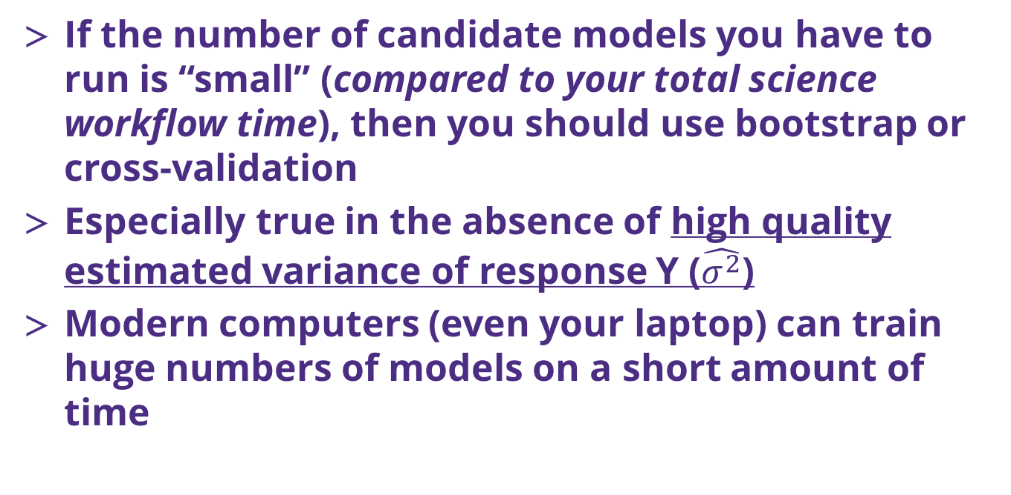
Resampling and testing error estimates
If the number of candidate models you have to run is “small” (compared to your total science workflow time), then you should use bootstrap or cross-validation
Especially true in the absence of high quality estimated variance of response Y ($\hat{σ^{2}}$)
Modern computers (even your laptop) can train huge numbers of models on a short amount of time

Slide 23
Regularization: big picture concepts
Instead of subset selection, another option is to fit a model with all possible (P) parameters and add a penalty to the RSS term to shrink them
Why do we want to do this? [THIS IS IMPORTANT]
Recall that models with more parameters will better estimate the training set, reducing the training error
However, adding more parameters increases the testing error (the variance of response Y is increased via the bias-variance tradeoff)
Reducing the magnitude of the coefficients, therefore is a plausible route to reducing test set error

Slide 24
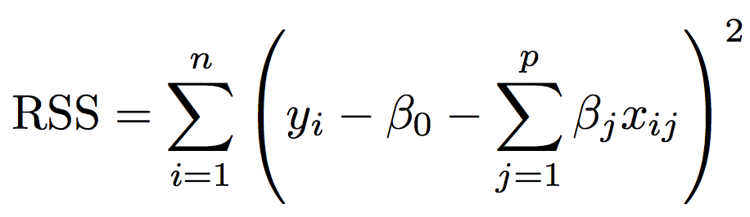
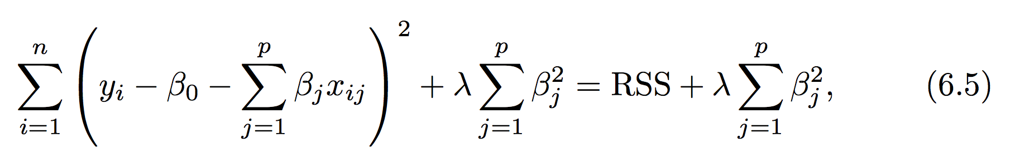
Ridge regression
Ridge replaces the RSS term: with a new minimizer that includes a so-called shrinkage penalty:
The adjustable parameter λ, trades the baseline RSS with a penalty for nonzero coefficients. As λ increases to infinity the minimized error drives all of the coefficients to zero

Slide 25
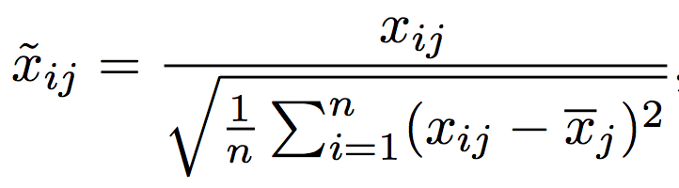
Ridge in practice
Unlike RSS minimizers, which are scale equivariant, the response data must be normalized in regularization methods:
Fit a series of ridge regression models across a wide range of λ and track the coefficient values and test set error (or estimate) as λ is changed
Determine the model that produces the smallest test error set
Alternatively determine the model w/smallest validation error and then estimate the true test error w/virgin data that was not used in the training

Slide 26
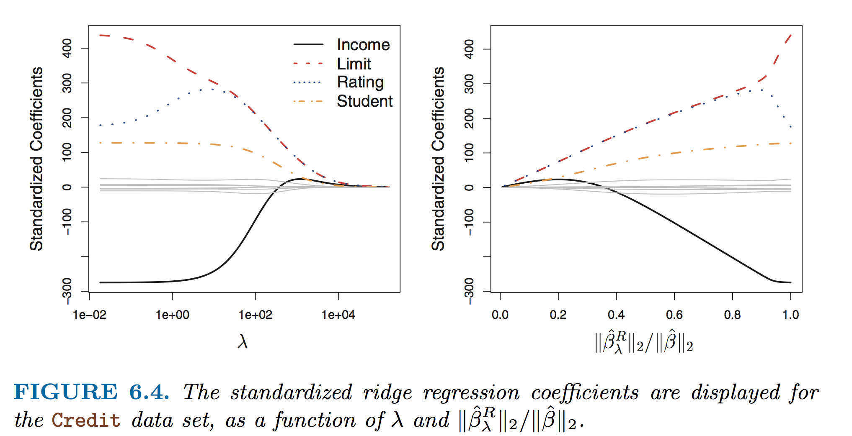
Expected response in ridge regression

Slide 27
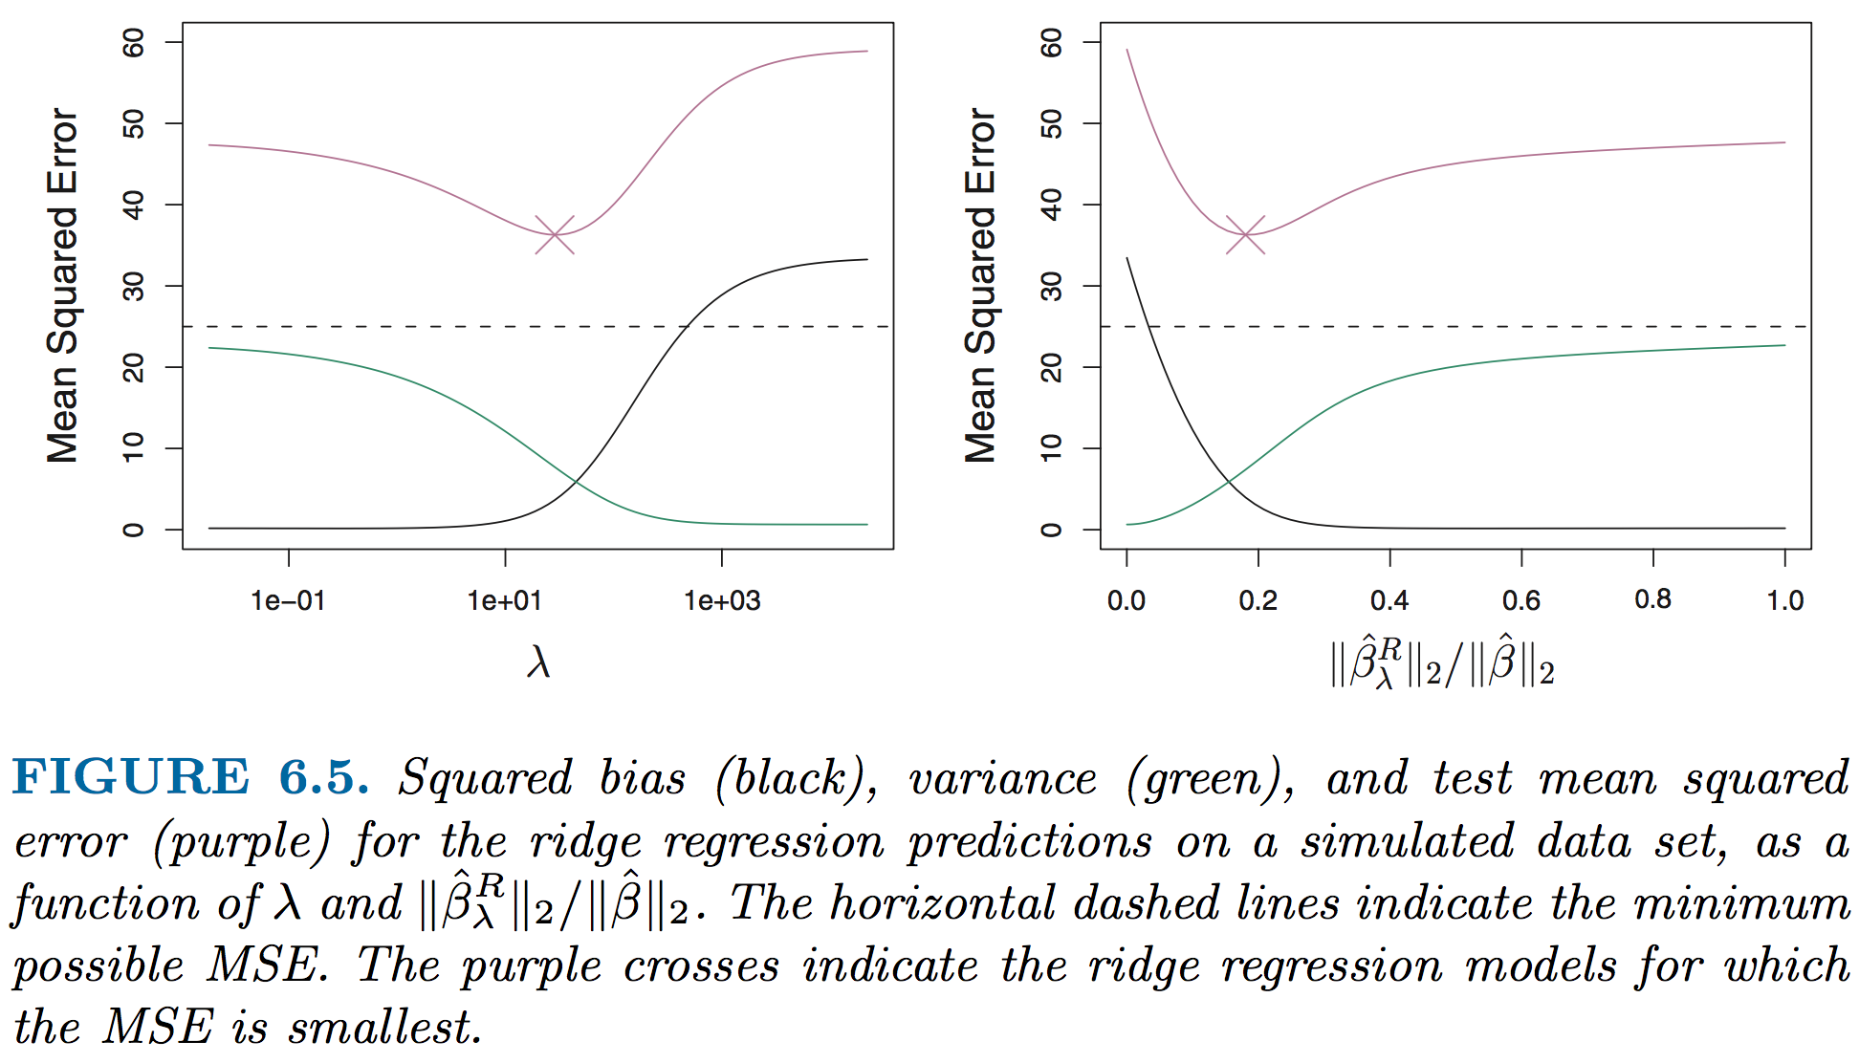
Expected response in ridge regression

Slide 28
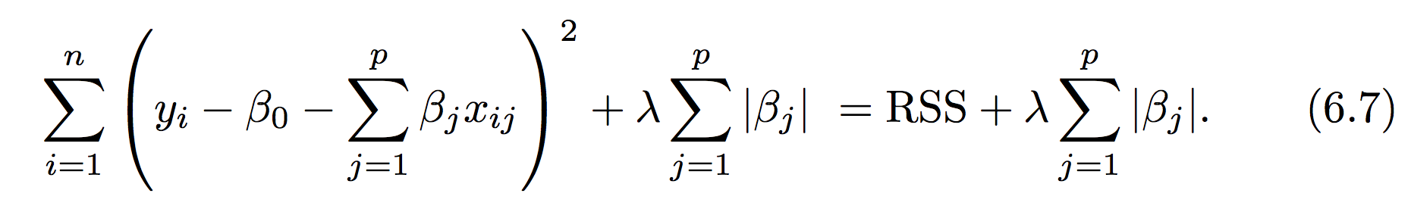
LASSO regression
Ridge regression does not set any of the coefficients exactly to zero but can shrink all of them
The LASSO regression was developed, inspired by ridge, to provide the possibility that some of the coefficients can take a value of zero
Like ridge, the LASSO operator is minimized as a function of an adjustable λ parameter

Slide 29
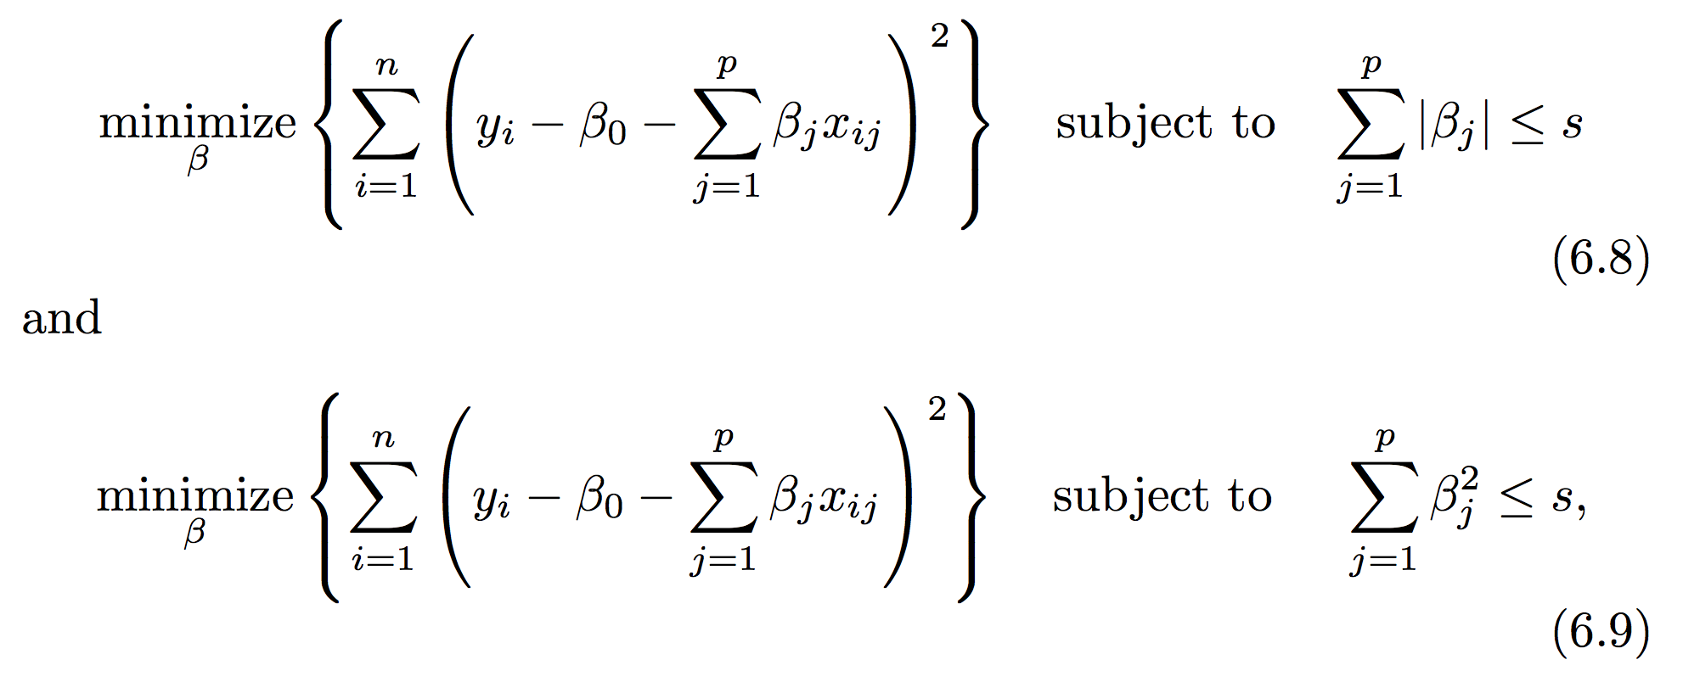
An extra bonus in LASSO: subset selection
The key difference is the penalty due to nonzero coefficients. Ridge it is squared, in LASSO it is not. You can also formulate both as constrained minimization problems.
A mathematical result of LASSO (6.8), is the possibility that some of the β values will be zero at the minimum error

Slide 30
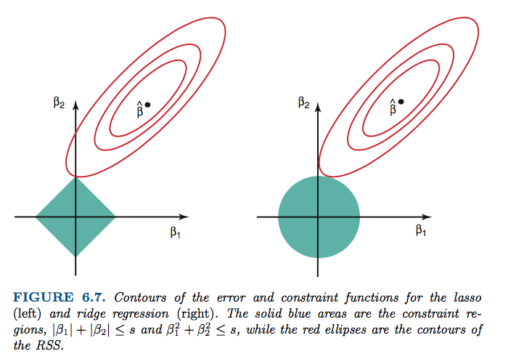
Why can LASSO coefficients become zero?
LASSO Ridge
Red = RSS
Blue = constraint zone
Notes:
Work through explanation and take some notes here!

Slide 31
Python practice
We will use a data set from UCI Irvine ML database related to insulation and energy efficiency
There are 8 predictors (X1-8) and 2 responses (Y1-Y2)
I have a notebook setup for ML regression, ridge and lasso. Some missing pieces and suggestions.
Find a friend and dig in!

Slide 32
Wrap up
Bootstrapping and cross-validation are near-universal in their applicability…
Must understand different methods for dealing with large P models!
Subset selection and regularization (shrinkage)
Also can use dimensionality reduction (see end of CH6, ISL)
These same concepts apply to many types of nonlinear models
What we didn’t cover in this module of the class:
Dimensionality reduction methods (CH6)
Nonlinear regression w/polynomials and splines (CH7)
Monday: CH8 , tree methods

