Slide 1

Data Science Methods for Clean Energy Research
k-fold cross validation + finish resampling
model selection and regularization
Feb 20, 2017
This is not my dog, but he is a really good dog…

Slide 2
Outline
Quick review from last time
Finish resampling methods
Cross-validation
Linear model selection / regularization
Subset selection
Ridge regression
LASSO regression
Python
Wrap up

Slide 3
Topics last time
Error in regression models
Multiple regression
Python example
Bootstrap and cross validation
Big picture concepts:
The training error (e.g., RSS) will always be lower than the validation set or test set error
Increasing the number of parameters (given P < N), always decreases the training error
The bias/variance tradeoff emerges when we have to make decisions about how much data to withhold for validation

Slide 4
Resampling methods (CH5, ISL)
Resampling concept
Doing more with your data
Repeatedly drawing samples from a training set and refitting a model for each sample
Obtain additional information about the fitted model
Trade computational expense for data
A big warning: as introduced today, the resampling schemes are not to be used to generate independent predictions (of Y) for averaging later.

Slide 5
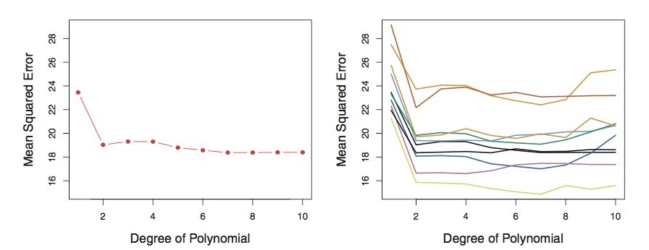
Test-train split, hold-out set, validation-set
Suppose you have one set of data and you have to decide how to break it into pieces for training and validation
Simplest approach is the “validation set” , just break it into two pieces
Example (Fig 5.2) looking at variation
Left: training MSE vs n for one data set
Right: training MSE vs n for 10 validation sets
Riddle me this, how many ways are there to choose two 500 data sets from 1000?

Slide 6
Cross Validation (k-fold)
Riddle me this, how many ways are there to choose two 500 data sets from 1000?
Left: training MSE vs n for one data set
Right: training MSE vs n for 10 validation sets

Slide 7
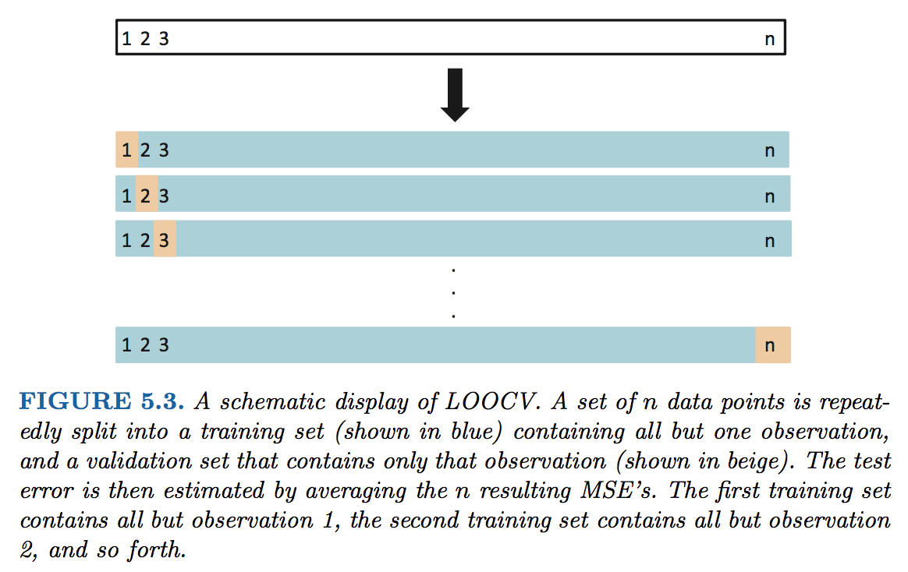
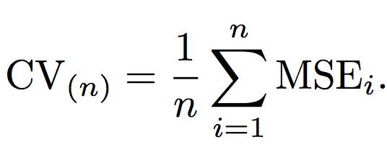
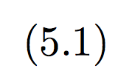
Cross Validation (k-fold)
Since you only use a portion of your data in the training, the ”validation set” approach will tend to overestimate your error!
Leave One Out Cross Validation approach

Slide 8
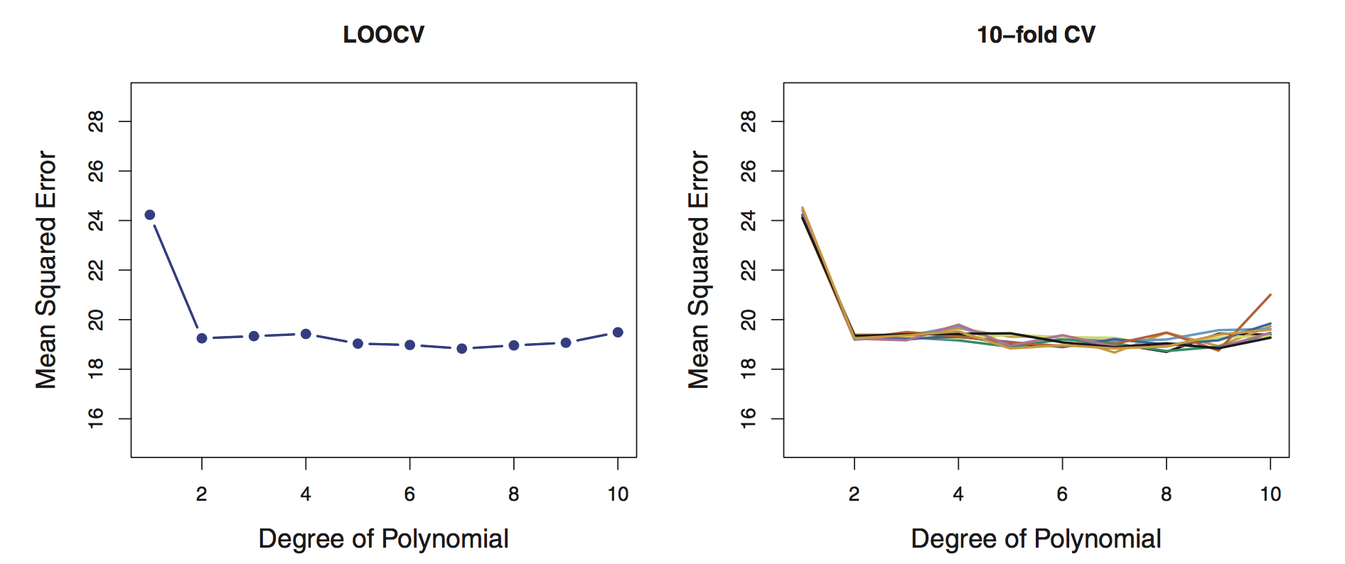
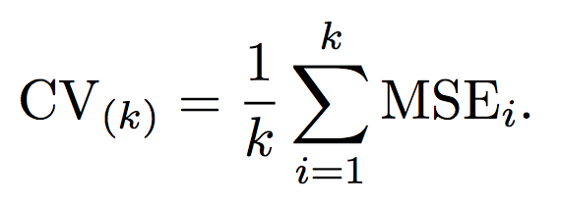

Cross Validation (k-fold)
LOOCV is way more accurate (Fig 5.4), but more computationally expensive!
An alternate is to break the data into larger pieces than n and n-1
We break it into “k” folds of data, e.g. 5-fold. The 1st set is saved for validation, remaining k-1 sets are used for training

Slide 9
Bias/variance tradeoff: use 5 or 10 folds
Bias
an error from erroneous assumptions in the learning algorithm. High bias can cause an algorithm to miss the relevant relations between features and target outputs (underfitting).
Variance
an error from sensitivity to small fluctuations in the training set. High variance can cause an algorithm to model the random noise in the training data, rather than the intended outputs (overfitting).
Bias variance tradeoff relates the simplification of a model to avoid overfitting to the complexity of a model to avoid underfitting.

Slide 10
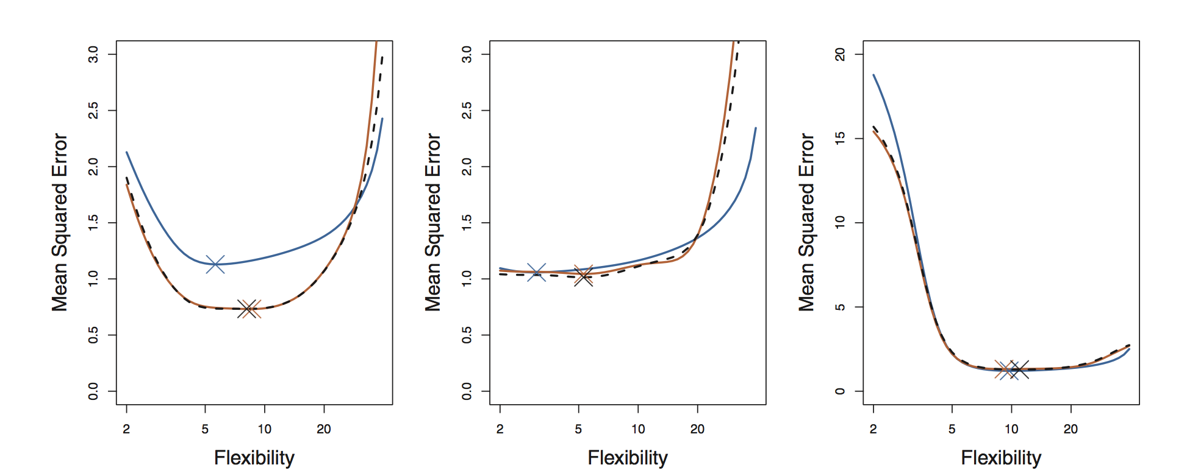
Bias/variance tradeoff: use 5 or 10 folds
Empirically people usually use 5 or 10 folds to avoid too much bias or variance in their resampling algorithm
This is a great way to get a true estimate of your model’s MSE
CV does not yield a new estimate, but evaluates the model itself
Fig 5.6 revisits Fig 2.9 in the context of k-fold cross validation

Slide 11
Bootstrap
The bootstrap is one of the most versatile tools you will use in statistical analysis of data sets
It involves resampling with replacement from your data set
Algorithm:
Randomly draw, with replacement, some subset from your training data
Train your model and make an estimate of your coefficient and MSE
Rinse and repeat until the errors converge

Slide 12
Bootstrap
Estimate variance and confidence intervals of
Your predictions
Your coefficients
Your …
But why?
We already can get 95% CI of coeffecients
In SLR, sure, but with more complex or non-linear models harder.

Slide 13
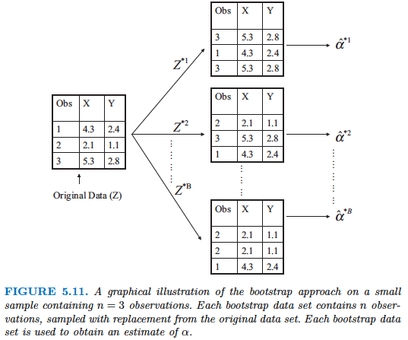
Bootstrap

Slide 14
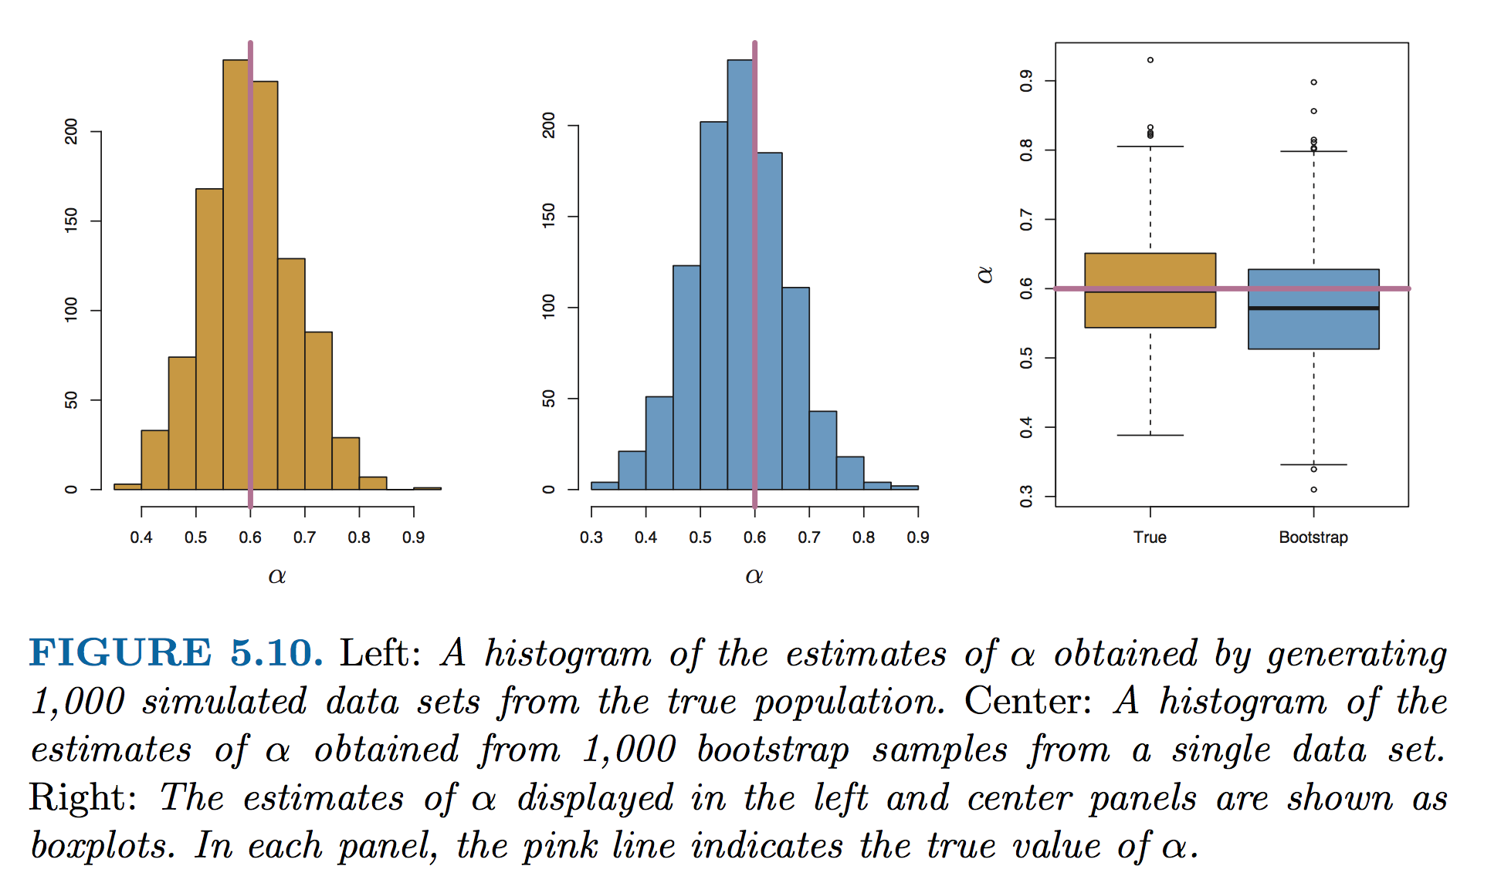
The power of the bootstrap in one figure
Fig 5.10, estimates of some parameter, α

Slide 15
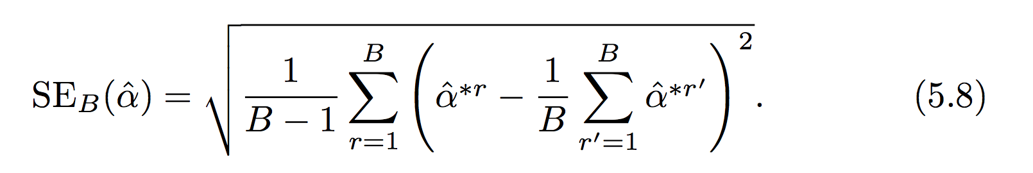
Take care
Depending on how large your bootstrap sample data set is, I recommend you avoid using the standard error formula (Eq 5.8) and instead you should use simply the standard deviation of the bootstrap estimates.
Can anyone explain why?
In this context α, could be any quantity from your training procedure (MSE, β, etc..)

Slide 16
Linear model selection and regularization (CH6 ISL)
The curse of high dimensionality and taking care with your training data
Linear model selection / regularization
Subset selection
Ridge regression
LASSO regression
Python
Dimensionality reduction approaches

Slide 17
When good models go bad
Increasing P can be seductive, especially if you “feel” like you have a large data set: In high dimension your training data may severely under sample the space of P
Supervised learning models are powerful: If you have a lot of data you can often get a model that is predictive
Can be difficult (or impossible) to make inference about important effects when P (the number of parameters) gets large..

Slide 18
The curse of dimensionality
Consider a situation in which you need n=10 in order to cover response range (in Y) for each X_{i}.
For P=1, n=1… P=2, n=100 P=3, n=1000…
Our ability to capture significant fractions of the predictor space collapses after a few dimensions
P₁
P₂
P₃

Slide 19
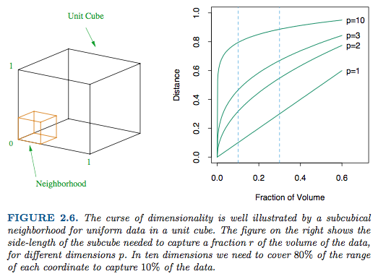
The curse of dimensionality
Figure 2.6, Elements of Statistical Learning

Slide 20
Three approaches to building a smaller model (ISL, p 204)
Subset selection: Systematically search different models created with subsets of all possible P values for an adequate model
Regularization (shrinkage): Fit a model w/all P values, but use a different error penalty to force coefficients to be smaller
Dimensional reduction: Fit a model with a reduced number of coarse parameters that represent subsets of groups of P’s

Slide 21
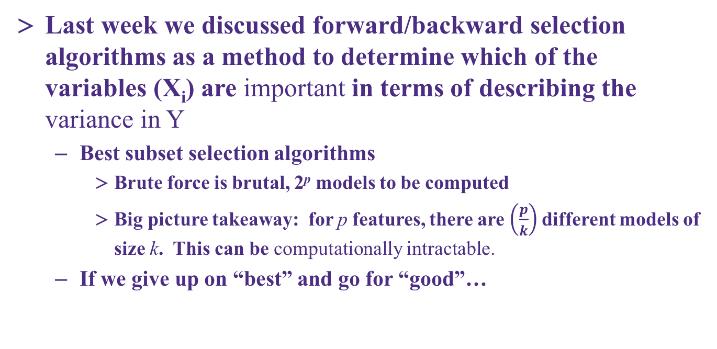
Subset selection: algorithms and challenges
Last week we discussed forward/backward selection algorithms as a method to determine which of the variables (X_{i}) are important in terms of describing the variance in Y
Best subset selection algorithms
Brute force is brutal, 2^{p} models to be computed
Big picture takeaway: for p features, there are $\left(\frac{p}{k}\right)$different models of size k. This can be computationally intractable.
If we give up on “best” and go for “good”…

Slide 22
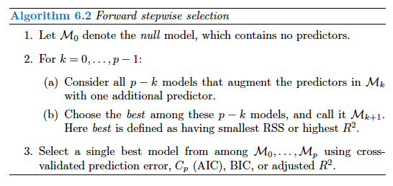
Subset selection: algorithms and challenges
Example forward stepwise selection
When p=20, requires fitting only 211 models vs. brute force’s 1, 048, 576 models

Slide 23
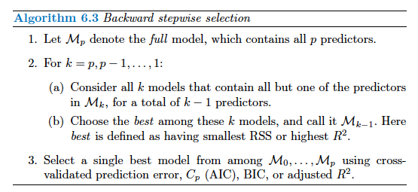
Subset selection: algorithms and challenges
Example backward stepwise selection
Requires n > p (forward has no such requirement, why?)
Number of models for brute force: 2^p
Number of models for both algorithms: 1+p(p +1)/ 2

Slide 24
Comparing alternative models
Key concept: The training error (RSS) will always decrease with increased number of parameters, how to evaluate different models with different number of parameters
We should therefore choose the best model considering the testing error. Two choices for this:
Use theoretical estimates of the test error. ISL offers four suggestions: Cp, AIC, BIC, adjusted R²
Use bootstrapping or cross-validation to evaluate the test error directly

Slide 25
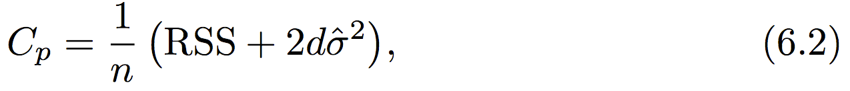
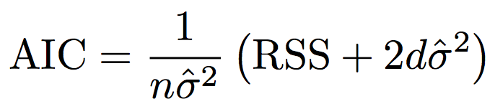
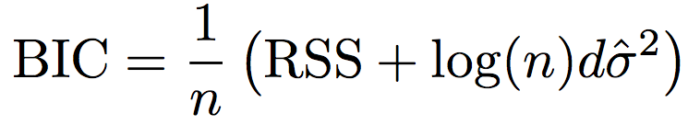
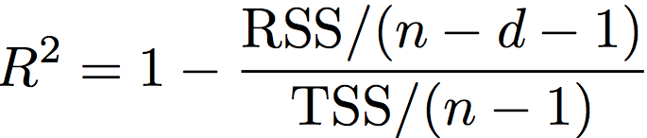
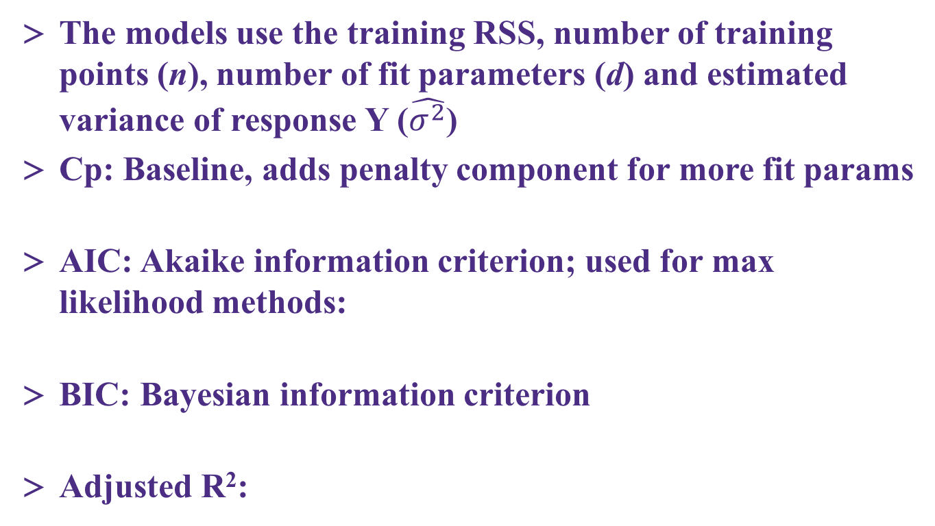
Theoretical models to estimate test error
The models use the training RSS, number of training points (n), number of fit parameters (d) and estimated variance of response Y ($\hat{σ^{2}}$)
Cp: Baseline, adds penalty component for more fit params
AIC: Akaike information criterion; used for max likelihood methods:
BIC: Bayesian information criterion
Adjusted R²:

Slide 26
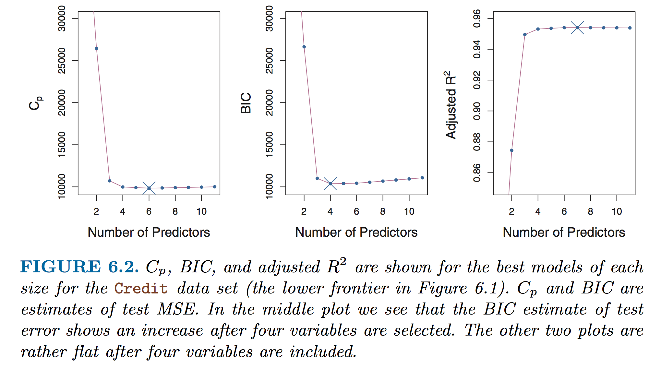
Comparison of test error estimates
This is a specific example from one of the ISL data sets!
In your own model subset exercise it is likely that you would have multiple models with same number of predictors!
Best practice is to monitor behavior of multiple test error estimates

Slide 27
Resampling and clarifying a bit of terminology…
The use of one large set of data combined with resampling yields the use of “training and validation” error estimates (in most statistical learning approaches)
Problem: In cross-validation or bootstrap, the learning algorithm “sees” all the data eventually
If possible, we often withhold a 3rd data set “the test set” that the model is totally blind to: testing error data is withheld until the final model is selected
Training data vs…
Validation data vs…
Testing data

Slide 28
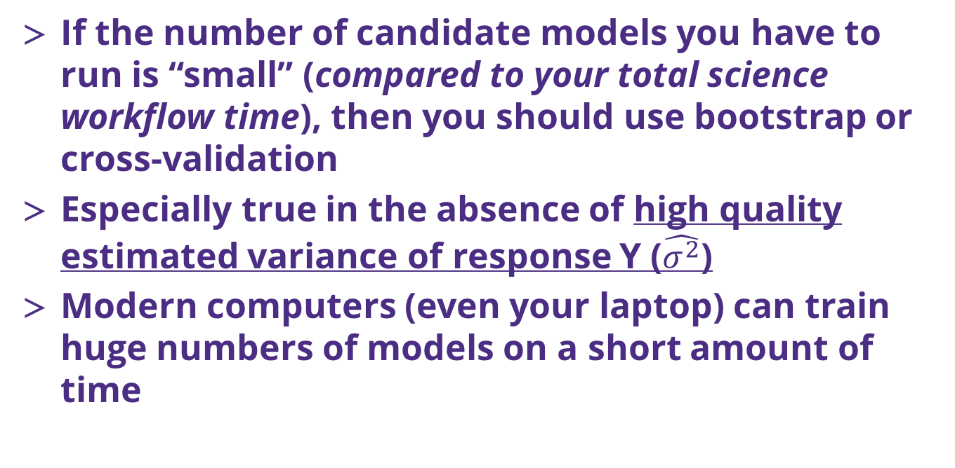
Resampling and testing error estimates
If the number of candidate models you have to run is “small” (compared to your total science workflow time), then you should use bootstrap or cross-validation
Especially true in the absence of high quality estimated variance of response Y ($\hat{σ^{2}}$)
Modern computers (even your laptop) can train huge numbers of models on a short amount of time

Slide 29
Regularization: big picture concepts
Instead of subset selection, another option is to fit a model with all possible (P) parameters and add a penalty to the RSS term to shrink them
Why do we want to do this? [THIS IS IMPORTANT]
Recall that models with more parameters will better estimate the training set, reducing the training error
However, adding more parameters increases the testing error (the variance of response Y is increased via the bias-variance tradeoff)
Reducing the magnitude of the coefficients, therefore is a plausible route to reducing test set error

Slide 30
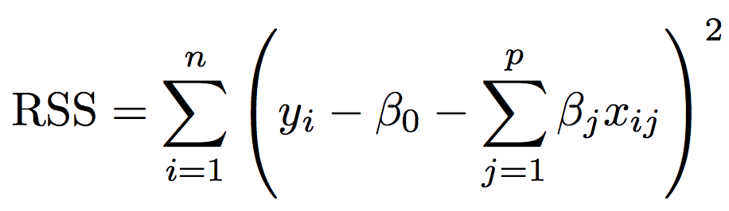
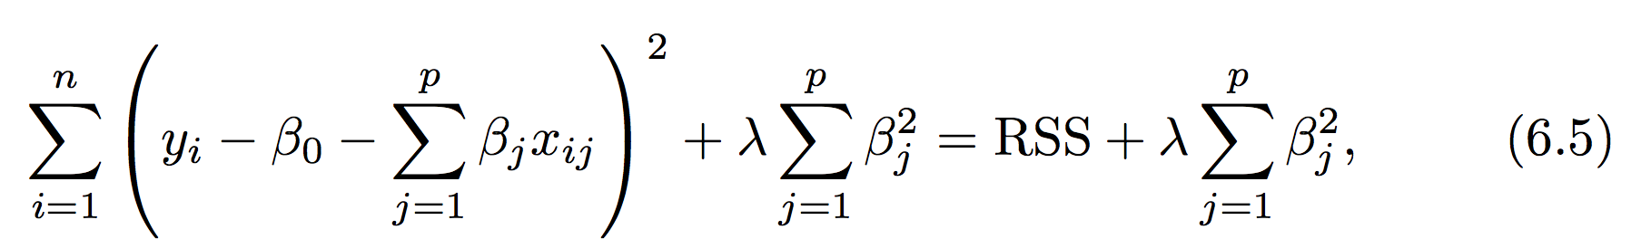
Ridge regression
Ridge replaces the RSS term: with a new minimizer that includes a so-called shrinkage penalty:
The adjustable parameter λ, trades the baseline RSS with a penalty for nonzero coefficients. As λ increases to infinity the minimized error drives all of the coefficients to zero

Slide 31
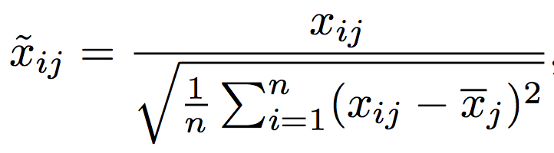
Ridge in practice
Unlike RSS minimizers, which are scale equivariant, the predictor data must be normalized in regularization methods:
Fit a series of ridge regression models across a wide range of λ and track the coefficient values and test set error (or estimate) as λ is changed
Determine the model that produces the smallest test error set
Alternatively determine the model w/smallest validation error and then estimate the true test error w/virgin data that was not used in the training

Slide 32
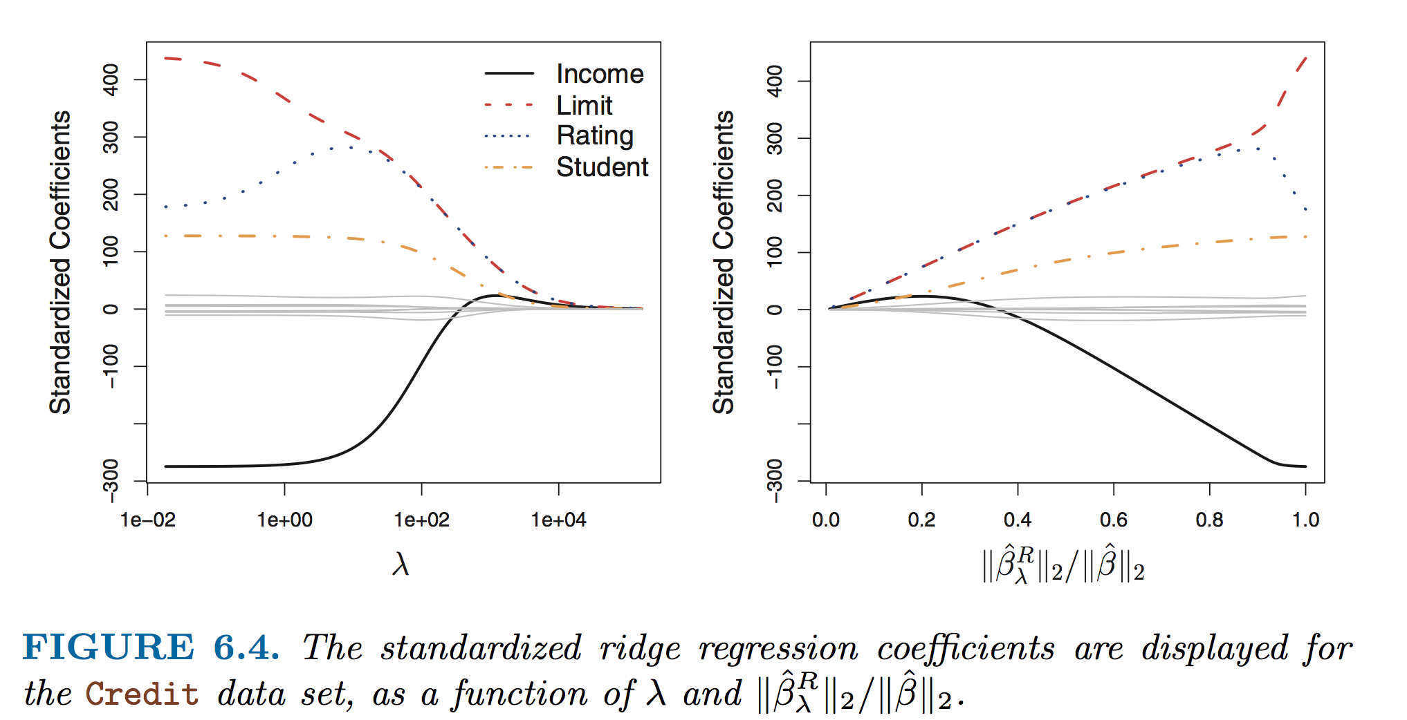

Expected response in ridge regression
= amount coefficients have been driven to 0 (smaller = more regularization)
= vector of least squares coefficient estimates
l₂ norm (distance of β from 0)

Slide 33
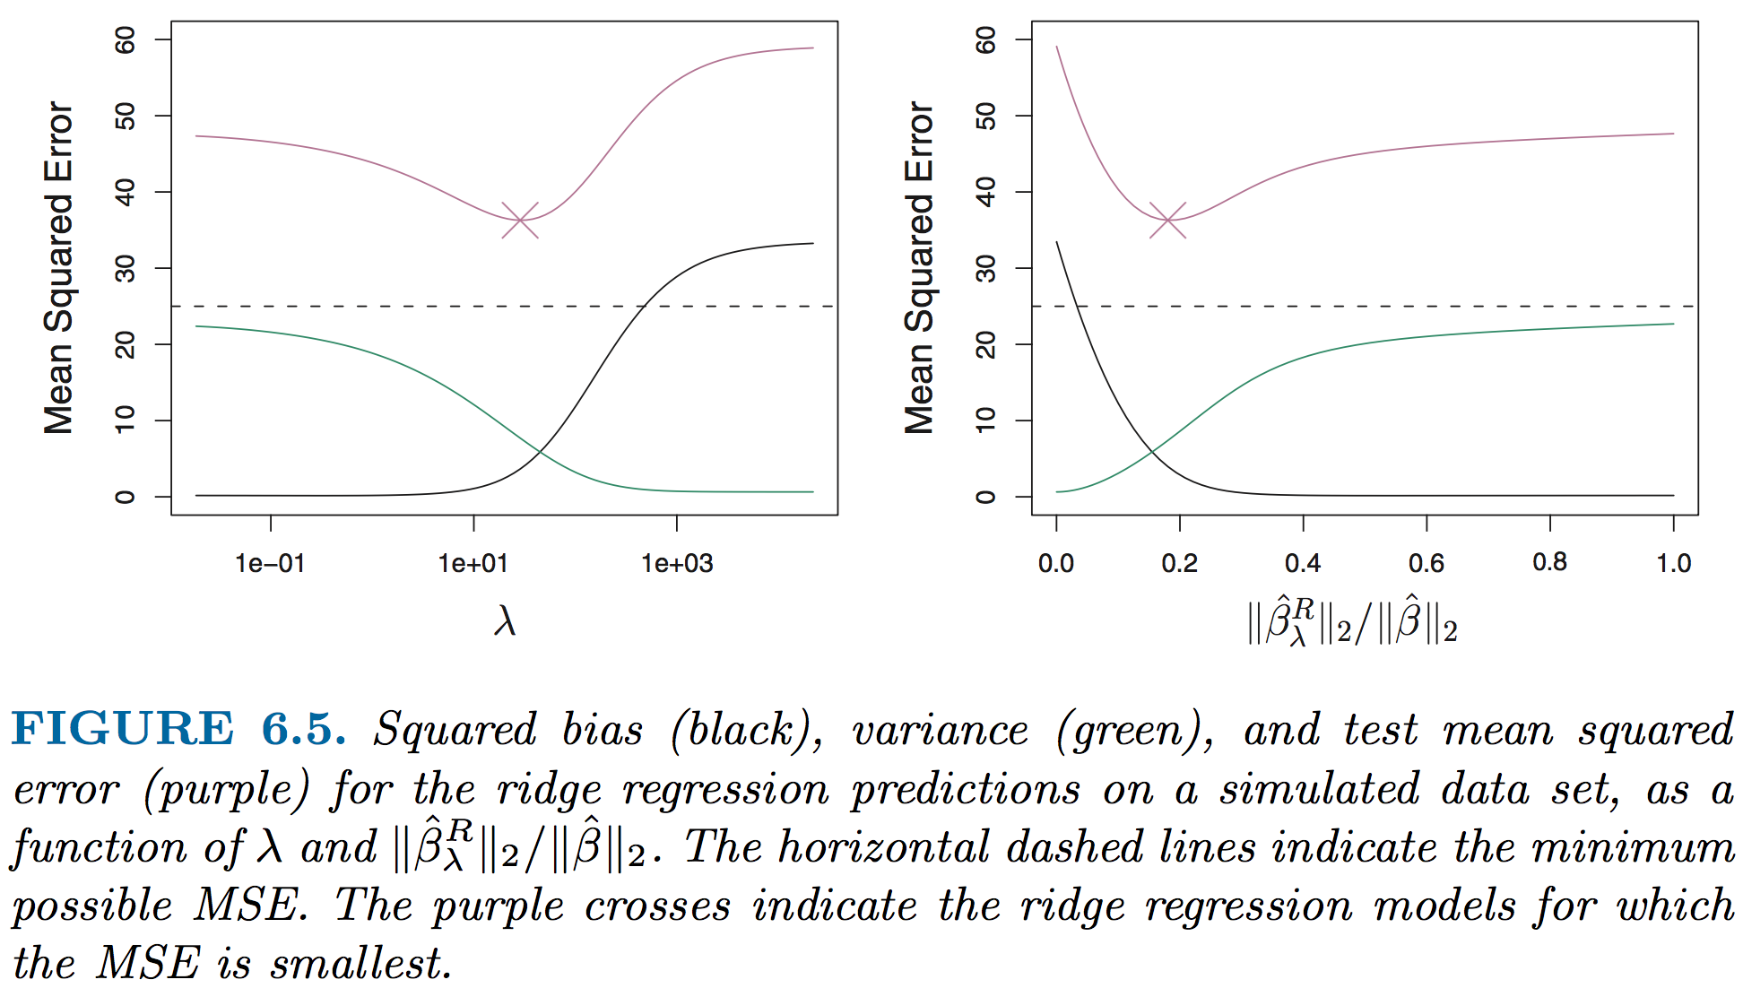
Expected response in ridge regression

Slide 34
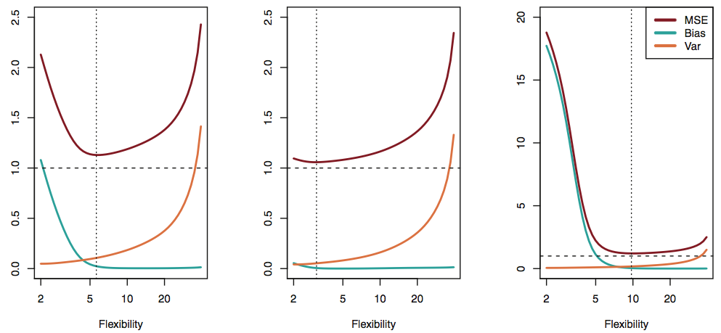
Ridge in practice
MSE
When 𝛌 = 0, Ridge = linear regression
Variance is high, but there is no bias
As 𝛌 increases, the flexibility of the regression decreases
Leads to decreased variance of prediction
Increased bias
The variance in the error shows us how much the error changes if we estimated f with a different set of training data (e.g., consider fit w/many splines)
The bias in the error shows us how much error is introduced by the simplicity of our model (e.g., curvy data w/linear fit)

Slide 35
Ridge in practice
Ridge is more computational feasible than forward and reverse best subset
Least squares linear regression can’t find a solution when n < p, Ridge can
Ridge works best when least squares estimates have high variance

Slide 36
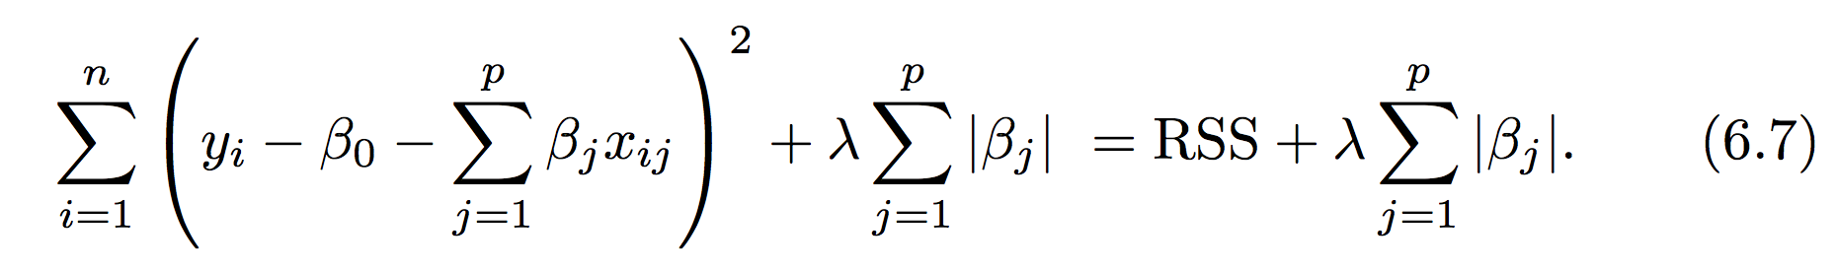
LASSO regression
Ridge regression does not set any of the coefficients exactly to zero but can shrink all of them
Final model still includes all p predictors
The LASSO regression was developed, inspired by ridge, to provide the possibility that some of the coefficients can take a value of zero
Like ridge, the LASSO operator is minimized as a function of an adjustable λ parameter

Slide 37
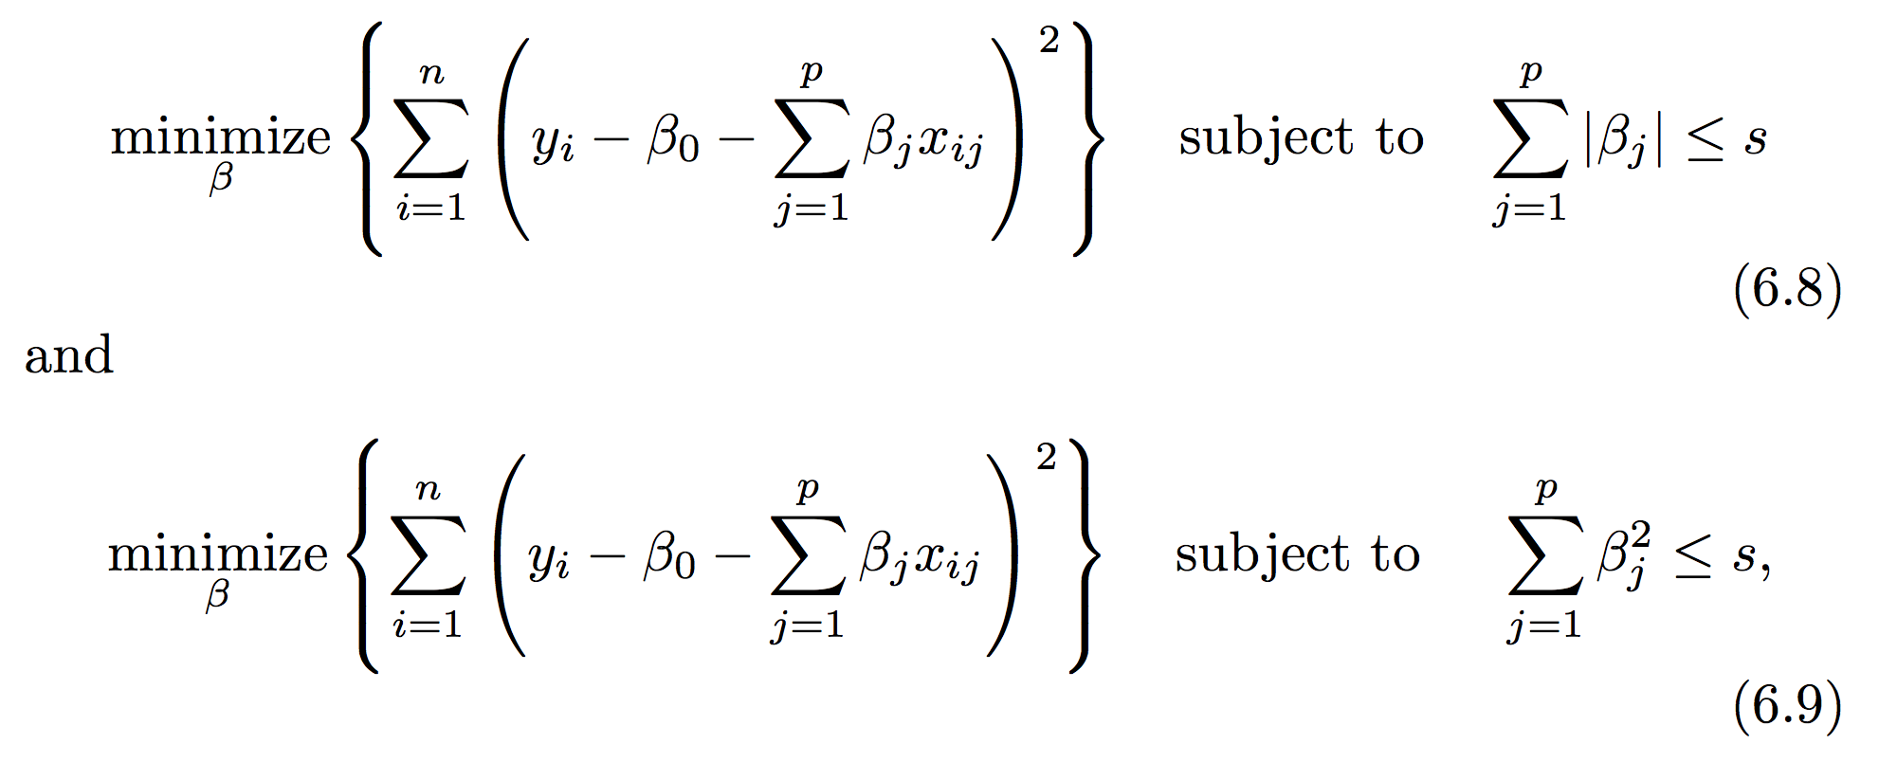
An extra bonus in LASSO: subset selection
The key difference is the penalty due to nonzero coefficients. Ridge it is squared, in LASSO it is not. You can also formulate both as constrained minimization problems.
A mathematical result of LASSO (6.8), is the possibility that some of the β values will be zero at the minimum error

Slide 38
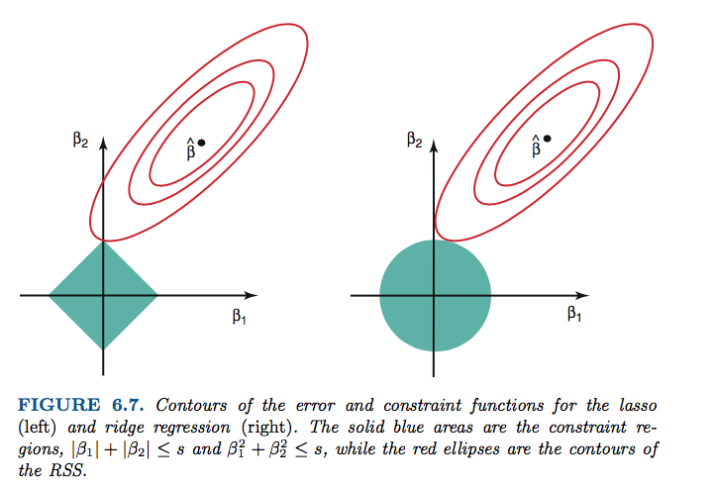
Why can LASSO coefficients become zero?
LASSO Ridge
Red = RSS
Blue = constraint zone
Notes:
Work through explanation and take some notes here!

Slide 39
Python practice
We will use a data set from UCI Irvine ML database related to insulation and energy efficiency
There are 8 predictors (X1-8) and 2 responses (Y1-Y2)
I have a notebook setup for ML regression, ridge and lasso. Some missing pieces and suggestions.
Find a friend and dig in!

Slide 40
Wrap up
Bootstrapping and cross-validation are near-universal in their applicability…
Must understand different methods for dealing with large P models!
Subset selection and regularization (shrinkage)
Also can use dimensionality reduction (see end of CH6, ISL)
These same concepts apply to many types of nonlinear models
What we didn’t cover in this module of the class:
Dimensionality reduction methods (CH6)
Nonlinear regression w/polynomials and splines (CH7)
Tuesday: CH8 , tree methods

