Slide 1



Data Science Methods for Cutting-edge Tec
Knowledge and solutions for a changing world
Advancing data-intensive discovery in all fields
Be boundless
UW DIRECT
(数据集中研究促进清洁技术)
https://uwdirect.github.io
Chad Curtis (ccurtis7)
Chemical Engineering

Slide 2
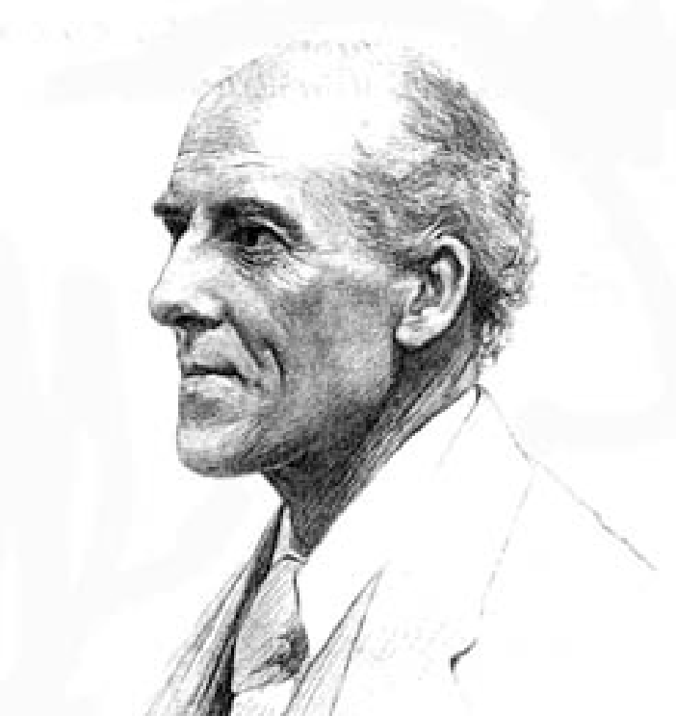

Statistics
“Statistics is the grammar of science.”
Karl Pearson
“73.6% of statistics are made up on the spot.”
Some guy on the internet

Slide 3
Statistics
I’m not talking about
Statistics are
There is a 50% chance your lost remote is stuck between your sofa cushions.
2% of Americans believe that Mitt Romney’s full name is Mittens.
Americans spend 1 hr 14 minutes eating each day.
Data collection (How do I design my experiment such that I can be confident in my results?)
Organization (How do I manage my data?)
Analysis (Hypothesis testing, regression, confidence intervals, etc)
Interpretation (What do I conclude from my data and analysis?)
Presentation (How do I visualize my data in a meaningful way?)

Slide 4
Statistics
Statistics does not tell us whether we are right in coming to a conclusion.
It tells us the chances of being wrong.

Slide 5


Statistics
Two key concepts:
Population
All possible values of an experimental variable
Sample
A set of data drawn from a population
Often want to know the mean (𝜇) and standard deviation (𝜎) of a population
Notes:
We aren’t limited to these descriptors: we could also look at the geometric mean, or the median.
(measure of the spread, measure of the central tendency).

Slide 6
Statistics
Mean and s.d. of a population
Nature, 2013. Importance of being uncertain.
Notes:
Normal distribution is just an example.

Slide 7
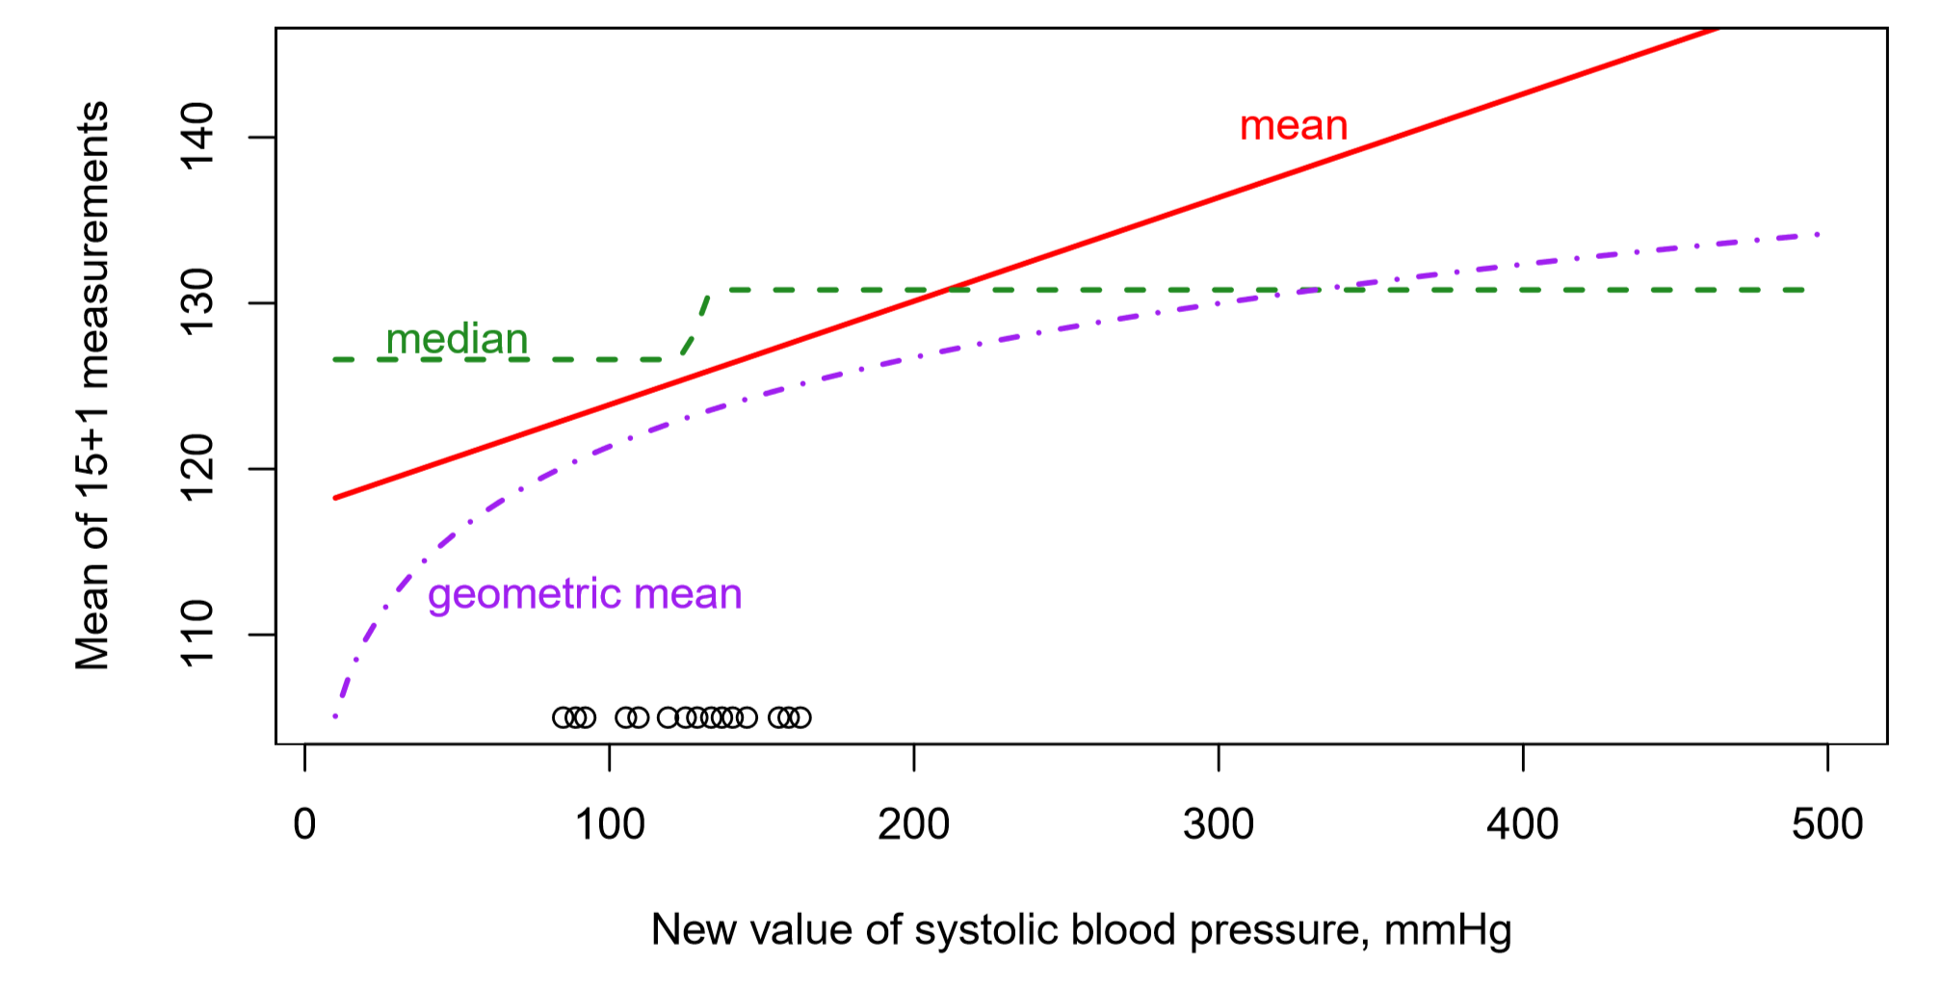
Statistics
Lines show the central tendencies of n=15 blood pressure measurements plus one new measurement.
Adapted from K. Rice, 2017
Notes:
Picking a measure of central tendency is very important.

Slide 8
Statistics
Median is often more robust than the mean in the face of skewed distributions and outliers
What is the median?

Slide 9

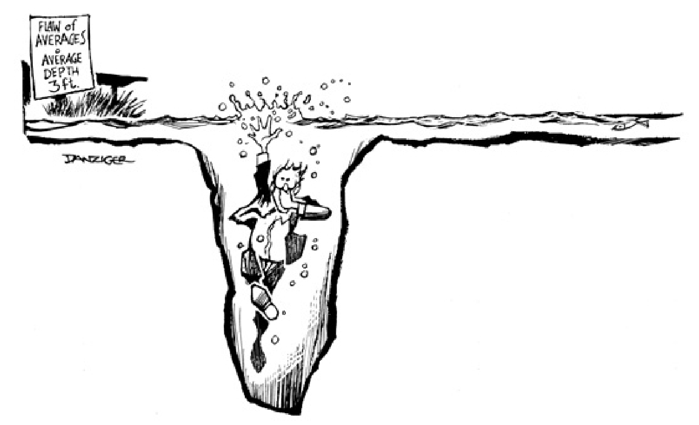
Statistics
We often talk about variance (𝜎²). Why?
The s.d. of a population with a normal distribution:
± 0.5 𝜎 contains 39% of possible values
± 1 𝜎 contains 68% of possible values
± 2 𝜎 contains 95% of possible values
± 3 𝜎 contains 99.7% of possible values

Slide 10
Statistics
Is it possible to obtain the population for an experimental variable?
Is it possible to directly measure the mean (𝜇) and standard deviation (𝜎) of a population

Slide 11
Statistics
Samples are sets of data drawn from the population
Describe a sample based on its size n
Denote a sample as X and indexed by subscripts, e.g. X₁
How to choose n?

Slide 12
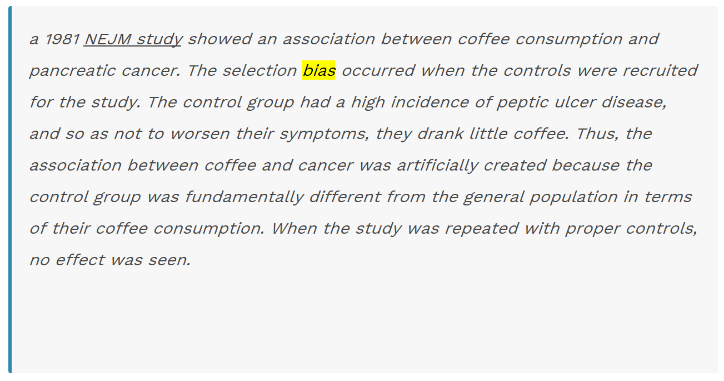
Statistics
How do we sample from a population?
Do all values in a population have the same chance of being selected?
If not, we have bias.
What is an example of bias in sampling?
https://en.wikipedia.org/wiki/Bias_(statistics)
Notes:
https://hearinghealthmatters.org/hearingeconomics/2017/coffee-health-hearing-2017/

Slide 13
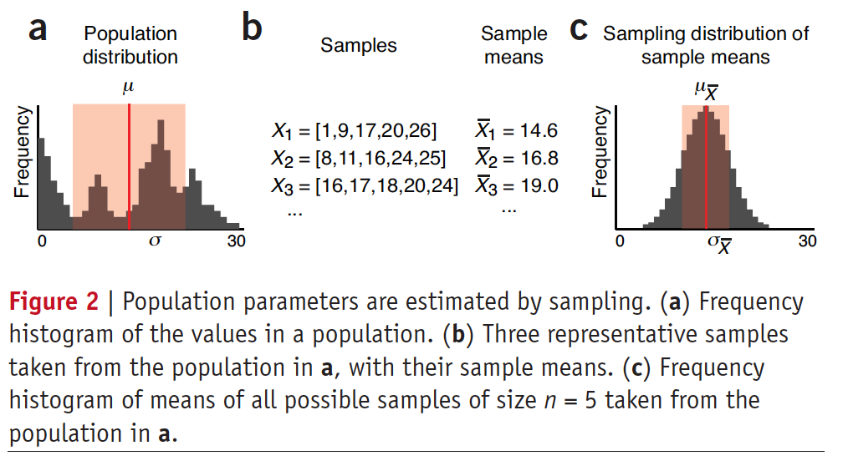
Statistics
Population: mean (𝜇) and s.d. (𝜎)
Sample: mean (X̅) and s.d. (s)
Nature, 2013. Importance of being uncertain.

Slide 14
Statistics
Sample parameters like X̅ have their own distributions – e.g. C below
Nature, 2013. Importance of being uncertain.

Slide 15
Statistics
Sampling with and without replacement
Population values = [12, 13, 14, 15, 16, 17, 18]
Sample with replacement (n=2)
How many total possibilities (assuming order is important)?
First sample, each item has 1/7 probability
Second sample, each item has 1/7 probability

Slide 16
Statistics
Sampling with and without replacement
Population values = [12, 13, 14, 15, 16, 17, 18]
Sample without replacement (n=2)
How many total possibilities (assuming order is important)?
First sample, each item has 1/7 probability
Second sample, each item has 1/6 probability

Slide 17
Statistics
Note that 𝜎_{X̅} < 𝜎
Also note that 𝜇 ≅ 𝜇 _{X̅}
Nature, 2013. Importance of being uncertain.

Slide 18
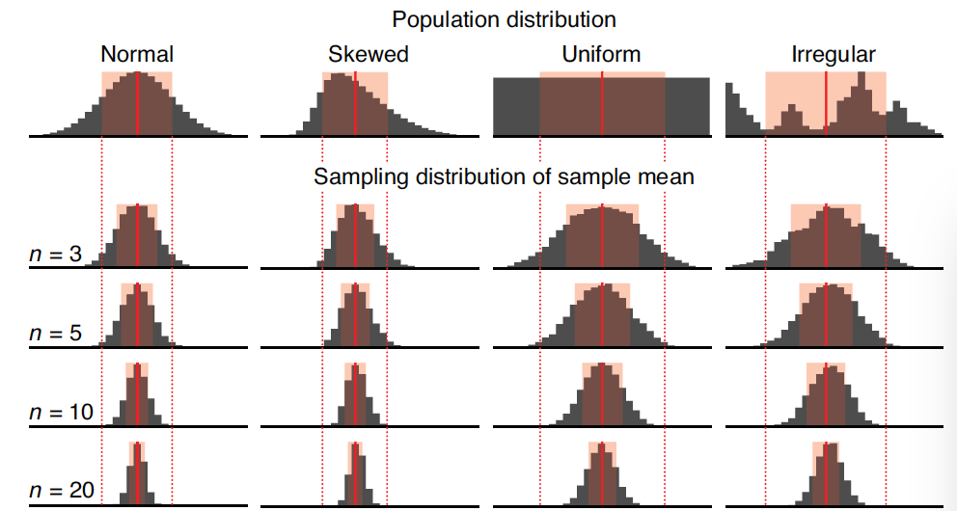
Statistics
Super important concept alert!
The central limit theorem (CLT):
As n increases, the distribution of sample means becomes more normal, regardless of population distribution shape
Nature, 2013. Importance of being uncertain.

Slide 19
Statistics
Super important concept alert!
The central limit theorem (CLT):
As n increases, 𝜇 _{X̅} decreases, i.e. we get better and better estimates of the population mean 𝜇
Thus big n makes 𝜇 ≅ 𝜇 _{X̅}
Nature, 2013. Importance of being uncertain.

Slide 20

Statistics
Super important concept alert!
The central limit theorem (CLT):
As n increases, $σ_{\overline{X}}$=$\frac{σ}{\sqrt{n}}$
Why is this super duper awesome?
Nature, 2013. Importance of being uncertain.

Slide 21
Statistics
Increasing sample size improves estimates
Nature, 2013. Importance of being uncertain.

Slide 22
Statistics
To Jupyter notebook for practical demonstration!
Download the notebook and open it in jupyter notebook.
Pair up with another individual in the class and go through the notebook.
This notebook will challenge you. It will require you use SEDS and DSMCER knowledge

