Slide 1
02 Simple User interface

Slide 2
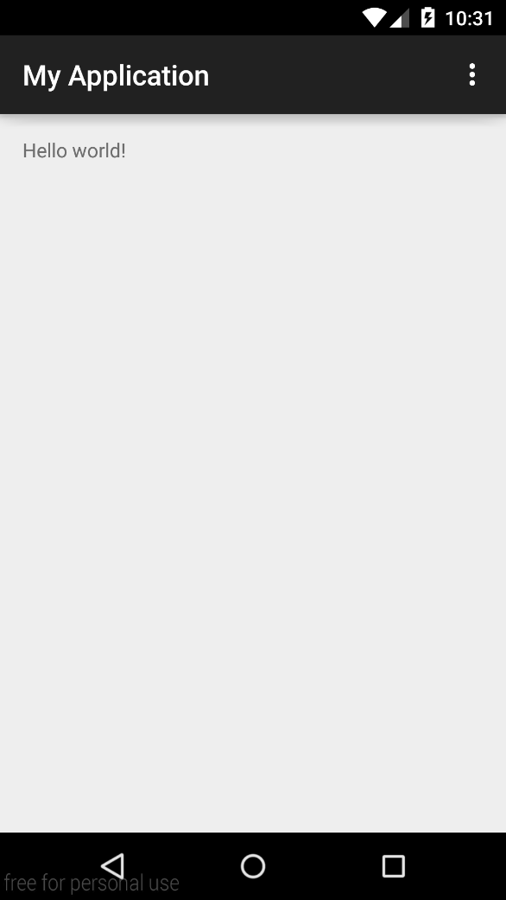
Hello world!

Slide 3
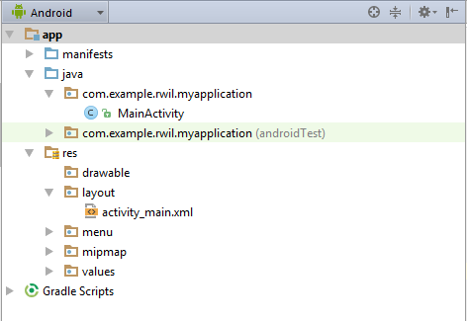
Android Project Structure

Slide 4
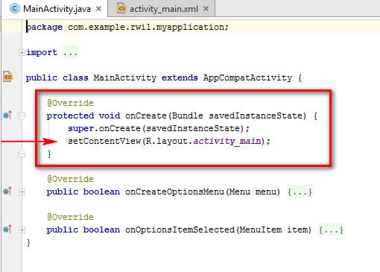
MainActivity.Java

Slide 5
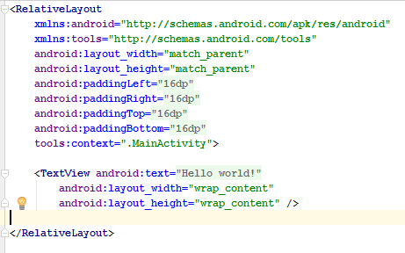
activity_main

Slide 6
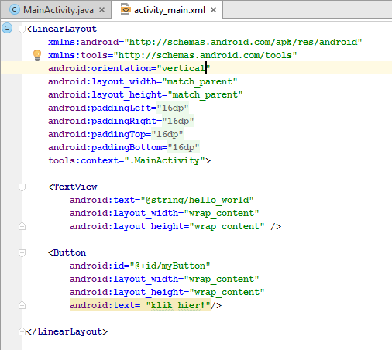
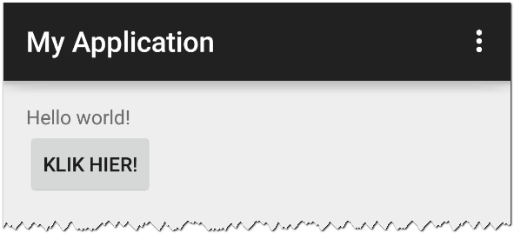
Linking Layout elements with Java objects

Slide 7
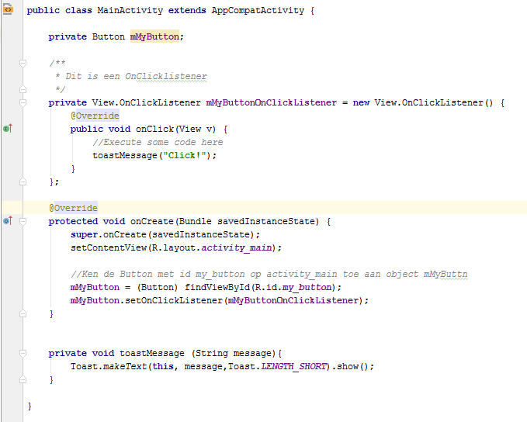

Slide 8
Different Layout elements

Slide 9
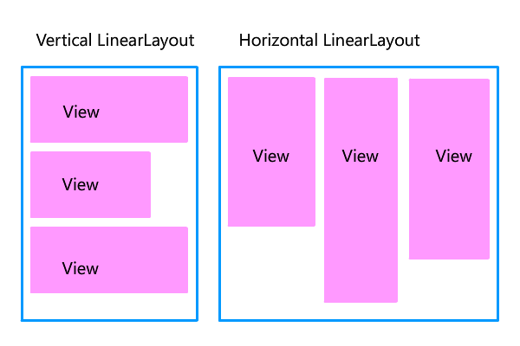
LinearLayout

Slide 10
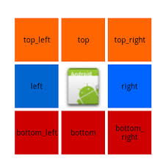
RelativeLayout
Position in layout
Postion relative to other elements

Slide 11
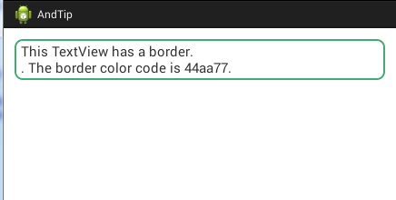
TextView

Slide 12
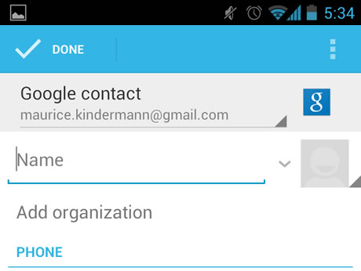
EditText

Slide 13

Button

Slide 14
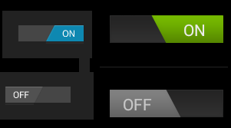
Switch

Slide 15
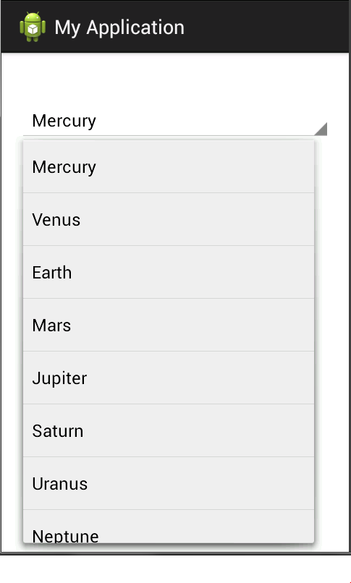
Spinner

Slide 16
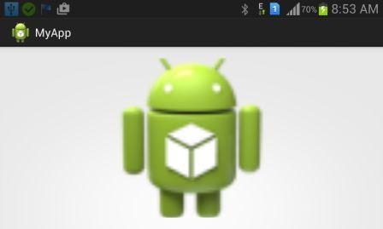
ImageView

Slide 17
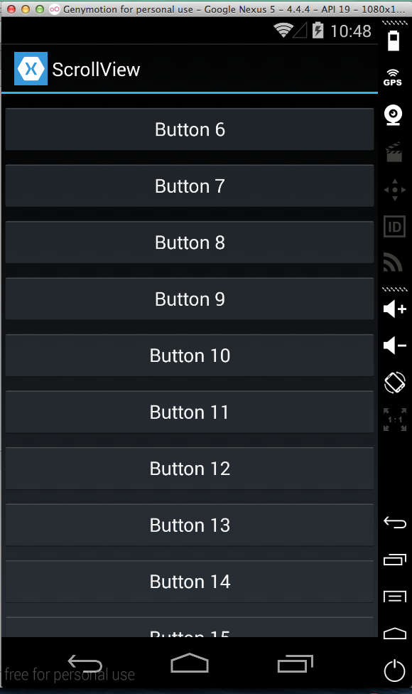
ScrollView

Slide 18
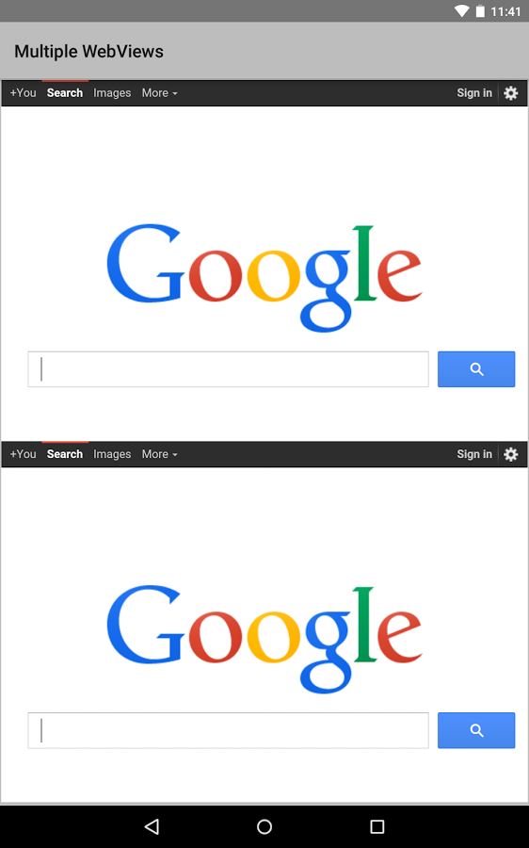
WebView

Slide 19
Hands on Lab!

