Slide 1
Getting Started with Android Studio

Slide 2
Android Studio
Officially supported IDE
IntelliJ based
https://developer.android.com/sdk/index.html

Slide 3
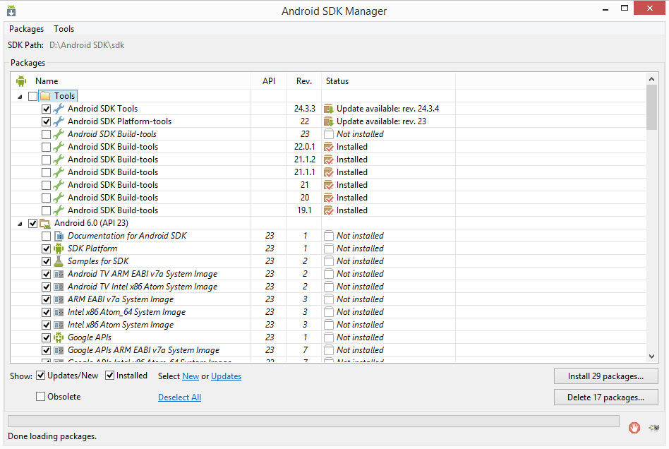
SDK and build tools

Slide 4
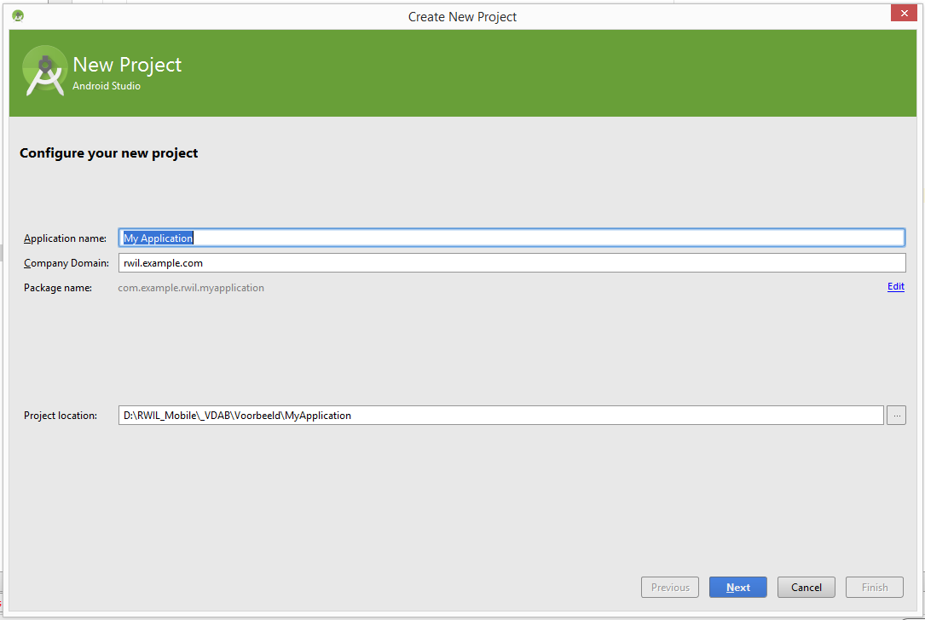
Creating your first app

Slide 5
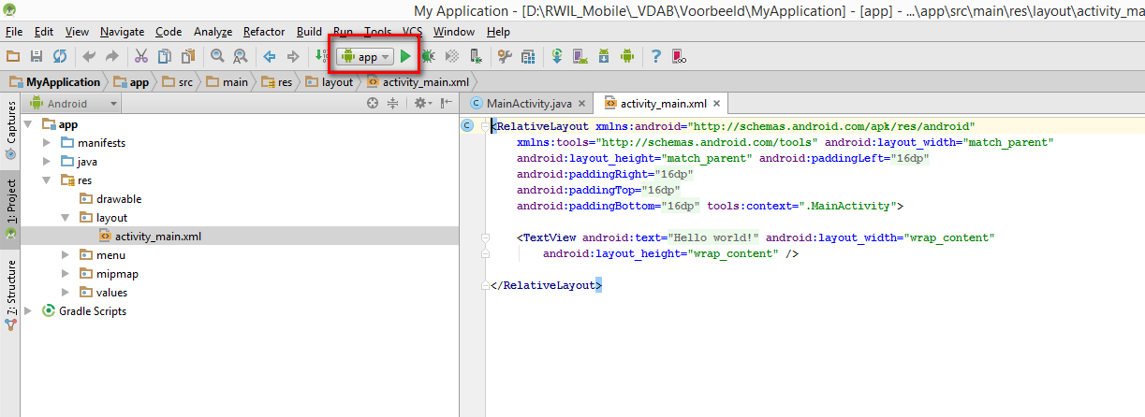
Running your Application

Slide 6
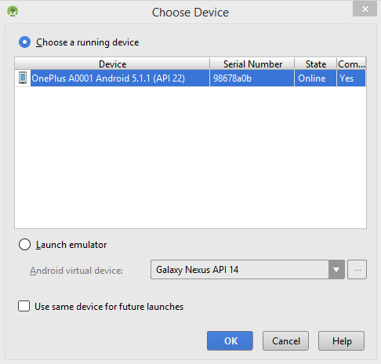
Target Devices
Device
Emulator
Simulator

